Slide 1
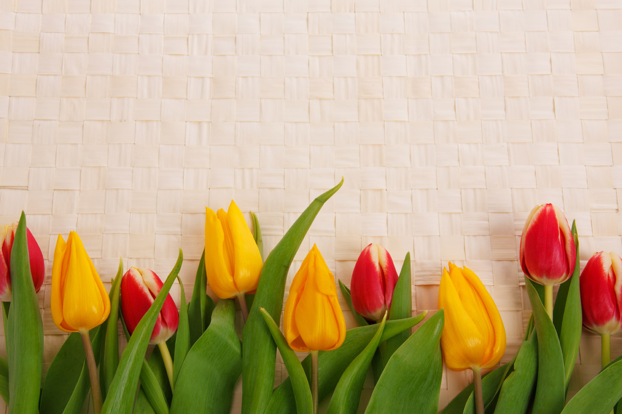

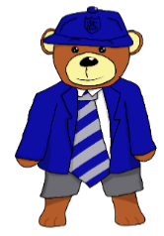
P4/5 Homework Grid Choose at least 2 tasks per week to complete.
Reading / Writing | Spelling | Numeracy | STEM | Topic | Other
Write a book review about a book you have read recently. How many stars out of 5 would you award it? Why? | Ask a member of your family to quiz you on your spelling words. | Log on to Sumdog and practise your numeracy skills. I have set a new challenge for everyone! | Raincloud in a jar experiment. Instructions are under the homework grid. | Research our Decade for the School Show and create a poster or PowerPoint with all the information that you find. | Go out for a walk or a bike ride.
Write a short, narrative story and try to include as many of your spelling words as you can. Remember your core targets, and most importantly; ensure your spelling is accurate! | Practise your spelling words by using the read, cover, write, check strategy. | Solve the Problem by Drawing a Diagram. Holly lined up her 39 teddy bears in a row. She chose every 5th teddy in the row to go on holiday with her. How many were chosen? |  | Practice our songs for the school show. | Play a board game with your family.
Read aloud to someone in your house. If you have a younger sibling, you could read them a story. | Write some silly sentences which include your spelling words. | Visit topmarks.com and play some maths games to consolidate your learning. E.g. Hit the Button - Quick fire maths practise for 6-11 year olds (topmarks.co.uk) |  | Start to think about your memories of P6/7. P7’s start to think about your memories of Primary School. | Help around the house. E.g. wash the dishes, sweep the floor etc.
April/ May
2024

