Slide 1
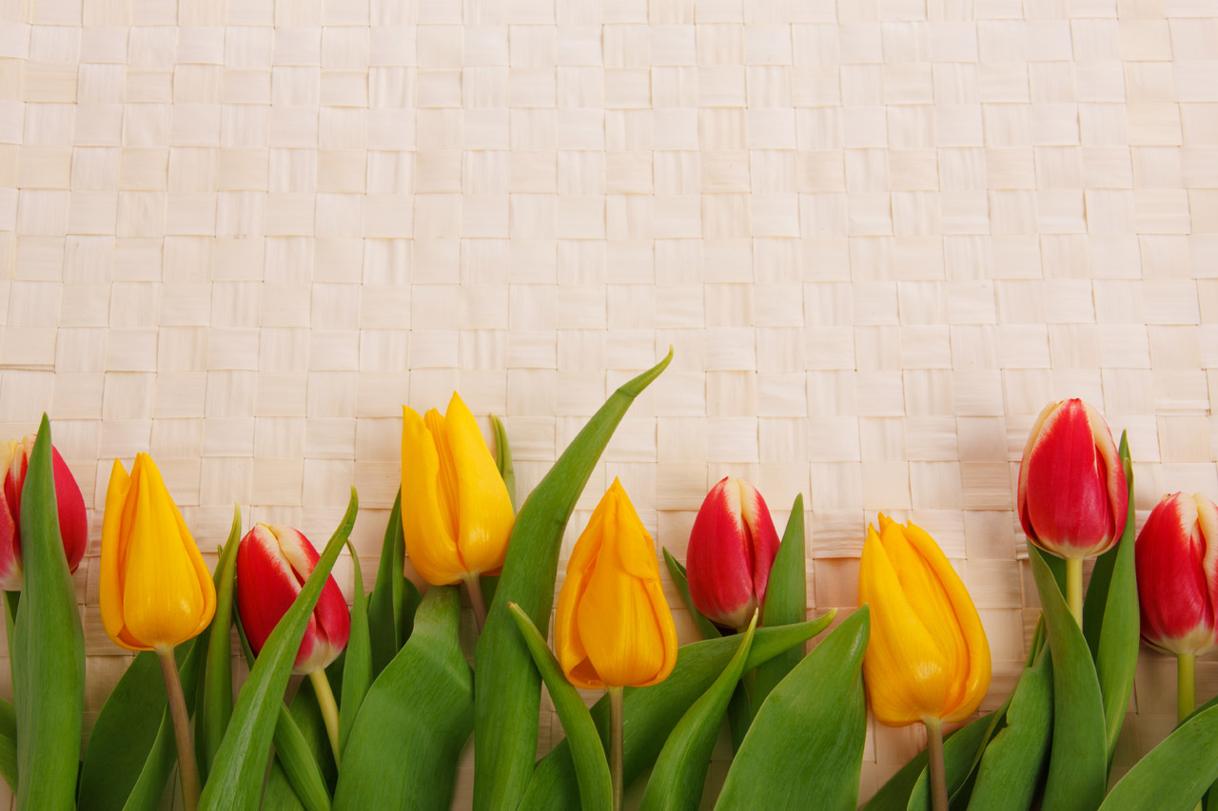
P6/7 Homework Grid Choose at least 2 tasks per week to complete.
Reading | Spelling | Numeracy | Topic | STEM | Other
Read a book for enjoyment. | Practice your spelling words with read, cover, write and check strategy. | Practice telling the time with an adult. https://www.topmarks.co.uk/time/teaching-clock | Create a presentation about your chosen topic. | Using recyclable materials, make the tallest tower you can. It must stand freely and not be attached to anything. Take a photo and upload it to Teams. | Take photographs of flowers. You might be able to spot daffodils appearing.
Write a book report about the book you have read. | Use your spelling words in 5 funny sentences. | Complete work set on Sumdog. | Create a mind map about the Easter story. | Use scratch to create a program. | Go for a walk outdoors.
Create a vocabulary list. New words you have learned from you reading and what they mean. | Practice writing your spelling words backwards e.g. happy = yppah | Practice your timestables. | Create a poster about the main articles you feel are important about Children's Rights (This can be presented digitally or on paper). | Construct a pair of sunglasses designed to fit the wearer safely and securely. | If you do not know how to practice tying laces.
March
2024

