Slide 1
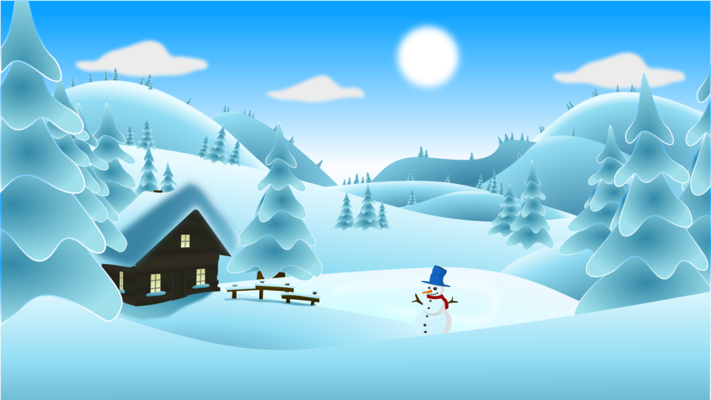
P6/7 Homework Grid Choose at least 2 tasks per week to complete.
Reading | Spelling | Numeracy | Topic | STEM | Other
Read a book of your choice for enjoyment | Practise your spelling words by using the read, cover, write, check strategy. | Practise your times tables and ask a family member ask you questions. | Practise our songs poems for Burns Supper and school show. Click on the links which will take you to the songs. Take my hand - Skerryvore - Take My Hand - Karaoke Version from Zoom Karaoke (youtube.com) I’m on my way - The Proclaimers - I'm On My Way - Karaoke Version from Zoom Karaoke (youtube.com) | Design a new school uniform and label your picture. Try to explain your choices. | Help around the house by helping to make dinner.
Practise reading aloud to a member of your family. | Practise writing your words in fancy writing. | Practise your number talks strategies by asking a family member to give you calculations. |  | Try the experiment that is on the back of this sheet. Take pictures and upload them to our Teams page. | Think of a riddle to tell the class.
Write a book report on a story that you have recently read. | Play ‘Knots and Crosses’ with your words. Ask someone in the house to challenge you. | Log into Education City and complete the challenges that have been set. |  | Log into our Teams page and say ‘Hello’ in the playground chat – you might what to put your riddle there. | Go for a walk or a bike ride.
February
2024

