Slide 1
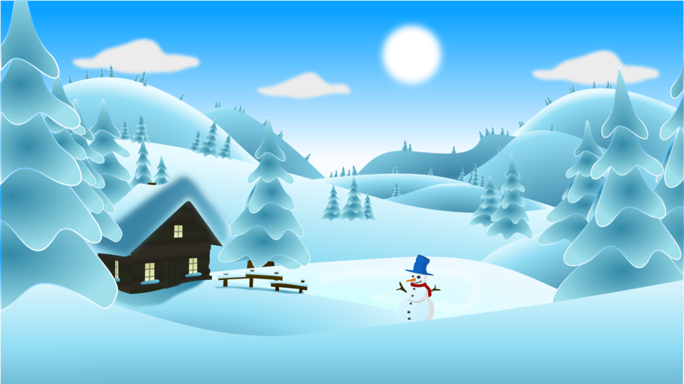
P6/7 Homework Grid Choose at least 2 tasks per week to complete.
Reading | Spelling | Numeracy | Topic | STEM | Other
Read a book of your choice for enjoyment | Write a few sentences about you did during the Winter Break | Practise your times tables and ask a family member ask you questions. | Watch or read the news and report back what you have learned. | Create a fort using recyclable materials. | Do something kind.
Write a blurb for your favourite book. | Practise your spelling words by using the read, cover, write, check strategy. | Complete work on Sumdog. | Research and create a PowerPoint on who was Robert Burns. | Use Scratch to create a program. | Play a board game
Listen to an E-book. | Use your spelling words in a silly sentence. | Visit topmarks.com and play some maths games to consolidate your learning. Hit the Button - Quick fire maths practise for 6-11 year olds (topmarks.co.uk) |  |  | If you don’t know how, practise tying laces
January
2024

