Slide 1
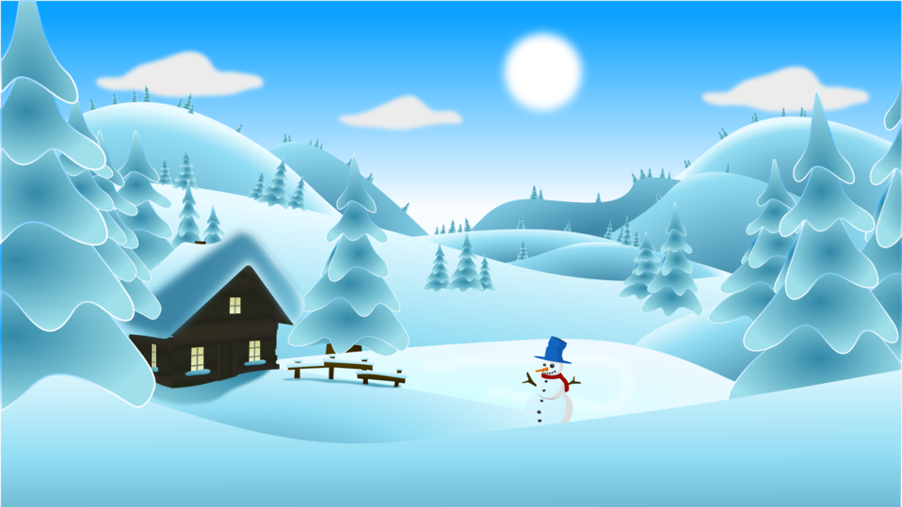
P6/7 Homework Grid Choose at least 2 tasks per week to complete.
Reading | Spelling | Numeracy | Topic | STEM | Other
Practise our songs for the Christmas Show. | Ask someone to quiz you on your spelling words this week. | Log into Education City and complete the challenges that have been set for you. | Fill out the topic review form, by clicking the link below: https://forms.office.com/e/S16nc5vBY6?origin=lprLink Or ask me for a paper copy in school and return it before the Christmas Break. | What works best for keeping an apple from going brown? With an adult’s help, slice up an apple and let each slice soak in a different liquid. Which ones go brown and which don’t? Try using water, salt water, sugar water, orange juice etc. | Take time to watch a Christmas film with your family.
Spend time reading your own book for enjoyment. | Practise your spelling words by using the read, cover, write, check strategy. | Visit the Daily 10 Challenge and revise your times tables, try to reduce the time you give yourself. |  |  | If you don’t know how, practise tying your tie or shoe laces!
December
2023

