Slide 1
Anti-Racism
By The Diversity + Equilty Monitors

Slide 2
What is a community????
a group of people living or working together in the same area.
A small group of people who all live in the same small area, near to one another.
the people with common interests living in a particular area.

Slide 3
the right to a fair trial. the right to privacy. the right to vote. freedom of expression. freedom of religion . freedom of assembly. freedom from torture, inhuman or degrading treatment and slavery.
What Are Human Rights???

Slide 4
What Is Racism???
Racism Is When Someone Makes Fun of Someones Skin Or Religion.
Racism Is illegal So You Can Be Put In Jail.
Racism adapts and changes over time, and can impact different communities in different ways, with racism towards different groups intensifying in different historical moments.
Racism includes all the laws, policies, ideologies and barriers that prevent people from experiencing justice, dignity, and equity because of their racial identity

Slide 5
What is Discrimination
Discrimination means treating some people differently from others. It isn't always unlawful - after all, people are paid different wages depending on their status and skills. However, there are certain reasons for which your employer can't discriminate against you by law.

Slide 6
Protected Characteristics
The protected characteristic of age applies to all ages.
Disability.
Gender reassignment.
Marriage and civil partnership.
Pregnancy and maternity.
gender

Slide 7
What can we do as a community to eliminate racial discrimination ???

Slide 8
Rosa parks
Rosa Parks was a civil rights activist who refused to surrender her seat to a white passenger on a segregated bus in Montgomery, Alabama.
Her defiance sparked the Montgomery Bus Boycott, which lasted for a year and launched nationwide efforts to end racial segregation of public facilities.
Rosa Parks was a member of a civil rights group which fought for black and white people to be treated the same.
Rosa Parks called Malcolm X her hero, and they interacted several times during the American civil rights movement.
Rosa Parks was not the first black woman to refuse to move from her bus seat; Claudette Colvin had done the same nine months earlier, and countless women had before that.

Slide 9
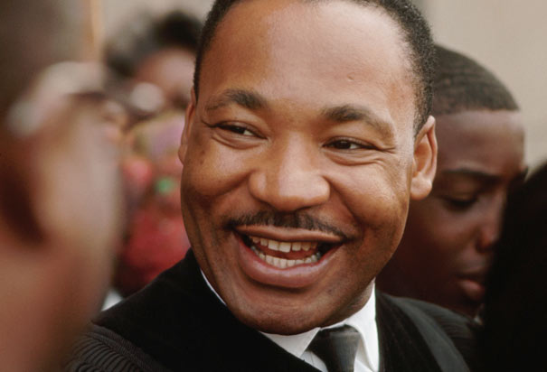
Martin Luther King. jr
I have a dream' speech was improvised.
His birth name was
Michael King.
King decided at college to become a preacher.
He was arrested more than 25 times. (hes not a evil person he just tried to make the world have equal rights)
He wrote five books.

Slide 10
Why should we celebrate our differences ???
hands up

Slide 11
Any questions?
????

Slide 12
everyone is welcome
Every one is equal

Slide 13
THANKS FOR LISTENING!!!

