Slide 1

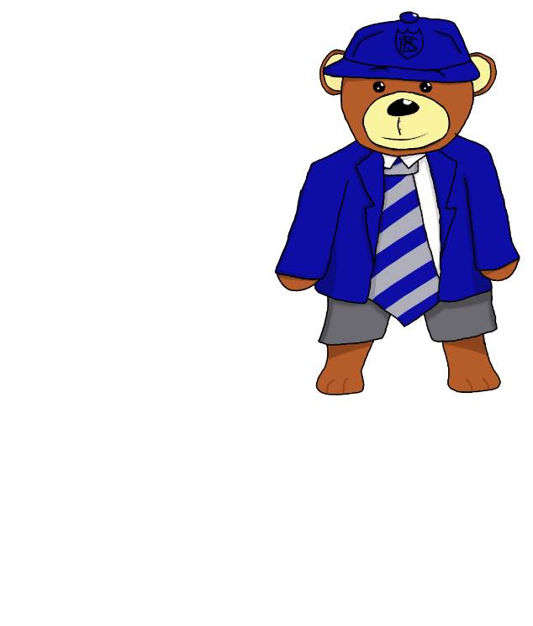
Bargeddie Primary School
Induction Information
Wednesday 25th May, 2022

Slide 2

Essential Information
Contact details from enrolment form – have these changed?
Emergency contact details
Any health issues / new concerns
Any medication
Any change in family circumstances

Slide 3
Primary One Class
16 Primary One children
Composite class, highly likely
        Classroom Assistant support, Additional Support for Learning, as required
        Teaching Students, Early Years Students, Parent Helpers, Work Experience Students

Slide 4
Important School Times
Breakfast Club 8.15am – 8.50am
School hours 9am – 3pm
Interval 10.30 – 10.45am
Lunchtime 12 – 12.45pm

Slide 5


Morning Routines
Breakfast Club
Children enter by the side gate on Langmuir Road, next to the football pitch from 8.15am
Not Using Breakfast Club
Children enter school by the back gate and back doors from 8.55am. Children go directly to their class. Children should be settled in class by 9am.

Slide 6


Absence Procedures
Parent/carer must notify the school office from 8.30am onwards
Pupil absence can also be notified via Parent Portal
Telephone every morning to provide an update on absence
A letter must be brought to the class teacher on your child’s return to school
Holidays are not permitted outwith normal holiday periods, unless there are exceptional circumstances – a letter requesting holidays must be brought to school
A text may be sent – please call the office to update staff

Slide 7
Attendance
Regular attendance is essential
Attendance is monitored monthly
Notify office early of pupil absences
Letters and attendance print out issued home detailing absences
Close links established with Children’s Reporter, Coatbridge Cluster Attendance Council
Missing pupils – police matter

Slide 8
Lunchtime Routines
Lunchtime - 12.15pm – 1pm
Options - packed lunch, school dinner – no children visit shops / vans
Hot meals and sandwiches available, menu online
P1 – 5 entitled to free school lunch and breakfast
Money for lunch paid online via I Pay, lunch card
Packed lunches – encourage healthy eating, no glass bottles/jars – named packed lunch box
Health Promoting School, Childsmile, Water fountain – bring water bottle every day, healthy snacks for interval etc.

Slide 9
School Uniform
All items of clothing must be clearly labelled
Uniform - white shirt, Bargeddie tie, royal blue sweatshirt, cardigan, pullover etc. with school badge, grey / black trousers or skirt / pinafore – worn every day to school
Bargeddie waterproof jackets / blazers, school bags / homework folders also available to buy
P.E. Kit - pale blue Bargeddie polo shirt, dark blue gym shorts, both with badge – worn to school on gym days, training shoes for P.E.
Supplier – Scotcrest - 01236 768686
Pre-loved clothing is available in various sizes

Slide 10

Outdoor Education
Waterproof jacket needed every day
Suitable outdoor shoes essential
Children will be outdoors, even in the rain
Children will have P.E. outdoors too
Unless extremely heavy rain, children will be out at intervals and lunchtimes.
Outdoors at other times e.g.
gardening, Eco, Maths etc.
In warm weather – apply sun cream before child comes to school, sun hat / cap, water bottle etc.

Slide 11

Injuries/Sickness
First Aider on site – Mrs Logan/ Mrs McFadden, fully qualified
Minor injuries will be treated e.g. cuts, bumps etc. head bump letter and text sent to parents
More serious issues – parents will receive a telephone call
Regular medication should be delivered to school office with Child’s Health Plan / Asthma Plan from GP
Unwell children – make a sensible decision when deciding whether to send them to school, check health exclusions with school office

Slide 12
Homework Routines
Homework routines established early – good practice
Regular tasks – common words, phonemes / sounds, reading, Education City/Sum Dog etc.
Whiteboards and phonemes should be regularly used at home to revise classwork
Read together often for pleasure
Revise new concepts regularly
All homework and reading books returned to school each day in bags. Reading books required every day in school!

Slide 13
Partnership Working
Best chance of success – parents and school in partnership, working together
Community Learning and Development link
Need for parent helpers - in school support, excursions, sports festivals, after school clubs, special projects etc.
Talents, special knowledge/skills welcome
Disclosure process essential
Parent Council

Slide 14

Special Financial benefits
Clothing Grant
Forms available from school office, certain conditions must be met before eligible, money specifically provided to equip children for school
P1-5 children entitled to free school meals
Pupil Equity Fund school allocation based on number of pupils receiving free meals
Other financial supports available as available e.g. Aberlour Fund, Scottish Child Payment, Winter Hardship Payment etc.

Slide 15


First Day at School
Pupils and family members should gather near to the infant door, at the bottom of the ramp, at 9.30am prompt.
Pupils remain in school until 3pm
Packed lunches/Snacks to Go may be best, until pupils feel comfortable with dining hall procedures/ food - dinner cards to follow
Parents can visit class base in small groups around 2.40pm to see their child at their desk.
Pupils should bring a water bottle for their desk.
Timetables to follow e.g. gym days

Slide 16

Question Time
Any questions?

