Slide 1
Early Numeracy and Maths
Session 2022/2023

Slide 2
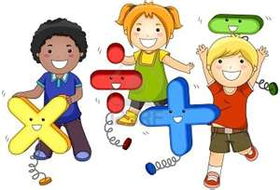
The Importance of Numeracy and Maths
Numeracy and maths skills aren’t just an important part of the curriculum, they’re a vital life skill that enable us to carry out all kinds of everyday tasks. It’s never too early to introduce children to concepts of numeracy and maths. Early childhood is a crucial time for brain development, so it’s important to think about how you can support your child to develop knowledge and skills, linked to these areas. When planning activities, remember to make them as much fun as possible. The more children enjoy themselves, the greater their level of engagement. This will lead to better learning outcomes and, importantly, positive associations with learning numeracy and maths concepts. All of this will lay strong foundations for the next stage of their learning.

Slide 3
Counting
Helping your child to recognise, count and write the numbers one to ten will be beneficial to them. Counting can easily be incorporated into most daily activities e.g. count the biscuits/blocks/crayons, but there are many other ways to focus on this skill:
Sing songs – lots of songs involve counting e.g. Five Little Speckled Frogs, Ten Green Bottles etc. Music is particularly effective when embedding learning.
Read books – there are plenty of books that support number learning e.g. The Very Hungry Caterpillar,
Play board/card games – any game that involves rolling dice and counting spaces e.g. Snakes and Ladders, Ludo etc. will help children learn their numbers. Other games such as Dominoes are also great for number recognition.

Slide 4
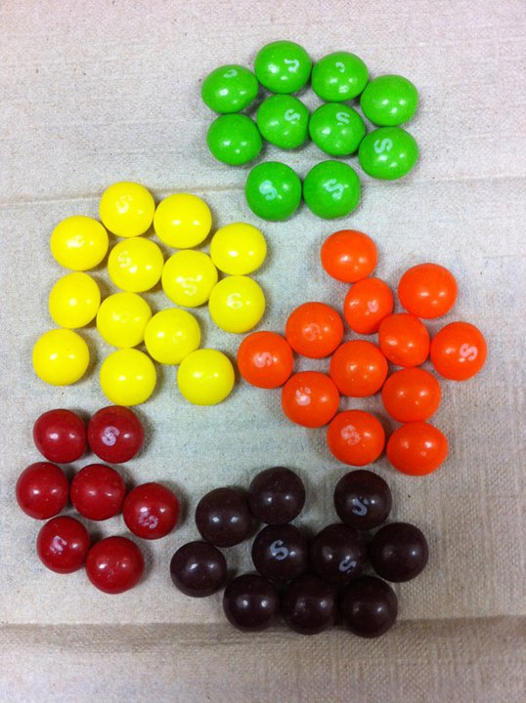
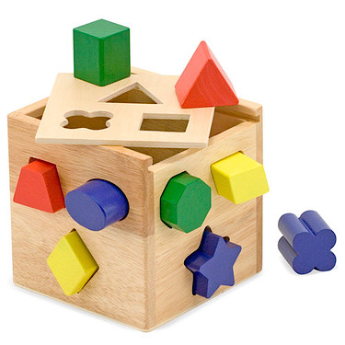
Sorting
Being able to classify things is a key aspect of maths. Matching and sorting, for example, by size, shape or colour, helps children make sense of the world and develops their logical thinking skills. Here are some ways in which you can support your child:
Set up sorting activities – there are plenty of variations to explore and lots of ideas if you search online, but for example, you could ask your child to sort crayons by colour, pasta by shape, or blocks by size.
Invest in sorting toys – there are many educational toys to help develop sorting skills.
Incorporate sorting into other activities – ask your child to sort things as they tidy away, or make it part of a nature walk e.g. collect leaves and then sort them by shape, colour or size.

Slide 5
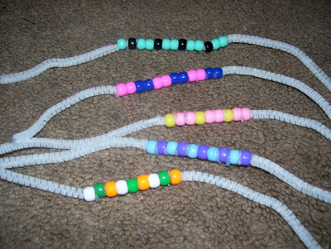
Recognising Pattern
Learning to recognise patterns is an important part of developing reasoning skills. There are lots of ways in which you can support your child with pattern recognition, and these fall into two categories – finding patterns and creating patterns. Here are some ideas for both:
Find patterns – help your child look for patterns in everything around them – on clothes, in pictures, while you’re out walking etc. Talk to them about the colours/shapes/sequences to help them understand about patterns. You could also explore more abstract forms of pattern, for example in their daily routine.
Make patterns – encourage your child to get creative with stickers, stamps or beads to make patterns, clap or beat out rhythms, building up a sequence; ask your child to cross the room or garden using a series of repeated movements e.g. skip, jump, stride etc.

Slide 6
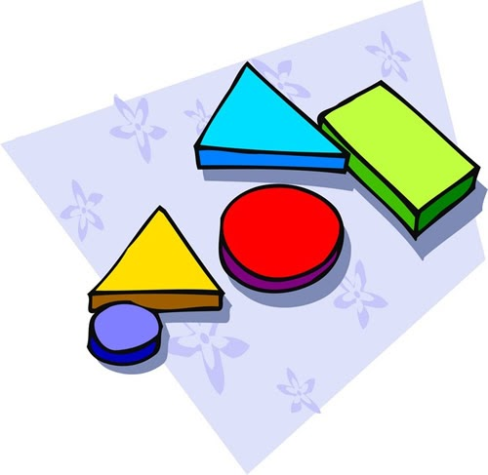
Recognising Shapes
The ability to identify shapes is the foundation for learning very basic geometry. By the time children start primary school, most children are able to recognise basic shapes such as a circle, square, rectangle and triangle etc.
There are lots of activities to support this, for example:
Go on a shape hunt – in the garden, or on a walk – ask your child to look for shapes in their everyday world e.g. the wheel on a car is a circle, the doorway is a rectangle etc.
Get creative with shapes – use shape stamps or shape cutters to make some artwork., or even when baking.
Invest in shape sorting/matching toys/games – there are lots of resources available to support shape recognition.

Slide 7
Useful Websites
https://www.sumdog.com
https://www.oxfordowl.co.uk
https://www.bbc.co.uk/cbeebies
https://educationcity.com
www.teachingyourchild.org.uk
www.doorwayonline.org.uk

