Slide 1
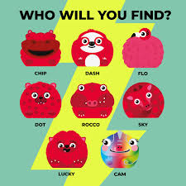
Comic relief-Red Nose Day
By Maisie, Shaw, Hughie, Dilara, Hayley, Nicole, Cameron, Bella and Catriona!

Slide 2
What is Red Nose Day?
Red Nose Day is a day when people across Britain raise money for charities in the UK and around the world.

Slide 3
When is Red Nose Day?
Red nose Day is on the 18th of March every year.

Slide 4
W is Red Nose ?
On red nose day people make donations to try and stop child poverty.
This Photo by Unknown author is licensed under CC BY-SA.

Slide 5
Non-uniform Day and
Wear Red
Wear a Red Nose
How Will
You
Celebrate
Red Nose
Day? ​
Cake sale
Dress up as Superheroes
Red nose and spoon race

Slide 6
Do you have any more Questions?
This Photo by Unknown author is licensed under CC BY.
This Photo by Unknown author is licensed under CC BY-SA.

Slide 7
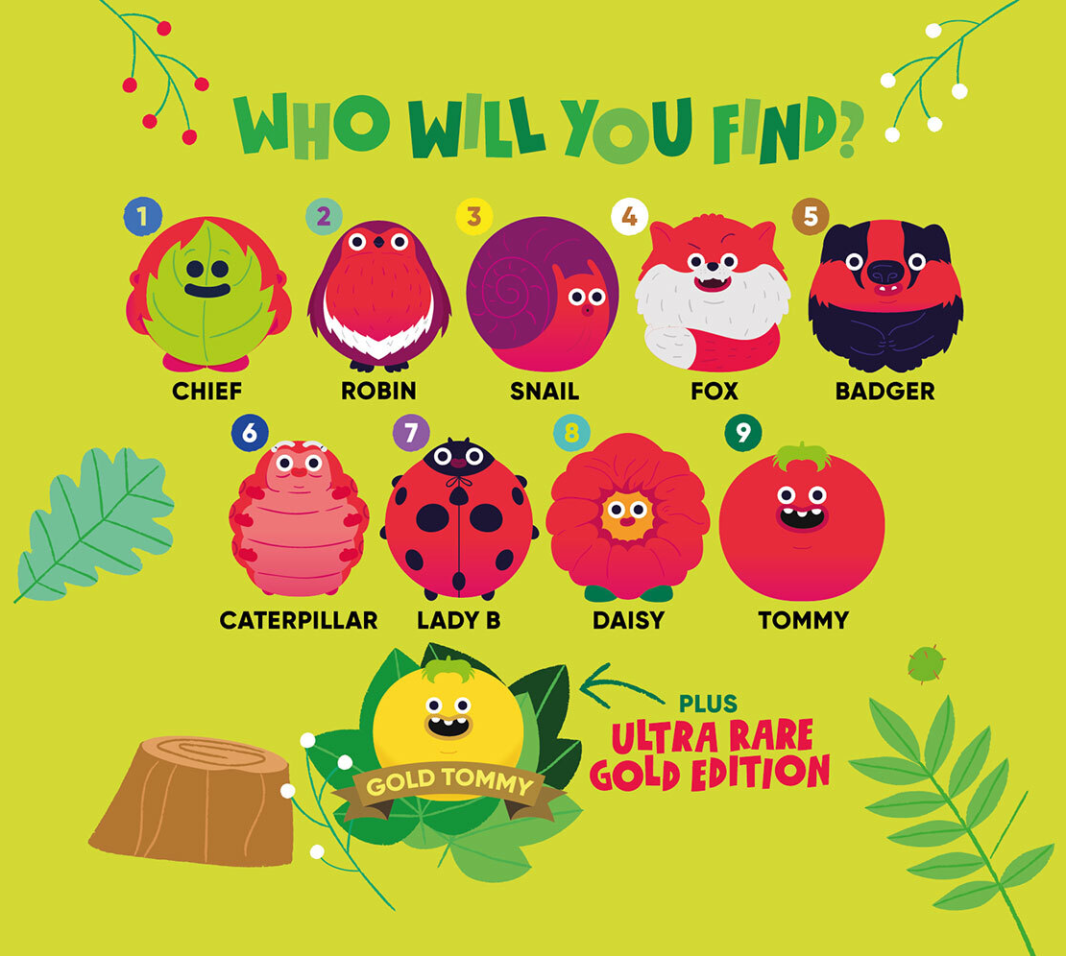
Thank you for Listening
P1-P3
This Photo by Unknown author is licensed under CC BY.

Slide 8
