Slide 1
Comic Relief
By Nicole Hayley Maisie Hughie Dilara Shaw Catriona Cameron and Bella

Slide 2
What is comic Relief?
Comic Relief was an irregularly held event, televised on BBC, which has raised and distributed nearly £50 million towards providing health
Comic Relief is a major charity based in the UK which strives to create a just world free from poverty – and we work 365 days a year to help that vision
What date is Comic Relief 2022?
This year, Comic Relief will air on Friday 18th March . This is also when Red Nose Day will fall in 2022, where schools and workplaces across the country encourage students and employees to buy and wear a red nose in support of Comic Relief

Slide 3
Who started comic Relief
in response to the concept of Comic Relief was to get British comedians to make the public laugh, while raising money to help people around the world and in the United Kingdom
Comic Relief is an operating British charity, founded in 1985 by the comedy scriptwriter Richard Curtis and comedian Lenny Henry

Slide 4
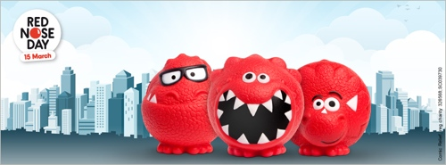
Red nose day ideas!
This Photo by Unknown Author is licensed under CC BY-SA-NC
From purchasing a red nose, to fundraising in your local community and making donations online, there are various ways you can get involved.
Related se
Red nose day cosmic kids' yoga!
Making your own red nose
Red nose day cross words
Watching the live red nose day from bbc.
Your teachers will have some activities for you to do in class!
From purchasing a red nose, to fundraising in your local community and making donations online, there are various ways you can get involved.
Related se

Slide 5
Why is red nose day important?
Why do we wear red noses on Comic Relief?
The basic answer to this is because Comic Relief runs a charity night every other year called Red Nose Day. These red noses are therefore a symbol to celebrate this event.
We're glad you asked! Red Nose Day is a campaign with the mission to end child poverty by funding programs that keep children safe, healthy, educated and empowered.

Slide 6
What does comic relief do?
charity here in the UK as well as elsewhere in the world. Since the annual fundraiser began, they have provided 26,030 grants to causes supporting those with health issues, those in poverty, or those escaping violence.

Slide 7
Why was it invented?
comedians who wanted to use comedy and laughter to let people know about poverty in the UK and in Africa. It was launched in 1985, from a refugee camp in Sudan. The launch was a broadcast live on Christmas Day on BBC 1.

Slide 8
That’s the end of our power - point on comic relief
Any questions?

