Slide 1
Mental health
Let's see what a normal and realistic mental health looks like

Slide 2
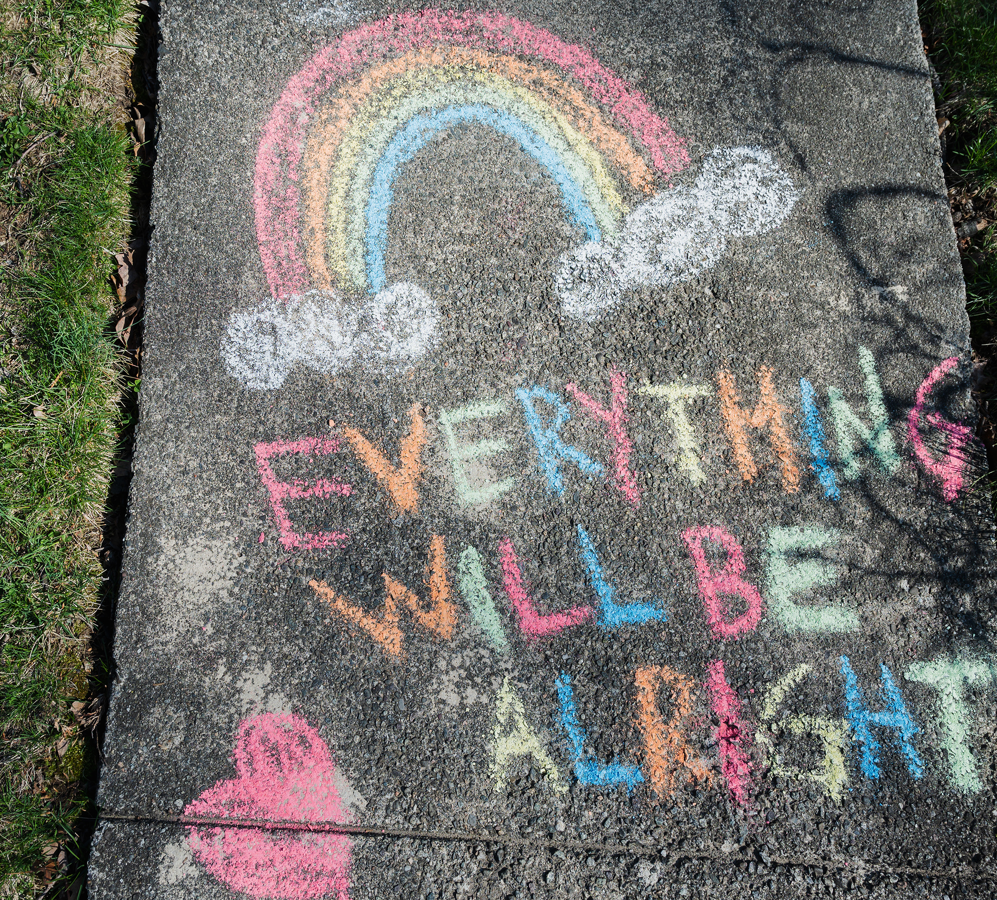
What is a growth mindset
A growth mindset is thinking...
I can't do it yet
I can achieve what I dream
I will try my hardest
This is a really good way to think and make everyone feel driven towards their dreams and you should be and try to always think positive.

Slide 3
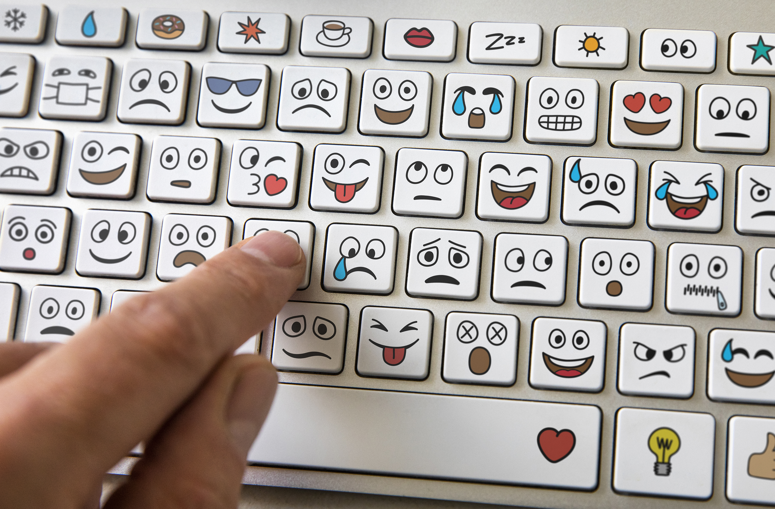
Being sad is normal!
It’s a matter of fact that no one is or can be happy all the time. It's impossible. We all have emotions and that is perfectly normal.
Put your hand up if you've ever thought "ugh" I can't be bothered.
Sometimes everyone feels like that!

Slide 4
Being happy
Being happy is a good feeling and it is amazing to feel happy but we cant always be it.
Its great to start the day with a positive mindset but it cant always be that way!

Slide 5
We are the mental health ambassadors
We can help you with anything to do with mental health or mindfulness.
We are always here to help.

Slide 6
What we have to help you
We have mindfulness colourings.
We brought books in.
We have fold and stick letters for ideas.
We brought in fidgets as well.

Slide 7
Thank you for listening to our power point

