Slide 1
P7 virtual information evening
November 2021

Slide 2
Welcome
Please ensure that your microphone and cameras are turn off for this meeting
If you have any questions, please post them in the comments section and we will reply to you.
We will also compile a list of FAQs and send this out to your primary school.

Slide 3
About this information evening
Explain the transition programme for this years P7 pupils
To introduce some members of staff who will be important to you
To hear from Mr Mackay and Mr Bryson who will speaking to you about literacy and numeracy
To have a virtual tour of our school prepared for you by our BGE Leadership Team
All presentations and future documents such as News Letters will be posted in this Team so please remember to check it regularly.

Slide 4
Transition 2021 -2022
Several lessons have been prepared by the different departments. Your teachers will deliver these throughout the year.
Videos Messages – My world of Work ambassadors, School Captains, the BGE leaderships team, PC Frew, Jamie Dungavel
Newsletters – November, March and May
Burns Competition
PE Event – June
Mrs Mills visits – June
A few P6 events throughout the year

Slide 5
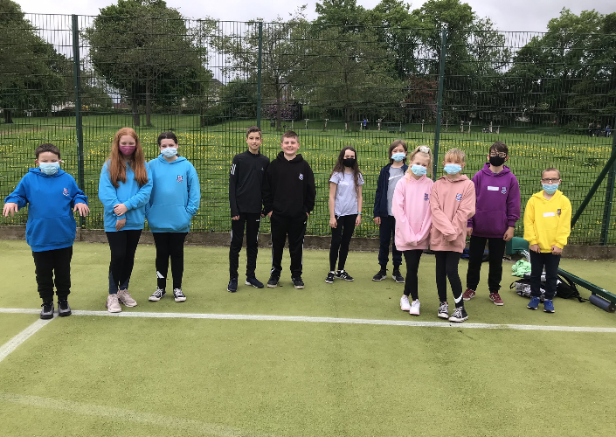
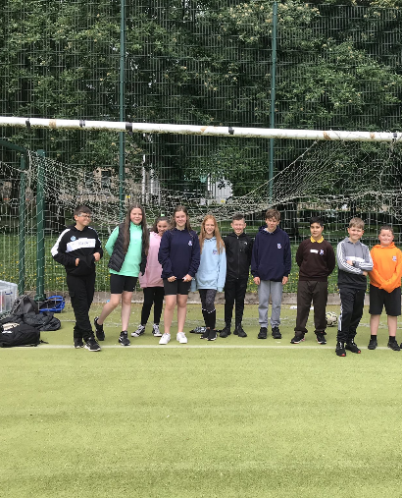

Slide 6
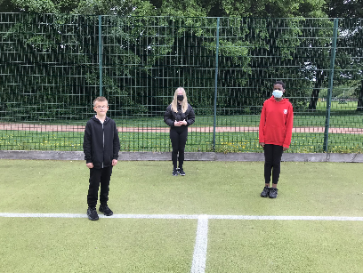
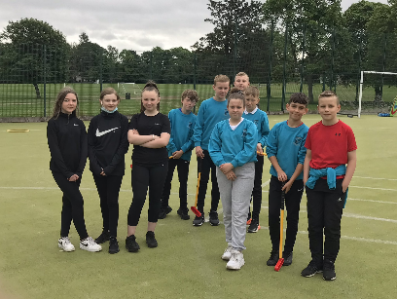
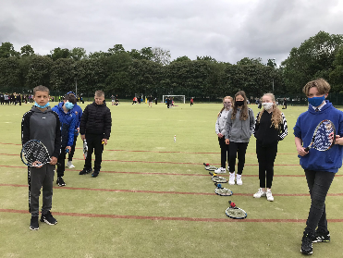
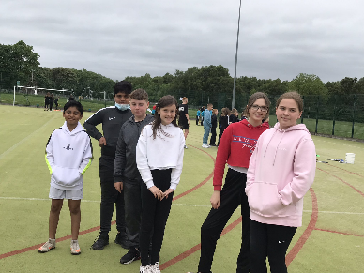

Slide 7
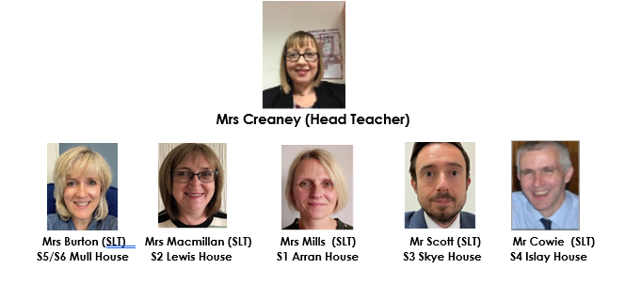
Meet the senior leadership Team

Slide 8
Meet the pupil support team

Slide 9
Mr Bryson – Faculty head maths

Slide 10
Mr MacKay – Faculty Head Languages

Slide 11
Thank you
Keep in touch........
Coatbridge High School | Dare to Dream; Aim to Achieve (glowscotland.org.uk)
@CoatbridgeHigh
@CHSTransition1
@DhtMills

