Slide 2
When pupils come to the English department, they will have the opportunity to:
Develop skills in reading, writing, listening and talking.
Develop skills for life. English is not simply about exams and assessments but helping pupils becomes well rounded, responsible and independent individuals.
Work as part of a group and individually.
Become involved in extra curricular activities within the department.
Have fun.

Slide 3
English
The English department try very hard to make the course fun, engaging, diverse and relatable to the world we live in today.
Pupils will continue to experience a wide variety of activities and the following are just some examples of the types of work and outcomes pupils will have the opportunity to complete in the department:

Slide 4
S1 Texts and Tasks

Slide 5
Tasks
Non-Fiction Writing e.g., autobiographies and persuasive writing.
Creative writing
Critical essays
Character studies
Research skills
Media studies – engagement in films/documentaries with various outcomes
Reading activities where we would look at journalism and how to answer questions in an analytical and evaluative way
Developing language skills with work on vocabulary and language techniques.

Slide 6
Progression
S1 classes are mixed ability
Classes will bet set from S2 upwards. Decisions will be based on work produced throughout the year.
This allows us to appropriately challenge each pupil as an individual and provide support for pupils as and when needed.
Nothing is set in stone and is reviewed throughout the year and at the end of each year.

Slide 7
S2 and S3 Texts

Slide 8
Teaching Methods and Senior Phase
We do not view BGE (S1 – S3) and the senior phase (National 4, 5 and Higher) as two separate courses.
We introduce the necessary skills in S1 in order to build pupil confidence
For example: Close Reading Skills and Critical Essay Skills.

Slide 9
Results
As a department we have an excellent success rate at National 5 and Higher level.
A – C pass rate 2021
National 5 - 94%
Higher – 81%

Slide 10
Additional Courses at Senior Level
Journalism
Media
Legal Studies

Slide 11
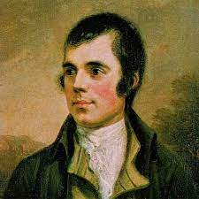
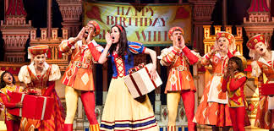
Extra Curricular Opportunities
Award Winning Rare Beast Magazine
Creative Writing Competitions
Public Speaking Opportunities
Burns Night
S1 Pantomime Trip

Slide 12
We talk to pupils all day, every day.
We teach pupils skills and values that they will apply and remember in school and in other areas of their lives.
We involve pupils in every aspect of our teaching and very importantly, every aspect of their learning.
That’s why we rock!

Slide 13
Modern Languages in Coatbridge High School
The languages you can learn are:
French Spanish German
Hola!
Guten Tag!
Salut!

Slide 14
Teaching Staff in the Modern Languages Department
Miss McGuigan
Miss McWhinnie
Mrs Urban
Mrs Wilson

Slide 15
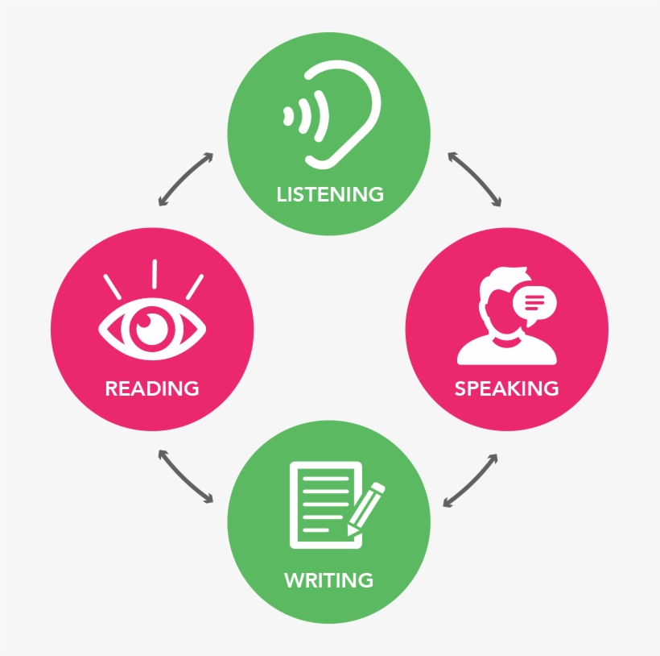
Skills in S1 Modern Languages
Reading
Listening
Writing
Speaking

Slide 16
Topics in S1 Modern Languages
Name, Age and Where you live
Family members
Pets
Numbers
Colours
Alphabet

Slide 17
Did you know….?
Our planet has over 6 billion people who speak between 6000 and 7000 different Languages
Only 6% of the world’s population are native English speakers
75% of the world’s population speak no English at all

Slide 18
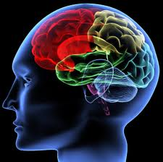
Why is Modern Languages important?
improves your communication skills.
boosts brain power, memory and creativity.
helps give you confidence.
widens your career / job options.
gives you a wider understanding of world affairs & makes travelling easier and more enjoyable.
helps you make friends in new countries.
shows you are open minded and tolerant.

Slide 19
You will work at BGE 2nd,3rd and 4th levels in S1-S3 and will have the chance to progress to:
National 4 and/or National 5
in S4
Higher
in S5/6
in S6
Advanced Higher

Slide 20
Learn a language
It will change your life for the better!
You will NEVER regret it!
Have a talent few people have!
This Photo by Unknown Author is licensed under CC BY-NC

