Slide 1
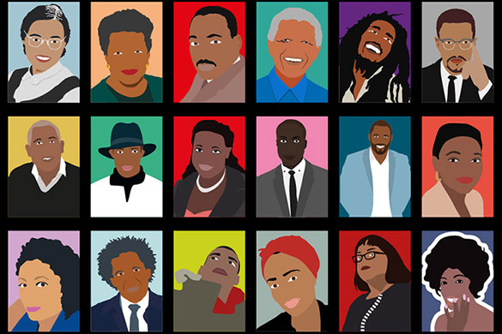
Black History Month
By The House Captains, Digital Leader & The Equity and Diversity Monitors

Slide 2
Hello everybody at Bargeddie Primary School. Today we are going to present a PowerPoint to everyone here today. It is about Black History Month. You probably guessed that this month is Black History month and with a little help from our house captains, Equity and Diversity Monitors and Lewis from the Digital Team we are delighted to present our PowerPoint about Black History Month.
‎
Black History Month is an Internationally celebrated event which aims to promote knowledge of black people’s history and experience. Since this month is October, we have made a PowerPoint about Black History Month and came here to present it!
We will show you the history and the great achievements of black people today, so let’s start!

Slide 3
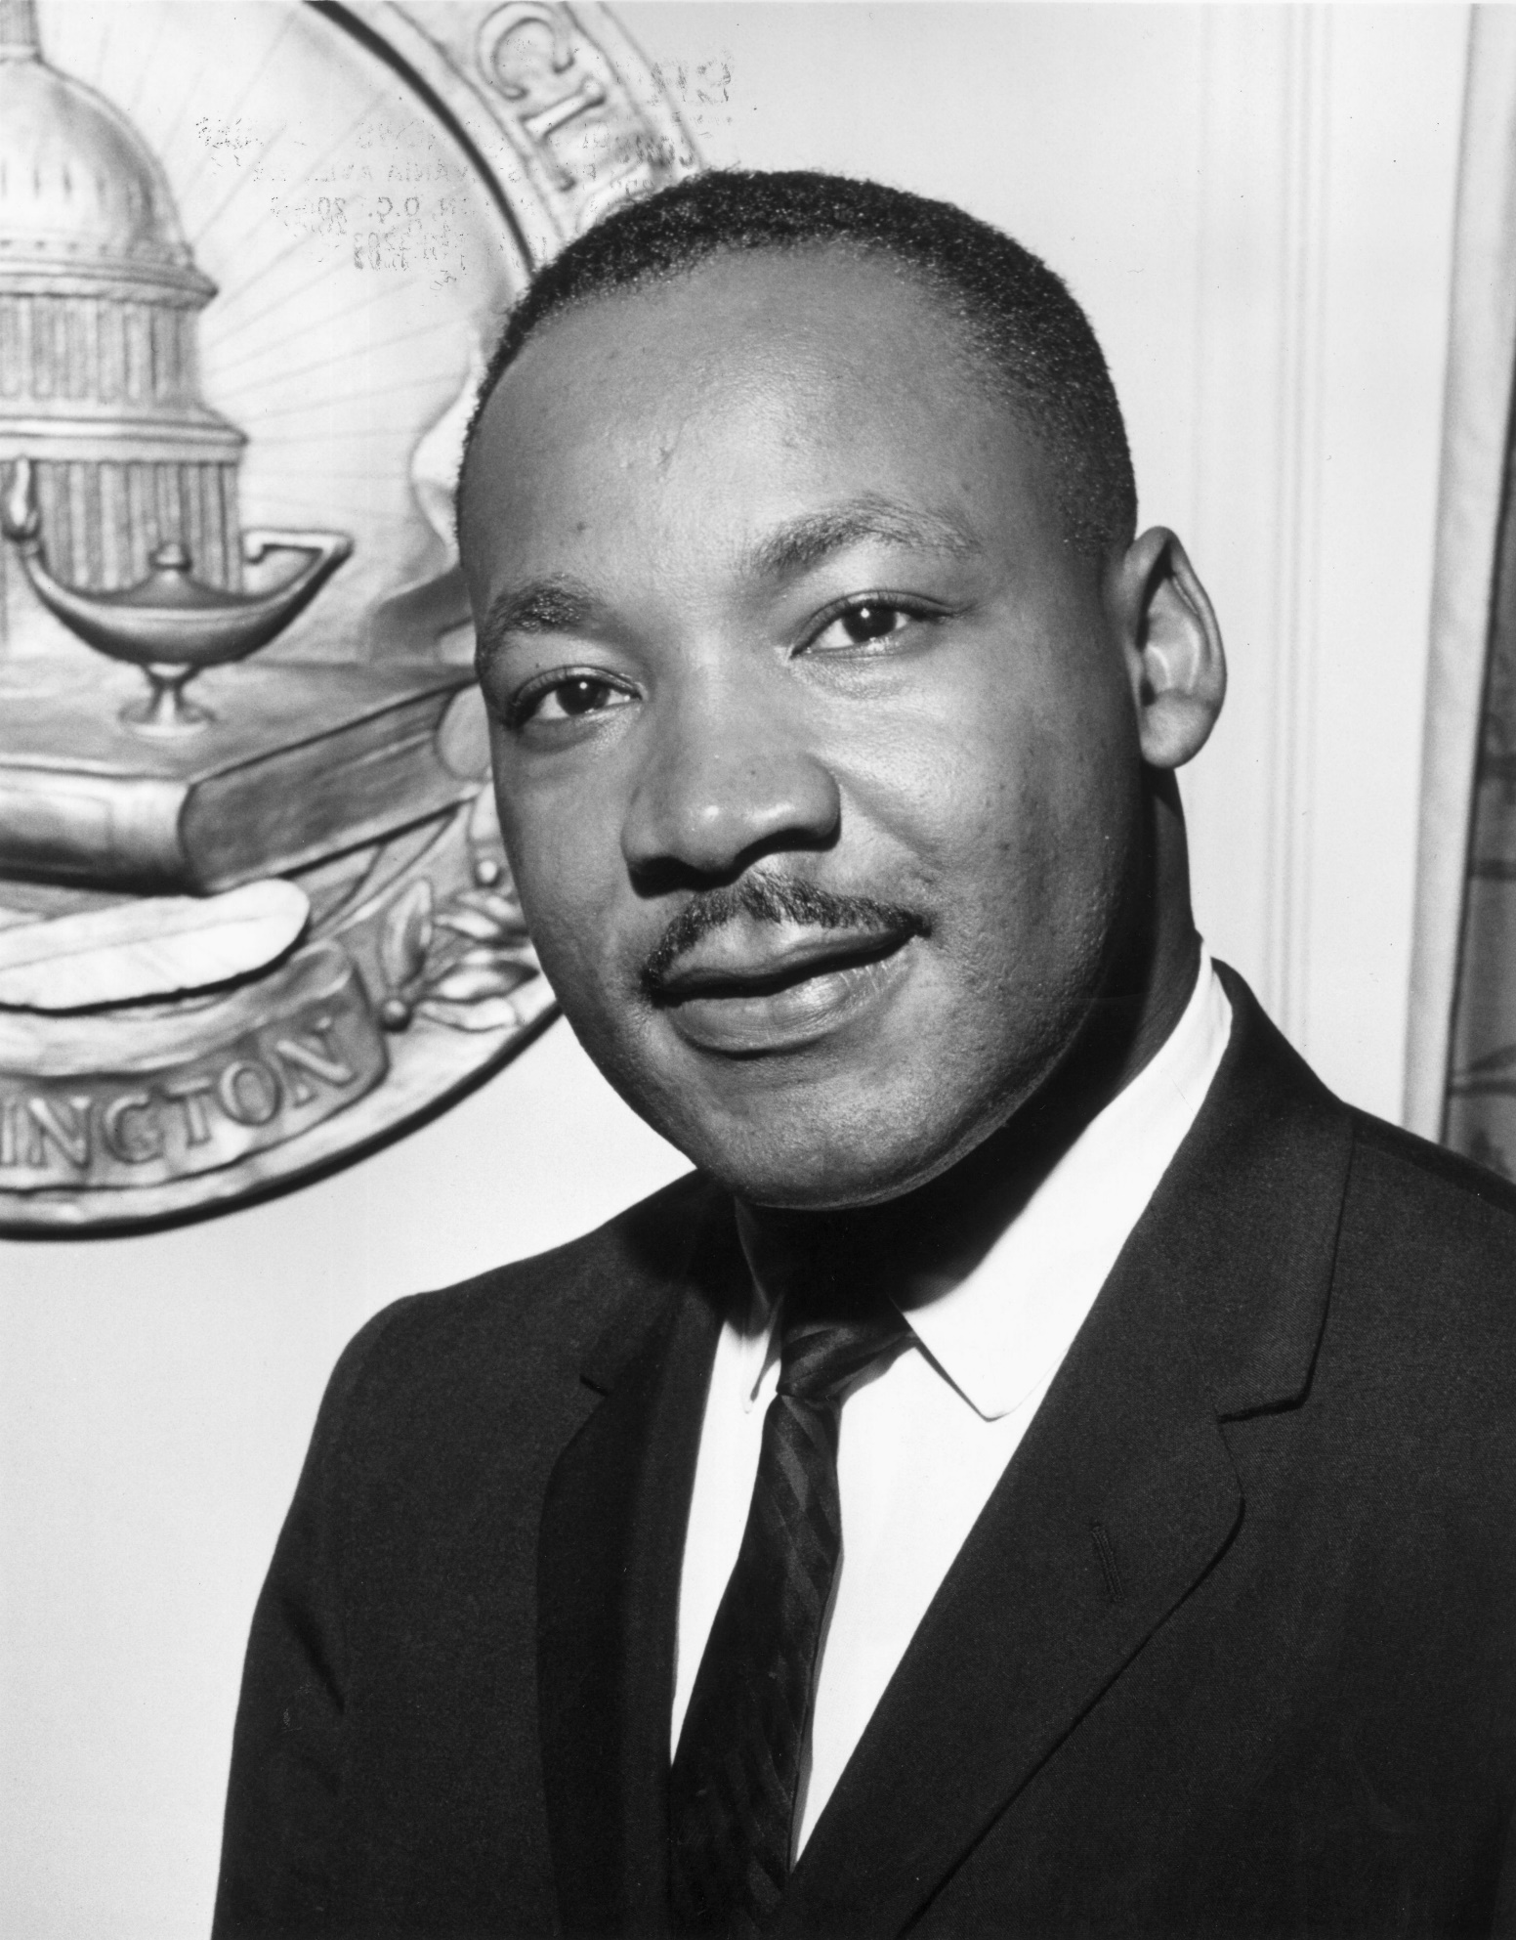
Dr Martin Luther King Jr

Slide 4
Dr Martin Luther King
Martin Luther King Jr was a civil rights activist. He led non violet protests to fight for the rights including African Americans. He hoped that America and the world became colour-blind society where race wouldn’t impact on a person’s civil rights.
Martin made a speech called “I Have a Dream” in 1963, in which he called for civil and economic rights and an end to racism in the United States.
Fun Facts:
Kings birth name was Michael, not Martin.
King entered collage at the age of 15.
King received his doctorate in systematic theology.
King’s I Have A Dream speech was not his first at the Lincoln Memorial

Slide 5
Marcus Rashford

Slide 6
Marcus Rashford
Marcus Rashford played for England in the Euros and missed a penalty because of this he received a lot of racial abuse on social media. He also has took part in a online safety advert to show that not everything online is safe and people you don’t know could text you. Marcus Rashford also gave food to people who couldn’t afford it over lockdown because he felt that it meant something to him. After all that stuff that he has done all the good stuff, he still gets racial abuse. In football during lockdown footballers started taking the knee, Marcus Rashford has took the knee in all his games because he knows that racial abuse is wrong.

Slide 7
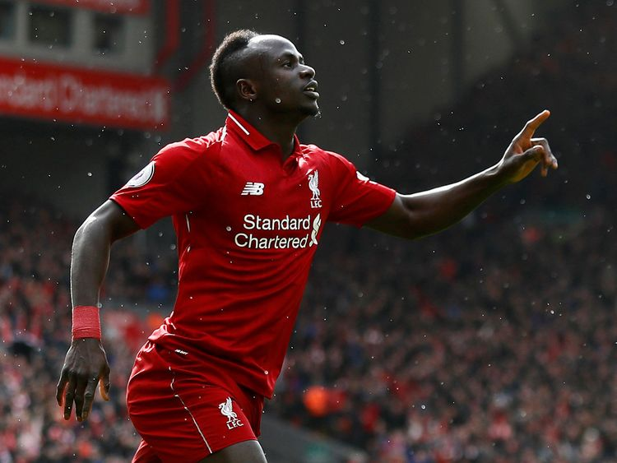
Sadio Mane

Slide 8
Sadio Mane
Sadio Mane is a footballer who plays for Liverpool and Senegal he plays as a left winger and is very good. He gives a lot of his wages to his hometown in Senegal. He has won multiple Premier League, Champions League, Club world cup and the super cup. He has scored 230 goals for his club Liverpool. Here are some facts.
His nickname is Said
He was born 10th April 1992
He was born in Sedhiou, Senegal

Slide 9
Raheem Sterling

Slide 10
Raheem Sterling
Raheem Sterling is a football player who plays for Manchester City and England. Raheem Sterling is originally from Jamaica. He was racially abused when he joined Manchester City. The worst part is the papers racially abused him. Now here’s some facts about Sterling.
He has scored 145 goals
He played for Liverpool before he moved to Man City
He was born on 8.12.94 [8th December 1994]
He was born in Kingston, Jamaica

Slide 11
Bukayo Saka
This Photo by Unknown Author is licensed under CC BY-ND

Slide 12
Bukayo Saka
Bukayo Saka is a football player, he plays for Arsenal and he is 20 years old. He was born in 5th September 2001. He is a left winger and a left back.
Saka is from London of Ealing.
Saka’s real name is Bukayo Ayoyinka T. M. Saka.
Saka’s brother is called brother Yomi.

Slide 13
Barack Obama
This Photo by Unknown Author is licensed under CC BY-NC

Slide 14
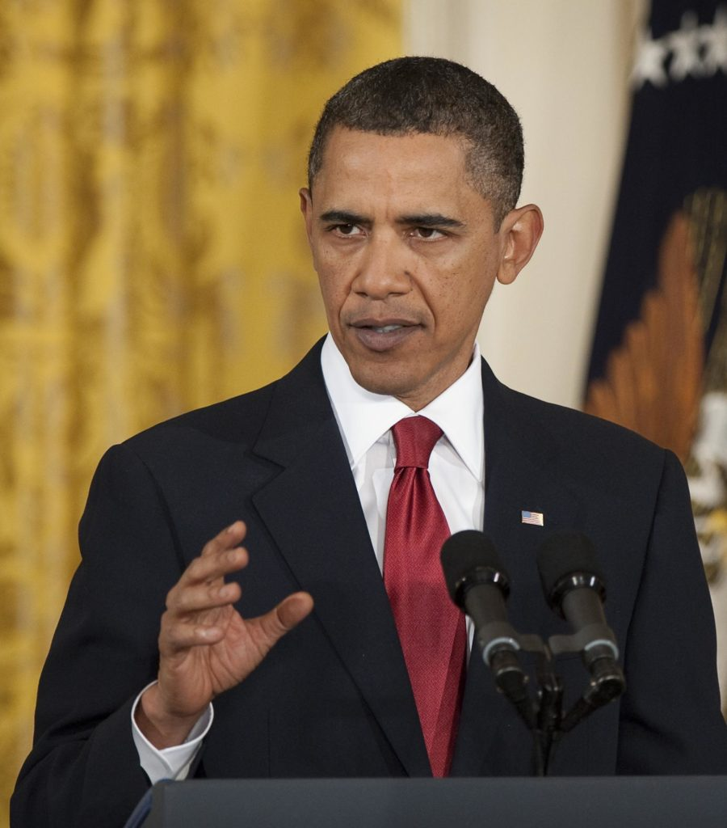
Barack Obama
Barack Obama was the first black president. He was president for 8 years. He was the 44th president. His middle name is Hassien. He was honoured with the Nobel Peace Prize in 2009. He was born in 1961 and he is 60 just now. He spent most of his childhood in Hawaii, Chicago and lllinois.
Fun Facts –
. When Barack Obama was President, Joe Biden was his Vice President.
. He was president from 2009 to 2017.
. He was the first African American president.

Slide 15
Rosa Parks
This Photo by Unknown Author is licensed under CC BY-SA

Slide 16
Rosa Parks
Early life
Rosa was born in Tuskegee February the 4th on the.she had a brother Sylvester
McCauley . her mother and father were James McCauley and Leona McCauley . Rosa started her protest in 1955 as a black women she refused to give up her seat on a segregated bus in Montgomery, of the bus boycott .

Slide 17
THANK YOU VERY MUCH
This Photo by Unknown Author is licensed under CC BY-SA

