Slide 2
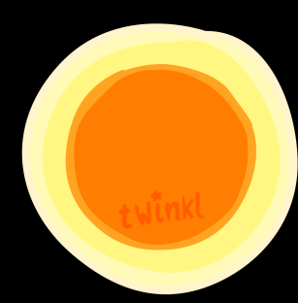
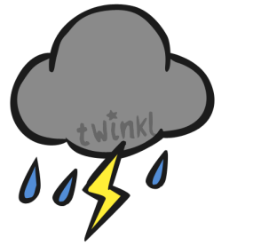
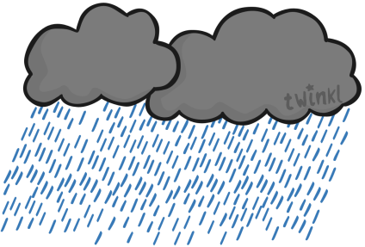
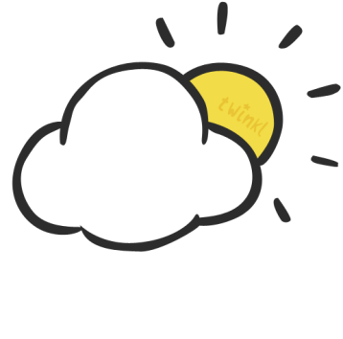
Today is
Monday
Tuesday
Wednesday
Thursday
Friday
Today’s weather is...
January
July
1
4
st
February
August
1
5
nd
2
6
rd
March
September
2
7
th
April
October
3
8
9
May
November
3
0
June
December

Slide 3
Today is
Monday
Tuesday
Wednesday
Thursday
Friday
Today’s weather is...
January
July
1
4
st
February
August
1
5
nd
2
6
rd
March
September
2
7
th
April
October
3
8
9
May
November
3
0
June
December

Slide 4
Today is
Monday
Tuesday
Wednesday
Thursday
Friday
Today’s weather is...
January
July
1
4
st
February
August
1
5
nd
2
6
rd
March
September
2
7
th
April
October
3
8
9
May
November
3
0
June
December

Slide 5
Today is
Monday
Tuesday
Wednesday
Thursday
Friday
Today’s weather is...
January
July
1
4
st
February
August
1
5
nd
2
6
rd
March
September
2
7
th
April
October
3
8
9
May
November
3
0
June
December

Slide 6
Today is
Monday
Tuesday
Wednesday
Thursday
Friday
Today’s weather is...
January
July
1
4
st
February
August
1
5
nd
2
6
rd
March
September
2
7
th
April
October
3
8
9
May
November
3
0
June
December

Slide 7
Today is
Monday
Tuesday
Wednesday
Thursday
Friday
Today’s weather is...
January
July
1
4
st
February
August
1
5
nd
2
6
rd
March
September
2
7
th
April
October
3
8
9
May
November
3
0
June
December

