Slide 2
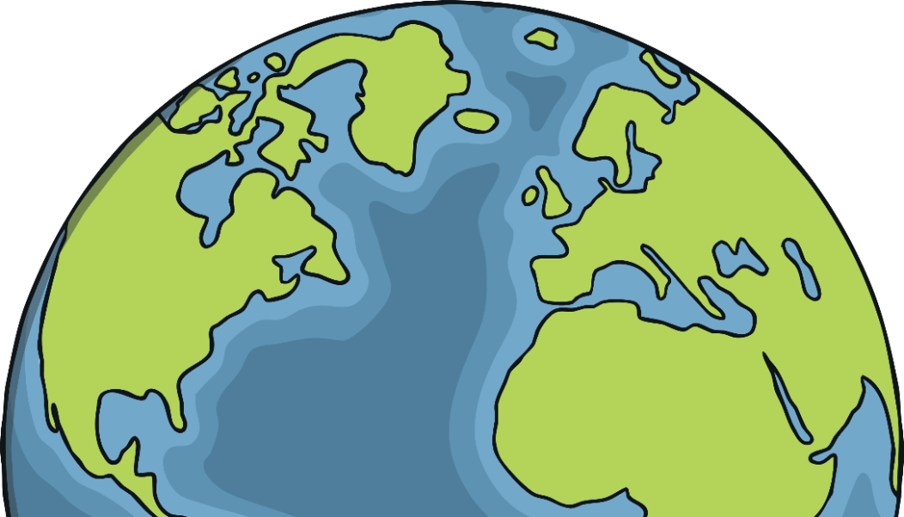
Our Earth
It meets our five basic needs to live:
Oxygen
Food
Water
Shelter
Warmth.
Our planet Earth is a unique place to live.
It has rivers, lakes, volcanoes, mountains, beaches and valleys. Nearly ¾ of our Earth is covered by water.
It is the only planet in the solar system with lots of oxygen and water, to support life.
It is about 4½ billion years old!
Fun Fact
Our environment is everything around us.
It includes plants, animals and other humans, and the air that we breathe.

Slide 3
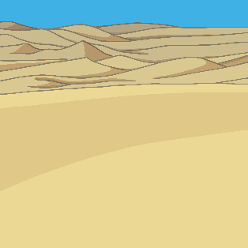
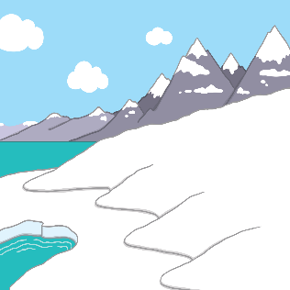
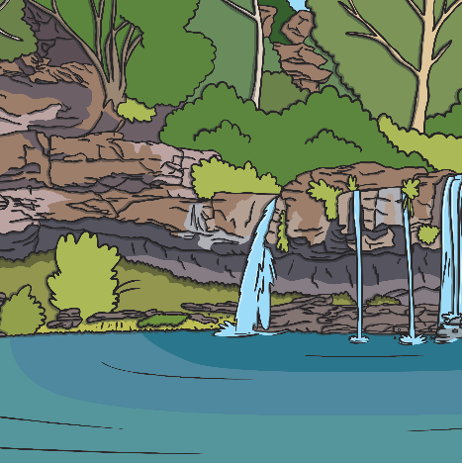
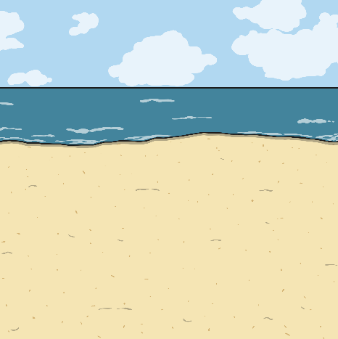
What Is a Climate?
Our Earth has lots of different types of weather in lots of different countries. We call these weather types climates.
The Namib desert is hot and dry.
The Antarctic is very cold – it is the coldest place on Earth.
The Amazon rainforest is wet and hot.
The beaches in the Mediterranean are warm.

Slide 4
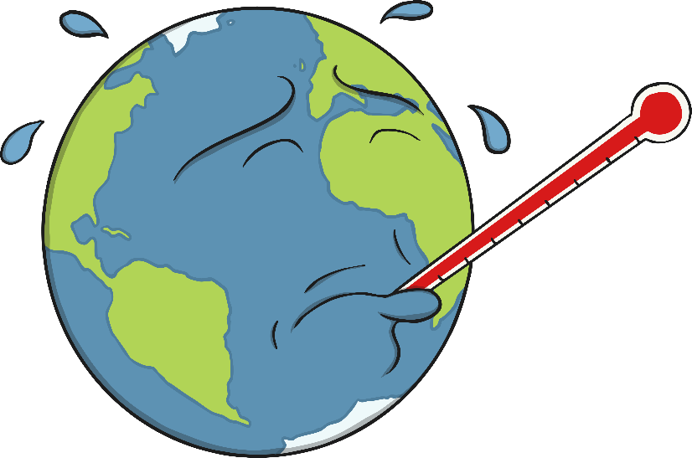
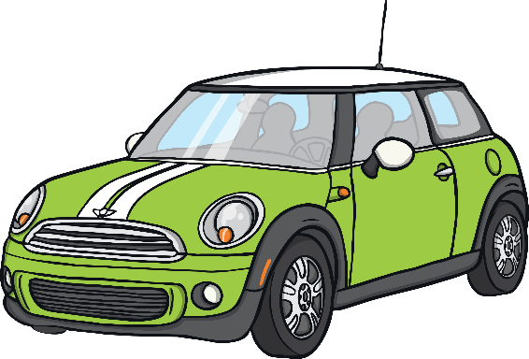
How Can a Climate Change?
Our planet’s climate is changing as its human population gets bigger. There are now more than 7,500,000,000 people.
How these people live their lives is making a big change to our climate.
Fun Fact
The Earth is wrapped by a huge, protective blanket called the atmosphere. It protects us from the sun and from meteors, too!

Slide 5
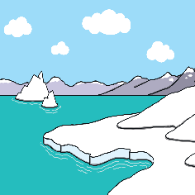
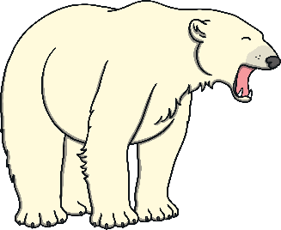
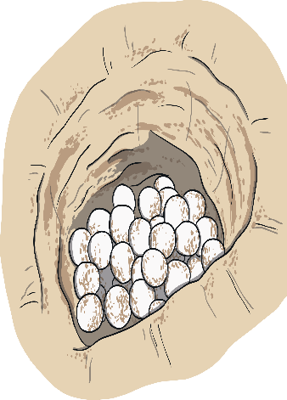
What Does Climate Change Mean for Us?
Global warming isn’t good for our Earth. It means that ice is starting to melt in the Antarctic and this could cause floods in other parts of the world.
Rising sea levels mean that animals, such as turtles, will no longer have nesting beaches on which to lay their eggs. The temperature of the nests also affects whether the turtles will be male or female and if the temperature continues to rise, more females will be born than males, increasing the risk of turtles becoming extinct.
Fact
Developing countries will experience more droughts (low rainfall) which will affect their livelihood, if they are unable to grow the crops they need.

Slide 6
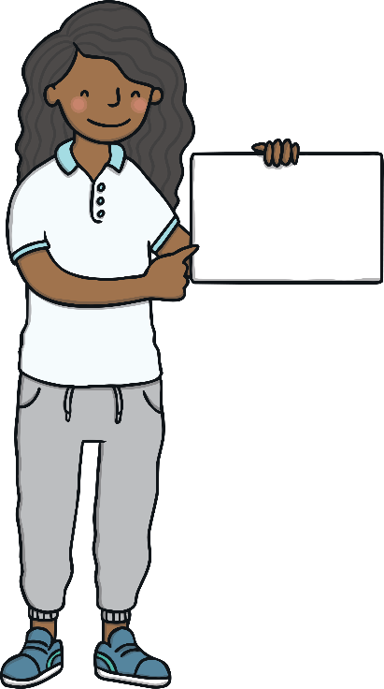
Climate Change Protests
Groups of young people all over the world are very unhappy about the changes in our climate.
They have written letters to important people, like politicians, as they wanted to show how serious they are about taking care of our Earth.
In February 2019, lots of young people didn’t go to school or college. Instead, they made posters and banners and took to the streets with their message to look after our Earth and stop polluting. We call this a protest.

Slide 7
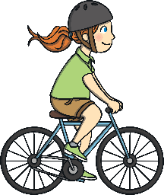
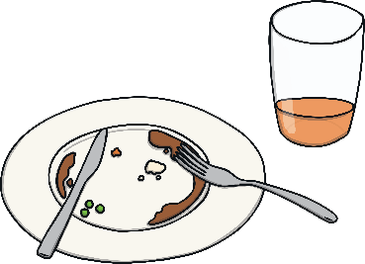
How Can We Help?
Everybody must do their bit. This is our Earth that we share. We only have one and we need to look after it.
Use cars less.
Reduce, Reuse, Recycle
Cars pollute the air. Walk or cycle to school.
Reuse what you don’t need any more. Waste less and recycle where you can.
Use less electricity.
Switch off electrical items when you are not using them. Leaving them on standby uses electricity!

Slide 8
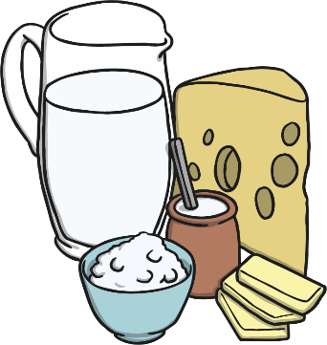
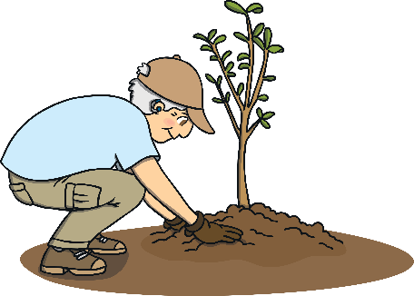
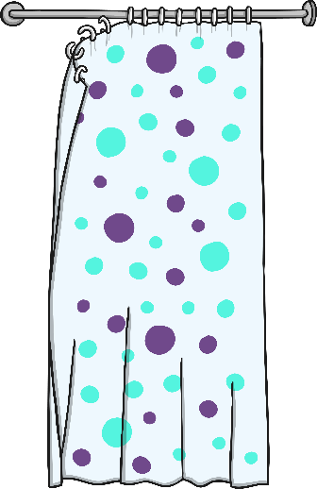
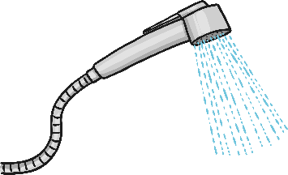
How Can We Help?
Everybody must do their bit. This is our Earth that we share. We only have one and we need to look after it.
Plant a tree.
Eat less meat and dairy.
Use less water. Have a quick shower instead of a bath.

