Slide 1
LESSON 2
Technology In the home

Slide 2
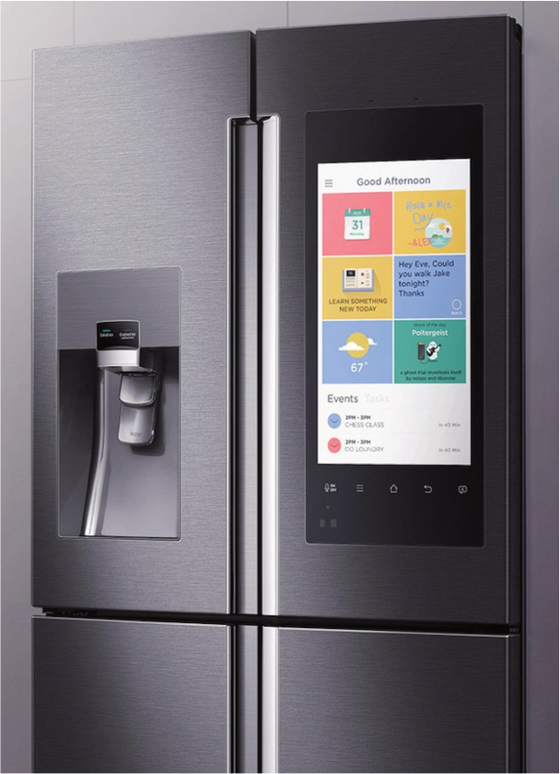
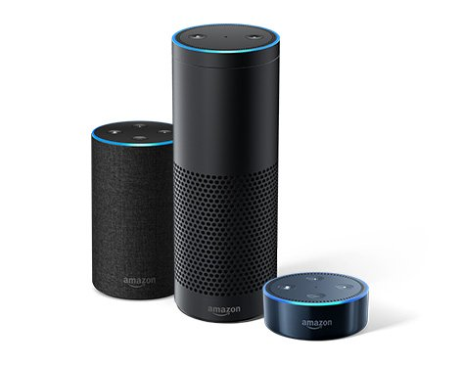
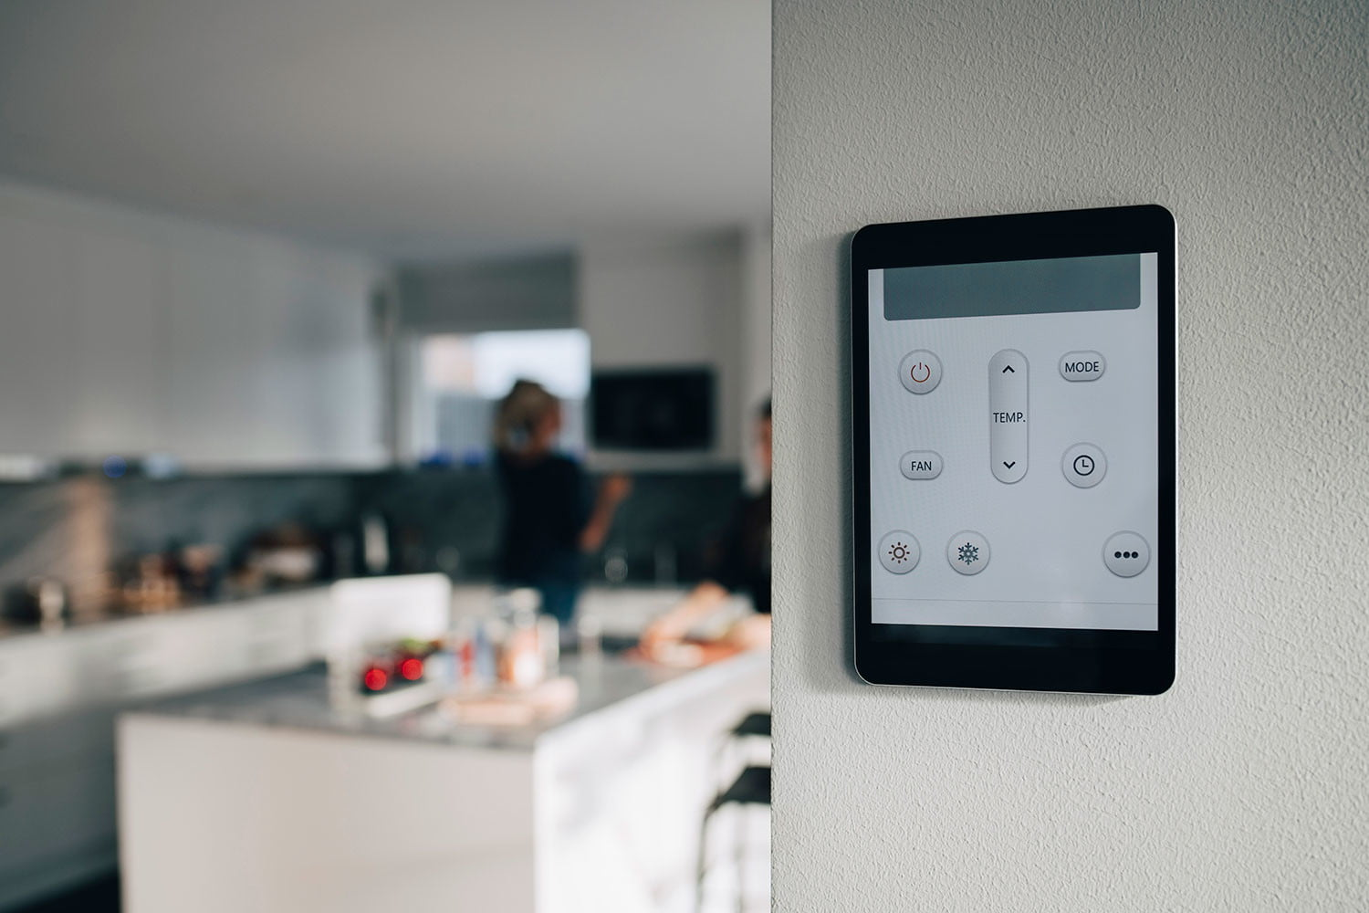
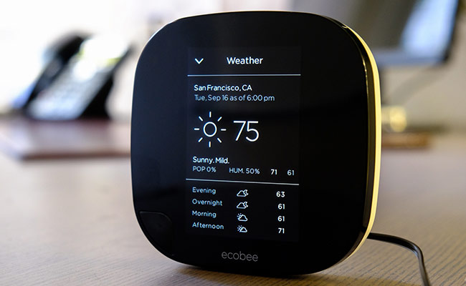
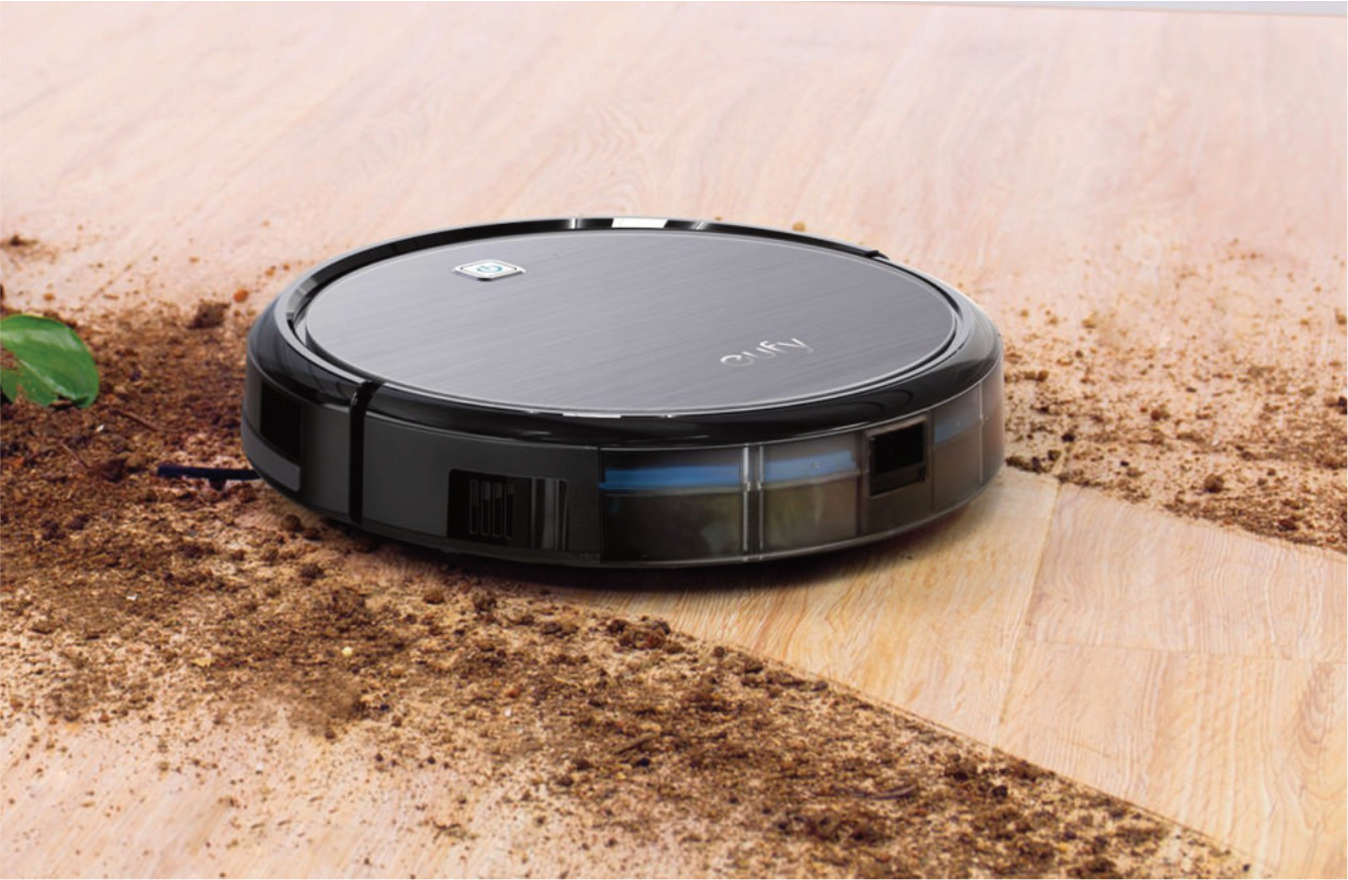
It seems like these days everything is becoming technologically ‘smarter’. How about our homes? Smart fridges will allow us to see on our phones exactly when we need to buy more milk or when our eggs will be out of date. Are there other smart devices we can add to our homes?
Lets think about the tasks we do at home. Could we design a device that would make them easier?
Look at these examples of smart devices that people have in their homes already.

Slide 3
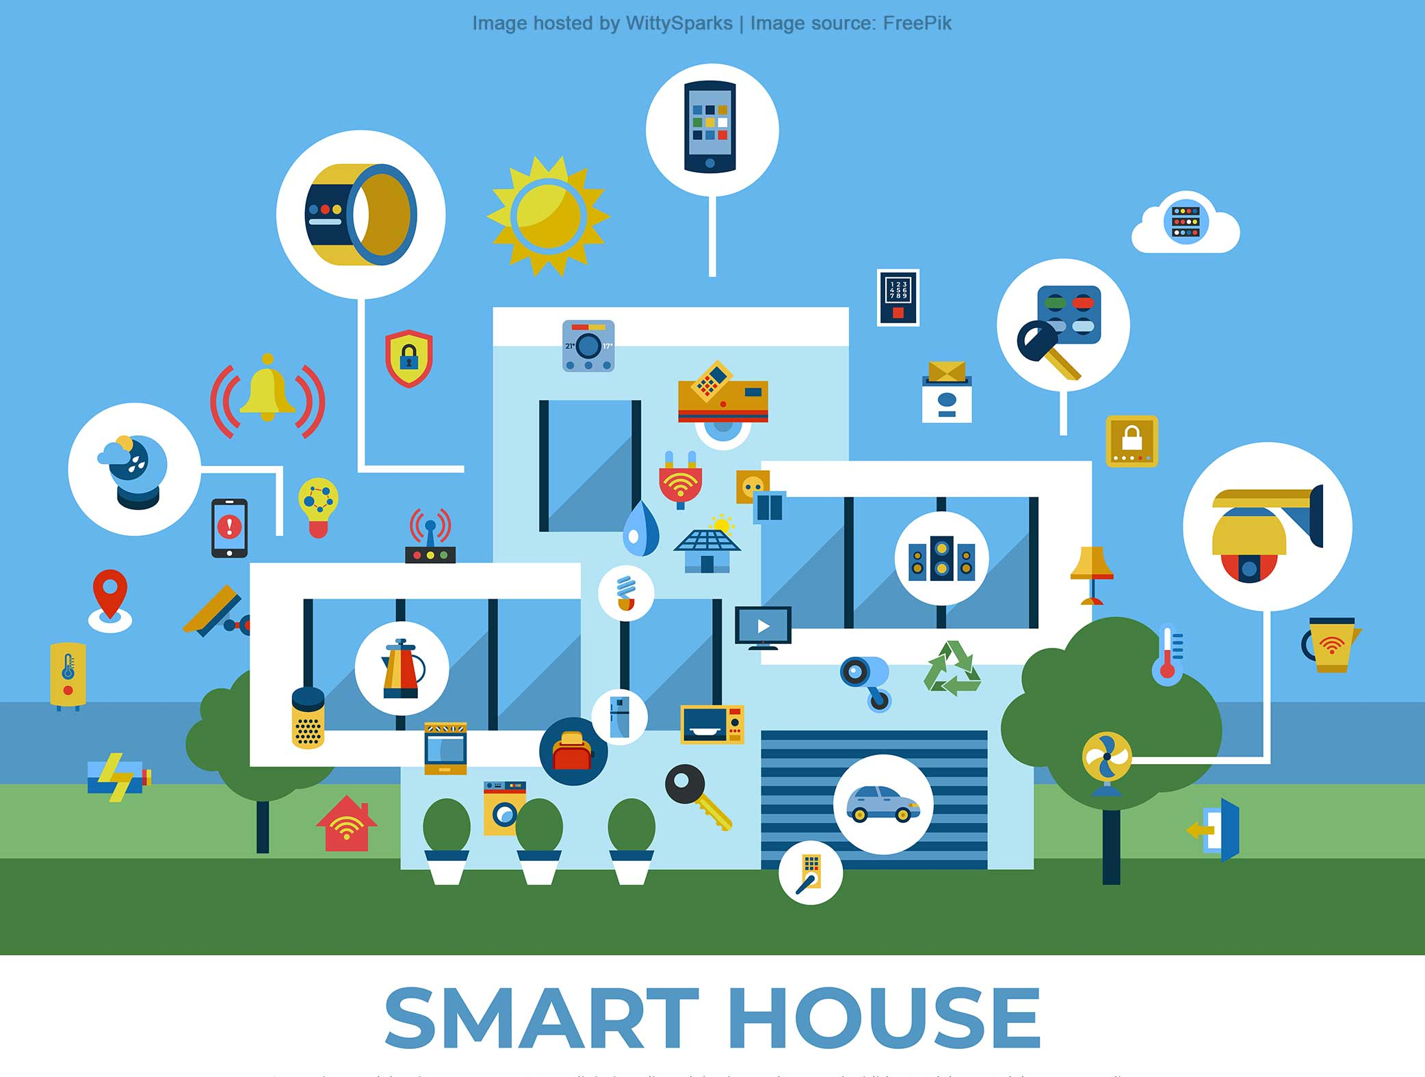
YOUR TASK
DESIGN A SMART DEVICE THAT WOULD HELP TO MAKE A TASK AT HOME EASIER.
FOR EXAMPLE – A FRIDGE WITH A SCREEN THAT TELLS YOU WHAT YOU CAN MAKE WITH THE FOOD THAT’S INSIDE IT.
OR A SENSOR ON YOUR BIN THAT TELLS YOU WHEN IT NEEDS TO BE EMPTIED.

Slide 4
TELL US WHAT YOUR NEW DEVICE IS AND WHAT IT DOES? DOES IT HAVE A NAME?
WHY DO YOU THINK THIS DEVICE IS HELPFUL?
SKETCH YOUR IDEA
WHAT MATERIALS AND TECHNOLOGY WOULD YOU USE? WOULD IT BE AN APP? A SENSOR? A TABLET? OR SOMETHING NEW THAT YOU HAVE CREATED?

Slide 5
Once you are finished designing your item take a photo of it and upload it into the other tray on assignments.

