Slide 1
Ways to pay

Slide 2
Different ways to Pay
Money – Coins
Money – Notes
Credit Card
Debit Card
Cheque
Smartphone App

Slide 3
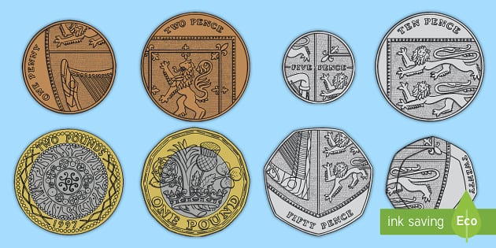
Coins
The first way you can pay for items is by using coins. You might pay with the correct amount of coins or you might pay with more coins which means you will get coins back. This is your change.

Slide 4
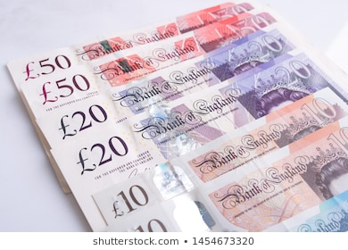
Notes
You can also pay for items using Notes. You might pay for items using the correct amount of notes or you might pay using extra notes. This means you might get notes or coins back. This is your change.

Slide 5
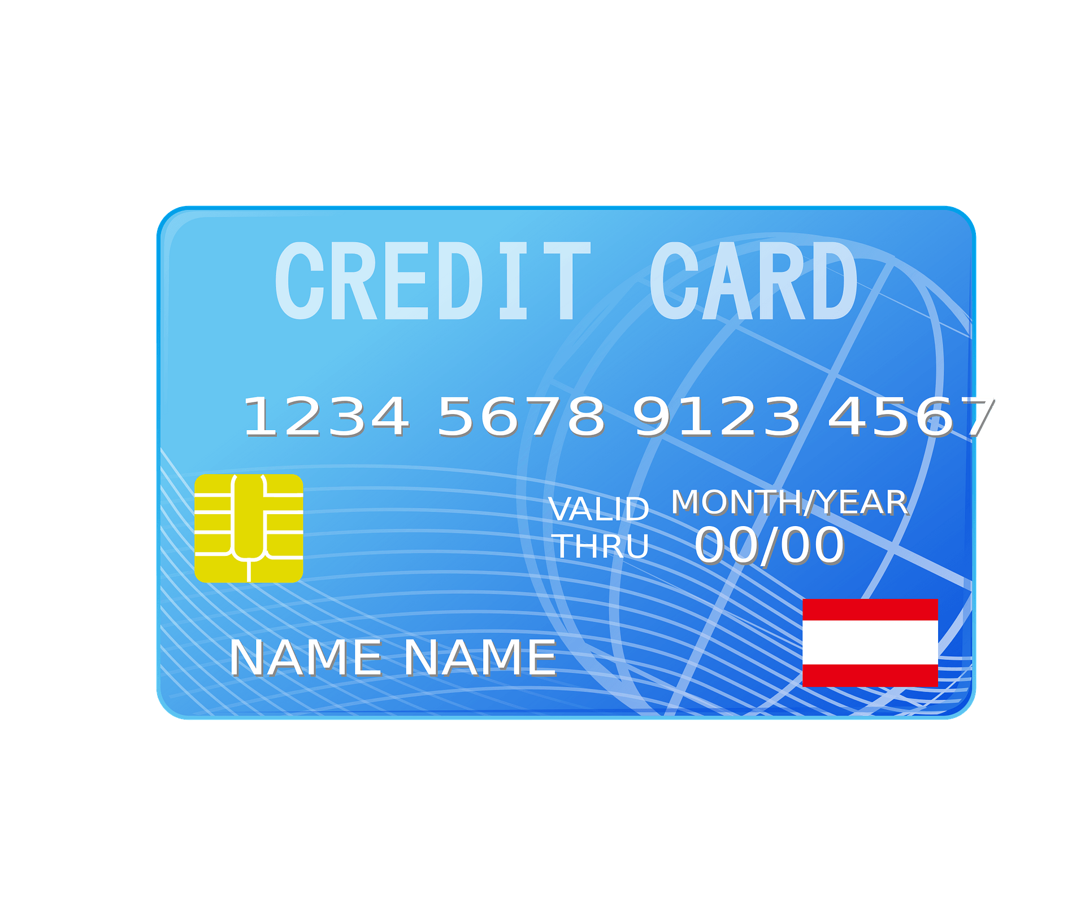
Credit Card
You can use these to pay in stores. This is not your own money, this is the banks money which you are borrowing. You need to pay this money back to the bank.

Slide 6
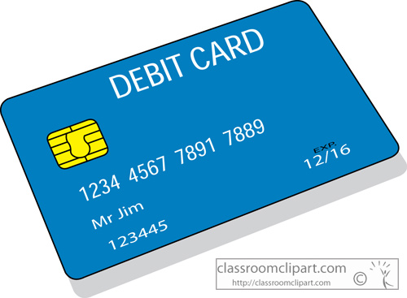
Debit Card
You can use these to pay in store. These are used to spend money from your bank account. When you buy something with a debit card the money comes out your bank account.

Slide 7
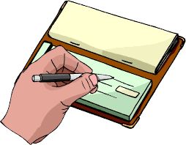
Cheque
This is a piece of paper that represents money. A personal check works like cash. You give it to someone to whom you owe money. That person can turn your check into cash and once they put it through the bank can use it just like money. A check is like a promise to the person you're giving it to that the amount you've written on the check is backed up by money in a checking account.

Slide 8
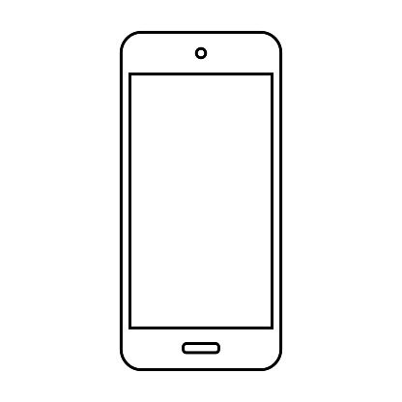
Smart PhOne App
Recently a new way to pay is through your phone. On your phone you can add your card. You can scan your phone in the shop instead of using your card but the money still gets charged to your card.

