Slide 1
Ways to pay

Slide 2
Different ways to Pay
Money – Coins
Money – Notes
Credit Card
Debit Card
Cheque
Smartphone App

Slide 3
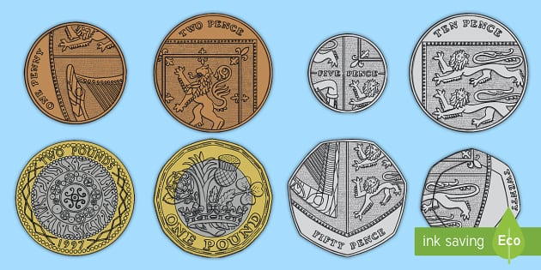
Coins
The first way you can pay for items is by using coins.

Slide 4
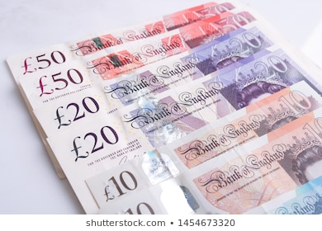
Notes
You can also pay for items using Notes.

Slide 5
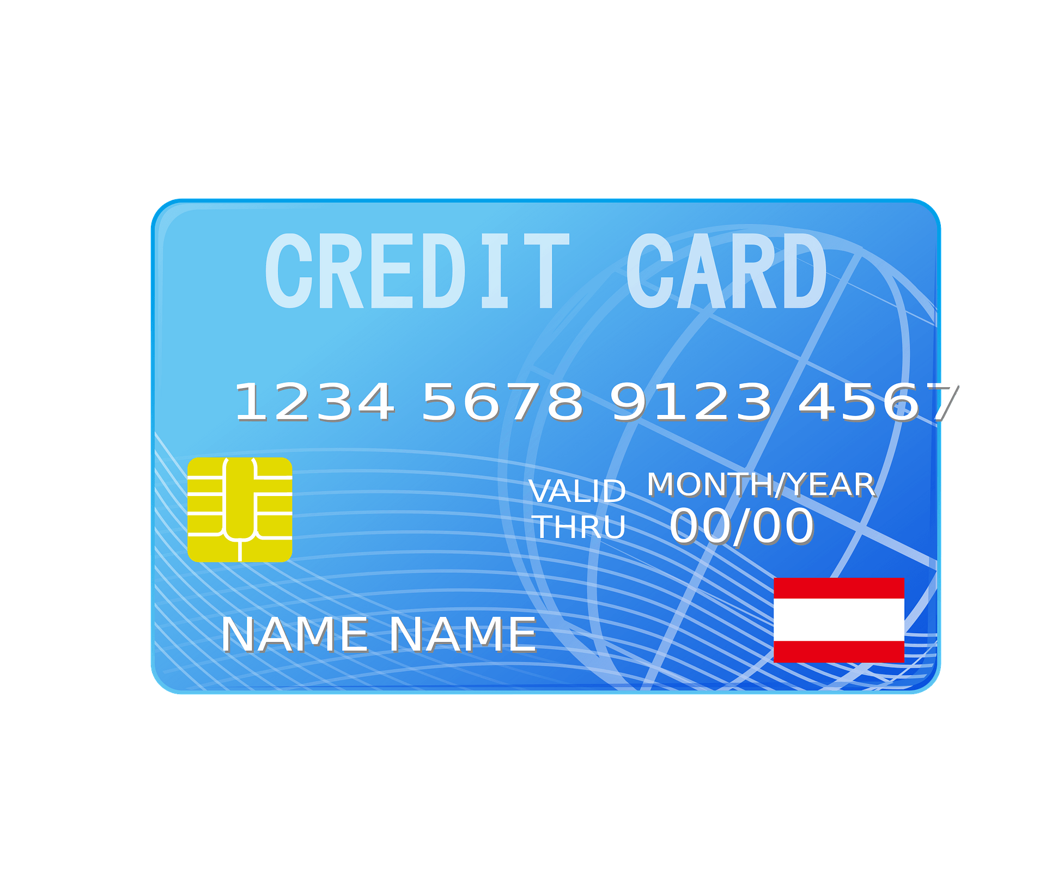
Credit Card
You can use these to pay in stores. This is not your own money, this is the banks money.

Slide 6
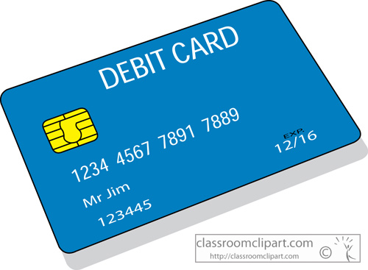
Debit Card
You can use these to pay in store. These are used to spend money from your bank account.

Slide 7
Cheque
This is a piece of paper that represents money.

Slide 8
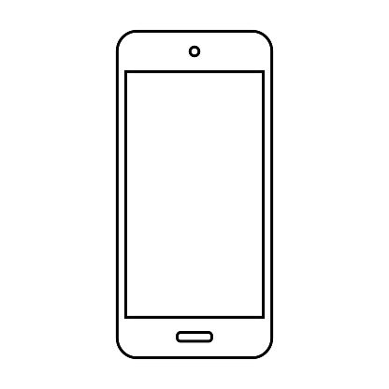
Smart PhOne App
Recently a new way to pay is through your phone. On your phone you can add your card.

