Slide 1
LESSON 1
CUPCAKE STAND DESIGN

Slide 2
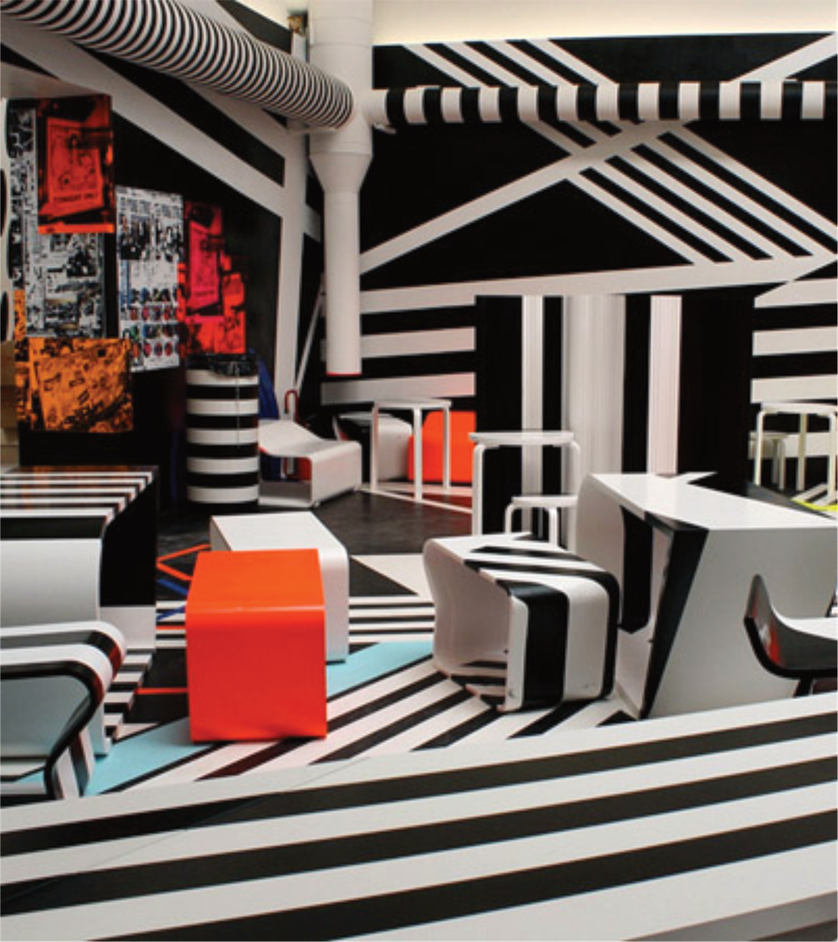
Tobias Rehberger is an artist. He designed this unusual cafe.
The cafe requires a cupcake display stand which can hold 6 cupcakes.
The display stand will sit on the counter beside the till and present cupcakes in an interesting way.
As the designer, it is your job to design the cupcake holder to fit in with the café.

Slide 3
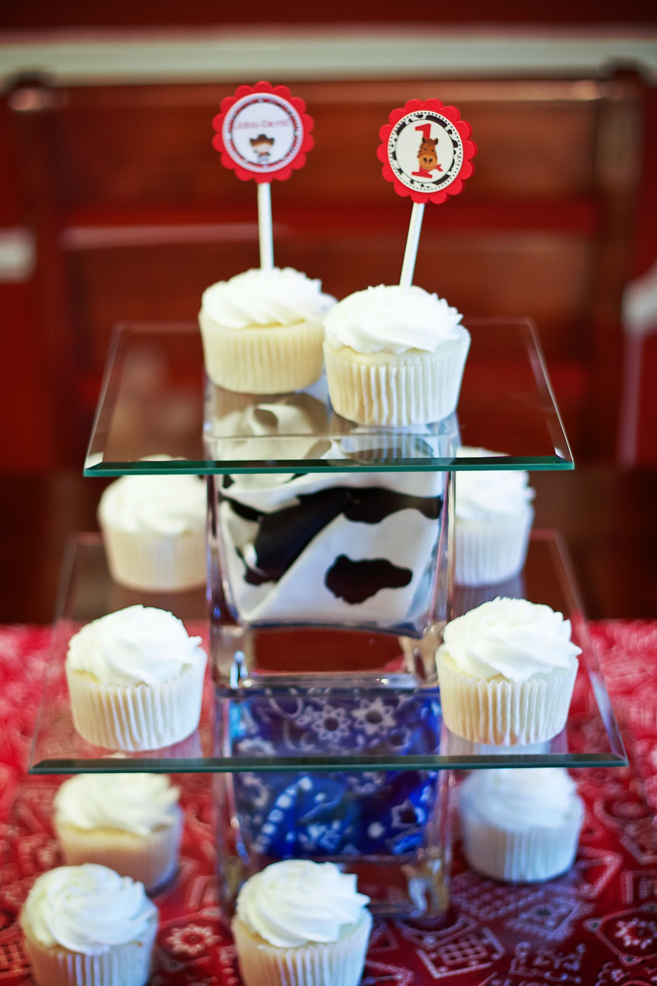
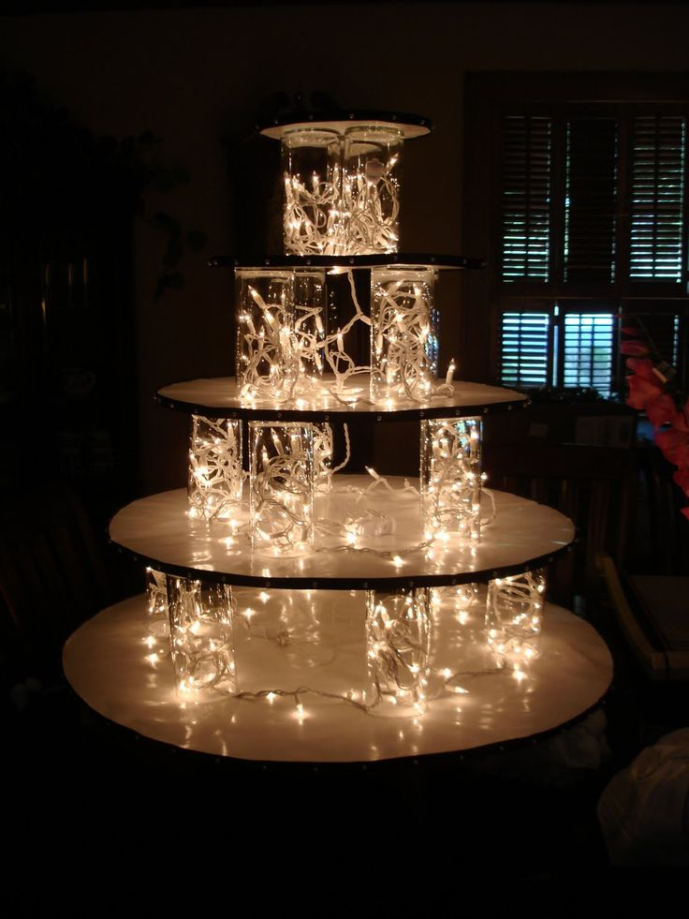
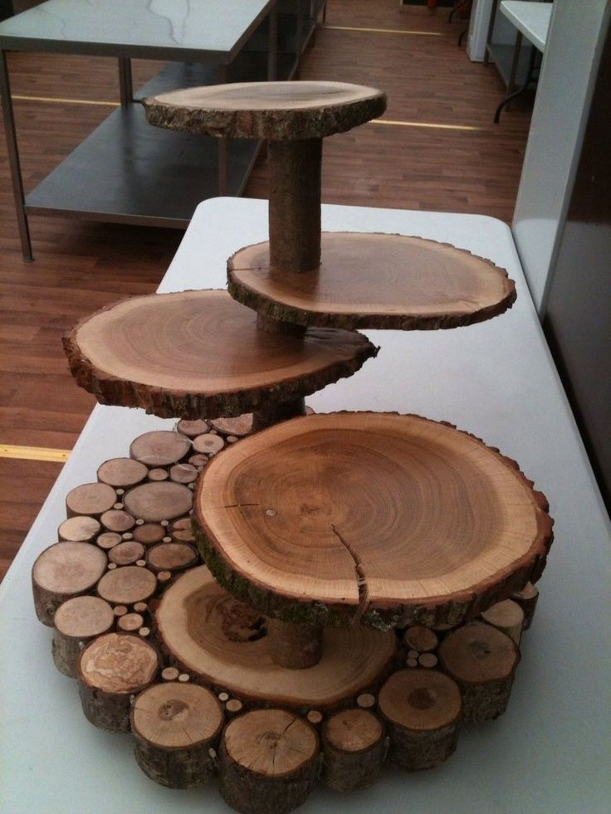
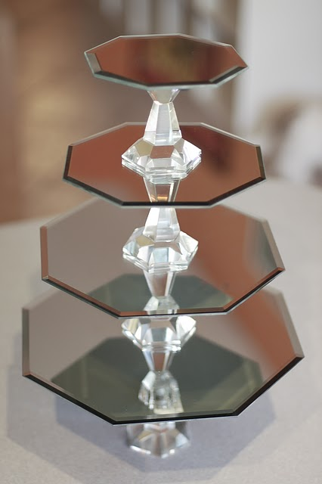
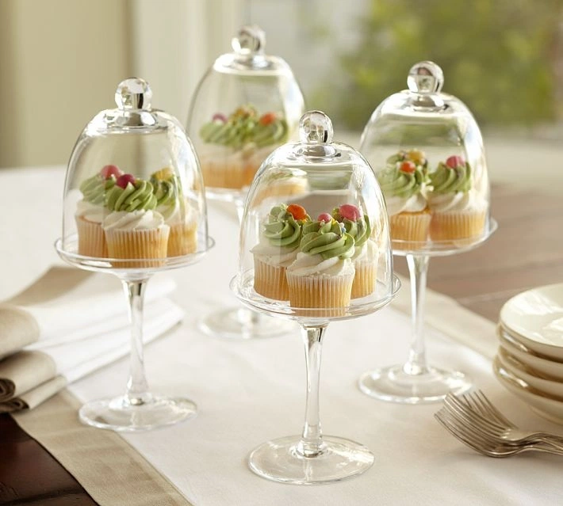
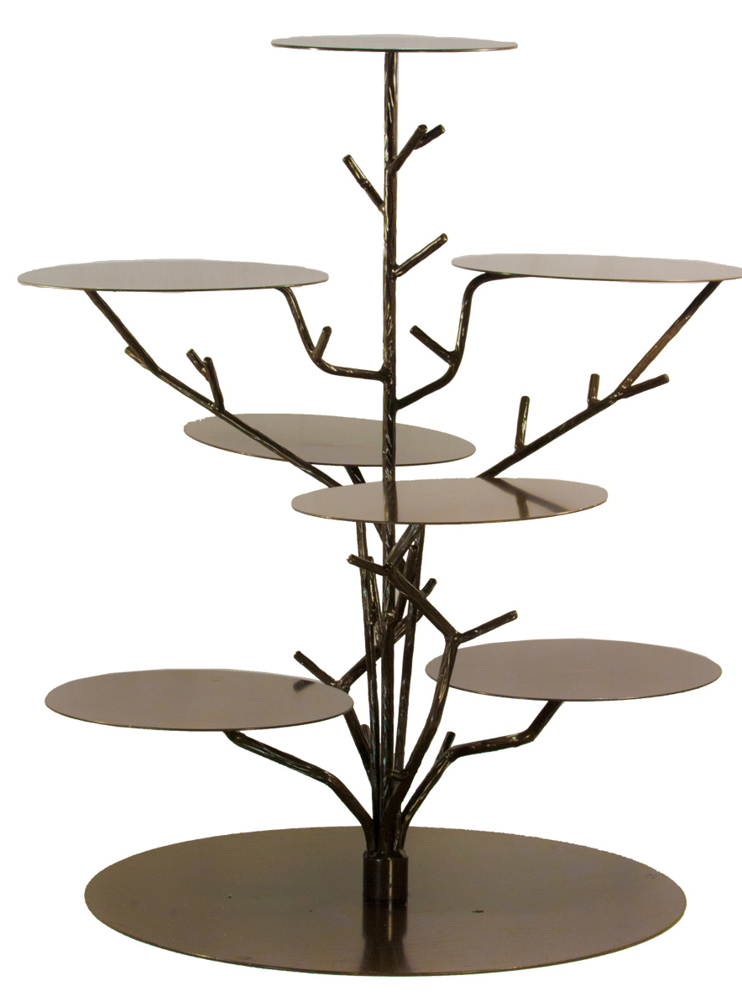
BEFORE WE GET STARTED
LETS LOOK AT EXISTING DESIGNS FOR CUPCAKE STANDS.
THINK ABOUT WHAT TYPE OF STAND WOULD FIT IN WELL WITH THE CAFÉ

Slide 4
LET'S LOOK AT THE CAFÉ AGAIN
THINK ABOUT THE COLOURS, SHAPES AND PATTERNS THAT YOU SEE

Slide 5
YOUR TASK
Draw a cupcake stand which you think would fit in well with this café. Think about the colours, shapes and patterns.

Slide 6
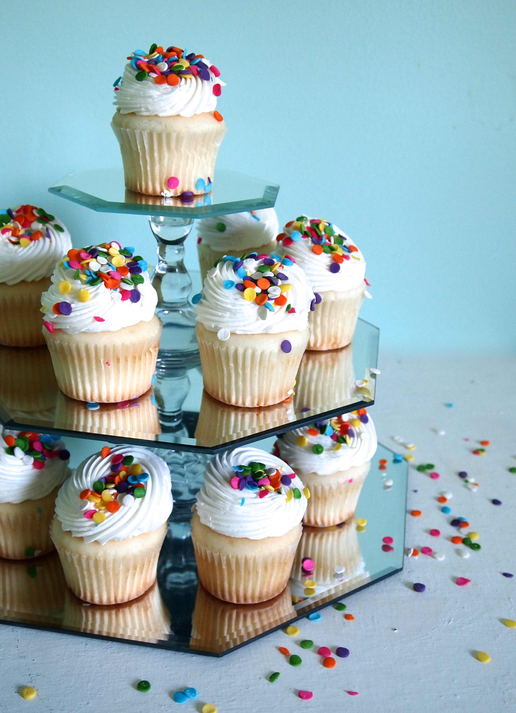
EXTENSION
ONCE YOU FINISH YOUR TASK, YOU COULD DRAW THE CUPCAKES ON TOP OF IT.

Slide 7
PLENARY
WHEN YOU HAVE FINISHED YOUR TASK AND SENT IT TO YOUR TEACHER YOU COULD SEND A PICTURE OF YOUR WORK IN THE CHAT AND NONSENSE CHANNEL.

