Slide 1
Using A.M. and P.M.

Slide 2
Aim
I can use a.m. and p.m. to say whether things happen before or after noon.
Success Criteria
I can use ‘a.m.’ to describe times from midnight to midday.
I can use ‘p.m.’ to describe times from midday to midnight.
I can write times using am and pm.

Slide 3
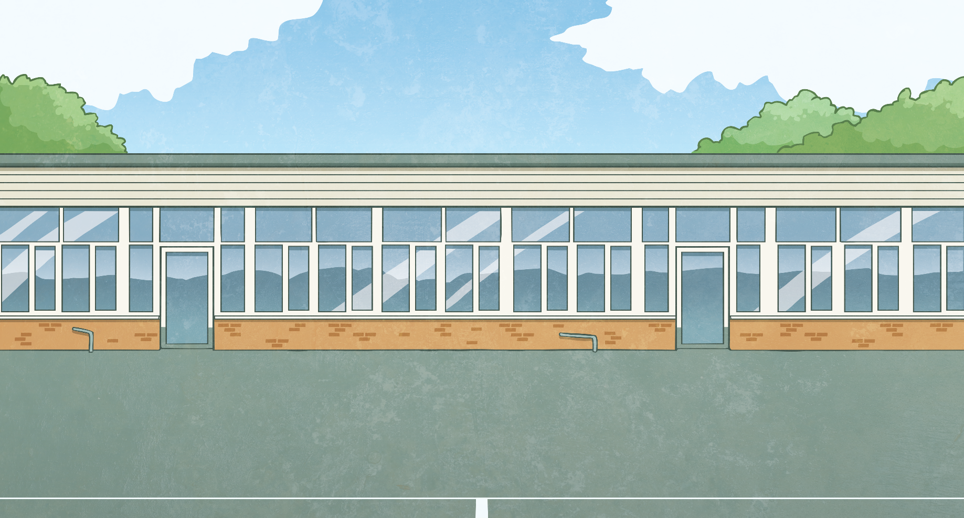
Times of the Day
There are 24 hours in a day, but there are only 12 hours on a clock.
We tell the time by splitting the 24 hours into two.
12 o’clock at night is called midnight.
12 o’clock in the day is called midday,
or noon.
The time between midnight and midday is referred to as a.m..
The time from midday to midnight is referred to as p.m..

Slide 4
Times of the Day
The day is split into different parts, like the chapters of a book.
Some events in the day happen during a.m. times, like waking up and going to school.
Some events happen at p.m. times, like going home from school and going to bed.
Some events might happen at both a.m.
and p.m. times.
a.m.
p.m.

Slide 5
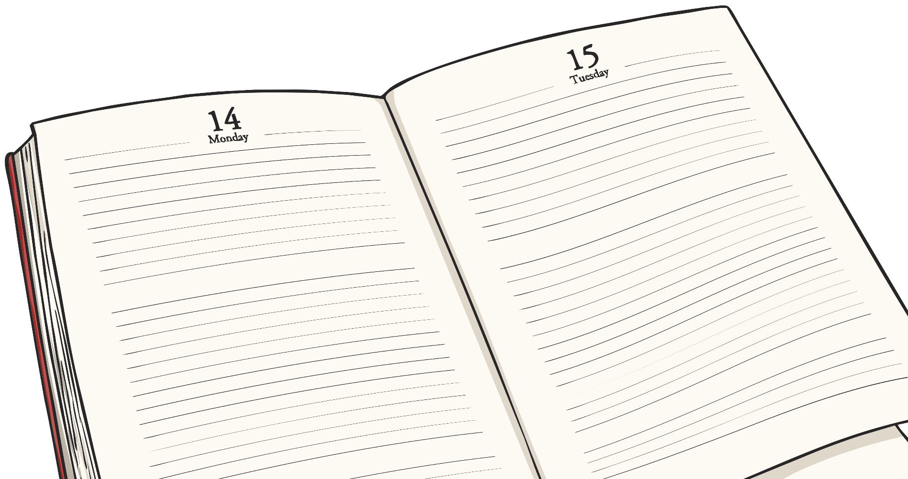
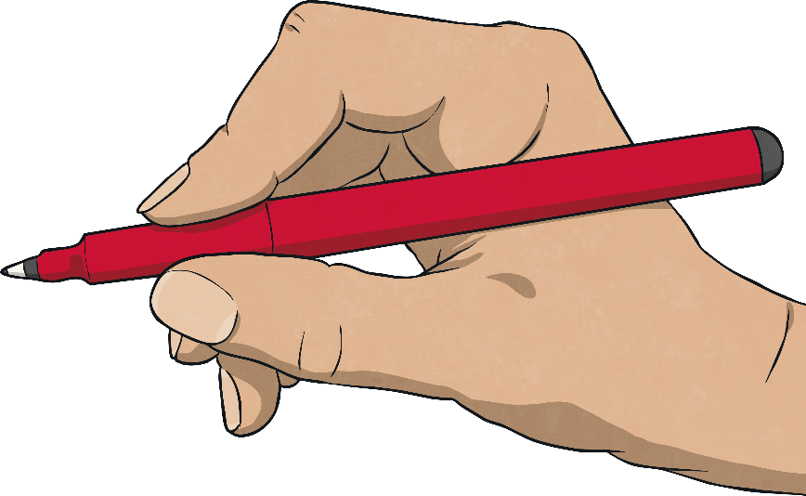
A.M. or P.M. or Both?
Say whether you think these are am, pm or both.
You go to sleep at night.

Slide 6
A.M. or P.M. or Both?
Say whether you think these are am, pm or both
You eat breakfast.

Slide 7
A.M. or P.M. or Both?
Say whether you think these are am, pm or both
You play with friends.

Slide 8
A.M. or P.M. or Both?
Say whether you think these are am, pm or both
You go home from school.

Slide 9
A.M. or P.M. or Both?
Say whether you think these are am, pm or both
You brush your teeth.

Slide 10
A.M. or P.M. or Both?
Say whether you think these are am, pm or both
You wake up in the morning.

Slide 11
A.M. or P.M. or Both?
Say whether you think these are am, pm or both
You go to an after-school club.

Slide 12
A.M. or P.M. or Both?
Say whether you think these are am, pm or both
You eat your evening meal.

Slide 13
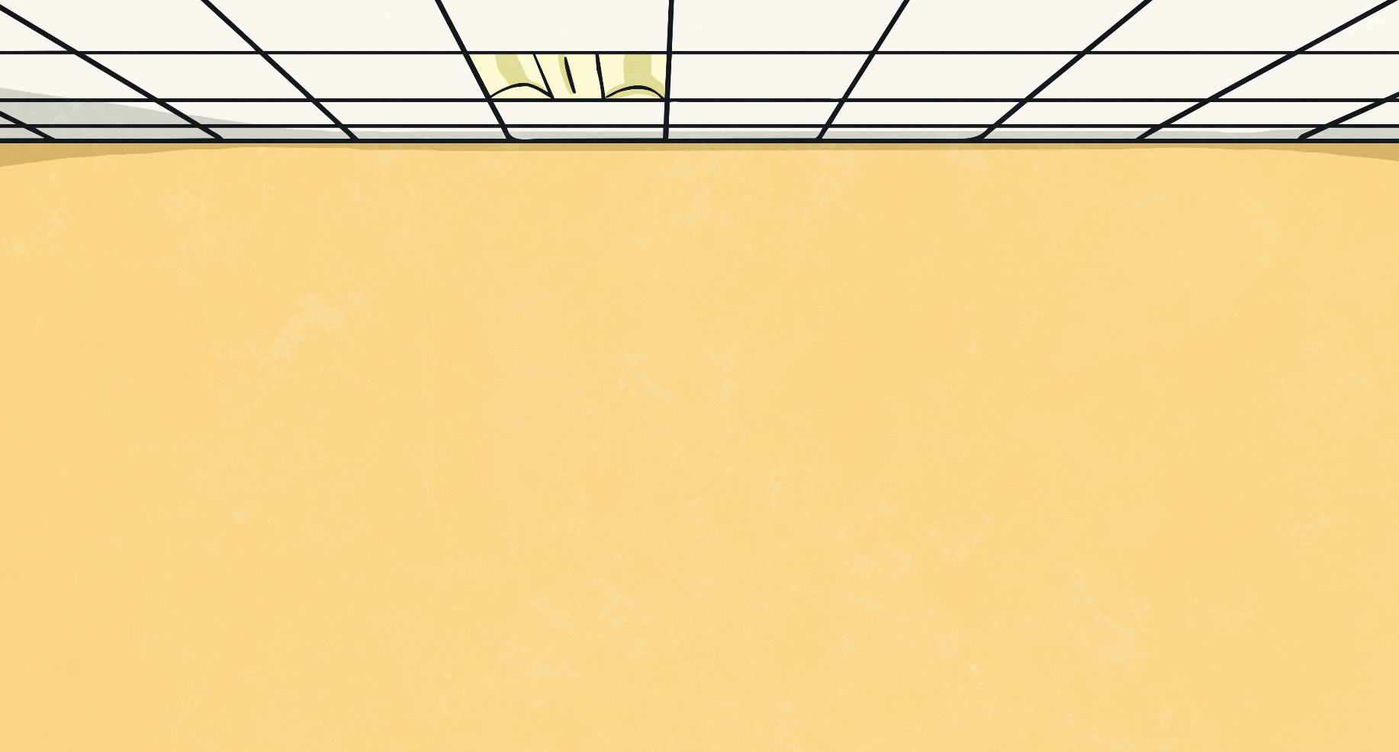
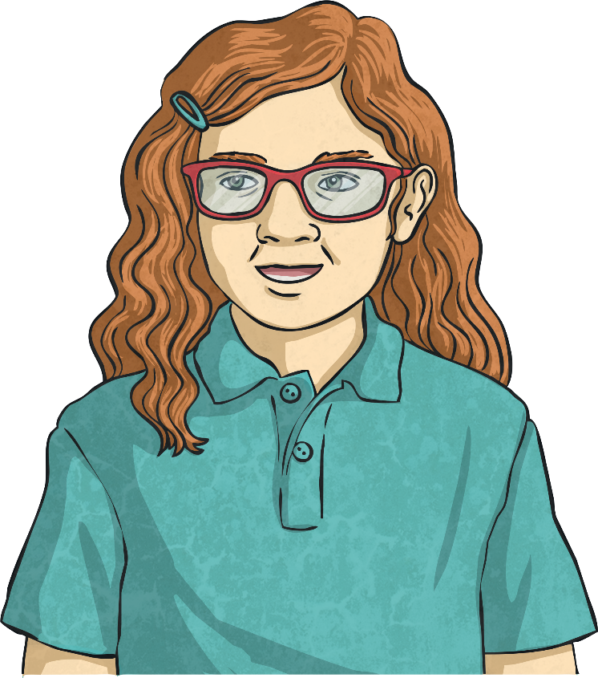
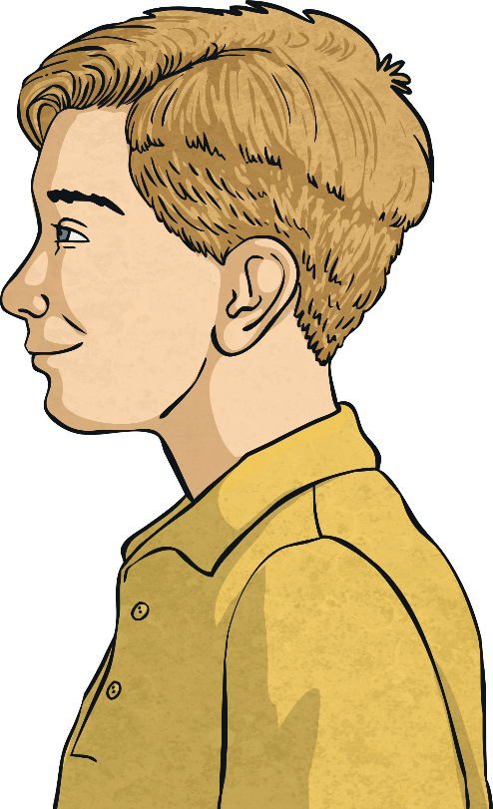
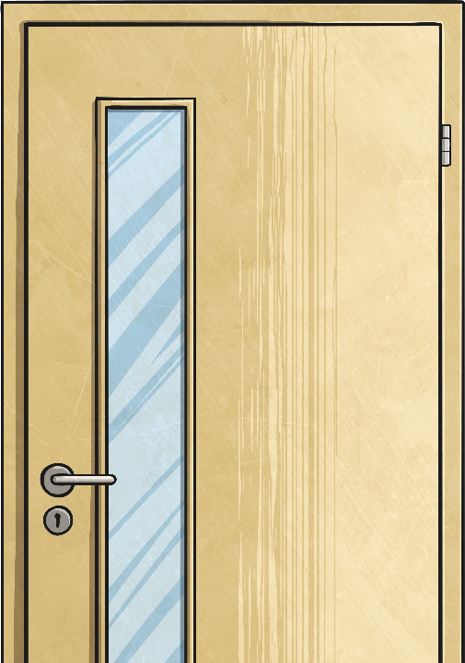
Writing Times Using A.M. and P.M.
Mostly, we use a.m. or p.m. when reading and writing digital times.
So 9 o’clock in the morning would be written as:
And 9 o’clock in the evening would be written as:
9:00 a.m.
9:00 p.m.

Slide 14
Aim
I can use a.m. and p.m. to say whether things happen before or after noon.
Success Criteria
I can use ‘a.m.’ to describe times from midnight to midday.
I can use ‘p.m.’ to describe times from midday to midnight.
I can write times using am and pm.

