Slide 1
The 24-Hour Clock

Slide 2
Aim
I can convert 12-hour times into 24-hour times.
Success Criteria
I can convert 12-hour digital times into 24-hour times.
I can write all 24-hour times with 4 digits.
I can write all 24-hour times with a colon (:) in the middle.
I remember that I do not need am or pm when using 24-hour time.

Slide 3
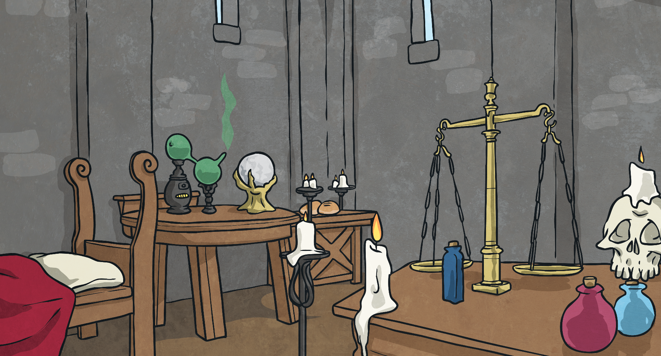
Add and Subtract
Solve this calculation by adding or subtracting 12.
+
=
5
12
?
17

Slide 4
Add and Subtract
Solve this calculation by adding or subtracting 12.
-
=
21
12
?
9

Slide 5
Add and Subtract
Solve this calculation by adding or subtracting 12.
+
=
4
12
?
16

Slide 6
Add and Subtract
Solve this calculation by adding or subtracting 12.
-
=
22
12
?
10

Slide 7
Add and Subtract
Solve this calculation by adding or subtracting 12.
-
=
24
12
?
12

Slide 8
Add and Subtract
Solve this calculation by adding or subtracting 12.
+
=
6
12
?
18

Slide 9
Add and Subtract
Solve this calculation by adding or subtracting 12.
+
=
9
12
?
21

Slide 10
Add and Subtract
Solve this calculation by adding or subtracting 12.
-
=
18
12
?
6

Slide 11
Add and Subtract
Solve this calculation by adding or subtracting 12.
+
=
10
12
?
22

Slide 12
Add and Subtract
Solve this calculation by adding or subtracting 12.
+
=
8
12
?
20

Slide 13
Add and Subtract
Solve this calculation by adding or subtracting 12.
-
=
17
12
?
5

Slide 14
Add and Subtract
Solve this calculation by adding or subtracting 12.
+
=
11
12
?
23

Slide 15
Add and Subtract
Solve this calculation by adding or subtracting 12.
-
=
19
12
?
7

Slide 16
Add and Subtract
Solve this calculation by adding or subtracting 12.
Why might this skill be useful when learning about time?

Slide 17
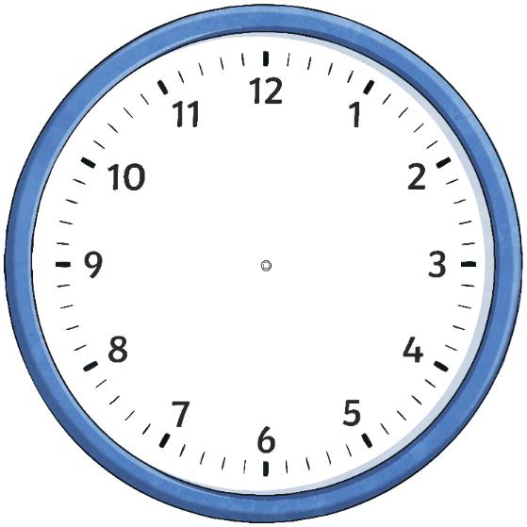
The 24-Hour Day
A day has 24 hours. A clock has 12 hours.
This means that every time will happen twice each day.
half past 9 in the morning
half past 9 at night

Slide 18
The 24-Hour Day
We have a few ways to tell the difference between these two times.
One way is to use a.m. and p.m.
a.m.
(ante meridiem – before noon)
p.m.
(post meridiem – after noon)
9:30 a.m.
9:30 p.m.

Slide 19
The 24-Hour Day
Another way is to use a 24-hour clock.
A four-digit format is used.
Two digits for the hour, a colon (:) and two digits for the minutes.
Instead of going back to the start after 12, the 24-hour clock carries on until midnight.
The hours after 12 noon are given the numbers 13:00 to 23:00.
9:30
21:30

Slide 20
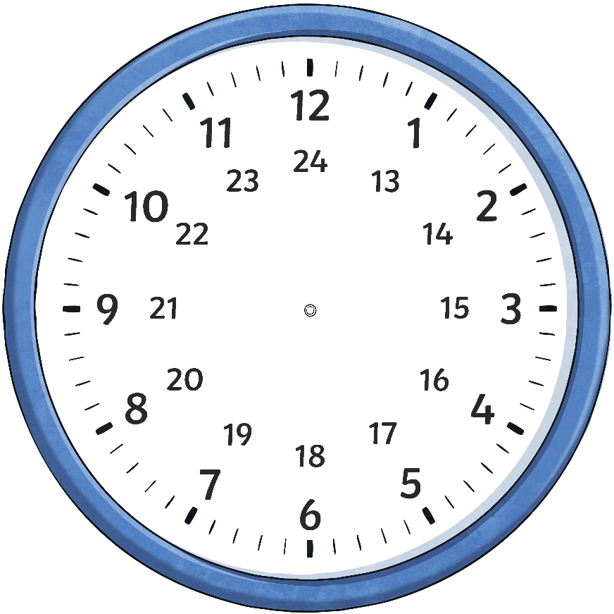
The 24-Hour Day
This clock and table show the corresponding hours on a 24-hour clock.
Midnight can be referred to as either 00:00 or 24:00

Slide 21
Changing 12-Hour Times
to 24-Hour Times
To change 12-hour a.m. times to 24-hour times, make sure the time is in a four-digit format. You do not need to write ‘a.m.’
10:30 a.m.
10:30
2:45 a.m.
02:45

Slide 22
Changing 12-Hour Times
to 24-Hour Times
Change these a.m. times into 24-hour times.
11:30 a.m.
6:45 a.m.
3:15 a.m.
10:00 a.m.
11:30
06:45
03:15
10:00

Slide 23
Changing 12-Hour Times
to 24-Hour Times
To change 12-hour p.m. times to 24-hour times, add 12 to the hour time. You do not need to write ‘p.m.’
10:30 p.m.
22:30
3:45 p.m.
15:45

Slide 24
Changing 12-Hour Times
to 24-Hour Times
Change these p.m. times into 24-hour times.
10:45 p.m.
5:30 p.m.
9:15 p.m.
7:00 p.m.
22:45
17:30
21:15
19:00

Slide 25
Changing 12-Hour Times
to 24-Hour Times
Change these a.m. and p.m. times into 24-hour times.
5:45 a.m.
7:30 p.m.
11:15 a.m.
1:00 p.m.
05:45
19:30
11:15
13:00

Slide 26
Changing 12-Hour Times
to 24-Hour Times
Change these a.m. and p.m. times into 24-hour times.
5:45 p.m.
2:15 a.m.
6:15 p.m.
10:15 a.m.
17:45
02:15
18:15
10:15

