Slide 2
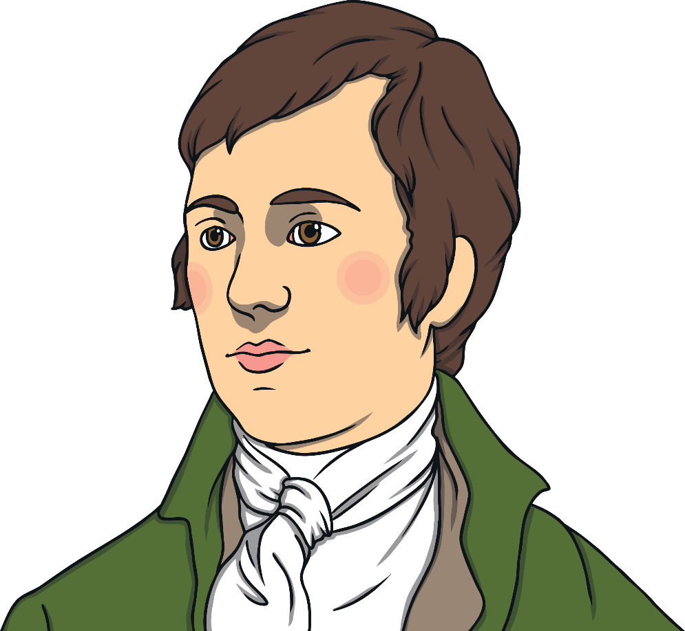
All About Robert Burns
My name is Robert Burns. I am a Scottish poet. I lived in Ayrshire, Scotland, over 250 years ago. Most of my poems were written in Scots and standard English. My most famous poem, ‘Auld Lang Syne’, is sung all over the world on Hogmanay.
Have you heard the song ‘Auld Lang Syne’?

Slide 3
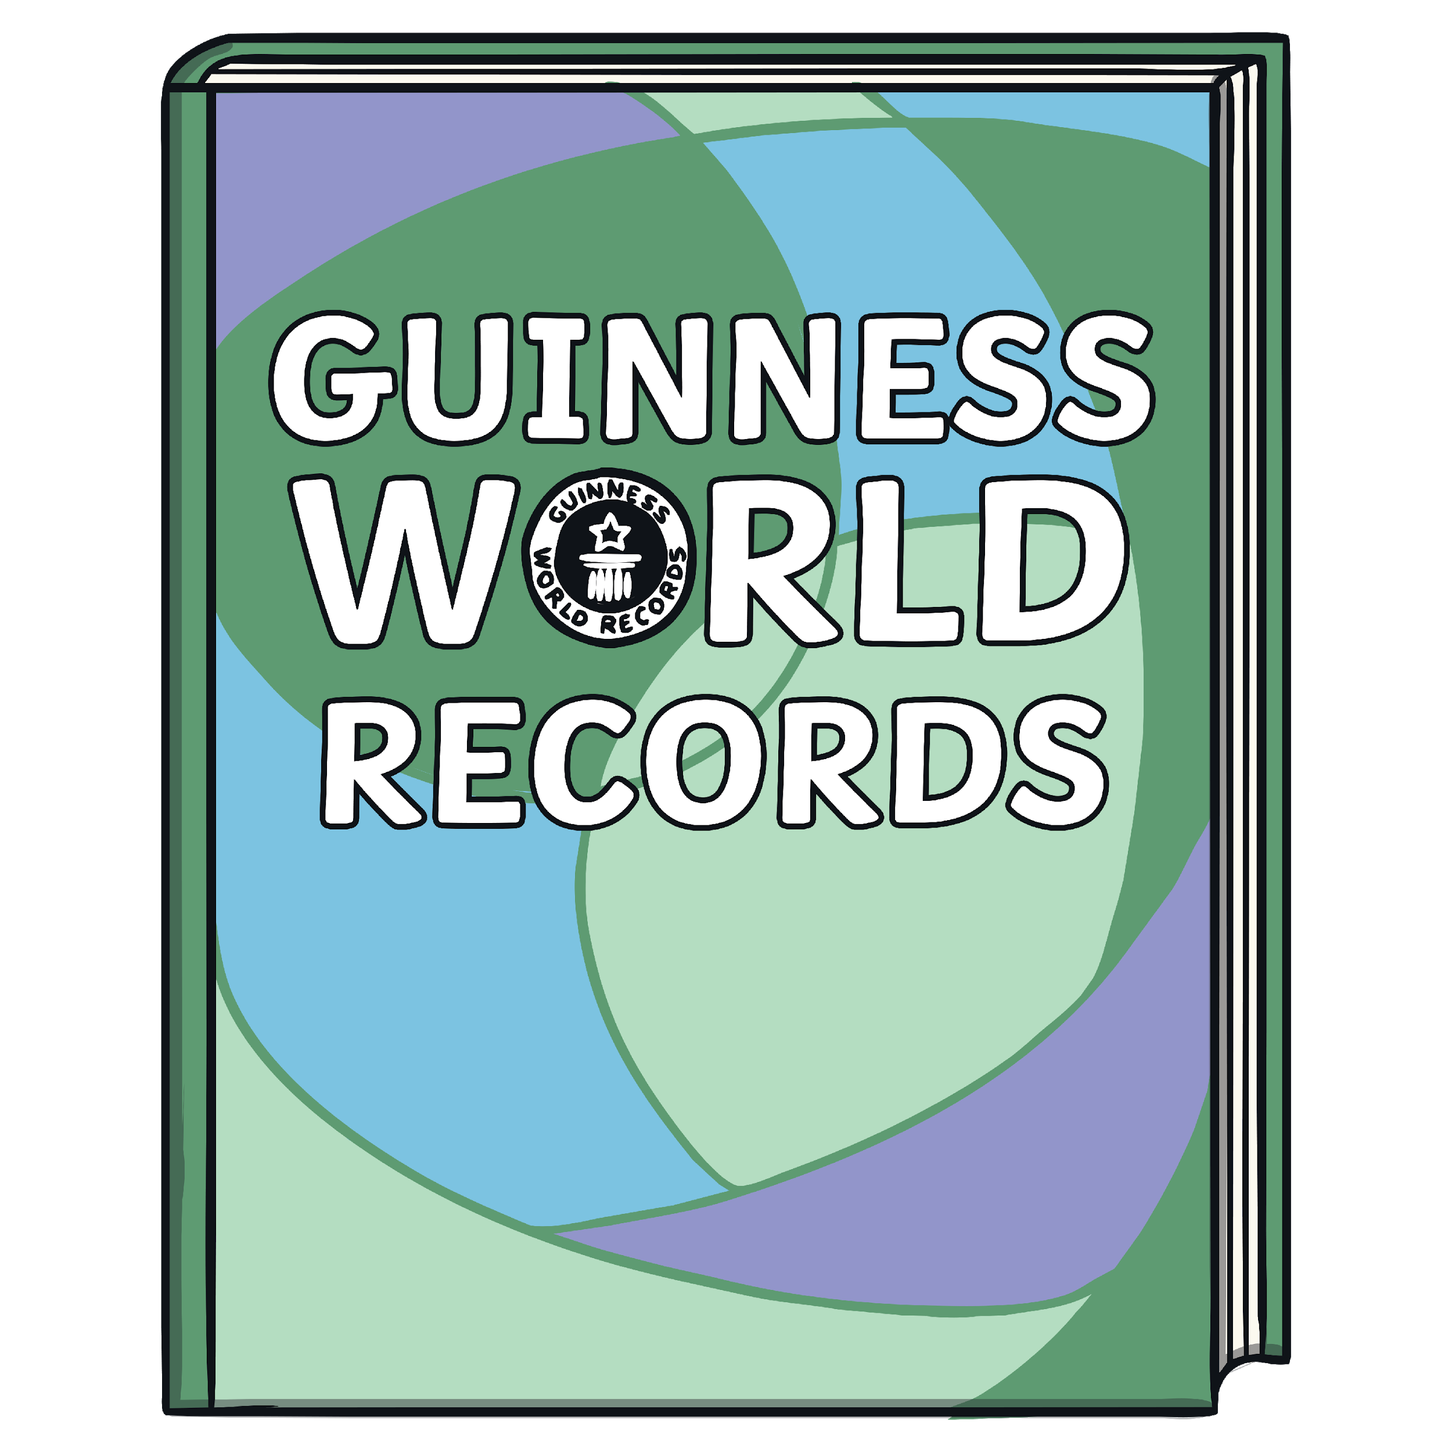
Did You Know…?
Auld Lang Syne is in the Guinness Book of World Records. It is one of the three most popular songs sang in the English language.
Can you guess which song is first?
Click to reveal answer
Happy Birthday

Slide 4
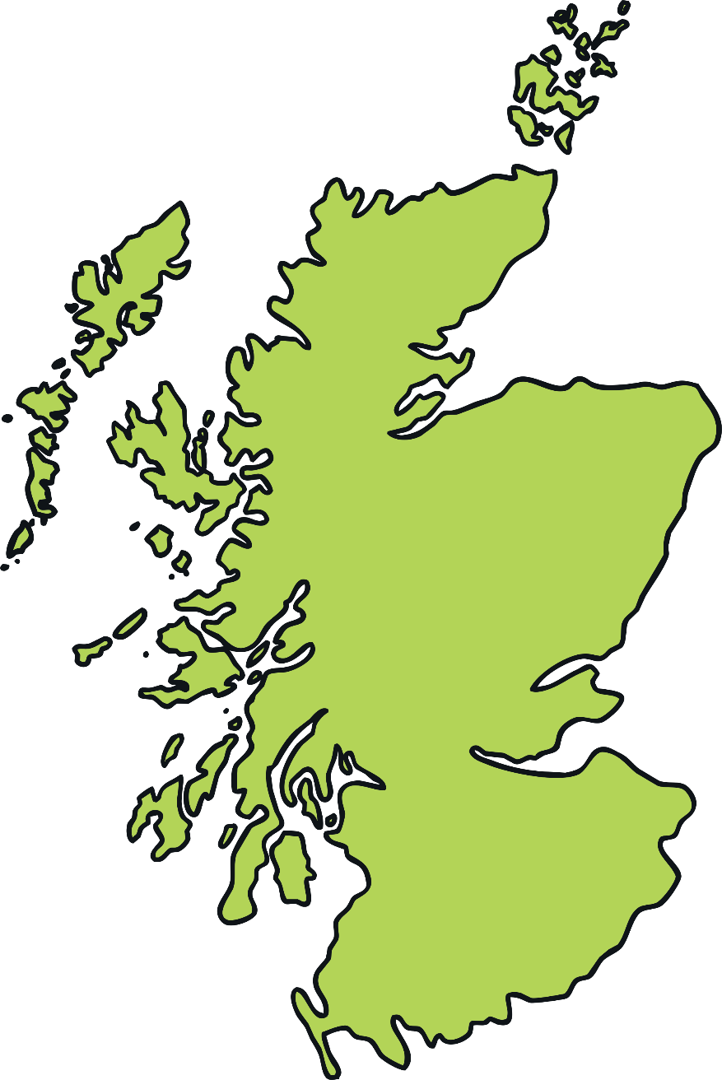
Robert Burns’ Early Life
I was a born in Alloway, Ayrshire, in 1759.
My parents were called William and Agnes.
I was the eldest of seven children.
My family were poor, but my father taught us how to read and write.
Alloway

Slide 5
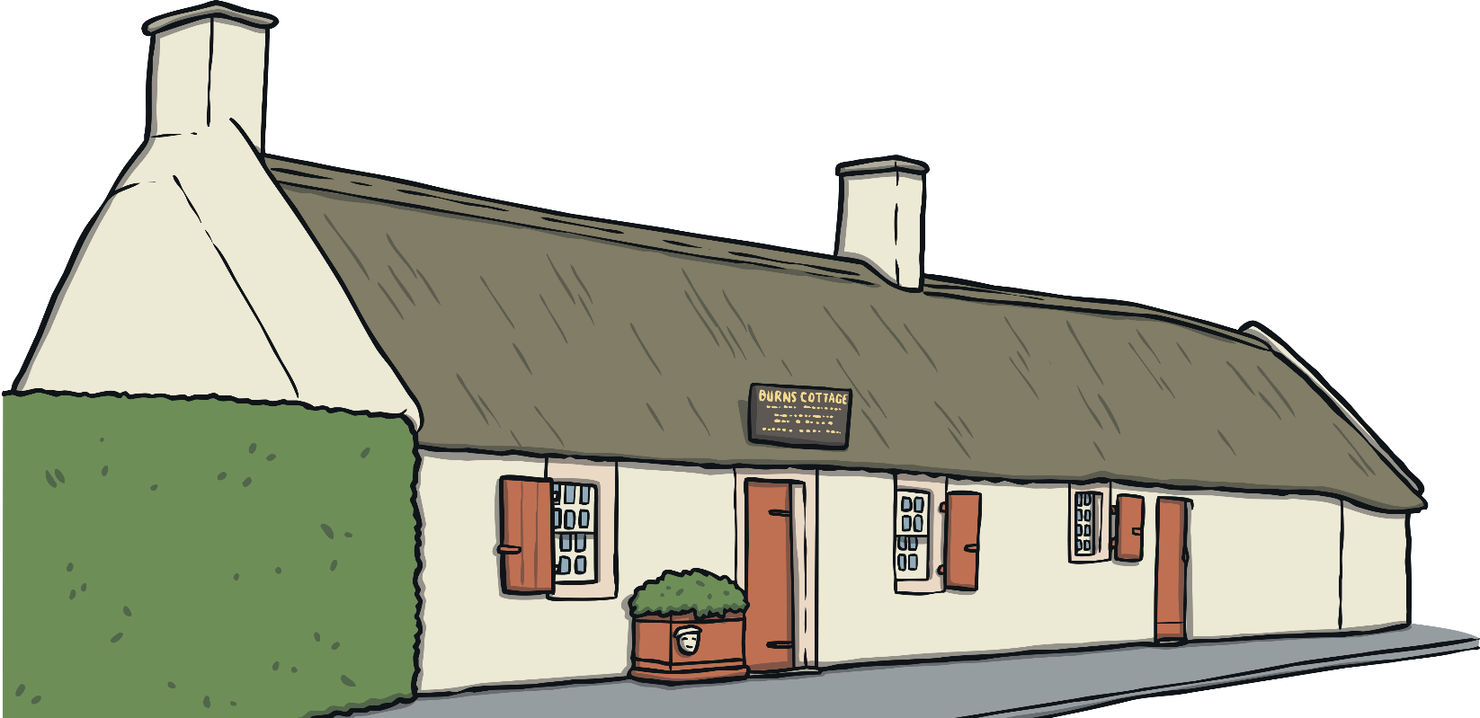
Did You Know…?
The house I was born in is now the Robert Burns Birthplace Museum. It is visited by over 100,000 people every year!
In the museum, there are hundreds of objects that belonged to me, such as the quills I used to write my famous poems.

Slide 6
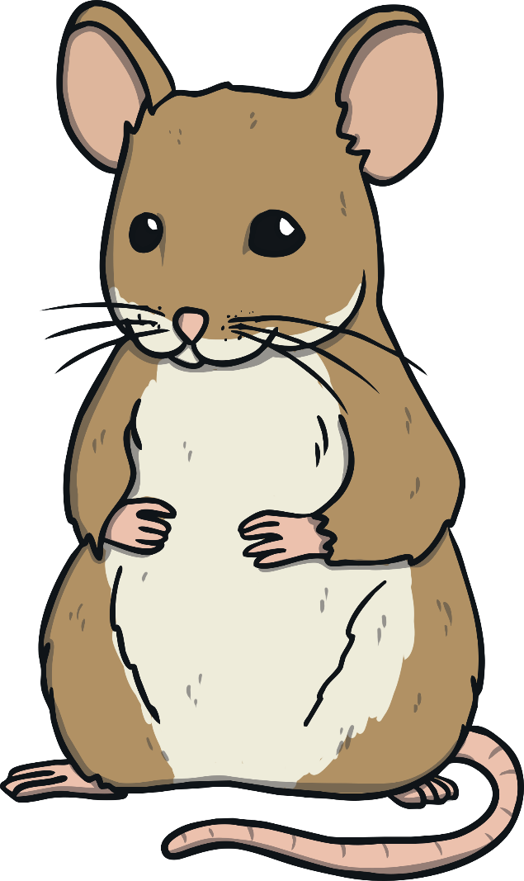
Robert Burns’ Early Life
My father was a tenant farmer and I had to help him on the farm from a young age.
This inspired me to write poems about the different things I saw. During this time, I wrote my famous poems about a mouse and a woodlouse!

Slide 7
A Red, Red Rose
The inspiration for many of my poems and ballads was about falling in love.
O my Luve is like a red, red rose
That’s newly sprung in
O my Luve is like the melody
That’s sweetly played in
A ballad is a type of poem, often a story set to music. Usually the second and fourth lines in each stanza rhyme.
June;
Is ‘A Red, Red Rose’ a ballad?
tune.

Slide 8
Robert Burns’ Life
In 1788 I married Jean Armour.
That year, I also travelled around Scotland collecting local songs and writing about my travels.
Inverness
Aberdeen
Here are just some of the places I travelled to.
Dundee
Can you name them?
Perth
Click on the red dot to reveal the place name!
Glasgow
Edinburgh

Slide 9
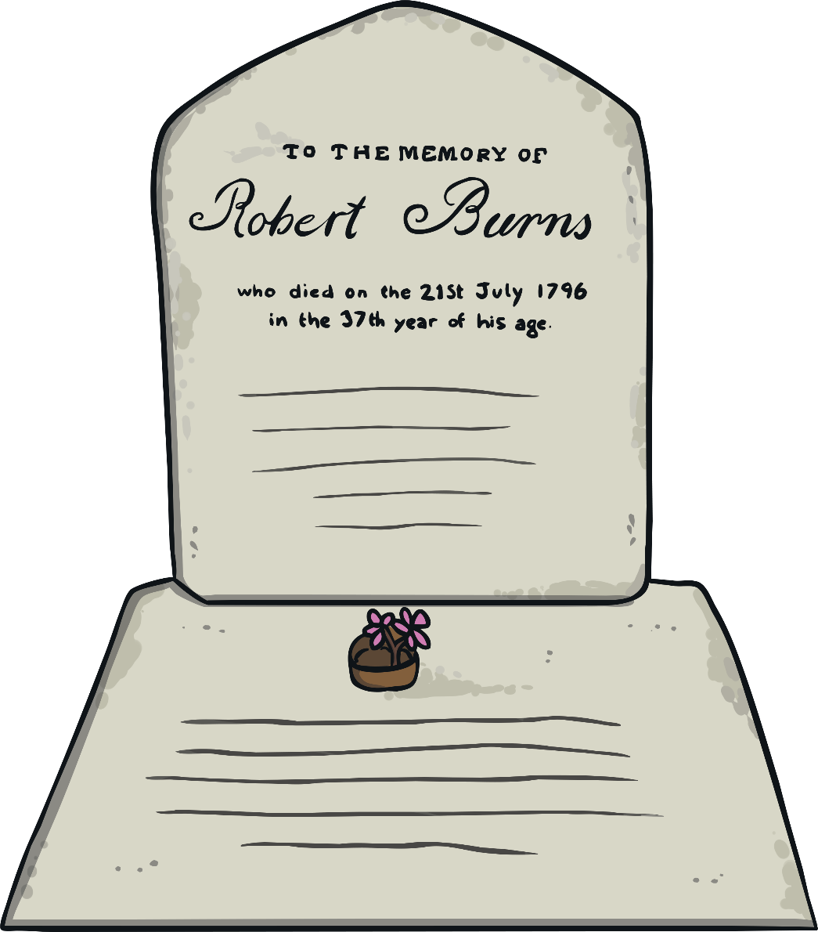
Robert Burns’ Death
I died on 21st July 1796, at the age of 37.
My funeral took place on the 25th of July, the same day my twelfth child, Maxwell, was born.

Slide 10
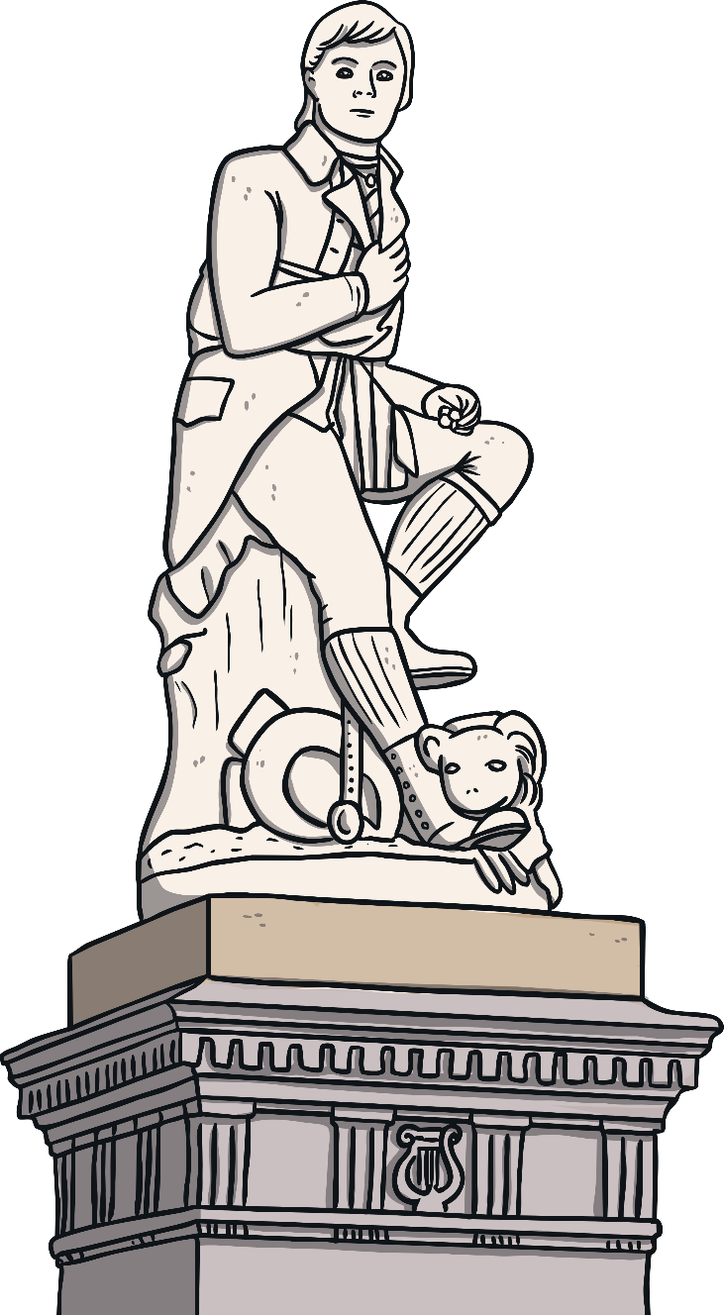
Did You Know…?
After Queen Victoria and Christopher Columbus, there are more statues of me around the world than any other non-religious person.
Guess how many there are?
Click to reveal answer
60

Slide 11
Burns Night
The first Burns Supper was organised by my friends. They wanted to celebrate my life and read my poems.
Today, every year on what would have been my birthday, people all around the world celebrate Burns Night. They eat haggis, neeps and tatties and recite my poems!

