Slide 1
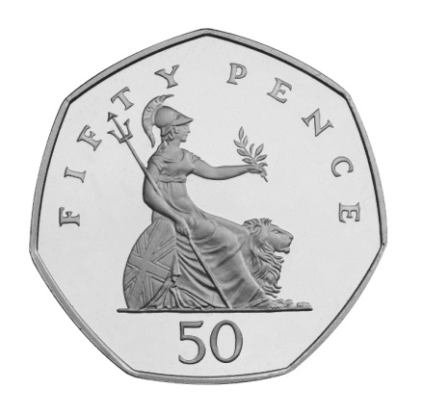
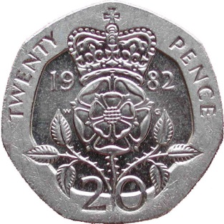
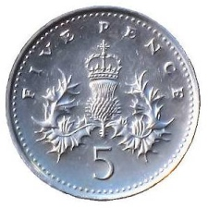
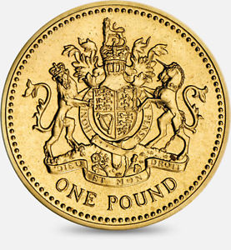
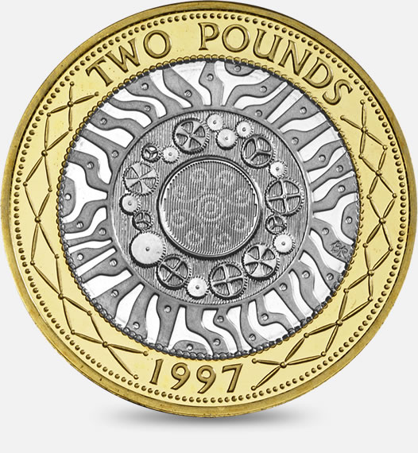
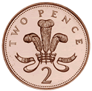
LC: Can I recognise coins?

Slide 2
LC: Can I recognise coins?
The coin with the lowest value is 1p. It looks like this:

Slide 3
LC: Can I recognise coins?
Next is the 2p coin. It looks like this:

Slide 4
LC: Can I recognise coins?
Next is the 5p coin. It looks like this:

Slide 5
LC: Can I recognise coins?
Next is the 10p coin. It looks like this:

Slide 6
LC: Can I recognise coins?
Next is the 20p coin which looks like this:

Slide 7
LC: Can I recognise coins?
Next is the 50p coin which looks like this:

Slide 8
LC: Can I recognise coins?
Next it the £1 coin which looks like this:

Slide 9
LC: Can I recognise coins?
The coin with the most value it the £2 coin. It can be seen below:

Slide 10
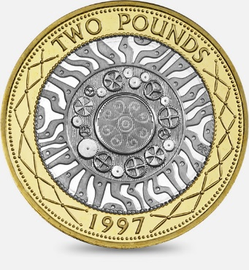
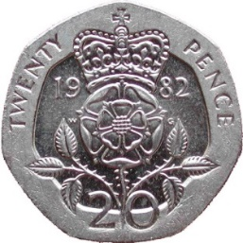
LC: Can I recognise coins?
Here are the coins in order of their value.

