Slide 2
Aim
I am learning about Charles Rennie Mackintosh and his iconic
rose design.
Success Criteria
I can create a piece of artwork in the style of Charles
Rennie Mackintosh.

Slide 3
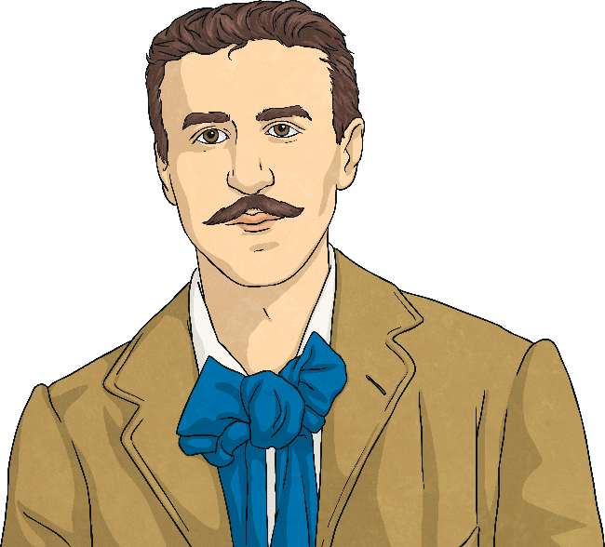
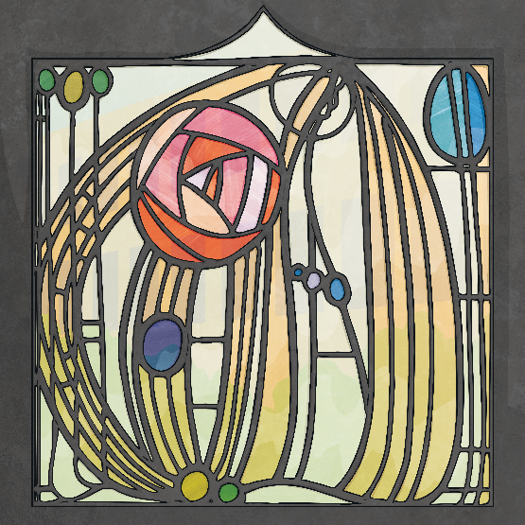
Charles Rennie Mackintosh
Charles Rennie Mackintosh was a Scottish architect, watercolourist and designer. He was born in Glasgow on 7th June 1868. His designs are instantly recognisable around the world. 2018, marked the anniversary of his 150th birthday.
Today, the Mackintosh-influenced rose design is hugely popular and can be found on anything from fabric, to home accessories, stained glass, bags and wallpaper, to furniture, jewellery and even food!

Slide 4
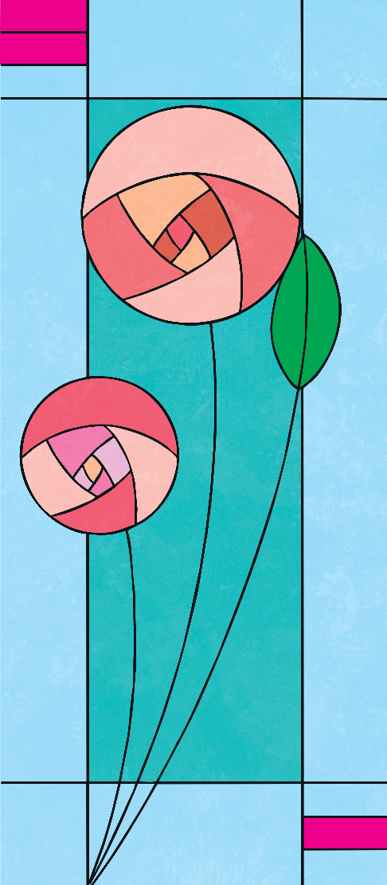
Charles Rennie Mackintosh
You will need:
A4 paper cut in half (portrait)
A circle to trace
Pencil
Rubber
Ruler
Black pen (permanent if you are adding colour with watercolours)
Materials for colouring (coloured pencils, pens or watercolours)

Slide 5

Trace a Circle

Slide 6

Draw a curved line across the circle.

Slide 7

Draw a curved line, starting half way across the line you have drawn.

Slide 8

Draw another line half way across the line you have drawn.

Slide 9
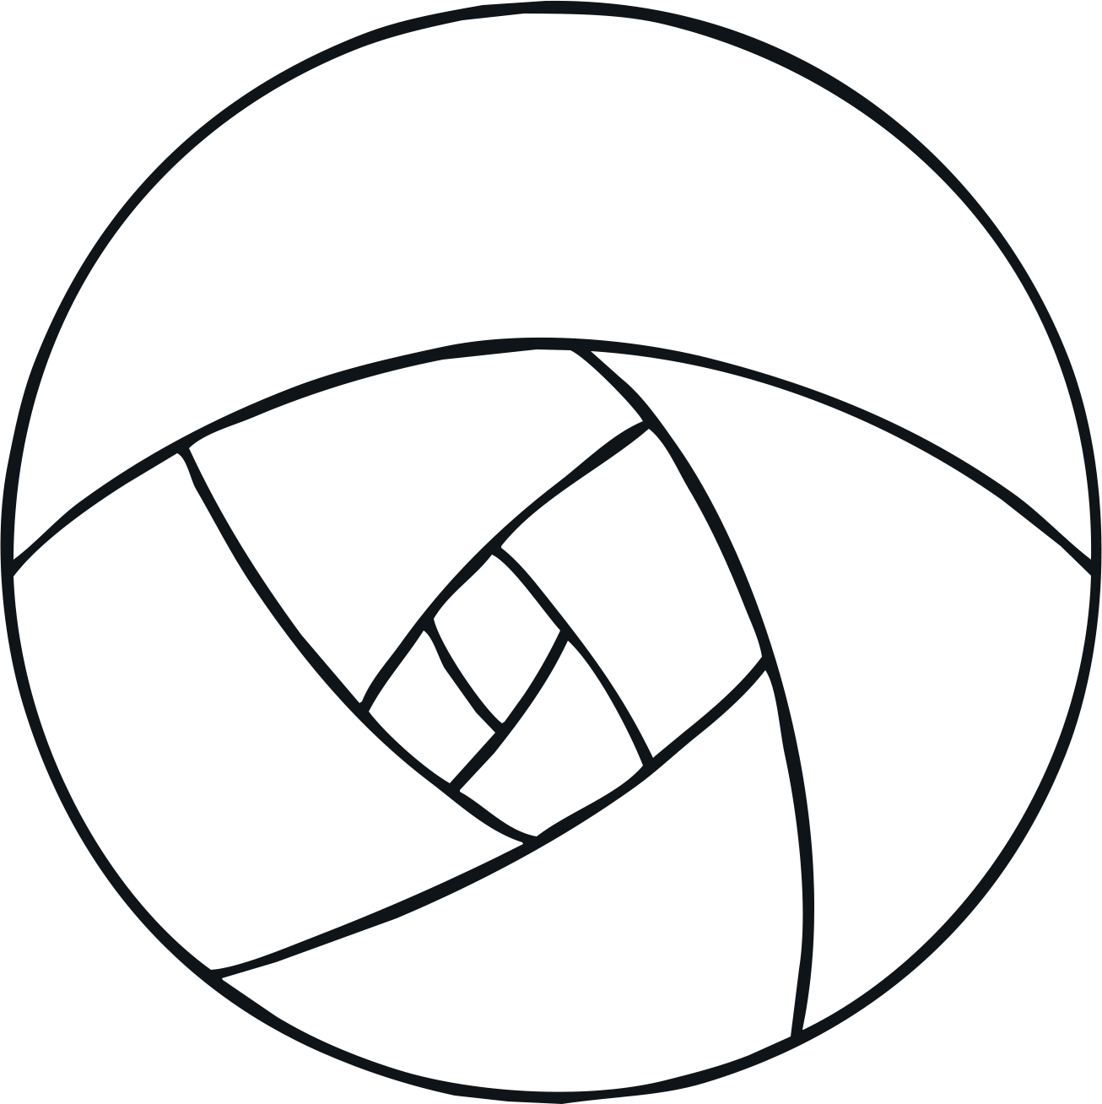
Continue drawing lines until you reach the centre.

Slide 10
Continue drawing lines until you reach the centre.

Slide 11
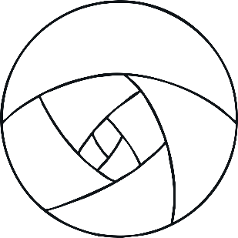
Draw over the pencil lines with pen.

Slide 12

Draw a line for the stem.

Slide 13

Draw a smaller circle. Draw a small rose.

Slide 14
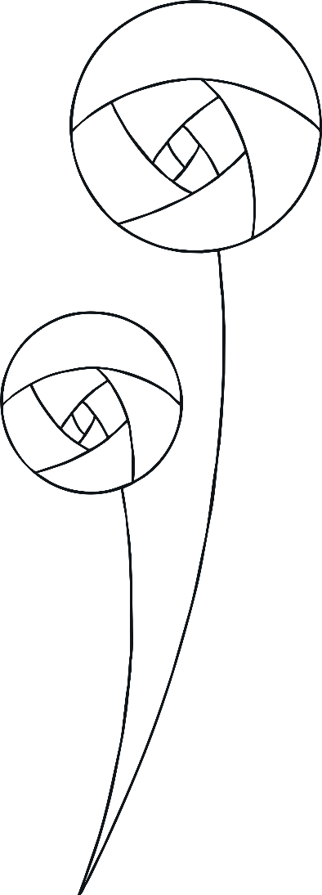
Draw a stem.

Slide 15
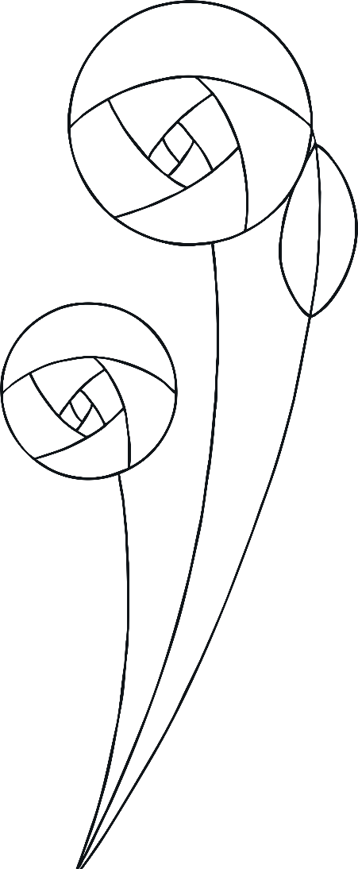
Draw another stem and add a leaf.

Slide 16
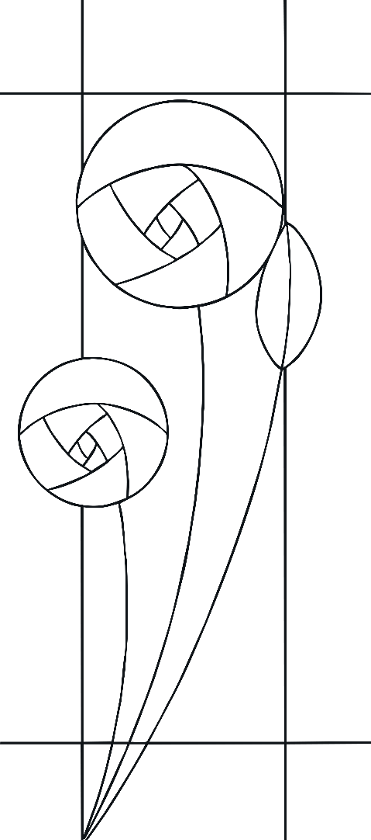
With a ruler, draw lines around the outside of the paper.

Slide 17
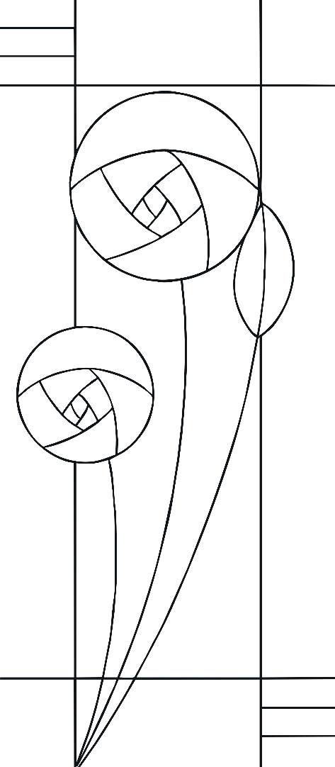
Draw lines in the corners.

Slide 18


Finally add colour to your design.
Well done!

