Slide 1
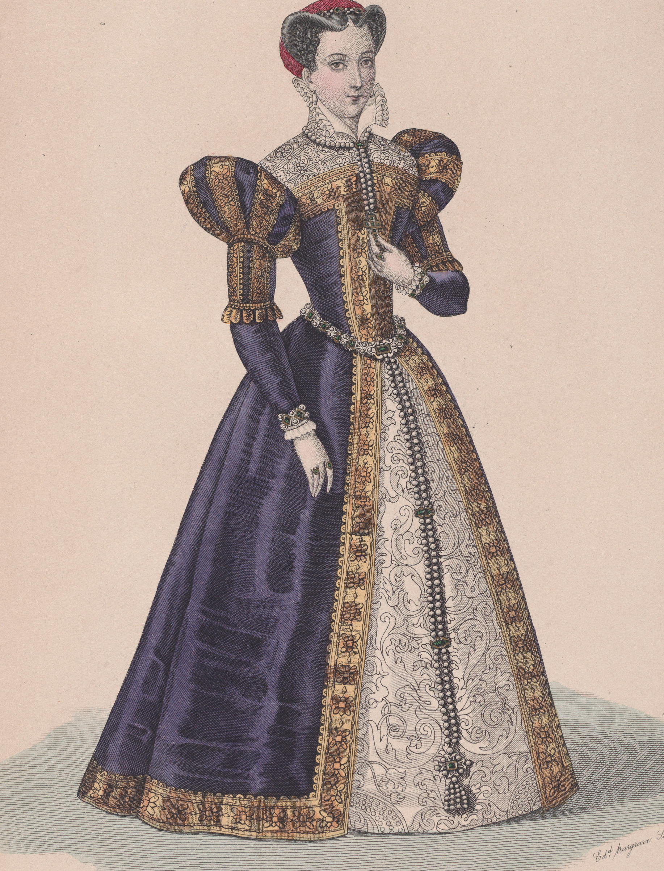
Mary Queen of Scots is famous for
Mary Queen of Scots did
Mary Queen of Scots was
Mary Queen of Scots

