Slide 1
Primary 4/5 would like to thank all their Parents/Carers for their support in preparing for today’s assembly. Thank you also to those who managed to come along. For those who didn’t, fear not. We have videoed the Assembly for you to watch at home. We do hope you enjoy it!

Slide 2
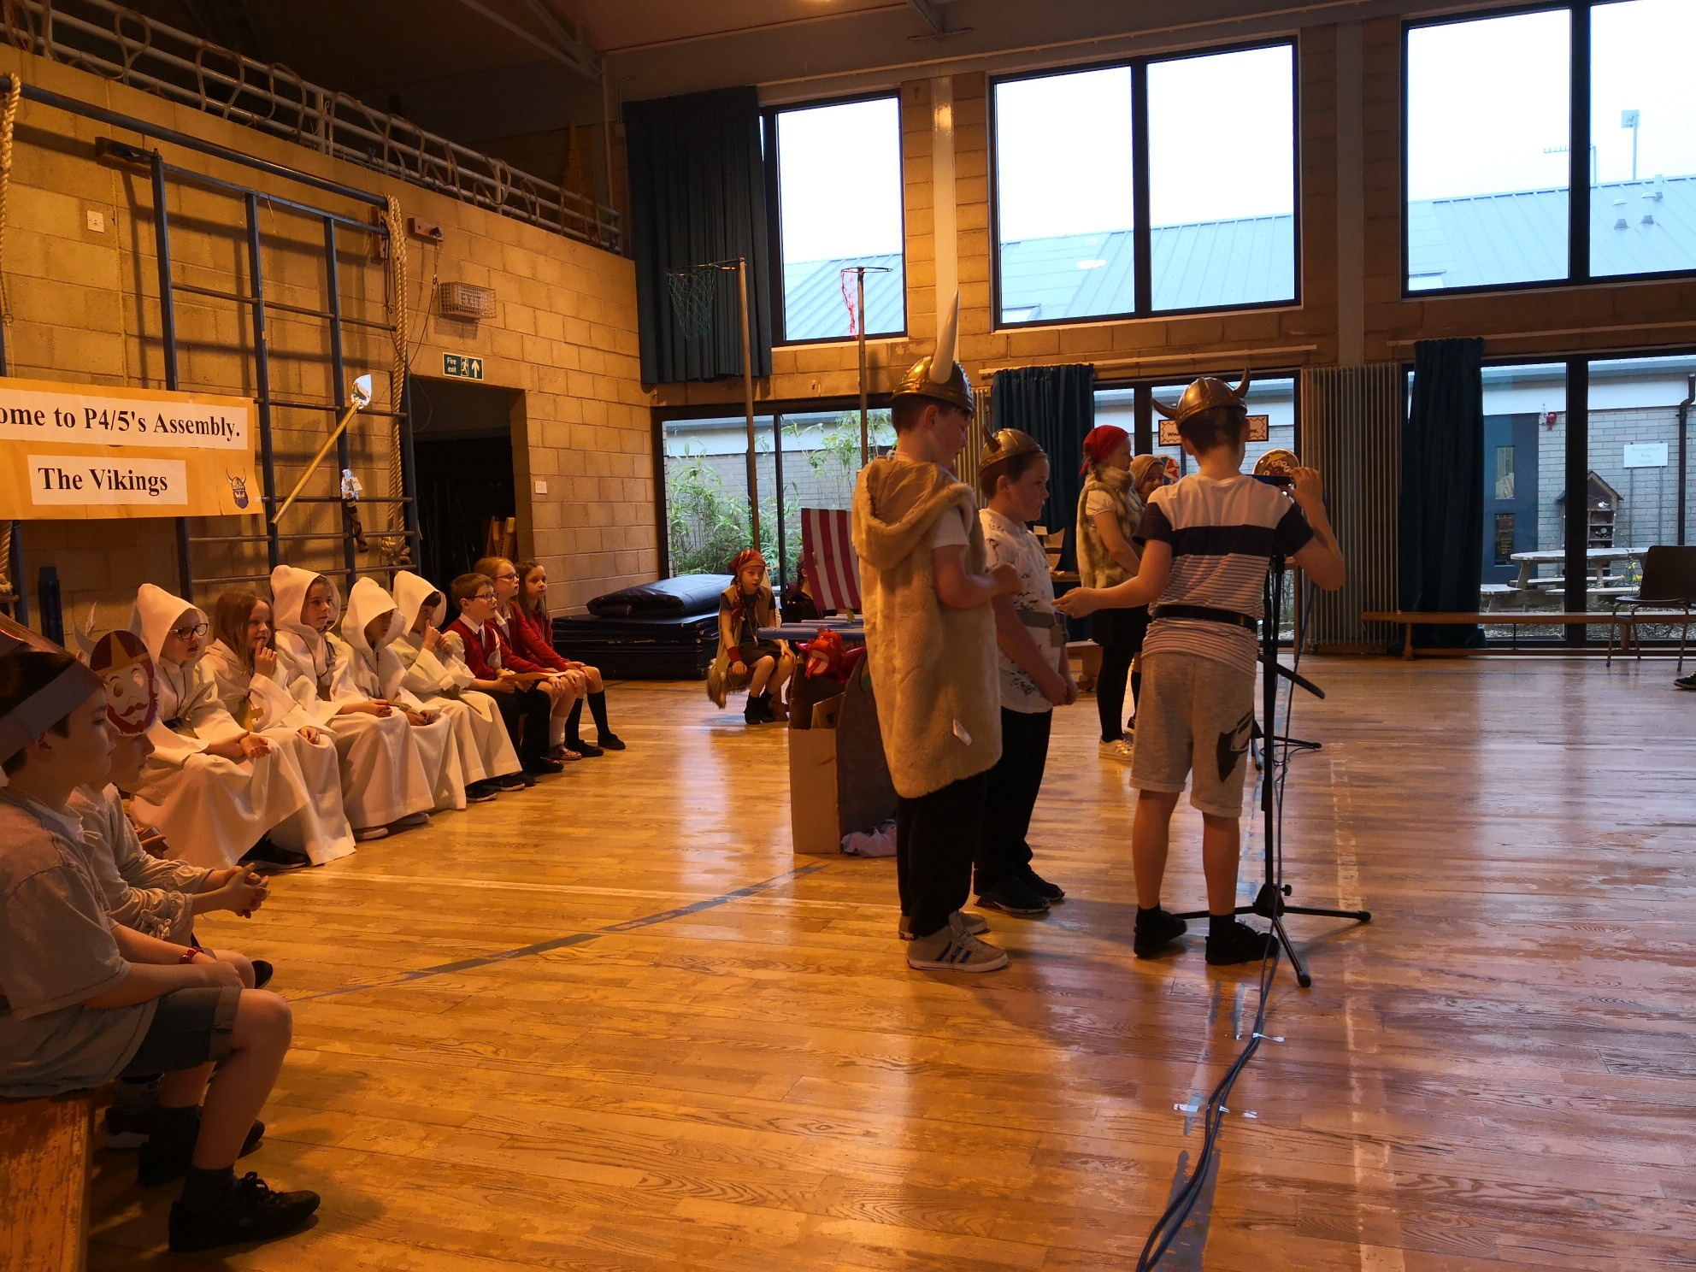
Getting ready to go A-Viking

Slide 3
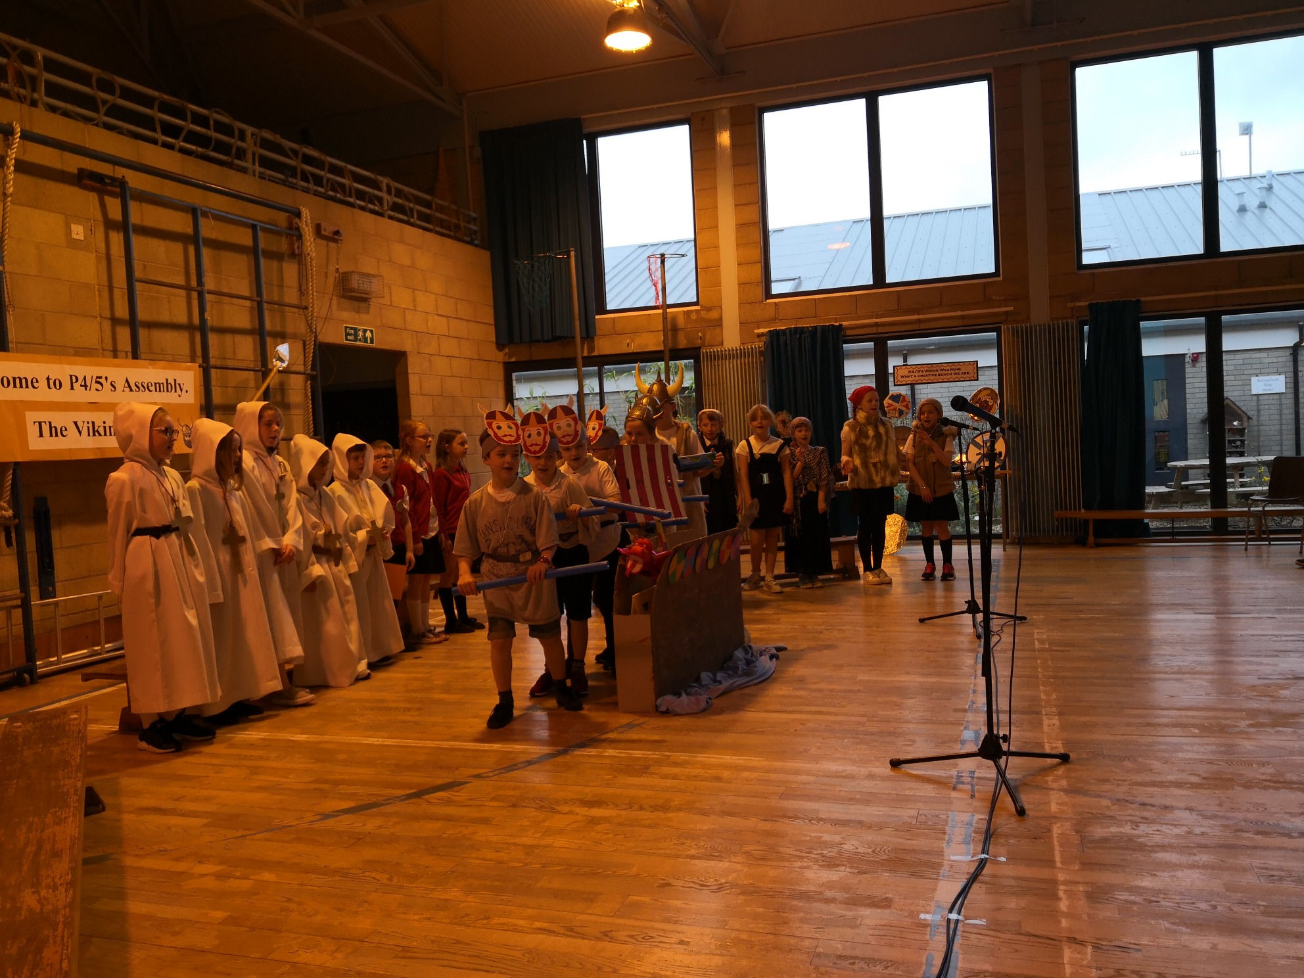
Going A-Viking by longboat from Scandinavia to Lindisfarne

Slide 4
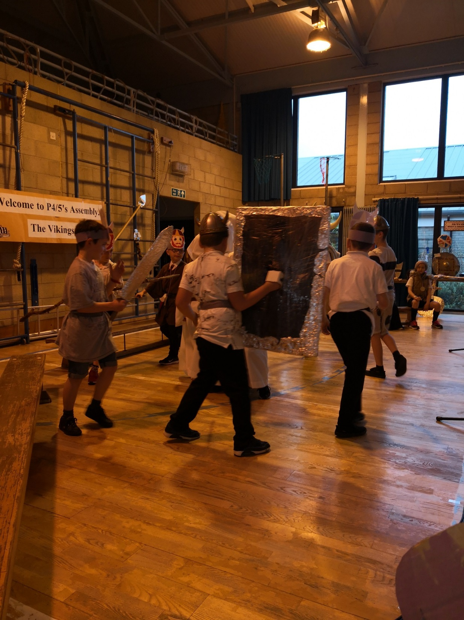
Raiding the Monastery at Lindisfarne

Slide 5
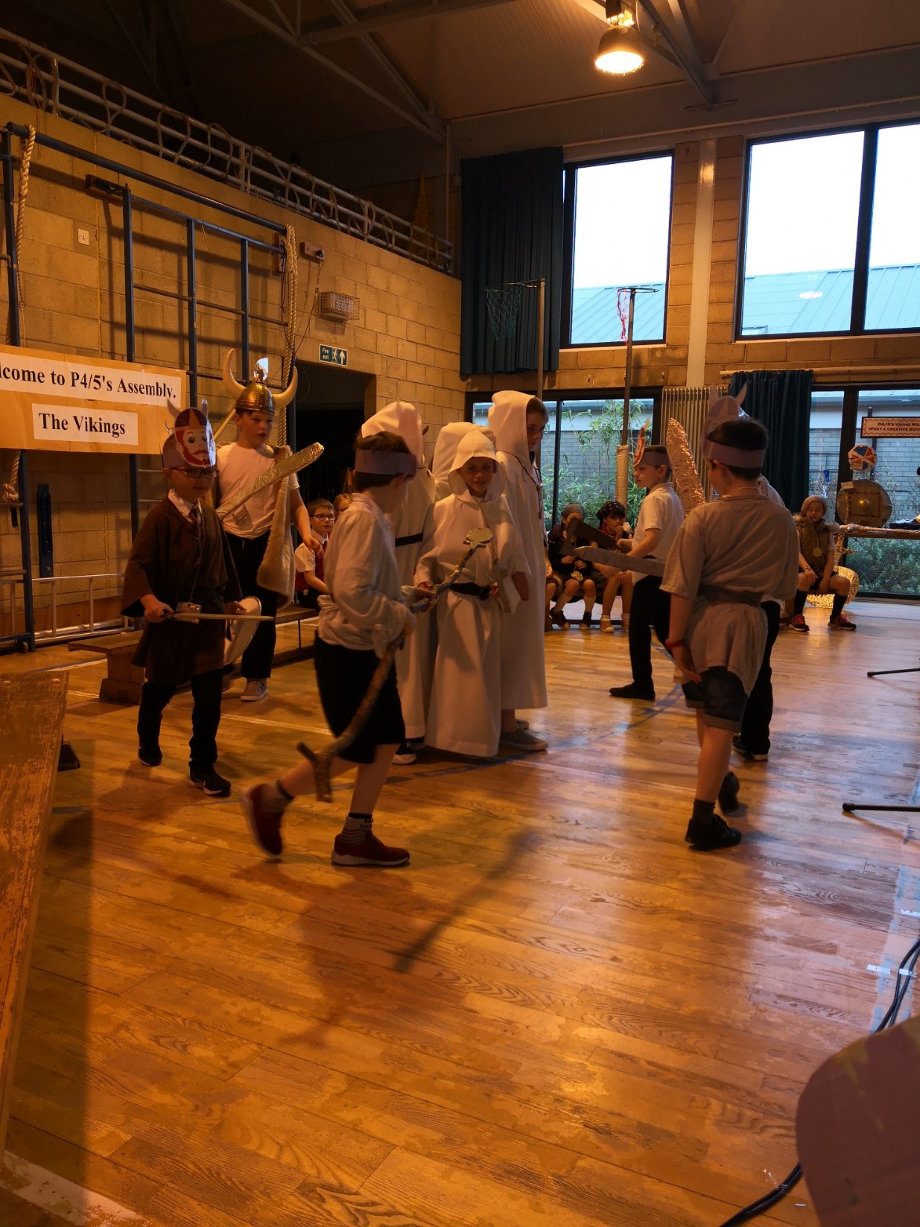
Viking raid

Slide 6
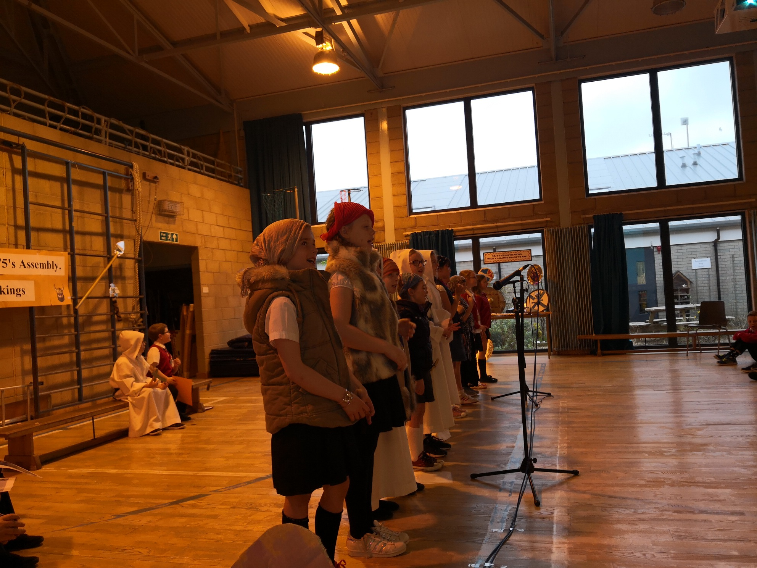
Who’d be a Viking Woman. These blokes get all the fun!

Slide 7
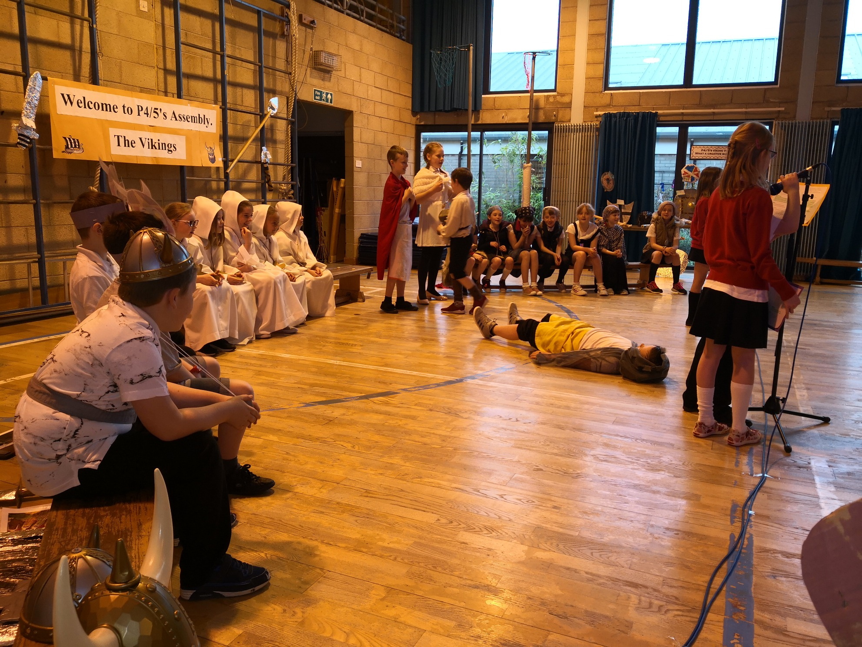
Thor getting his revenge

Slide 8
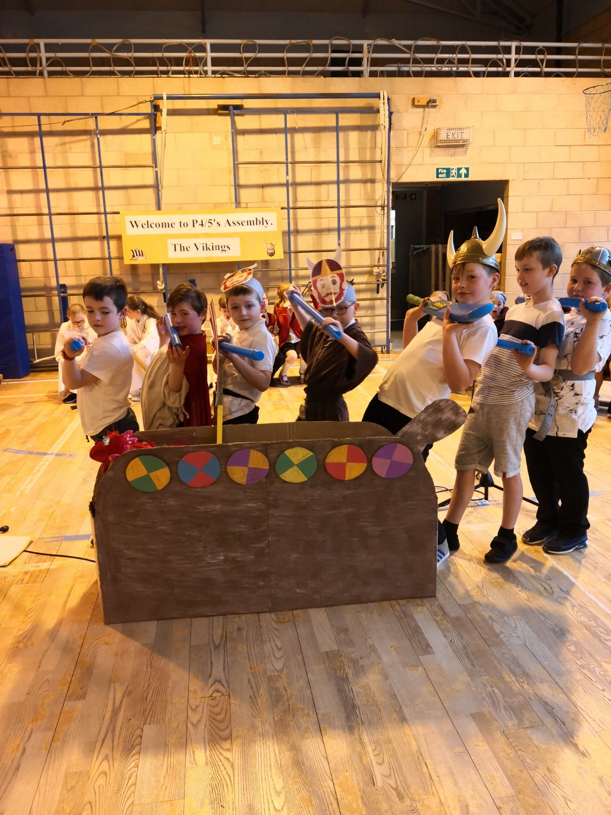
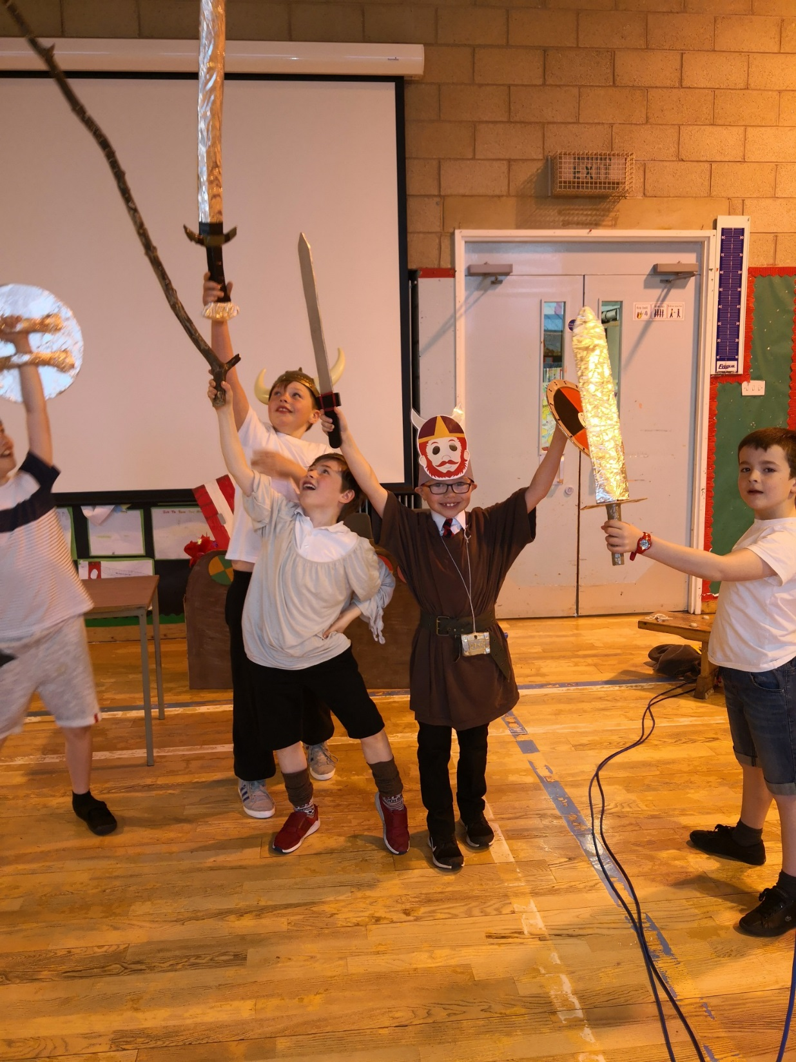
Some after assembly pics

Slide 9
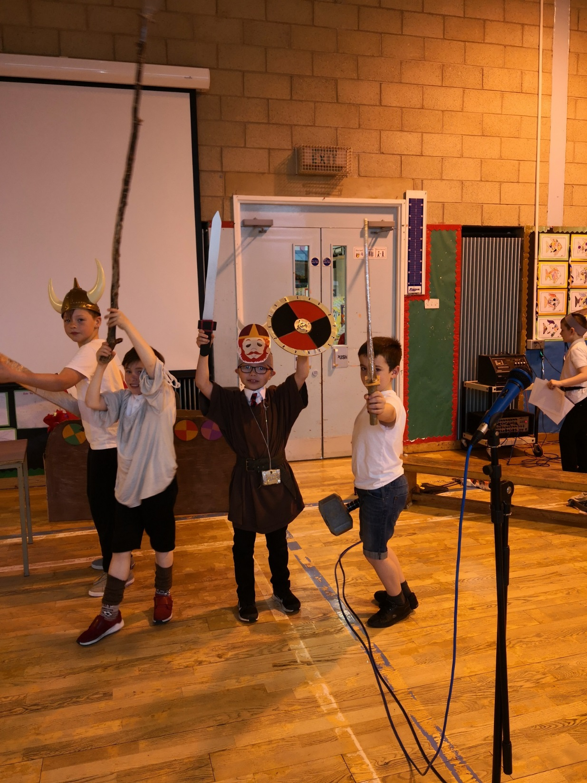
Triumphant

Slide 10
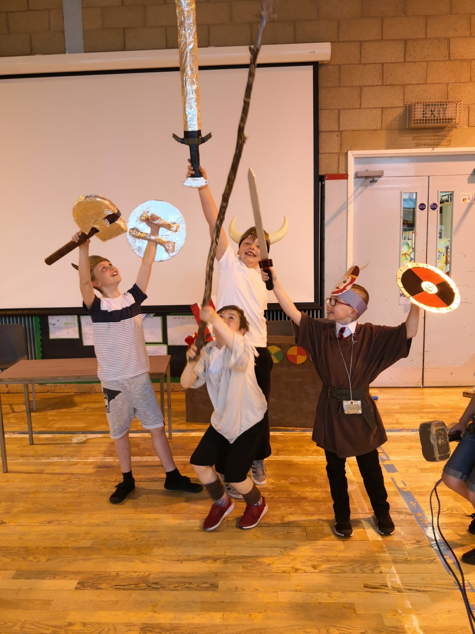
And again!

Slide 11
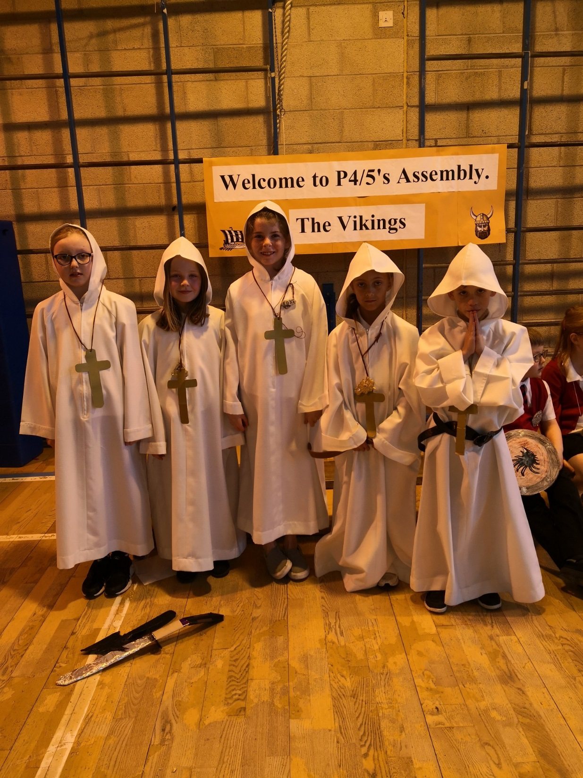
Our Monks

Slide 12
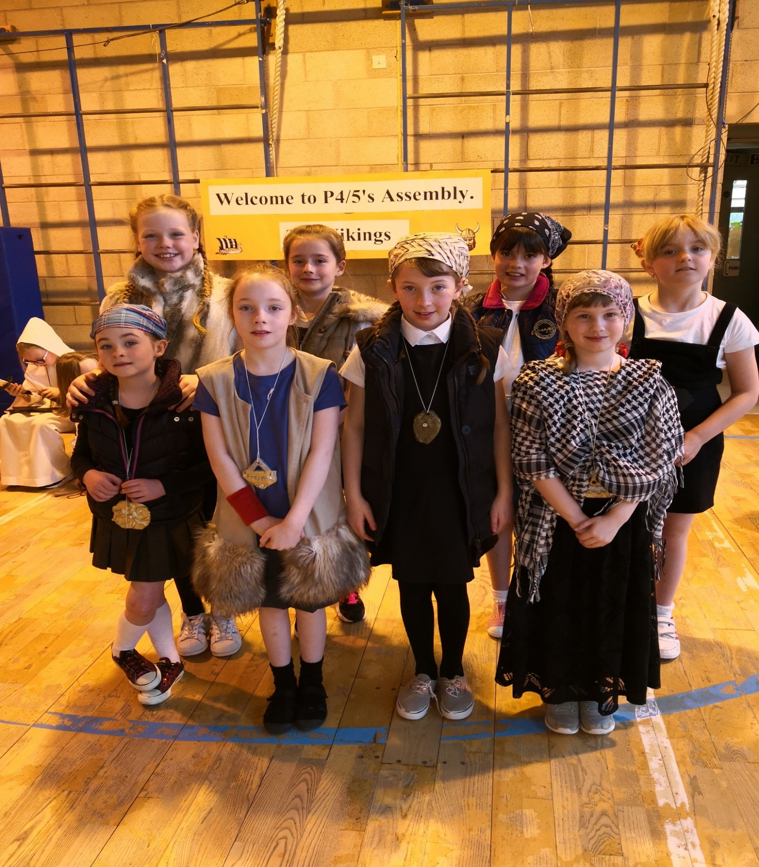
Our Viking Women

Slide 13
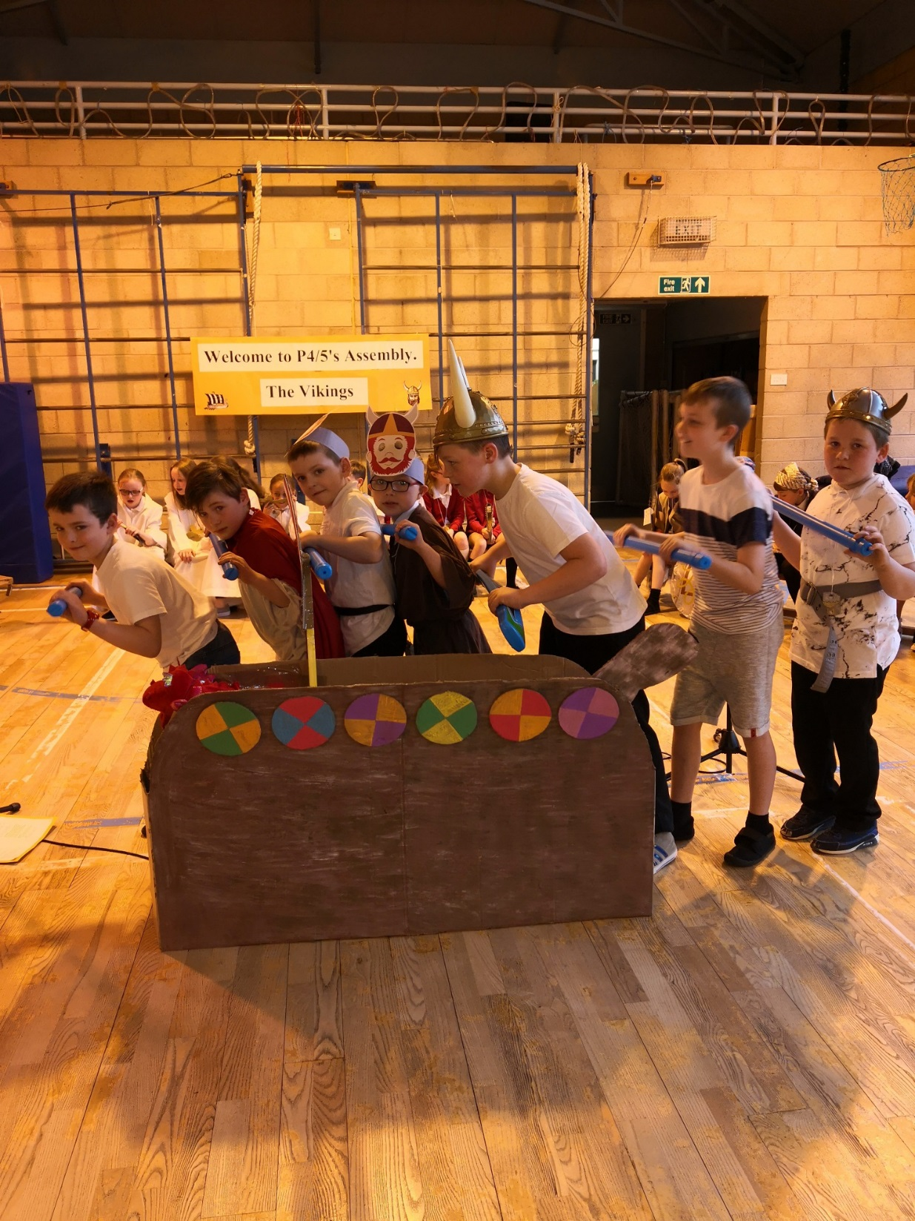
Our Viking Men

Slide 14
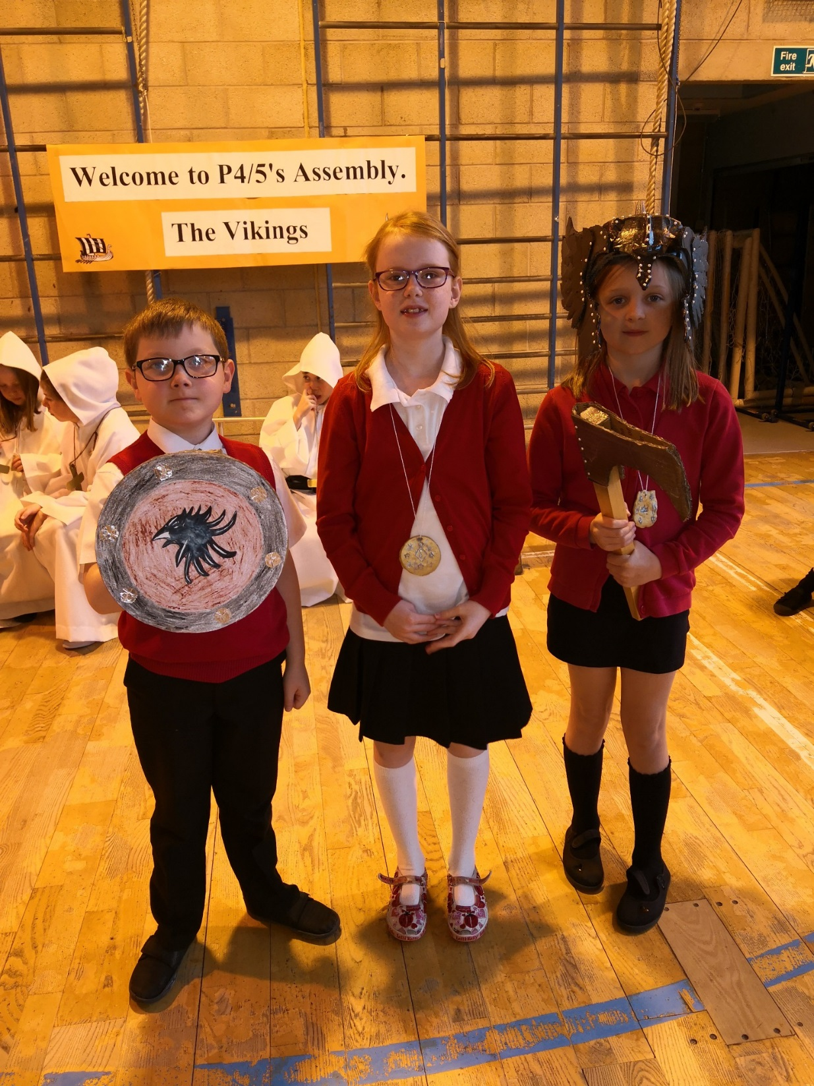
Our Saga Tellers

Slide 15
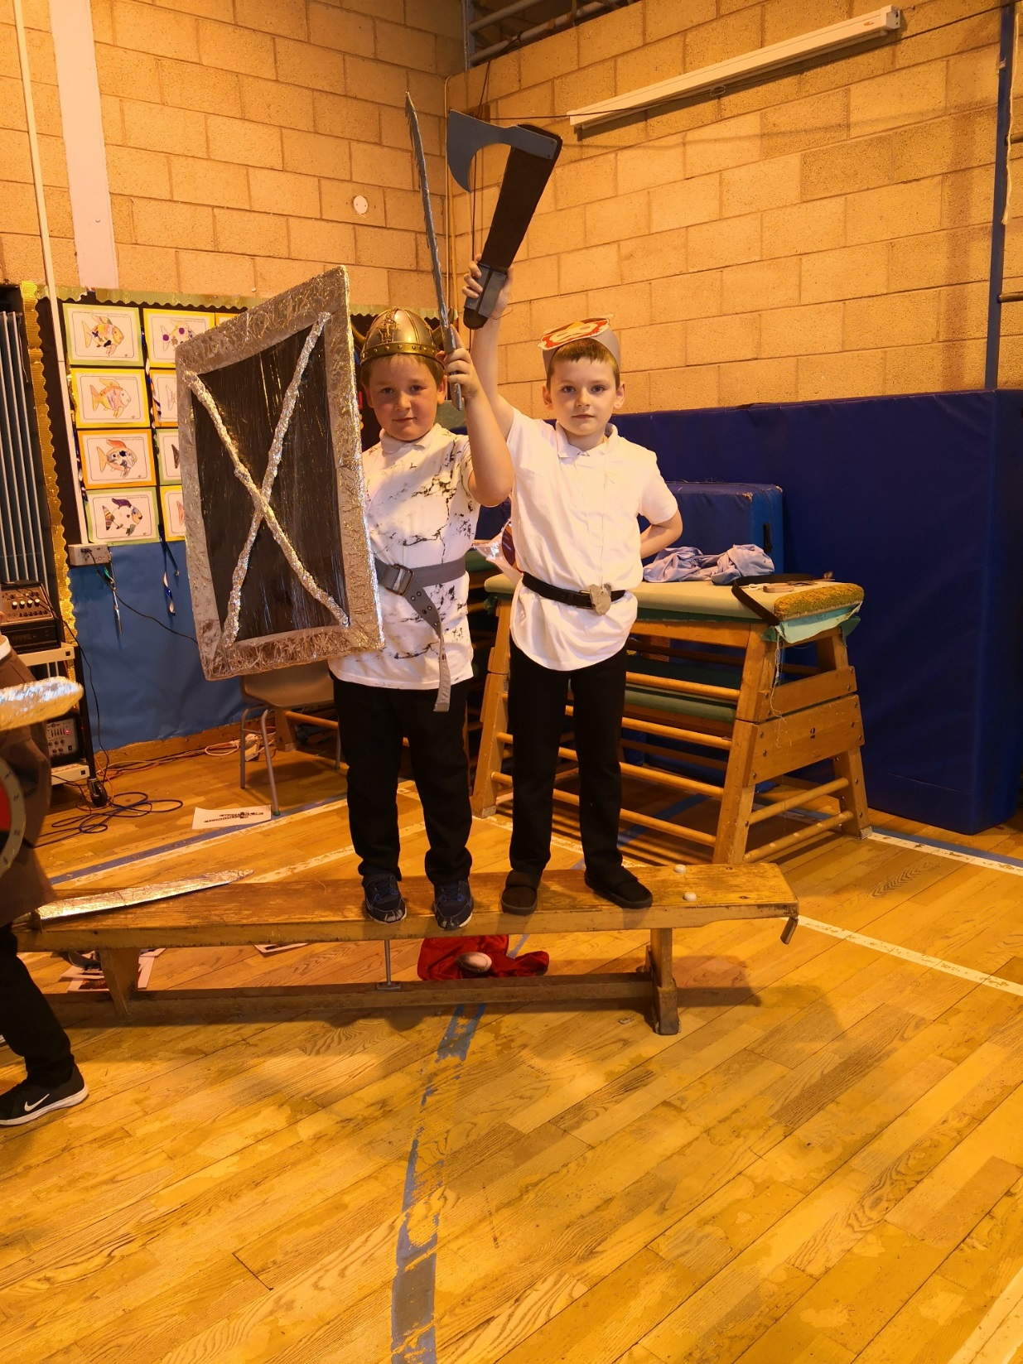
Our Viking Weapons. What a creative bunch we are.

Slide 16
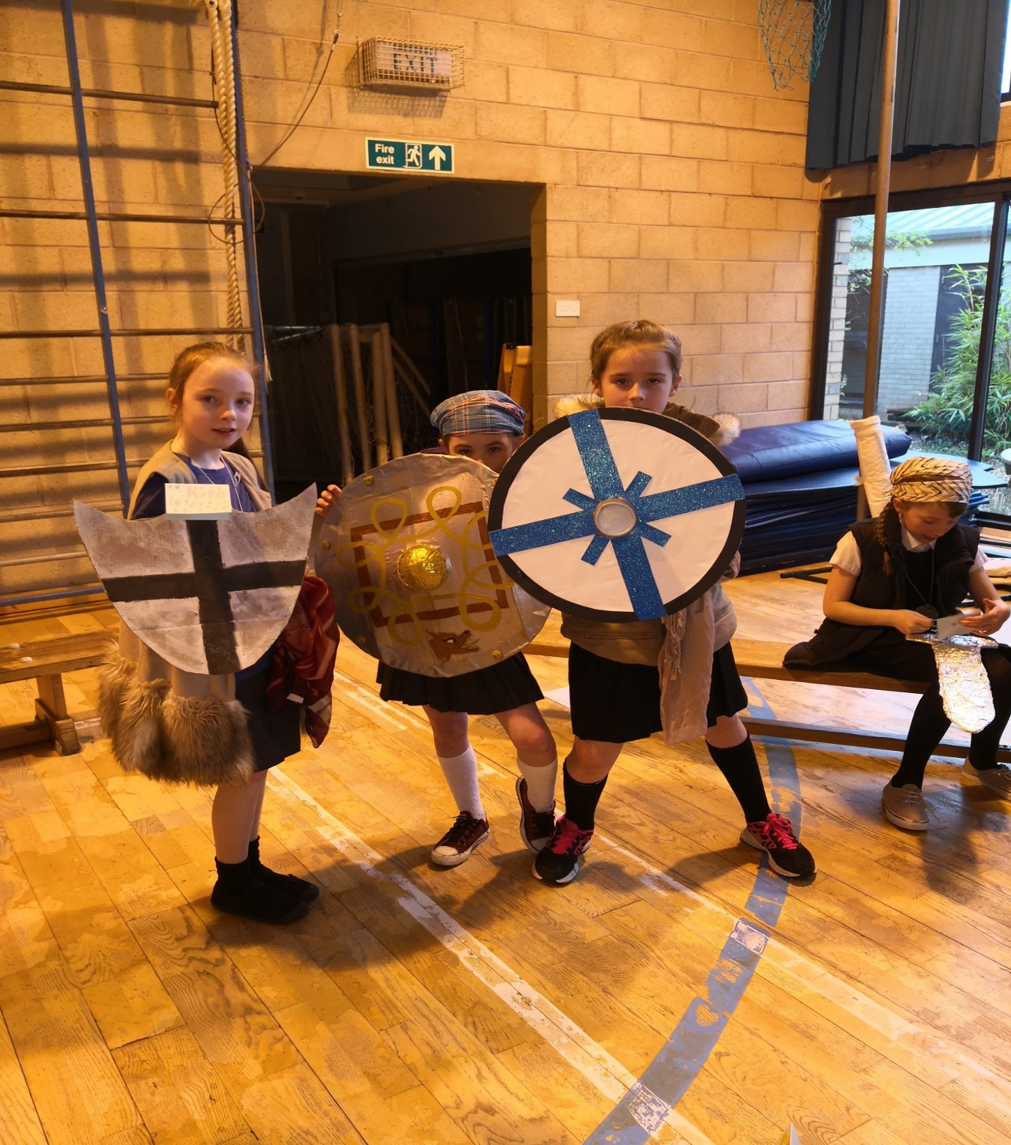

Slide 17
