Slide 1
Advanced Higher Computing Based on Heriot-Watt University Scholar Materials
Applications of AI – Vision and Languages
1

Slide 2
Lesson Objectives
Computer Vision
Natural Language Understanding
Speech Recognition
Stages of NLU
Ambiguity
Simple Grammar
2

Slide 3
Stages in Vision
Capturing and understanding an image is a 5 stage
process:
Image acquisition -
Signal processing
Edge detection
Object recognition
Image understanding
Each stage is complex. This sub-topic looks at the object
recognition stage
3

Slide 4
Challenges in Computer Vision
Humans take their vision system fro granted. We can capture and
make sense of complex scenes in a fraction of a second.
Computer vision programs need resolve ambiguity – where an object, or
parts of an object can be classified from a range of possible objects.
If we have a circle, should it be interpreted as the top surface of a cylinder,
the bottom face of a cone, the base of a hemisphere or the outline of a sphere?

Slide 5
Challenges in Computer Vision II
Another challenge lies with optical illusions that produce two different
interpretations depending on how you look at the picture.
In the picture above, can you see either a white vase or the side profile
of two faces?

Slide 6
Digitisation (Higher revision)
From an image source such as a digital camera, a scanner or even a
satellite image, the source is represented as an array of pixels (bitmap).
Problems at this stage – quality of the image (poor lighting, dust on lens
or electronic distortion.
Depending on quality, the edge of an object (see line above) may
appear pixelated ie as a saw-tooth line.

Slide 7
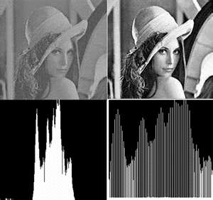
Signal Processing (Higher revision)
Calculations are performed to improve the quality of the image.
Signals of interest can include:
1. Time-varying measurement values.
2. Sensor data, for example biological data such as
electrocardiograms,control system signals, telecommunication
transmission signals such as radio signals, and many others.

Slide 8
Edge and region detection (Higher revision)
Stages
the computer defines and locates objects and areas.
The values of adjacent pixels are compared and so edges are detected.
In both these stages there are a number of mathematical methods
employed to analyse and interpret the pixels.
BUT – artificial intelligence only begins to be applied at the next two
stages:
Object recognition
Image understanding

Slide 9
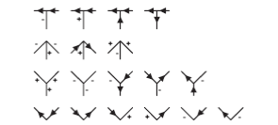
Concave or convex?
How do we now get the computer to decide on concave or convex
edges?
1. The boundary lines of the object obscure the background and so all of these lines can be marked by a set of clockwise arrows
2. The lines that form the faces meet at vertices where three faces have a common point - hence the name trihedral vertex. There are 18 possible trihedral vertices that can be categorised as T junctions, arrows, forks (Y junctions) and L junctions.

Slide 10
Categorising the trihedral vertices
Inspect the currently labelled lines at each vertex and decide which of
the above 18 possible patterns our vertex fits. It may not be possible to
categorise a vertex at first, but another vertex will supply information to
categorise on a second or later repetition
Try the examples on Page 119 of Scholar notes.

Slide 11
Natural Language Understanding (NLU)
Humans use their ears to input sound waves and the brain processes this data to try to make sense of the sound.
You decide a response and then use the throat, lips and tongue to create sound waves to convey your response.
A computerised natural language understanding system must be able to mimic the human natural language understanding system as closely as is possible.
Speech in
Speech out
Speech Recognition
Natural Language Understanding
Natural Language Generation
Speech Synthesis

Slide 12
Speech recognition (Higher revision)
NLP systems can provide input in the form of text (typed or written) and
this form of data does not need to be split up into ‘words’ as it already
has been.
Input in the form of a sound wave WILL need to separated into
recognisable words that are formed by the sounds.
Stages
Analyse the digital sound data (frequency spectrograph)
Break continuous data stream into individual sounds)
Human language has around 50 of these called phonemes

Slide 13
Activities
Do all Review questions in Scholar pp112 – 122 and check solutions

Slide 14
Stages of NLU
Having a list of probable words is just the first stage. Need to determine
what the list of words mean.
Natural Language Understanding has the following stages:
Syntactic Analysis – words fit together into allowed structures. A simple approach is Eliza which uses simple pattern matching – need something more sophisticated (grammar checks and
Semantic Analysis – extracting meaning (the boy ate the chocolate, etc.)
Pragmatic Analysis – deciding meaning based on context (what went before and what comes after)

Slide 15
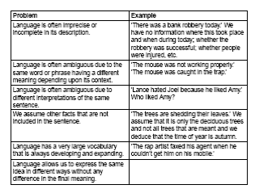
Dealing with Ambiguity
Ambiguity is where a sentence can have more than one meaning and
this can happen at any of the three stages
Let’s discuss Q7 – Q14 on page 124 of Scholar notes

Slide 16
A simple grammar
Restrict the problem to a limited vocabulary with a limited grammar
Problem with word matching:
1. The boy ate the chocolate
2. The chocolate ate the boy
In sentence 1, the verb = ‘ate’ and subject= ‘boy’ - acceptable
In sentence 2, the verb = ‘ate’ and subject= ‘chocolate’ - not acceptable
Word match exactly but need to examine the structure to determine if
the sentence makes sense

Slide 17
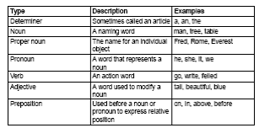
Building Blocks
Let’s look at the task: Identifying word types on page 125 of Scholar
notes

Slide 18
Combining words together
In our simplified grammar, a sentence will consist of a noun phrase
followed by a verb phrase eg ‘boy jumps wall’:
The following sentences fit our simple grammar:
1. Rome is a city.
2. Rome is a beautiful city.
3. The tall man wrote a long letter.
4. The computer works.
Simple Prolog rule:
sentence(X,Y) :- noun_phrase(X), verb_phrase(Y).

Slide 19
Limited vocabulary of simple grammar
Let’s explore page 127-128 of Scholar Notes
Do activity Creating a parse tree on page 129 of Scholar notes

