Slide 1



S2 into S3 OPTIONS Information D. Jacobs - Acting DHT

Slide 2
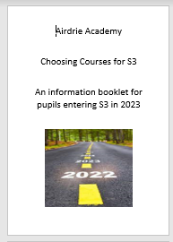
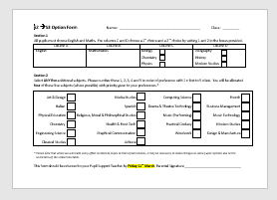
Your young person should have received an
Option booklet
and
Draft option form

Slide 3
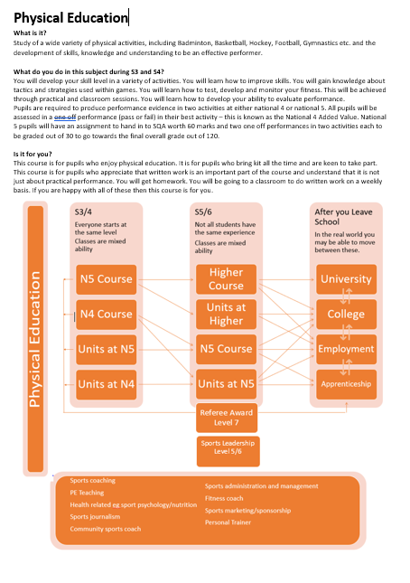
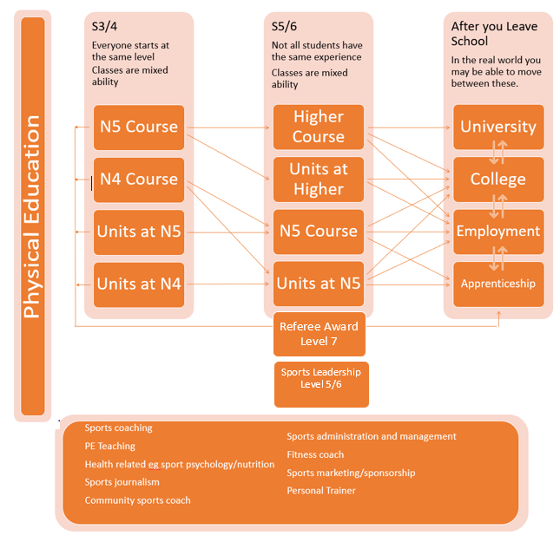
Options Booklet

Slide 4
Things to consider when choosing your options
Do you have a career/job in mind and if so which subjects would be helpful to do this job?
If you know the course you would like to do at college or university, research the subjects that would be helpful to get into that course. Some courses request certain subjects so make sure you look into it.
If you are still unsure about what you want to do then think about what subjects you enjoy and the ones you think you are best at.
Choosing a range of subjects areas keeps your options open, especially if you are unsure about what you would like to do.
Please ask for advice if you need it – Class teacher/Pupil Support / SDS

Slide 5
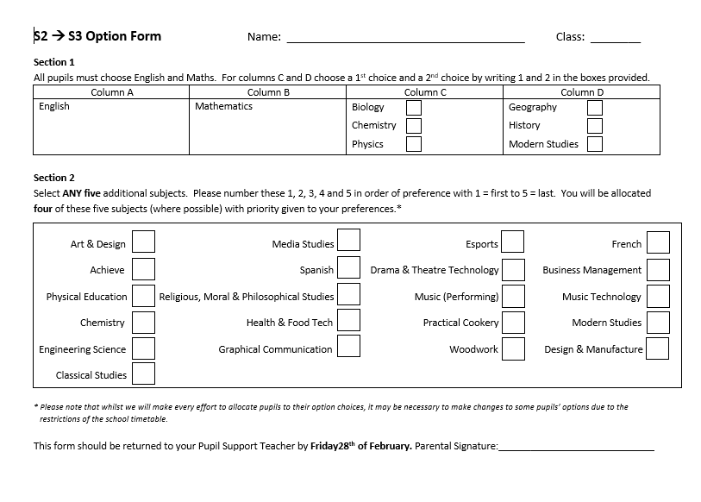
Option form

Slide 6
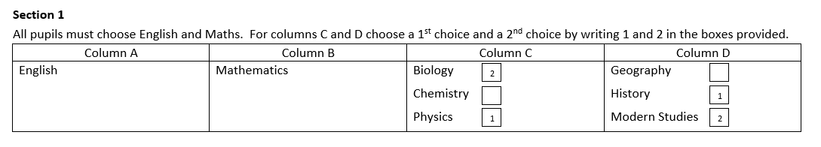
Section 1
You must choose English and Maths. These appear in Column A and B.
For columns C (Science) and D (Social Subjects) choose a 1st choice and a 2nd choice by writing 1 and 2 in the boxes provided

Slide 7
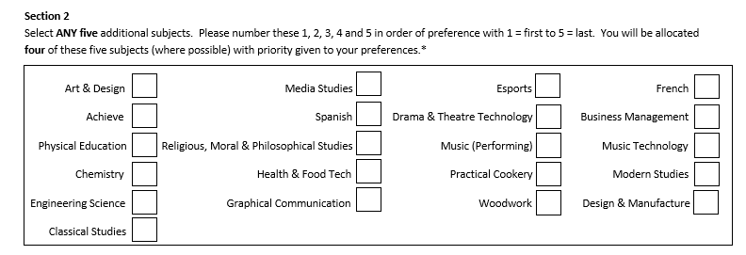
Section 2
Select ANY five additional subjects. Please number these 1, 2, 3, 4 and 5 in order of preference with 1 = first to 5 = last. You will be allocated four of these five subjects (where possible) with priority given to your preferences.

Slide 8
The subject order from 1 to 5 is important
We always try and give you 4 out of the 5 you pick.
If there is limited places in a subject, the pupils who pick it as their 1st and 2nd option will get priority as this is in their top 2.
Whilst we will make every effort to allocate your option choices, it may be necessary to make changes to some pupils’ options due to the restrictions of the school timetable. This is rare but can happen.

Slide 9
FAQs
Can I pick a subject I did not take in S2?
Can I pick 3 Sciences?
What if I make a mistake or change my mind?
Any other questions?

Slide 10
We will ask you, parent/carer, to sign your young persons completed form before they return it. Deadline Friday the 27th of February.

