Slide 1
UNICEF UK/Dawe
Notes:
UNICEF UK/Dawe
Students at a Gold Rights Respecting School.

Slide 2
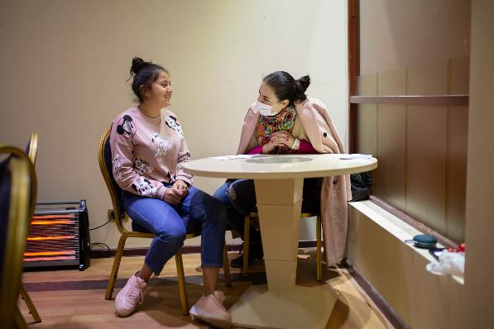
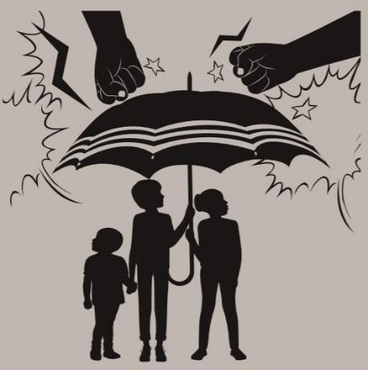
Guess the Article
These pictures provide a clue to this week’s article.
How do these pictures help you? Can you guess how they are linked together?
Write down your thoughts or discuss with someone in your house.
NSPCC/ChildLine
Unicef/Mahari
Notes:
From left to right:
The ChildLine logo
Psychologist Lusine Aghabekyan is talking with a girl from Nagorno Karabakh, temporarily residing in a shelter in Armenia. Image credit Unicef/Mahari
The image to represent 'protection' from the UNICEF UK Rights Respecting Schools 'Wants and Needs' activity pack.

Slide 3
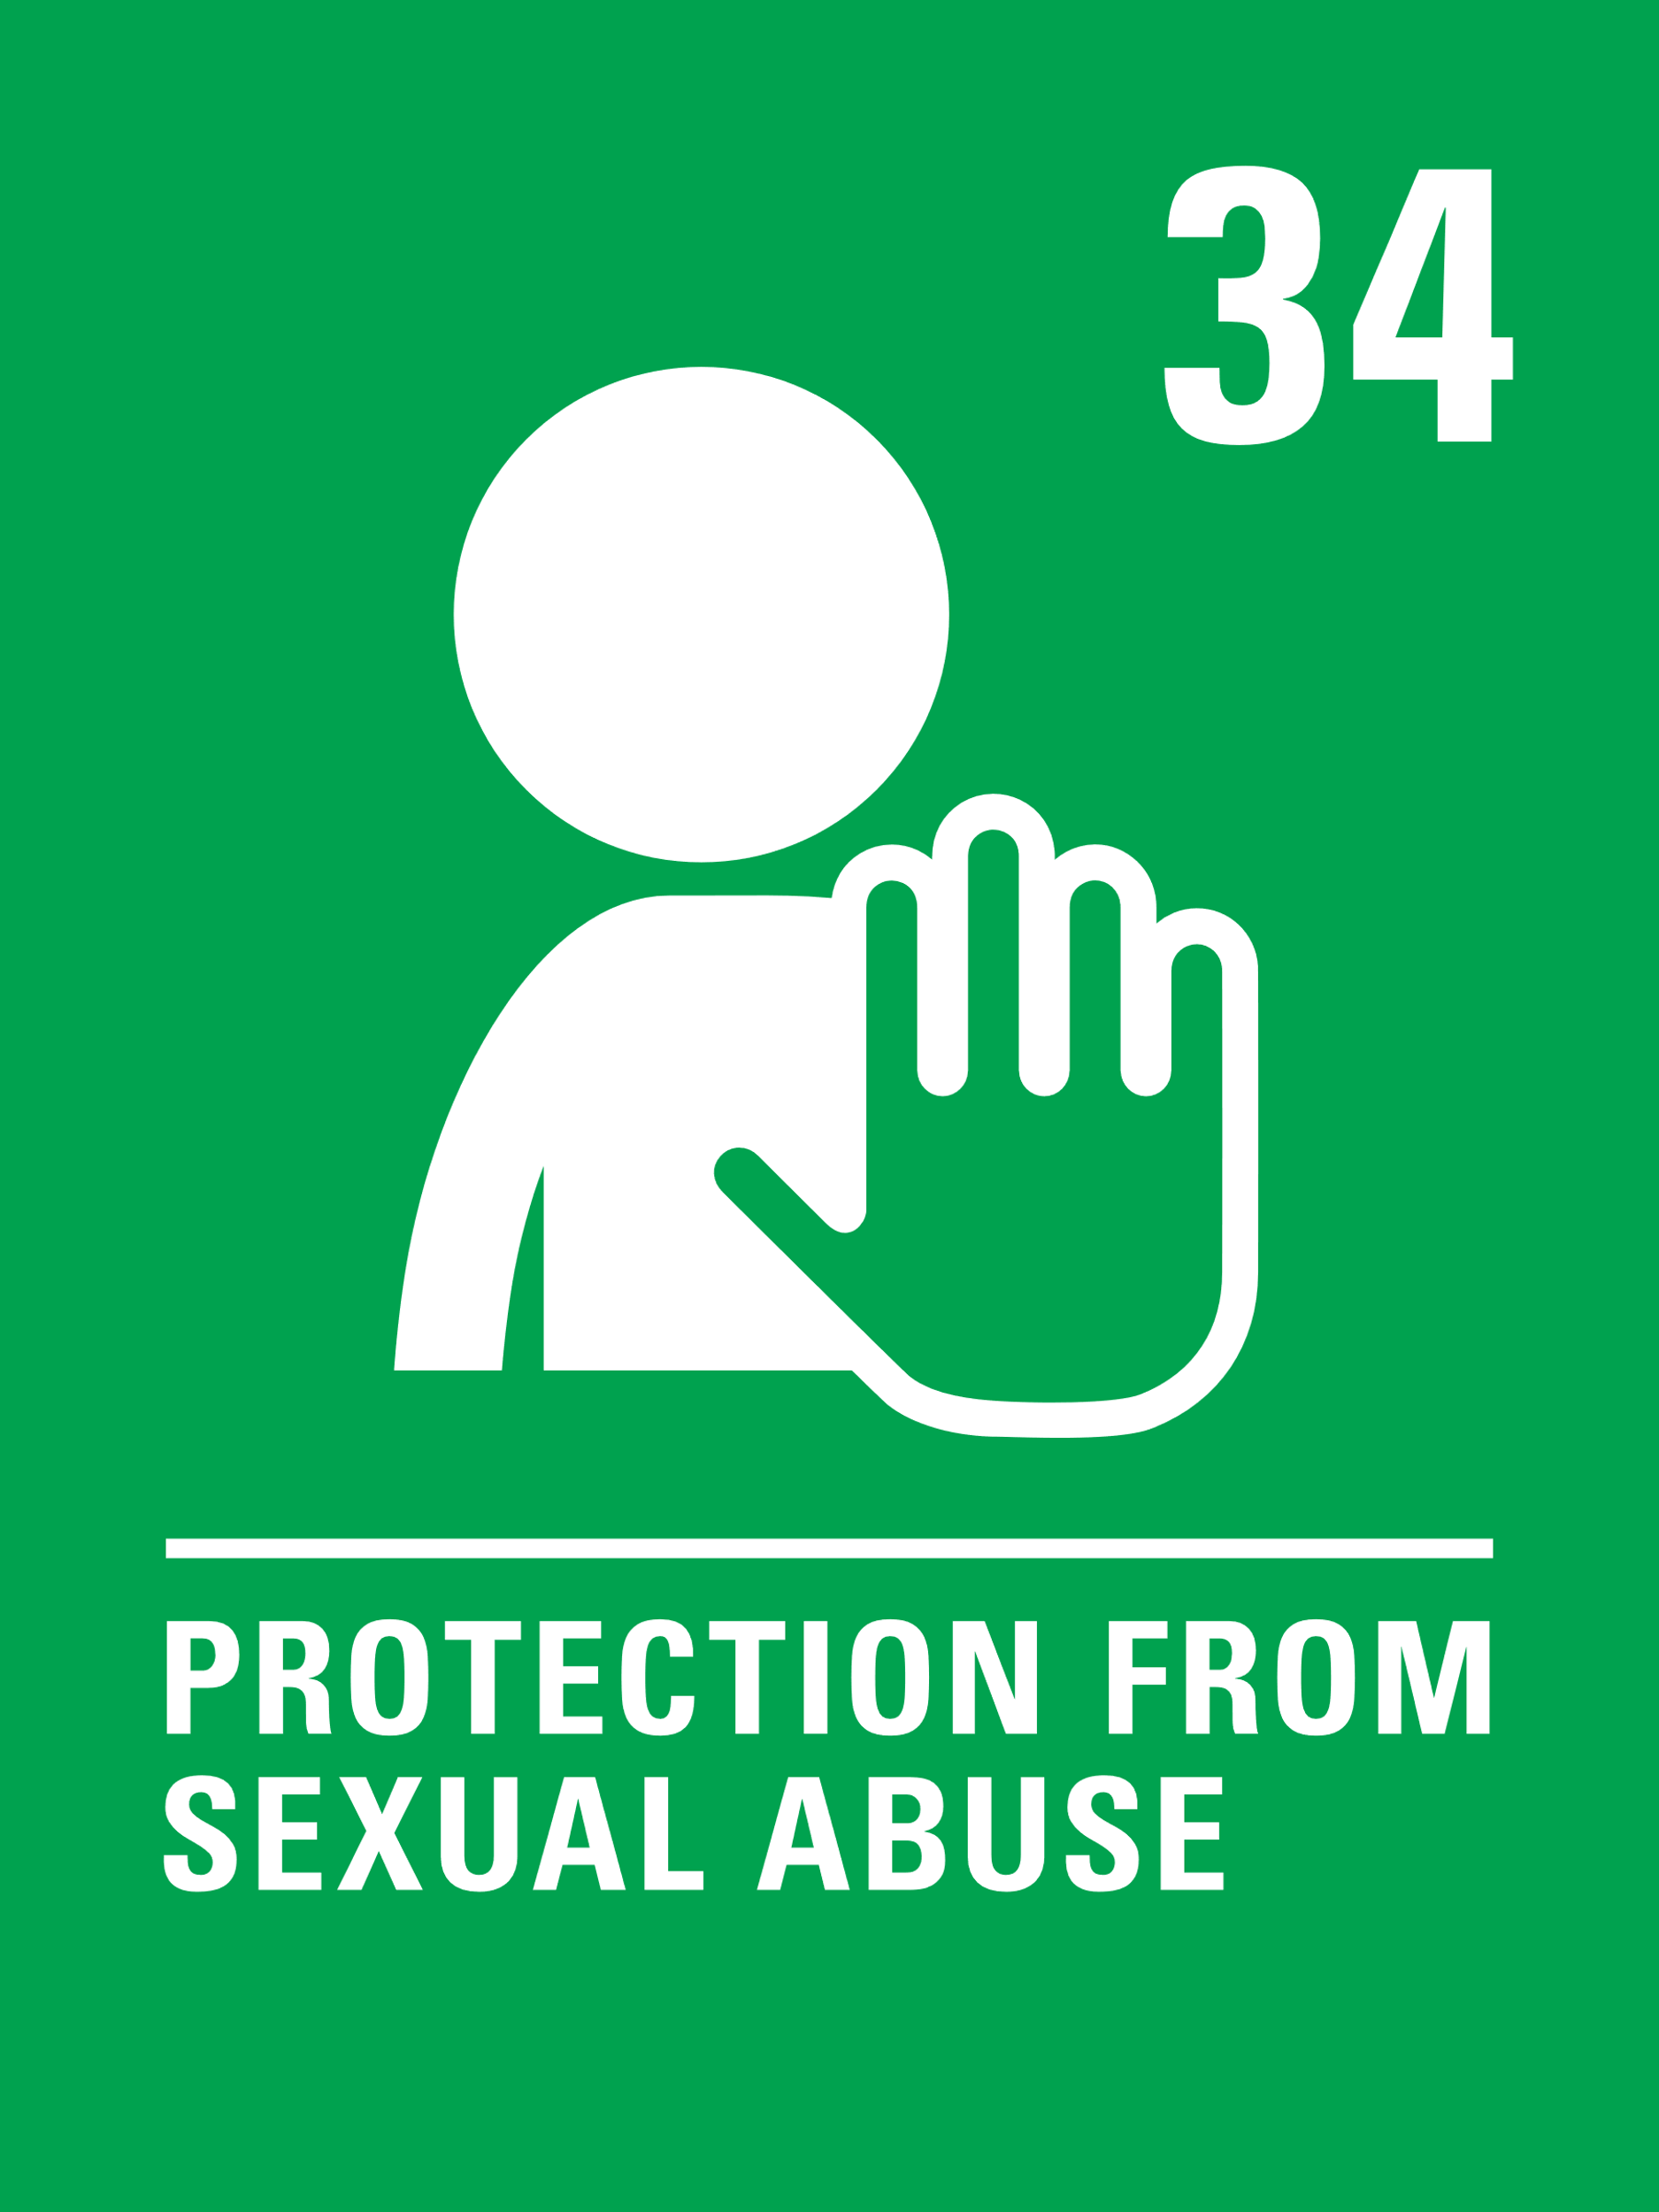
INTRODUCING ARTICLES 19 AND 34
Sarah, Head of Safeguarding at UNICEF UK introduces this pack
Article 19 – protection from violence,
abuse and neglect
Governments must do all they can to ensure that children are protected from all forms of violence, abuse, neglect and bad treatment by their parents or anyone else who looks after them.
Article 34 – protection from sexual abuse
Governments must protect children from all forms of abuse and sexual exploitation.
Click here to watch on YouTube

Slide 4
EXPLORING ARTICLES 19 AND 34
What do you need to feel safe and protected?

Slide 5
How many of these did you get?
To be confident that adults take your safety seriously and do all that they can to keep you safe.
Having a home that you feel safe and secure in.
To be able to talk honestly about where, when and why you might not feel safe and know that adults will work to put this right.
For everyone to consider what behaviours need to change so that all children and young people feel safe.
To know that the government prioritises children's safety and wellbeing when making decisions.
What others did you think of?
Being able to talk about your emotions and feelings
Having the information to know how to keep safe, including online.
To know who to talk or what to do if you don’t feel safe.
Having people around you who listen to your worries or concerns.
Feeling you can trust adults who care for you.

Slide 6
Some governments empower schools to take measures to protect their students – this can include searching and screening pupils for dangerous or inappropriate items like drugs, alcohol, or weapons. How do you feel about this? Could this be a topic for discussion between adults and young people that forms the basis of a policy that respects students’ privacy but also keeps students safe. If so, have a go at drafting such a policy or expressing your thoughts through poetry.
What are the five most important things your school does to protect your rights to be safe from all kinds of harm and exploitation? Write a list and compare your list with others in your class.
In January 2019, UNICEF presented the #ENDviolence Youth Manifesto to ministers at the Education World Forum to help keep children safe in school. Have a look at the manifesto. Are there things in the manifesto that are relevant for your school or local community? Have a go at writing a manifesto to help keep young people safe at your school or in your local community.
All the learning you do around personal, health, relationships and sex education helps you to be safe and protected from many harms including sexual exploitation. Discuss how the knowledge and skills you gain in these areas help to empower and protect you. Think about other skills and qualities you develop in school too such as confidence and self-esteem.

Slide 7
The idea of consent and the importance of being able to say ‘no’ may be something you have learnt about. Think about all your rights – which of them relate to your understanding of consent? Work on this with a partner and then share ideas in a form or class discussion.
‘Mental health is as important to a child's safety and wellbeing as their physical health’ (NSPCC).
It’s not always easy for young people to speak about things that are worrying them. Consider starting a Student Wellbeing group in your school where young people can share ideas about what helps them to improve their mental health and to share sources of information, such as Young Minds and CAMHS, that aim to help with mental health problems such as depression, anxiety, self-harm and eating disorders.
A growing number of children and young people have revealed they have been sexually abused or harassed at school.
Schools should be safe places where people treat each with dignity and respect. Abuse should never be dismissed as ‘boys being boys’ or ‘banter’ but seriously tackled. What systems are in place in your school for discussing and addressing this issue? What changes, if any, need to take place? Think of three key recommendations you could take to your School Council or Headteacher to ensure people are treated with dignity and respect.
Article 34 refers to protection from sexual exploitation. Sadly, this affects some children and young people all around the world including in the UK. Look up the word ‘exploitation’. Discuss as a class what it means and consider how different types of sexual exploitation cause harm to a child and might affect many of their other rights.

Slide 8
REFLECTION
Try to find somewhere peaceful and spend a few minutes being quiet and still … then think about these questions…
The International Director of UNICEF, Henrietta Fore, said recently:
“Let us make 2021 the year we start to build a fairer, safer, healthier world for children.”
Thinking about children in different situations across the world, think about one thing that
Governments, schools, local organisations could do to help the world be a safer place for children.
What could you do?
UNICEF UK/Dawe

Slide 9
THANKYOU
UNICEF UK/Dawe

