Slide 1
The transition from p7 – s1

Slide 2
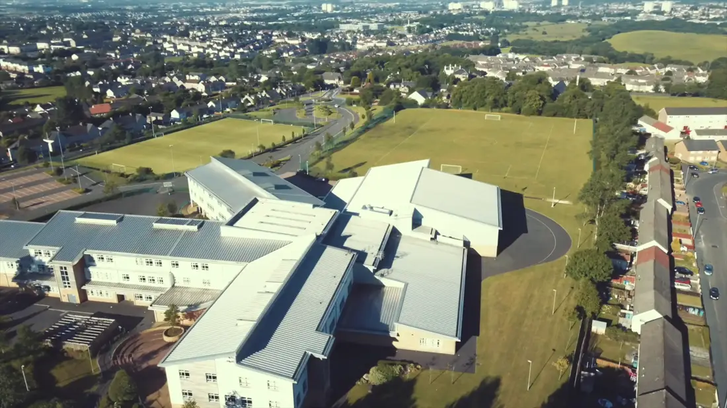
Layout Of The School
At first you might not be able to get around the school for a while as it is a big change of scenery from what you are used to.
For the first week you will have a senior guide show you around and take you from class to class. Once you know your way around it is hard to forget,
my tip is to learn where all the stairs are and which corridor they take you to. Then to learn which subjects are on what Floor.
Don’t worry too much about getting lost on the first few weeks as your teachers will understand.

Slide 3
Subjects
In first year you will study almost all the main subjects taught at Airdrie academy. These subjects will include:
P.e, Music, Drama, History, Modern Studies, Geography, Fashion, Home economics and Tech
Business Studies, Information Technology, Science, Maths and Numeracy
English, ART and French
When I was in first year I had a subject named Scottish studies where you take part in activities in each department based on Scotland.

Slide 4
Times & Periods
Each period lasts a total of 50 minutes:
Period 1: 08:55-09:45
Period 2: 09:45-10:35 Break: 10:35-10:50
Period 3: 10:50-11:40
Period 4: 11:40-12:30 Lunch: 12:30-13:15
Period 5: 13:15-14:05
Period 6: 14:05-14:55
Period 7: 14:55-15:45

Slide 5
Homework
There is no question you will get homework in most subjects in school.
In first year some subjects will give you a lot more homework compared to others.
At first I did not like the idea of getting homework, nobody does, but you don’t get as much as you expect to get. Obviously some days you will have more homework than others.
It is really important you do homework in High school as it helps you to learn things and when it comes to tests you have something you revise with.

Slide 6
Clubs
There are clubs for every day of the week at lunch time and after school.
There are clubs for everybody at Airdrie academy and teachers are constantly encouraging pupils to sign up for one as it is good for mental and physical health. It is also a good way to get to meet new friends.
Clubs range from sports to movies to learning languages.

Slide 7
Uniform
• School Blazer with Badge
• School Tie
• White or light blue shirt or blouse
• Black trousers or skirt
• Navy/black cardigan/jumper – (No Logo’s)
• Shoes

Slide 8
Break and lunch
Break time falls between period 2 and 3 and lasts 15 minutes, food and drinks are available from the cafeteria at this time.
Lunch time falls between period 4 and 5 and lasts 45 minutes food is also available at the cafeteria.
Yow will not be allowed to leave the school premises for you lunch for the first couple of months, this includes going out to the van or a shop for food.
Break and lunch wont be the same way for you as it is for the rest of the school for the first couple of weeks but this is just to get you used to the ways of working.

Slide 9
House Identity
As you know already, you belong to one of the four houses in Airdrie Academy:
Cleddans-blue
Faskine-yellow
Monklands-red
rochsoles-white
Each of your classes is based on the house you are in.
Each house has its own captain, vice captain and prefects who will help you throughout your years at Airdrie academy.

Slide 10
Friendships
One day you will eventually know everybody in your year. It may seem scary at first but the best thing you can do in high school is to make friends.
The easiest way to make new friends is just to introduce yourself, talk to people in your class and just be nice - people will start to like you if you’re kind to them and by no time you’ll have plenty of friends.

Slide 11
Thank you and good luck

