Slide 1
A Parent’s Guide to Show My Homework

Slide 2
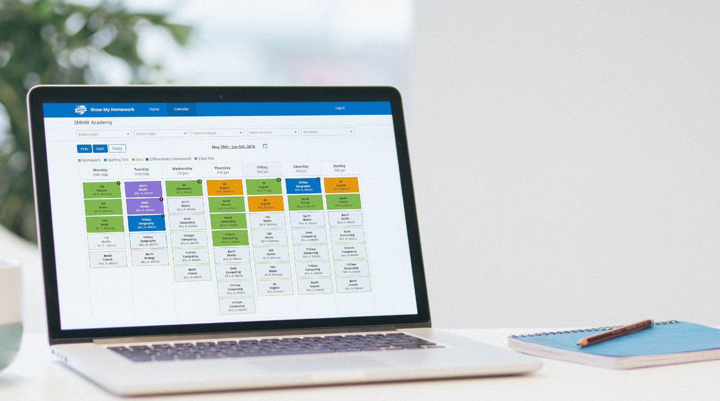
What is Show My Homework
A simple online solution for students and parents to view homework details and upcoming deadlines.
Mobile apps and notifications ensure you always know what homework your child has and when it’s due.

Slide 3
How Show My Homework can Help You
Get notifications straight to your phone
See when homework has been submitted and the grades awarded for it.
Visibility - See exactly how much homework has been set and when it’s due

Slide 4
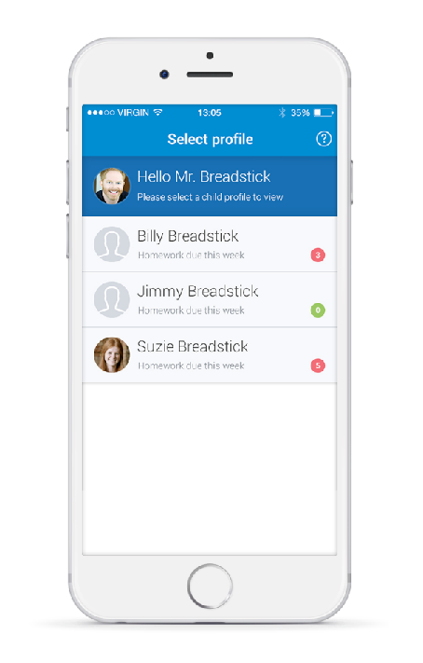
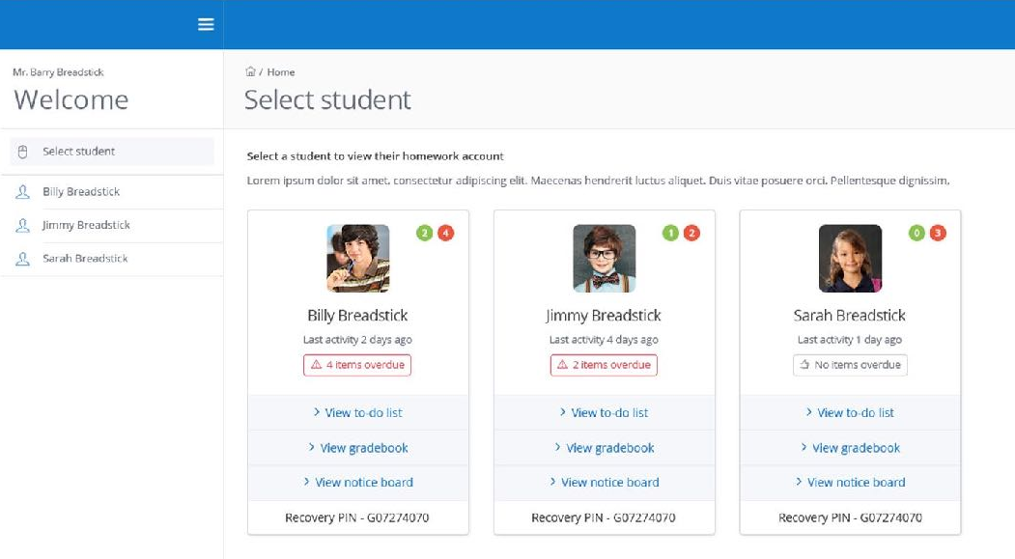
More Than One Child?
More than one child at the school? Don’t worry they’ll appear on the same page.

Slide 5
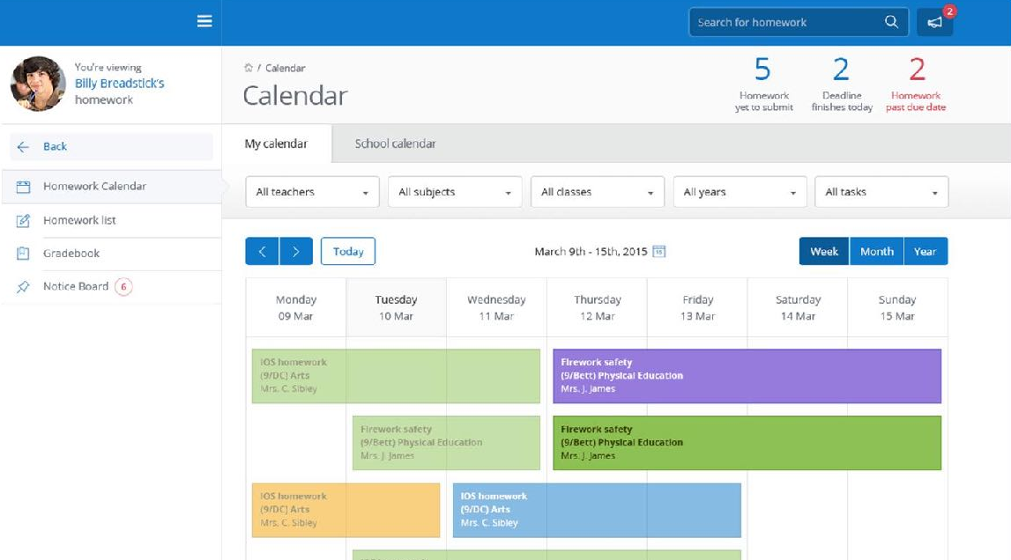
The Homework Calendar
Homework appears as a block, stretching from the issue date to the due date.

Slide 6
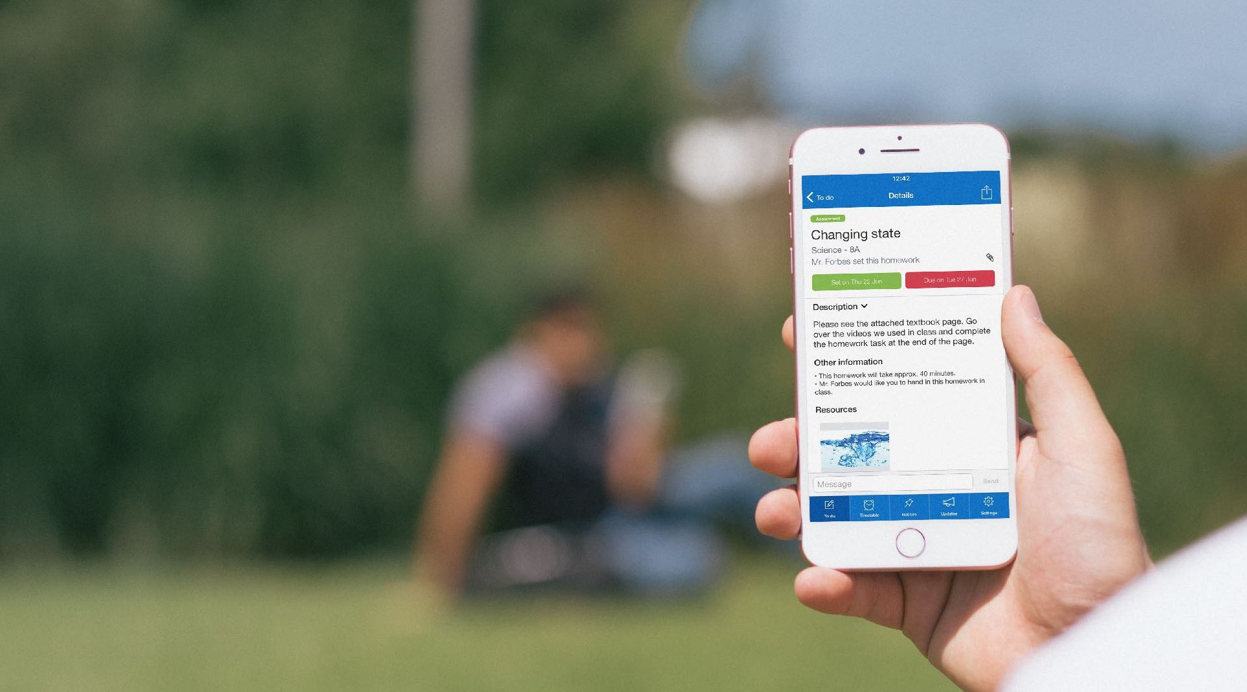
Homework Description
Here is a task’s title and description, issue and due dates and how it should be submitted.

Slide 7
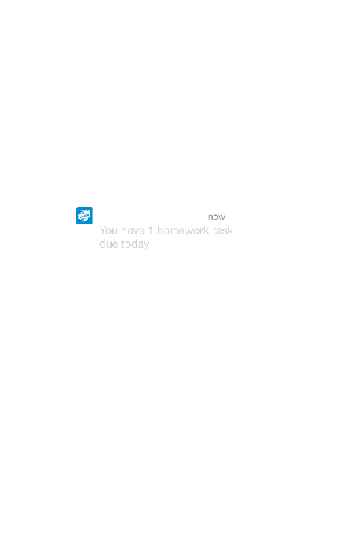
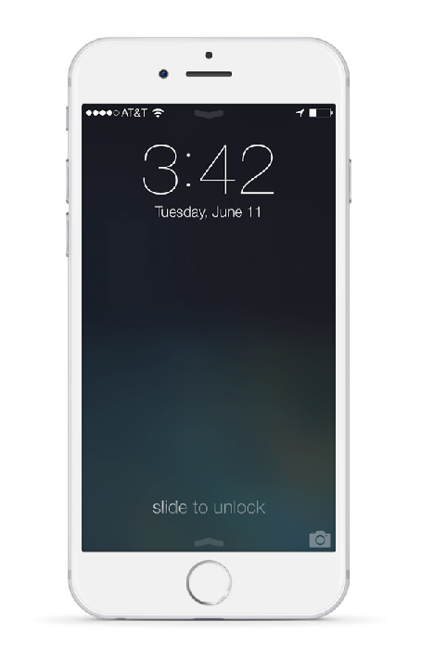
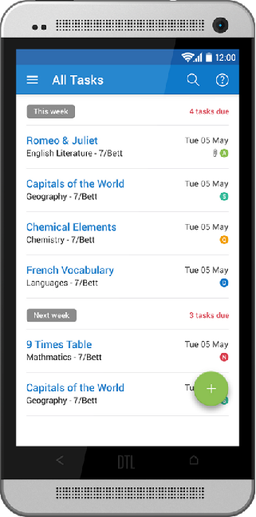
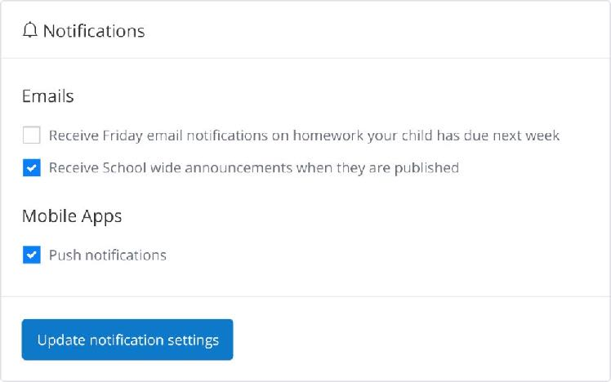
Get Notified
In Settings, you can manage notifications

Slide 8
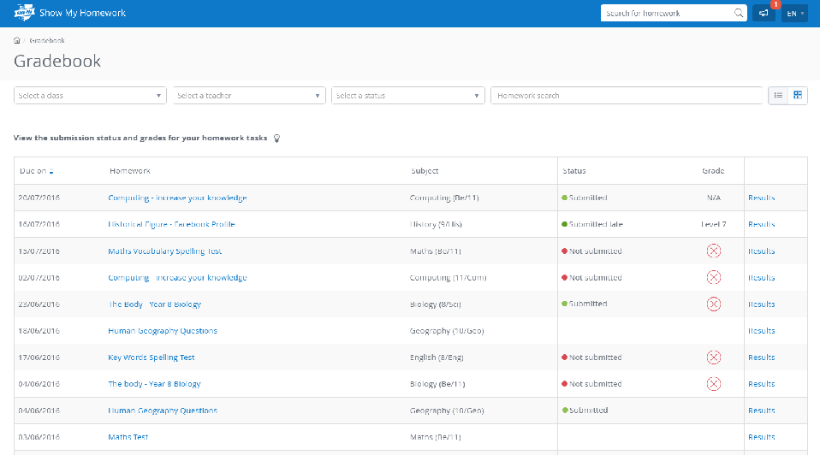
The Gradebook
The Gradebook helps you keep track of the submission status of homework and grades, if applicable.

Slide 9
Downloading the App
Please all get your mobile devices out and download the Show My Homework App.
Open the app and type in your school’s name.
Type in your email/username and password.
You will be taken to your child’s To-do List
You can start using Show My Homework on the go

Slide 10
Get Notified
In Settings, you can manage notifications

Slide 11
Support
Unlimited support for teachers, students and their parents from our highly skilled team of experts.
help.showmyhomework.co.uk
020 7197 9550

Slide 12
www.teamsatchel.com
0207 197 9550
help.showmyhomework.co.uk
@team_satchel

