Slide 1
Rights Respecting Schools
Airdrie Academy

Slide 2
What is the UNICEF UK Rights Respecting Schools Award?
The Rights Respecting School Award (RRSA) is all about making sure that young people know and understand their rights as global citizens and respect the rights of others.
We want to ensure that all students at Airdrie Academy fully understand their own responsibilities in making sure that their own and other people’s rights are not abused or neglected.

Slide 3
Being part of an RRS school I will…
Learn about my rights
Learn the difference between wants and needs
Feel included
Ensure my self-esteem rises
Begin to think about others and their rights
Learn to negotiate
Extend my language and thinking skills

Slide 4
What is a RRS like?
This video “TRS What are the Rights of the Child 2014?” shows some of the articles in the United Nations Convention on the Rights of the Child (UNCRC) and how they affect Children and Young People in school. https://blogs.glowscotland.org.uk/nl/airdrieacademy/category/rights-respecting-schools/

Slide 5
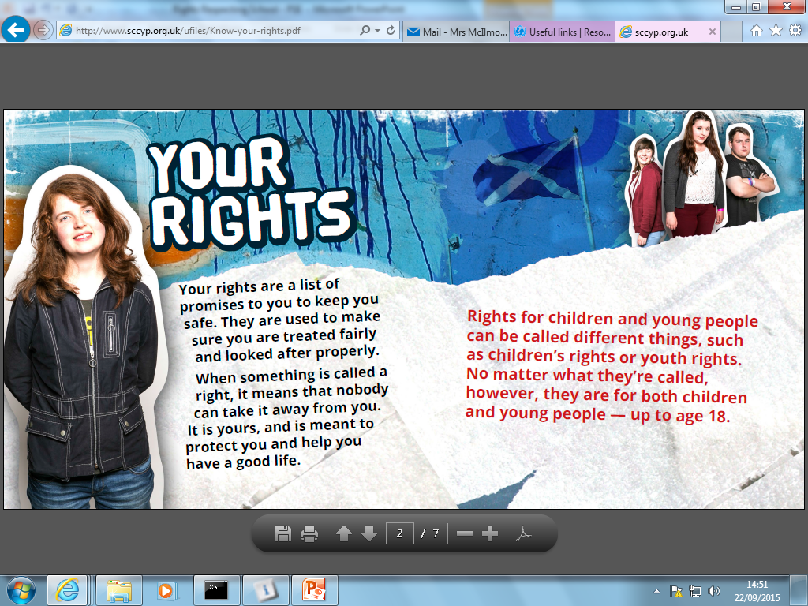

Slide 6
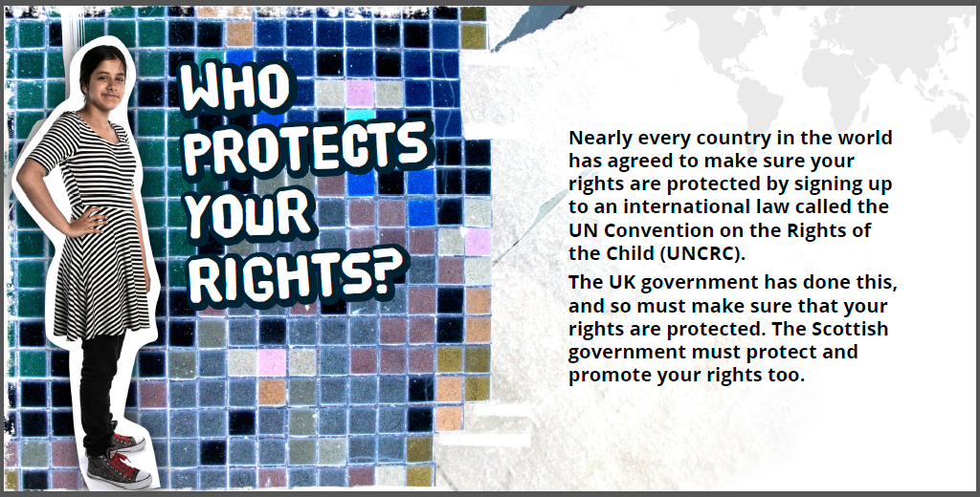

Slide 8
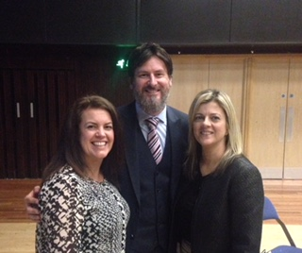
Scotland has a Commissioner for children and young people His name is Bruce Adamson. He is someone who can stand up for your rights, and who you can get in touch with if your rights aren’t being respected. He looks after the rights of: -everyone under the age of 18 -everyone in Scotland under 21 who is care experienced He works to make a difference in your life by: - listening to you - helping you learn more about your rights - asking people in power, such as members of the Scottish Parliament, to think about how new laws might affect you - speaking out if children and young people are not getting a fair deal

Slide 9
What are these “Articles”?
There are 42 Articles that affect you directly, the others are the responsibility of adults to ensure your rights are upheld.
TASK: Look at and consider the list of Articles. Decide in your pairs/groups which 10 you feel are the most important ones that we can work on together as a school next session. Work as a class to create a class “Top 10”.
Notes:
Discuss with class – feedback and decide on 10. Complete “Top 10 UNCRC Articles” and submit one per class.

Slide 10
Why does it work and what are the benefits?
If we respect each person’s rights, we will find that we are working together to improve everyone’s lives and therefore our own.
We will understand that people are all individuals and their needs may be different from our own, but they are just as entitled to their rights and respect.
We will become more of a community.

Slide 11
Whilst this is a Worldwide Convention, some children in some countries find their rights are not being upheld.
https://blogs.glowscotland.org.uk/nl/airdrieacademy/category/rights-respecting-schools/
Watch “Scottish Students Speak Out” and David Tennant videos via above link

Slide 12
Where next? We are working towards obtaining our Bronze Award (Recognition of Commitment) by June 2018. Pupils interested in becoming an Airdrie Academy Rights Respecting School Ambassador and working with staff to promote Children’s Rights within the school, should give their name to their FOL teacher.

