Slide 1
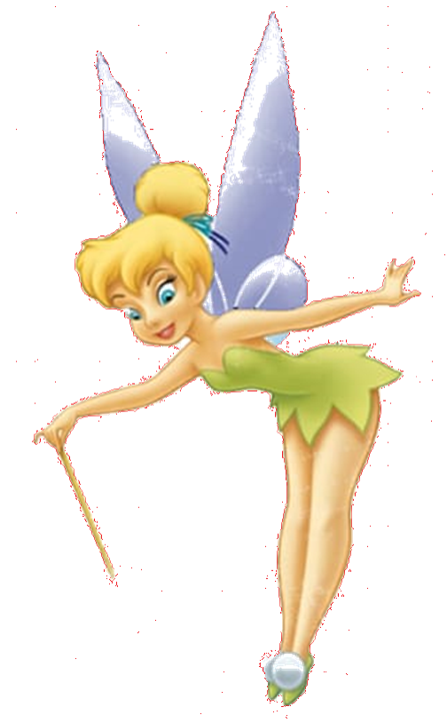
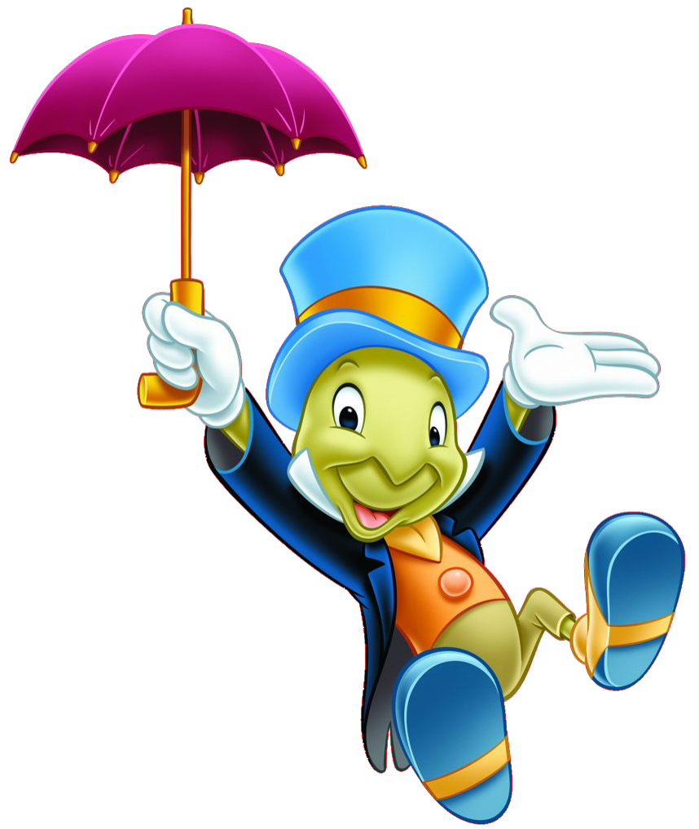
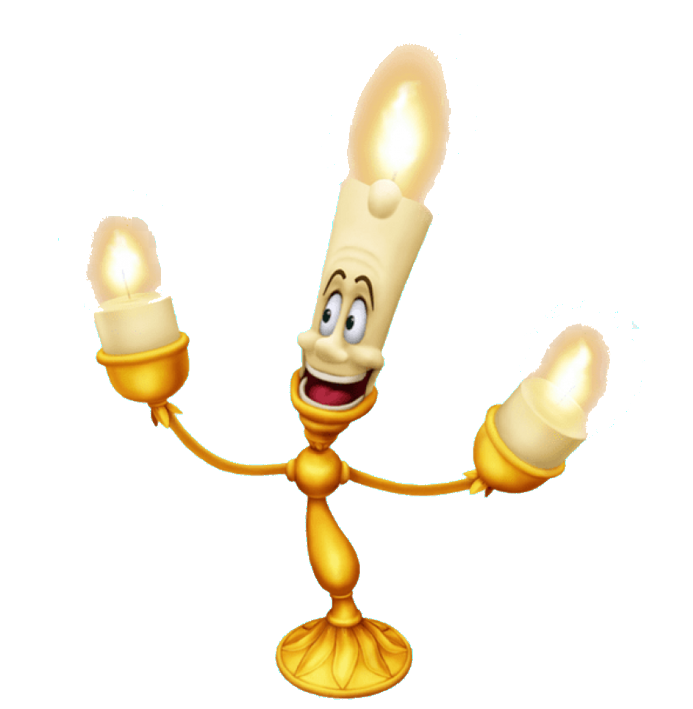
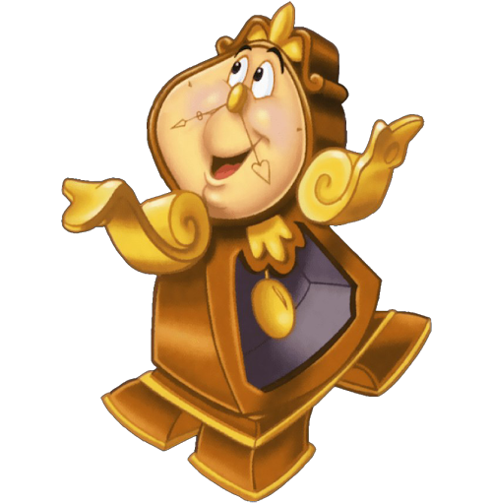
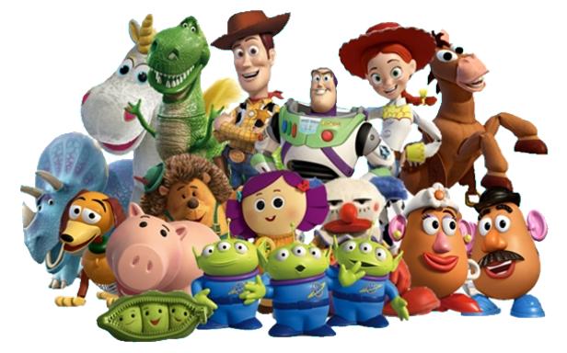
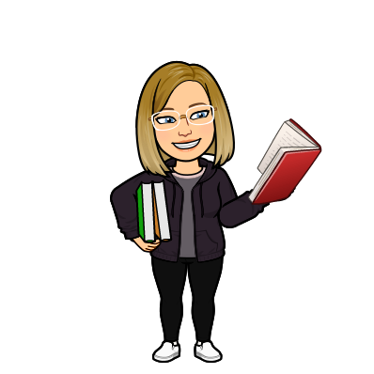
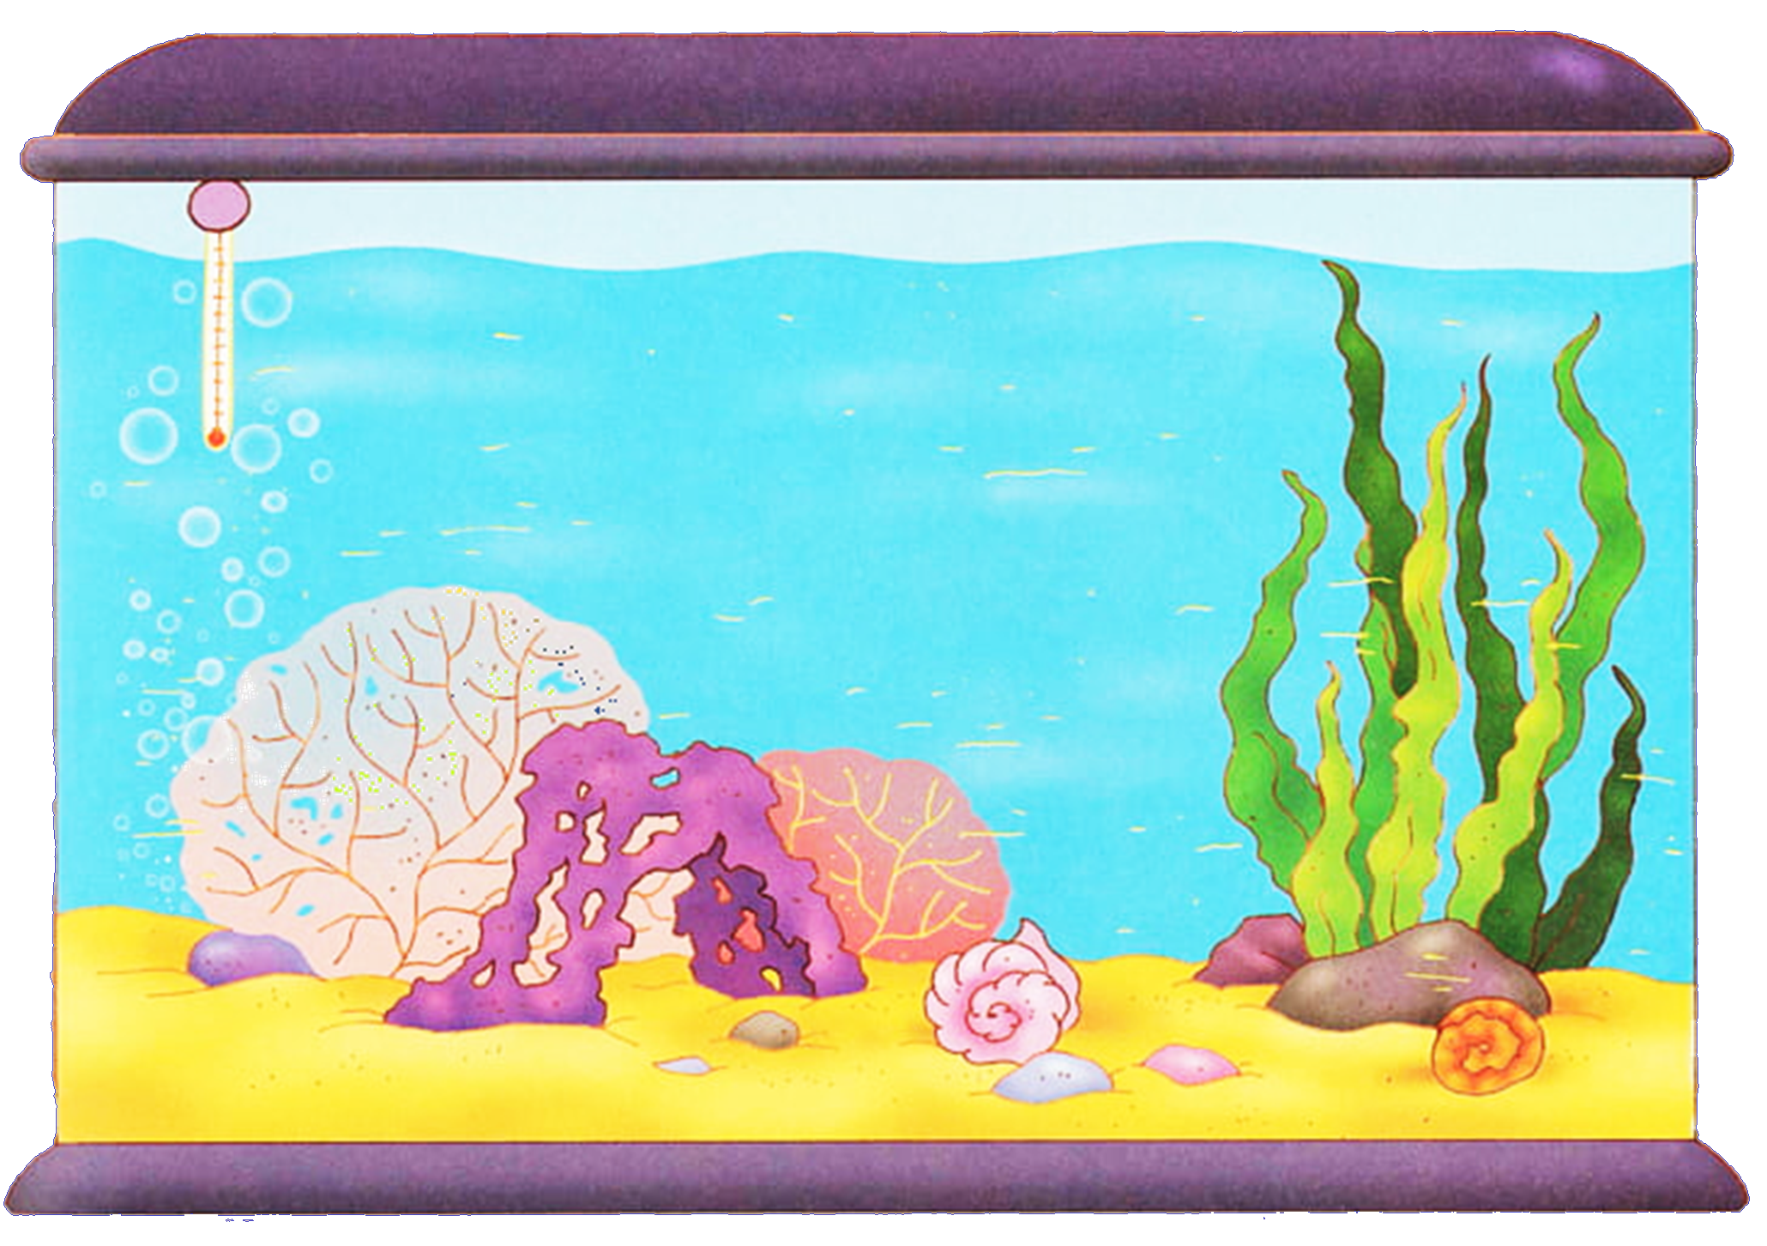
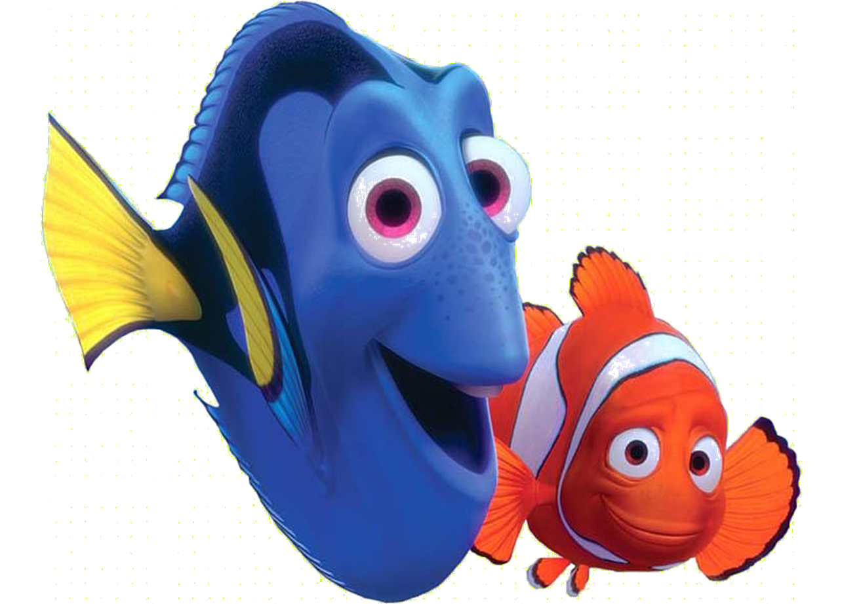
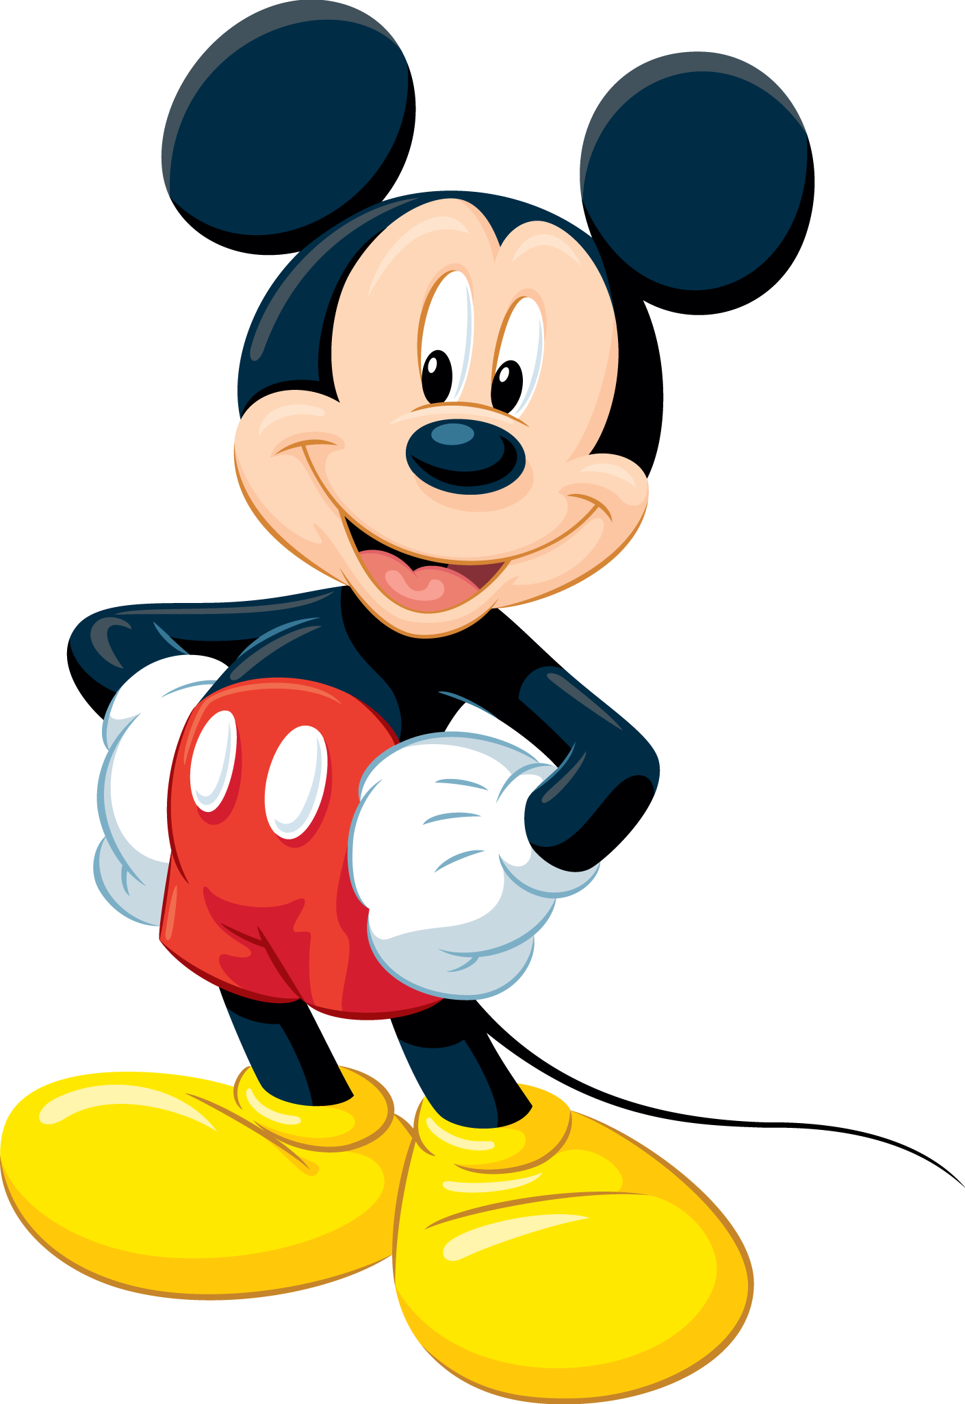
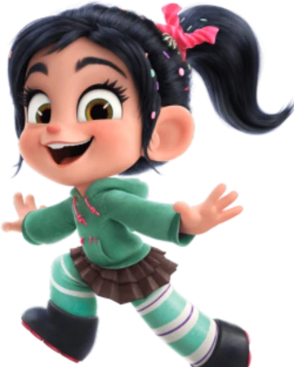
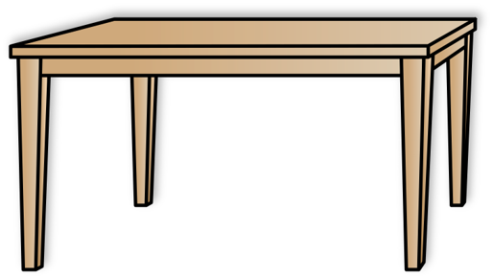
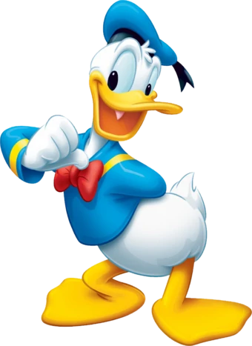
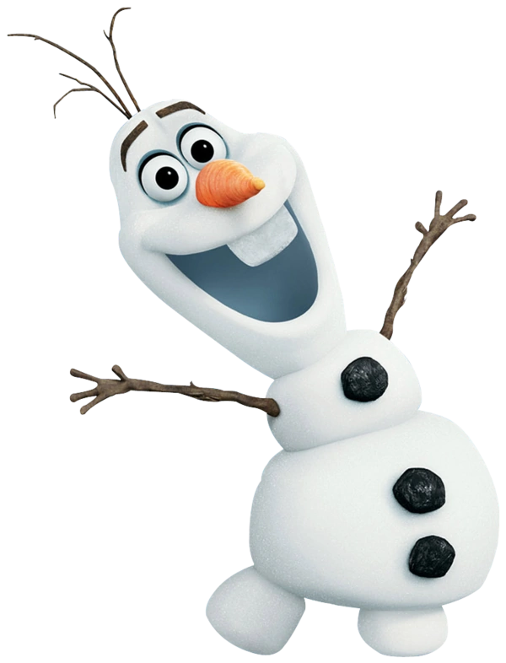
Mrs McElroy
P5
Recognition Board
Hello, I’m Mrs McElroy and I will be teaching P5 this year. Click any of the links to find out what we are doing this term.
Literacy
Important Information
Maths
Topic
Health and wellbeing
Homework

Slide 2
Literacy
Back to home screen
Reading
This term, we will be reading our whole class novel ‘This Morning I Met A Whale’ by Michael Morpurgo. We will be using the North Lanarkshire Active Literacy strategies to explore the text.
Writing
​We will be writing imaginative texts as well as reports and explanation texts linked to our topic.
Spelling​
This term we will be catching up and assessing spelling before moving forward with new phonemes, words and rules. ​
​
​

Slide 3
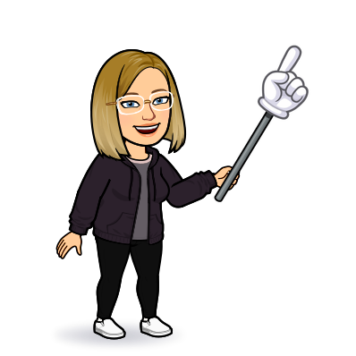
Maths
Back to home screen
This term, we will be focusing on place value, addition, subtraction, multiplication and division.
We will be using a variety of active learning methods, outdoor maths, games, textbooks and worksheets.
We will be revising the 3x and 4x tables before beginning the 6x table.
​
​
​
​

Slide 4
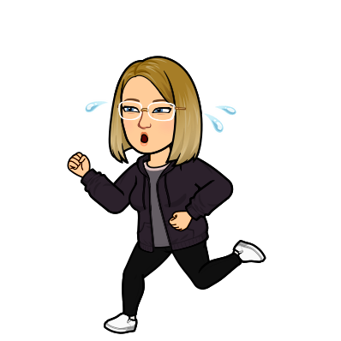
Health and Wellbeing
Back to home screen
We have been working on ways to look after our health and wellbeing, both physical and mental.
P.E. will be outdoors as much as possible for now, with no P.E. kit changes. It is advised that children wear shorts under skirts, a polo top and bring trainers to change into. Pupils can also wear black/grey leggings or joggers on P.E. days. We may still head out in the rain so please come prepared with a waterproof jacket.​
Our outdoor P.E. times are Wednesday and Friday mornings. ​

Slide 5
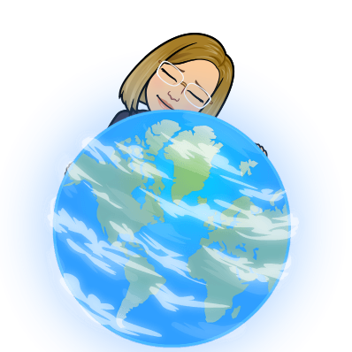
Topic
Back to home screen
Global Goals and Natural Disasters.
Through the topic, we will be covering different areas of the curriculum such as geography, science, art, literacy, maths and health and wellbeing.​
Children will be asked to research some areas of the topic at home.​
​

Slide 6
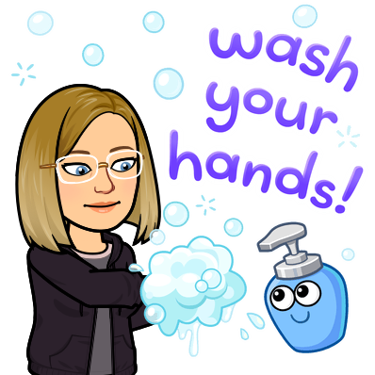
Important Information
Back to home screen
​Our P.E. days are Wednesday and Friday
Children must wash their hands each time they enter and exit the classroom.
Homework to be handed in by Friday.

Slide 7
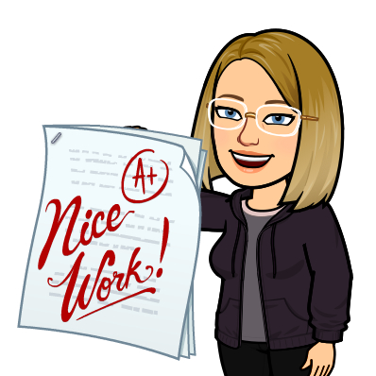
Homework
Back to home screen
​Homework will be issued on a Monday and will be due back in on a Friday. If you would like to hand it in earlier than Friday there is a box to pop it in.
It is given in termly grids of which you can choose one spelling and maths task to do each week.
Reading pages will be issued weekly.

Slide 8
Recognition Board
Back to home screen
In class, we will be celebrating children who meet their target for the week by displaying their names on the recognition board.
This is to focus on positive behaviours and we will reward children at the end of the week on a Friday.​
Targets could relate to attitude, effort, concentration, manners, achievement and anything else that we focus on.​
​

