Slide 1
`
Meet the Teacher – Plan for the Year
Welcome P6 to your virtual classroom!!
Click on an image or word to take you to a website we will be using when we are learning from home ☺
Literacy
Maths
Topic
HWB
Trip to the Library
Password and login details

Slide 2
Return to Classroom
We will be issuing homework online (and when requested using paper) this term to ensure things are set up for home learning.
Your child will be issued with passwords for home learning for the following:
Glow
Sumdog

Slide 3
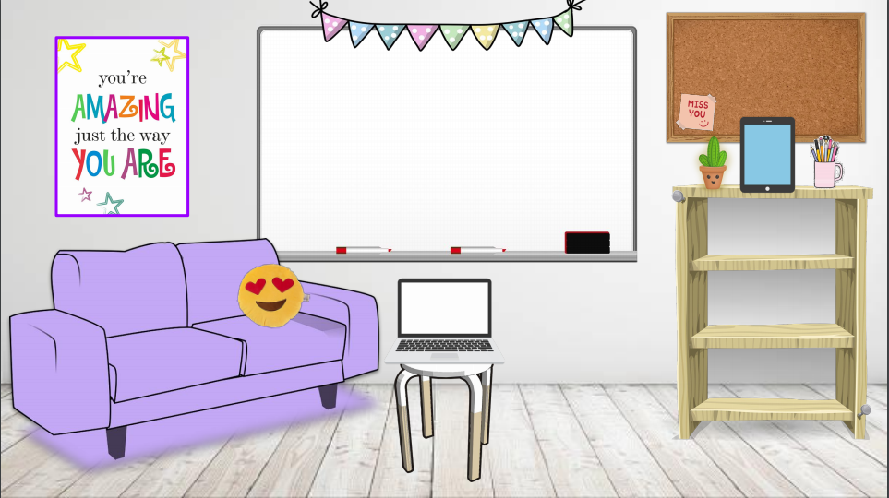
Return to Classroom
Welcome to the Library!
These are some of the books we’ll be covering this term.

Slide 4
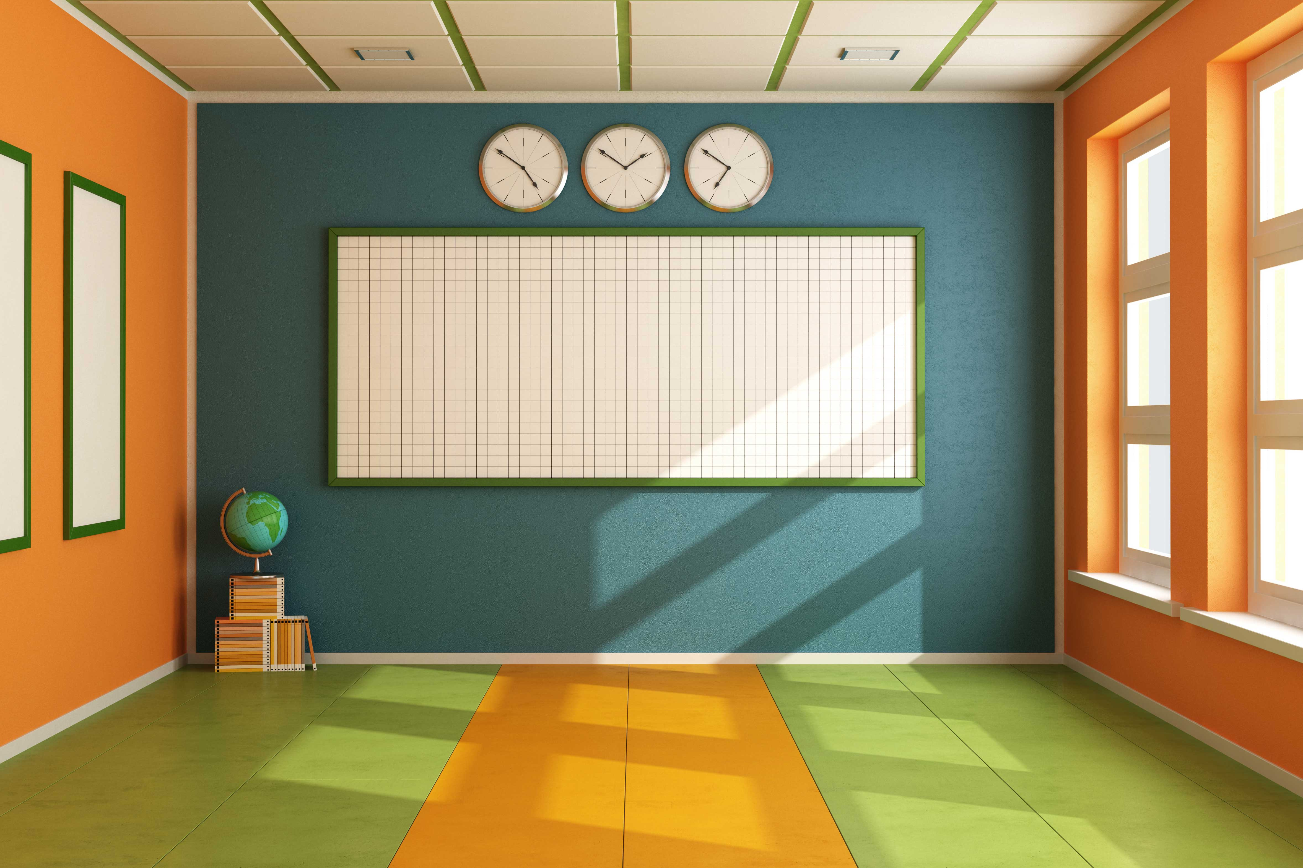
Return to Classroom
Writing:
This term we will be focussing on narrative/imaginative writing and persuasive writing.
Reading:
Novels will be kept in school.
Reading at home is encouraged (books, magazines, comics etc.)
Literacy help:

Slide 5
Return to Classroom
Maths
In class we will be using a variety of worksheets, active maths games and textbooks.
Click here for websites for home learning…..

Slide 6
Return to Classroom
For now PE will be mostly outside.
P.E. Days and outdoor slots will be:
Monday Afternoon (P.E.)
Wednesday Afternoon (outdoor learning)
Friday Afternoon (P.E.)
Please make sure your child is already wearing comfortable shoes, polo shirt and shorts underneath skirts, leggings or joggers.
We may still be outside in light rain so if you can please provide your child with a waterproof jacket or jacket with a hood or replacement clothes.

Slide 7
This term we will be learning about the Global Goals that were set up by the United Nations. We will be doing a range of art, drama, cooking , maths and literacy surrounding this topic.
Return to Classroom

