Slide 1

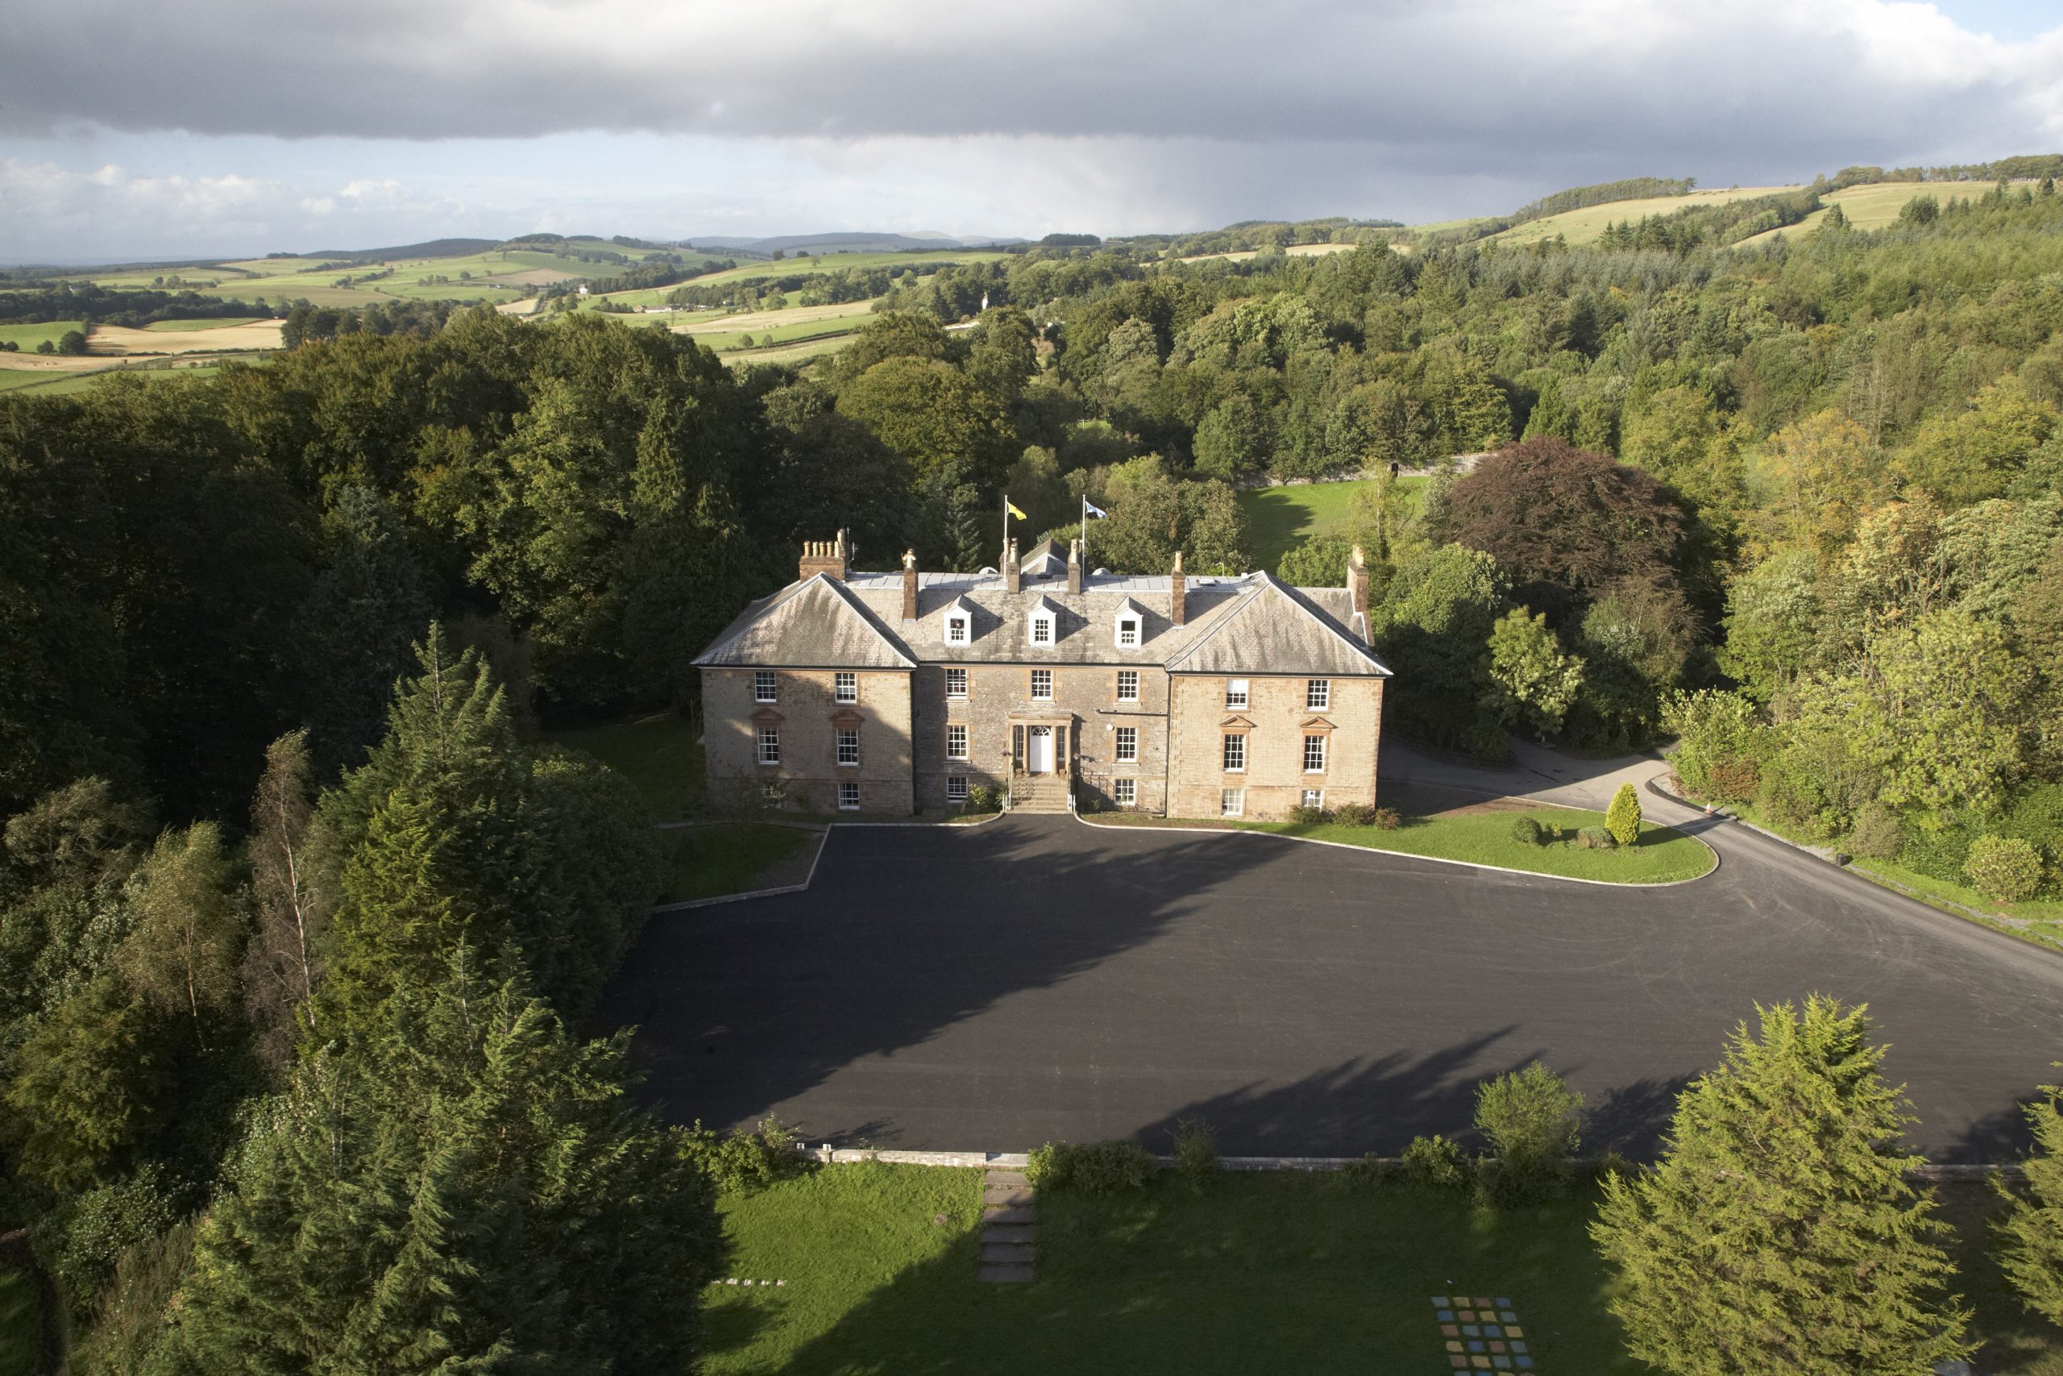
Sacred Heart
P7
Residential Trip
13th – 15th May 2026
Lockerbie Manor

Slide 2
Welcome
Sharing key information
Explain logistics, safety and expectations
Q&A Session

Slide 3
Why Residentials Matter?
Independence
Confidence
Teamwork
Resilience
Communication
Problem Solving
Personal Growth
Leadership Skills

Slide 4
About Lockerbie Manor
Lockerbie Manor is Scotland’s flagship school residential centre, set within 78 acres of woodland in Dumfries & Galloway.
Built in 1814, the manor retains its historic character with original features, such as ornate ceilings and wood panelling, while offering premium facilities including en suite accommodation, a private lake, and a wide range of expertly led activities.
It’s a residential experience that feels both inspiring and personal, where pupils grow in confidence, develop new skills, and create lasting memories.

Slide 5
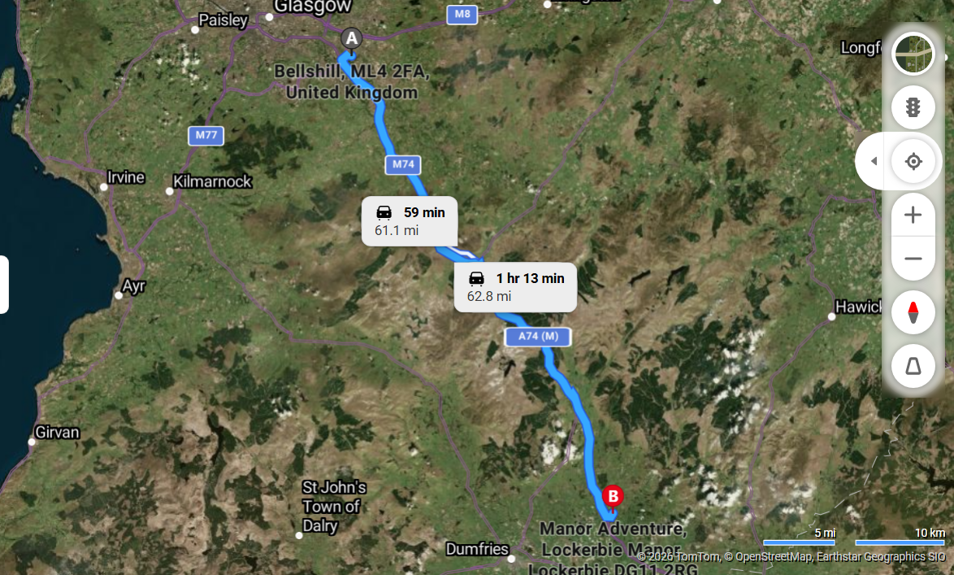
Lockerbie Manor
Lockerbie
DG11 2RG

Slide 6
Dates & Travel Arrangements
Departure - Wednesday 13th May 2026
9am start as usual
11.00 home for change/lunch
12.00 return to school to board bus and set off.
OR
9am school start ready to leave
11.00 am lunch in school
12.00 prepare to board bus and set off.

Slide 7
Arrival at Lockerbie Manor
2.30 arrival time
Settling in time in dormitories
Sorted into groups
Activity Session 1 (Afternoon)
Dinner
Activity Session 2 (Evening)

Slide 8
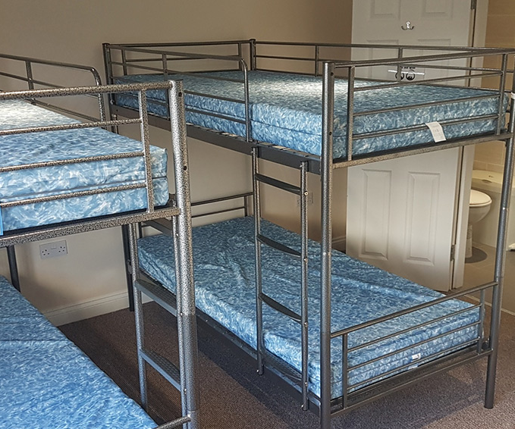
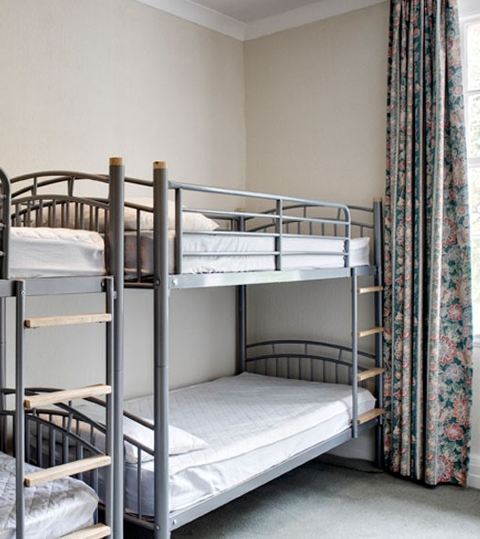
Accommodation & Facilities

Slide 9
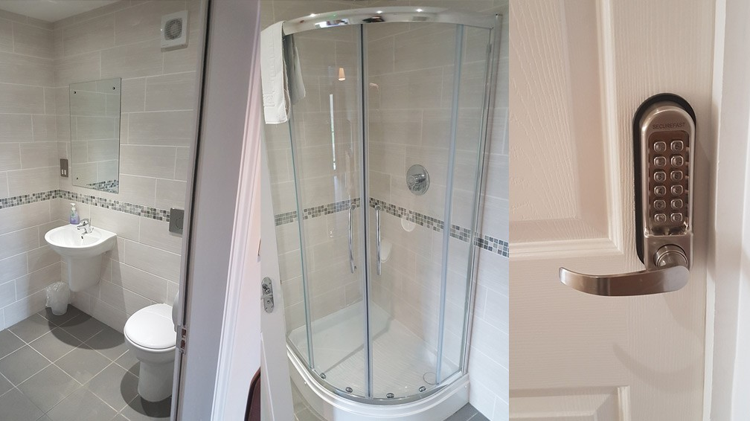
En-suite Facilities

Slide 10
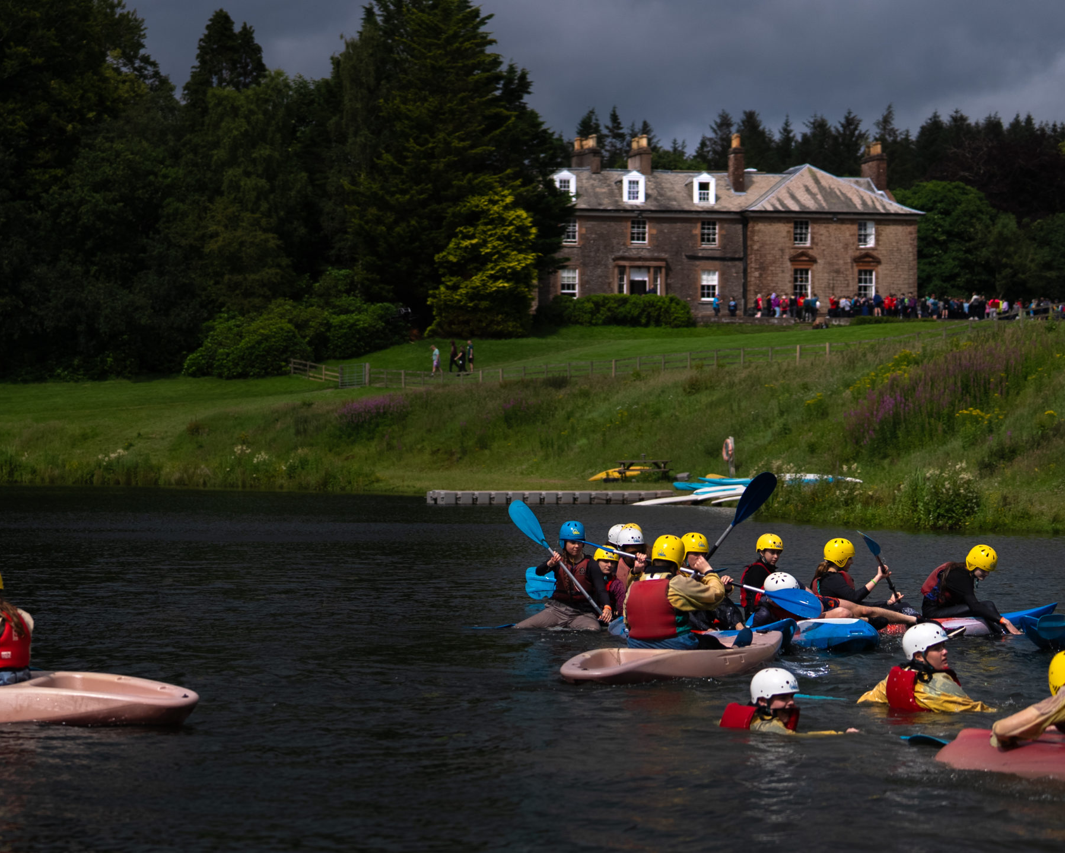
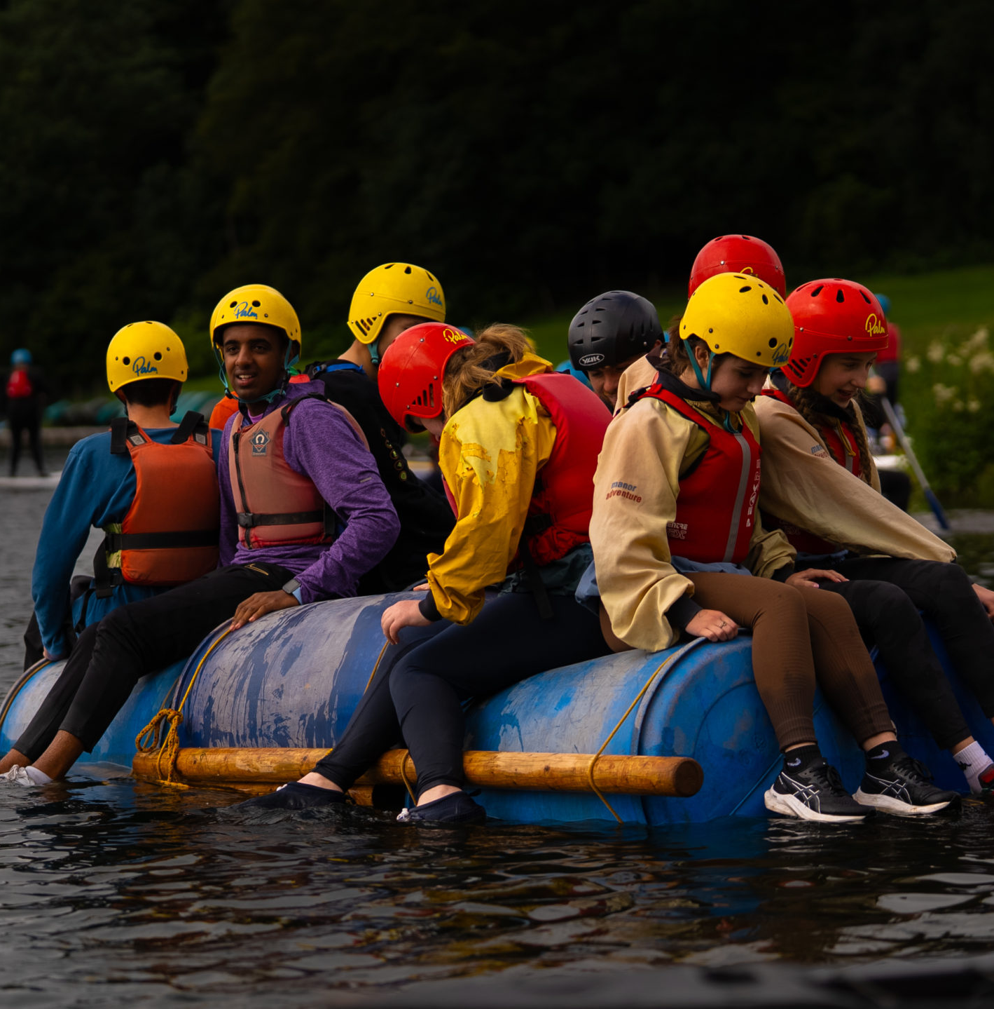
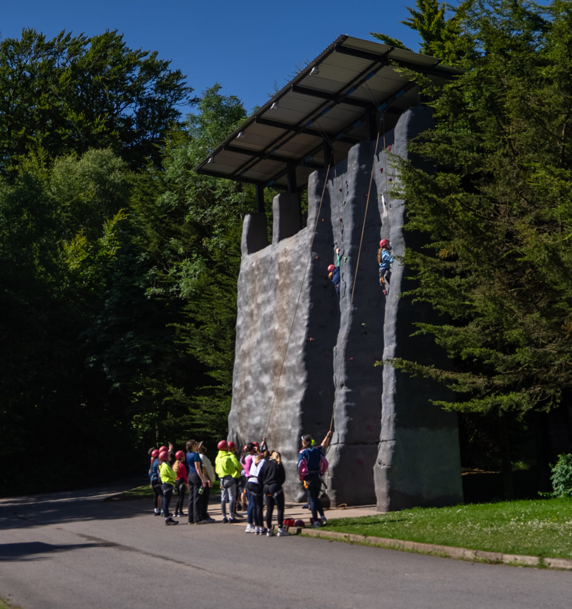
Activities Programme

Slide 11
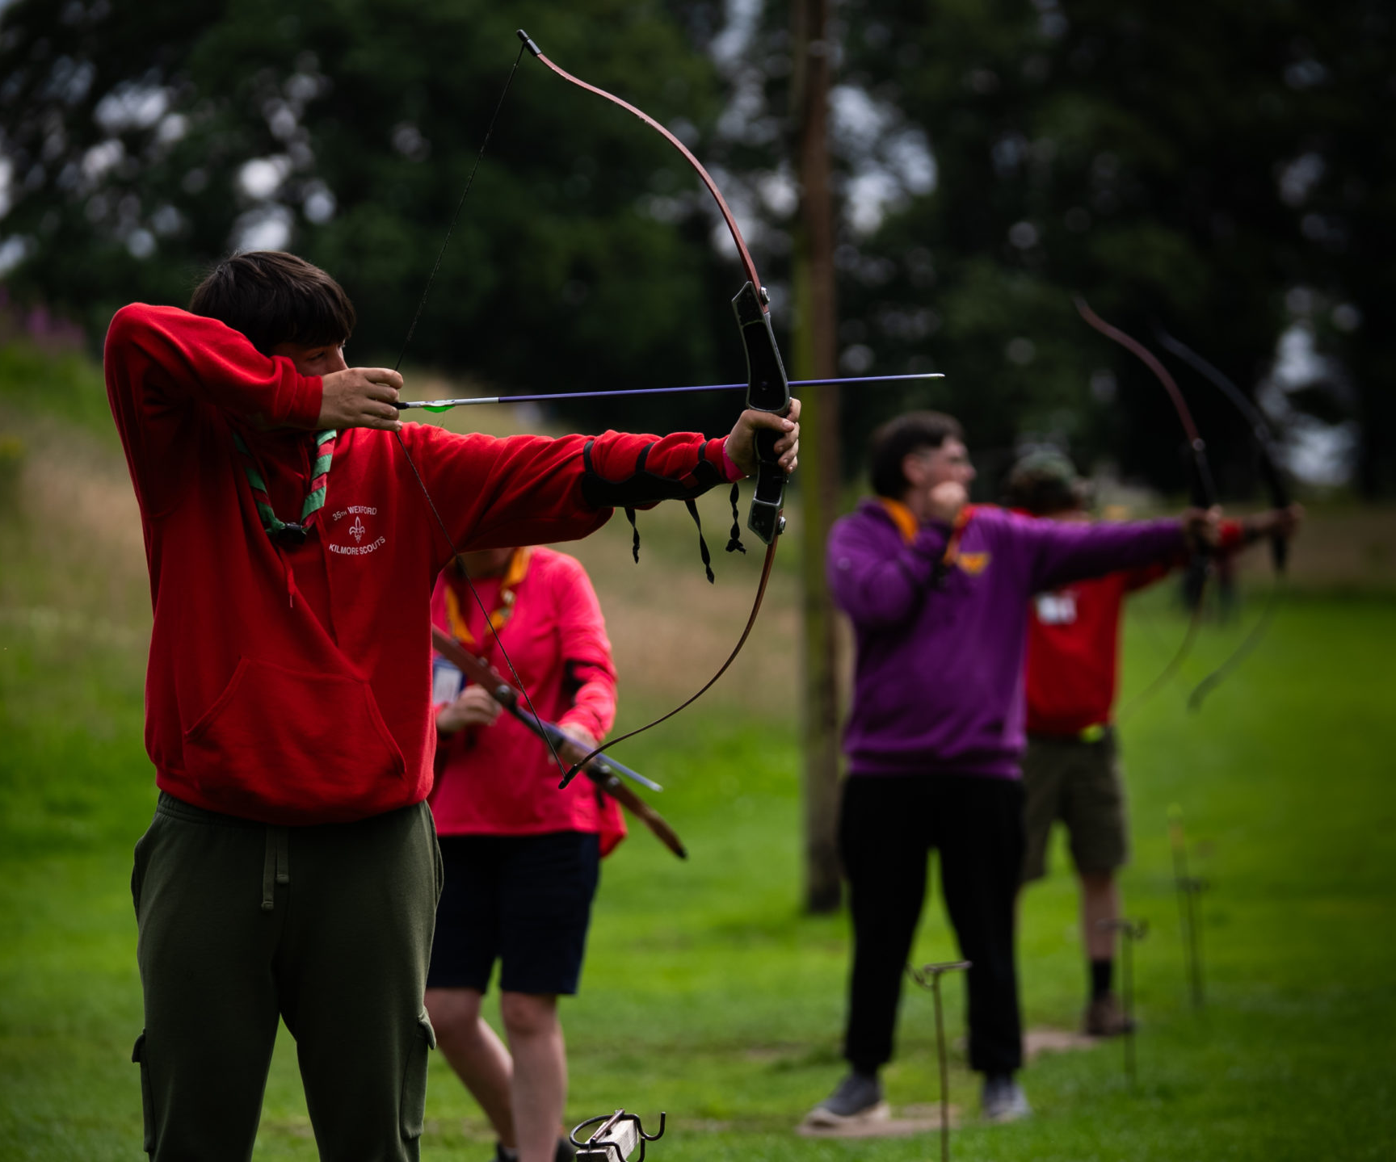
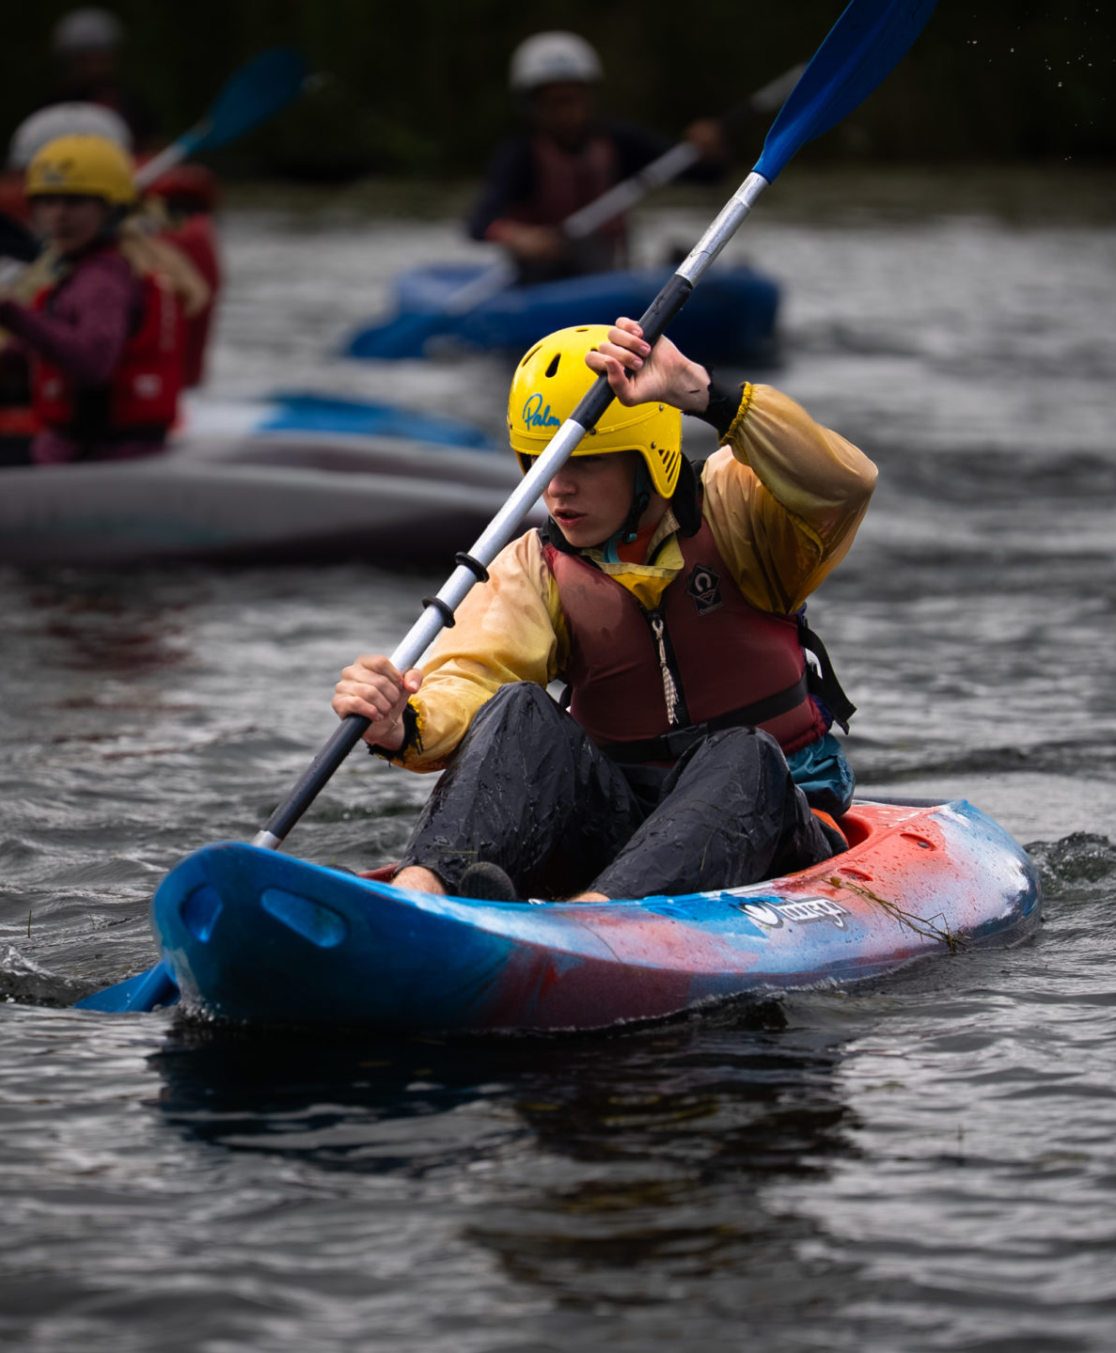
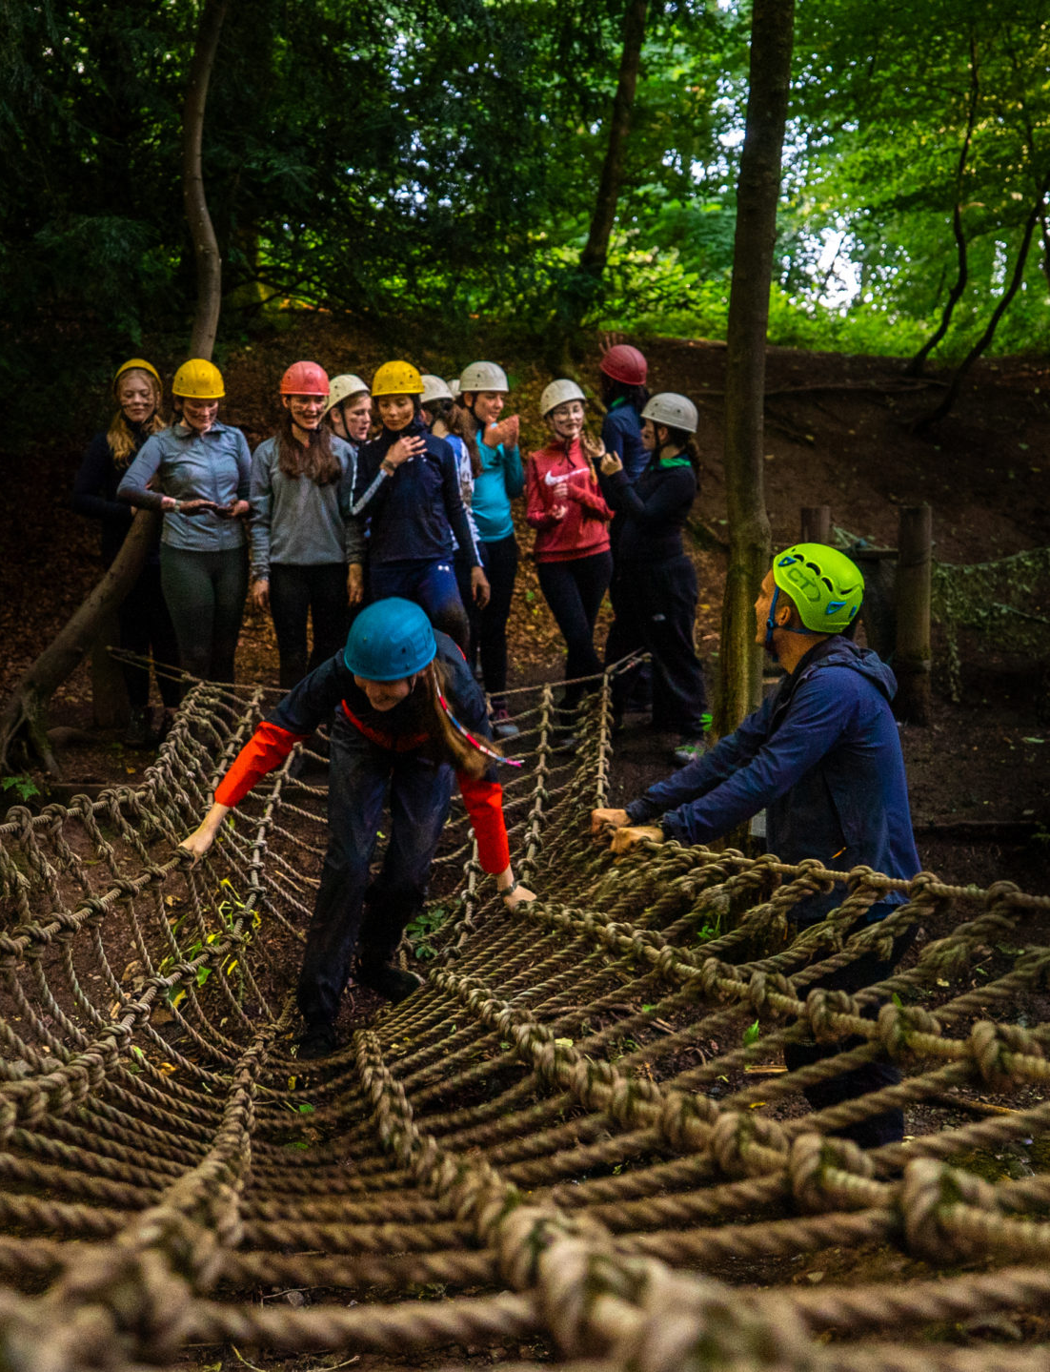

Slide 12
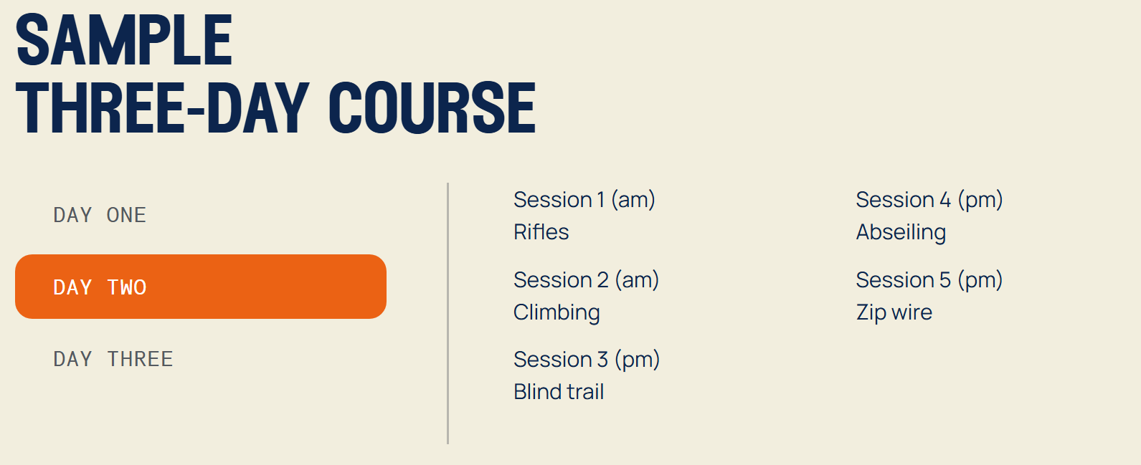

Slide 13
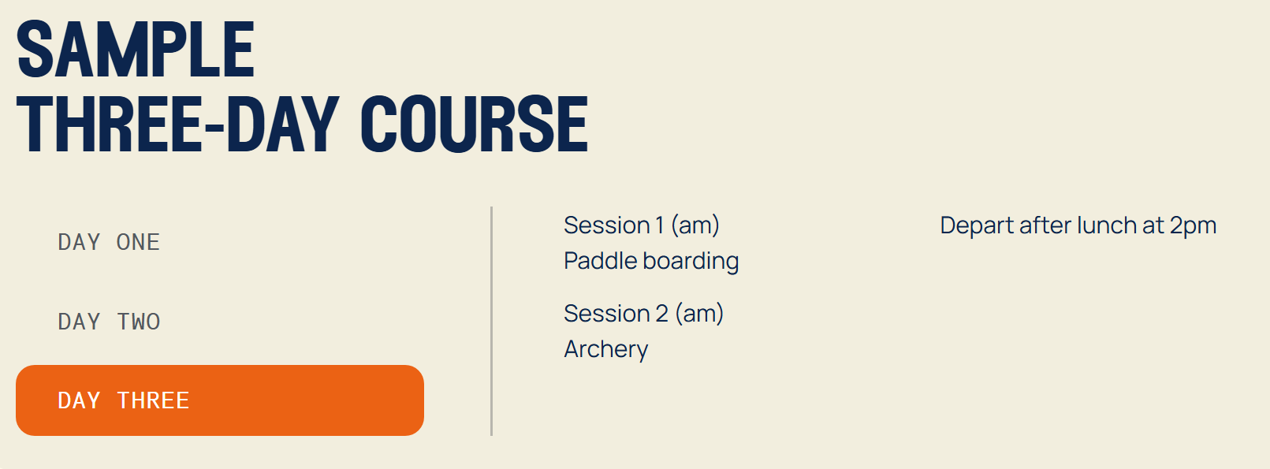
1-1.30pm

Slide 14
Activities
Hill Walking - double session activity
Canoe/Kayak - double session activity
Raft Build
Zip Wire
Film Studies/Video Climbing Blind Trail
Rifle Shooting Quiz Nature Walk
Volleyball Manor Olympics Tug Of War
Scavenger Hunt Orienteering Campfire
Abseiling Team Games
Bivouac Exercises Wide Games
Low Ropes Compass Work
Stand up Paddle Boarding (very wet activity)
Fencing
Archery Disco
Survival Skills Evening Walk
Axe Throwing Obstacle Course
Aeroball Initiative Exercise

Slide 15
Food & Catering
BREAKFAST | MONDAY | TUESDAY | WEDNESDAY | THURSDAY | FRIDAY | SATURDAY | SUNDAY
 | Porridge Sausage Bacon Hash Brown Potato Scone Scrambled Egg Beans Tomatoes Toast | Porridge Sausage Bacon Hash Brown Potato Scone Scrambled Egg Beans Tomatoes Toast | Porridge Sausage Bacon Hash Brown Potato Scone Scrambled Egg Beans Tomatoes Toast | Porridge Sausage Bacon Hash Brown Potato Scone Scrambled Egg Beans Tomatoes Toast | Porridge Sausage Bacon Hash Brown Potato Scone Scrambled Egg Beans Tomatoes Toast | Porridge Sausage Bacon Hash Brown Potato Scone Scrambled Egg Beans Tomatoes Toast | Porridge Sausage Bacon Hash Brown Potato Scone Scrambled Egg Beans Tomatoes Toast
LUNCH | STAFF | 2 x Soups Morning Rolls – choice of 3 fillings Cheese & Bacon Twist Margarita Twist Salad Bar | Chicken Goujons Beef Burger Seasoned Wedges Beans Salad Bar | 2 x Soups Baguette – choice of 3 fillings Steak Bake Nachos Salad Bar | Chicken Burger Scotch Pie Veg Burger Skinny Fries Beans Salad Bar | Cornish Pastie Panini Waffle Fries Spaghetti hoops Salad Bar | Sunday Roast 2 x meat Veg option Yorkshire Pudding Gateaux
DINNER | Chicken Curry Beef Hotpot Gravy Rice Naan Mixed Veg Cold Dessert | Lasagne Garlic Bread Southern Fried Chicken Chips Hot Dessert | Steak Pie Roast Chicken Mashed Potatoes Carrots Cold Dessert | Breaded Fish Carbonara Chips Peas Hot Dessert | Stew & Dumplings Breaded Chicken Mushroom sauce Mash Carrots & Peas Cold Dessert | Meatballs in Gravy Chicken Kiev Baby Mids Cauliflower Cheese Hot Dessert | STAFF

Slide 16
Packing & Kit List
See information sheet provided.
No aerosols
No electronics
No MOBILE PHONES
Snack/sharing sweets

Slide 17
Medication/Allergies
Prior to trip we will issue medical forms for you to return.
Bring medication on day of trip and hand to staff.
Travel sickness medication, let staff know in advance. (Return journey)

Slide 18

Behaviour Expectations
Be Safe
Be Ready
Be Respectful

Slide 19
Communication
Daily updates via X
Message to parents/carers on arrival
Message of estimated time of arrival home
Staff remain in daily contact with school
Only be contacted in case of emergency.
No mobile phones

Slide 20
Costs & Payments
Final Balance Due 4th March 2026
Lockerbie Manor £272 per pupil
Transport Cost covered through fundraising from
- Church Donation
Football Cards
Christmas Fayre
Please return unsold football cards to school asap. (Audit)
Spending Money – Max £5 (to be brought in week prior to trip)

Slide 21
Questions?
Alessandro Rimola, School Journey Advisor, Manor Adventures.
https://teams.microsoft.com/meet/38409213617329?p=ZmoJ4oARMYpJlrLiIt
Meeting ID: 384 092 136 173 29
Passcode: 2T6Mz6oE

