Slide 1
Christmas
Writing

Slide 2
Chapter 1
Describe Christmas Eve
Introduce your characters. Who is the hero?
BE DECRIPTIVE!
What Openers and WOW words can you use?
Introduce the problem – The family have gone missing.
Find something magical – bauble? Snow globe?
Leaving point – Riddle that leads your character to New York
Grammar Focus – Adjectives, WOW words
You can use your own riddle or use the one provided by Mrs Donnelly – Find in Red Christmas Writing box in Room 13

Slide 3
Chapter 2 – New York
https://www.youtube.com/watch?v=T8wV_znPvyo
NYC from 48 seconds in
Remember the landmarks you see!
Yellow taxis Brooklyn Bridge
Rockefeller Christmas Tree Toy store
Central Park

Slide 4
Chapter 2 Plan
Describe New York at Christmas
Where is the next clue? Statue of liberty? Empire state? Special Christmas Toy Shop?
Find or be given an angel? What does the angel represent? Your character should start to make links between angel and Nativity story.
Leaving point- Rub the magic item and head for Washington DC – Use your own riddle or one from Mrs Donnelly (in red tray)

Slide 5
Chapter 2 – Page border
Design and create a border that has a NYC theme to it.
How can you do this?
New York skyline? Yellow Taxi? Statue of Liberty?
Have a look at the next slide for ideas

Slide 6
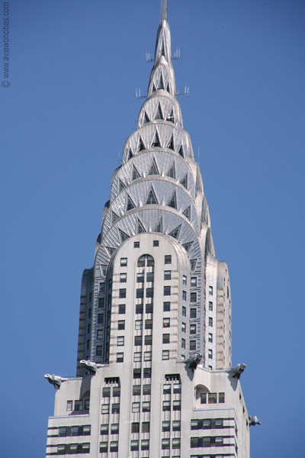
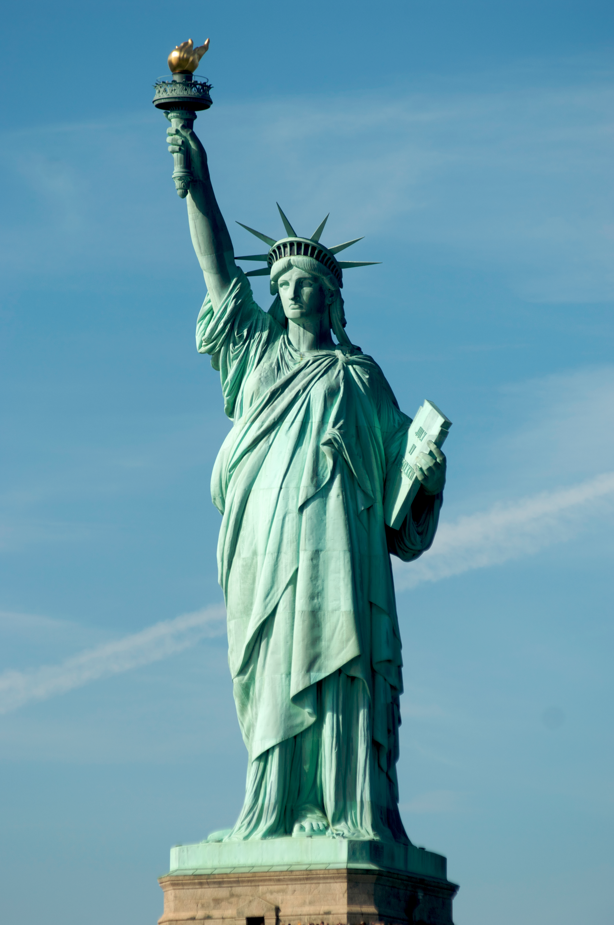

Slide 7
Chapter 3 The White House
https://www.youtube.com/watch?v=98U2jdk8OGI
As you watch, think of all the words that you can use to describe how grand the White House is.

Slide 8
Chapter 3
Describe the white house at Christmas. Do the security guards chase you?
Where in the WH is the next clue? Is it the oval office? Library? The President’s meeting room?
Give or find a small donkey bauble. Why is the donkey important? riddle appears – Head to North Pole

Slide 9
Chapter 4 – Santa’s Workshop
Describe Santa’s workshop. What does Santa want from your character? (Find the true meaning of Christmas)
Explain religious meaning of the holiday
Find magic key to open door to reveal your family.
Add alliteration
Ending, back at home on Christmas eve
KEY INGREDIENTS- similes, alliteration, OPENERS (a must), WOW words, describe what your character can see, feel , think etc

