Slide 1
Judo
By Hannah Malcolm

Slide 2
Judo facts
Judo is an Olympic sport.
It was created in Japan by a man called Jigoro Kano.
It was created in 1882.
The word judo means ‘gentle way’.

Slide 3
Judo kit
The Judo kit is called a Judogi.
The belt is called an Obi.
The part that folds over is called the Lapel.

Slide 4
Grip Game

Slide 5
Basic Judo Words
Hall – Dojo
Mats – Tatami
Teacher – Sensei
Start – Hajime
Stop – Matte

Slide 6
Judo Belts

Slide 8
Favourite throws
O Goshi

Slide 9
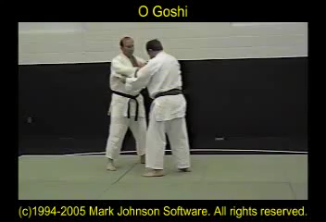

Slide 10
Favourite throws
Ippon Seoi nage

Slide 11
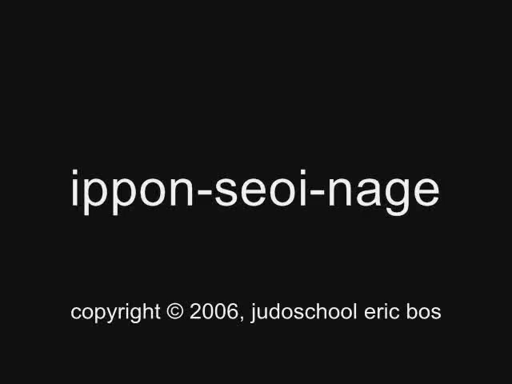

Slide 12
Tomoe nage

Slide 13
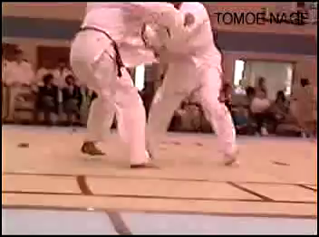

Slide 14
Hold down

Slide 15


Slide 16
Top 5 Judoka

Slide 17


Slide 18
Famous Scottish Judoka

Slide 19
Euan Burton
D.O.B- 31st March 1979 (age 38)
Height- 1.82
Weight- 81 kg
Education- University of Edinburgh
Commonwealth Games Gold

Slide 20


Slide 21
Louise Renicks
D.O.B- 11 September 1982
Height- 1.6 m
Parents- Thomas Renicks, Agnes Renicks
Siblings- Kimberly Renicks, Thomas Renicks Jr
Won Commonwealth Games Gold

Slide 23
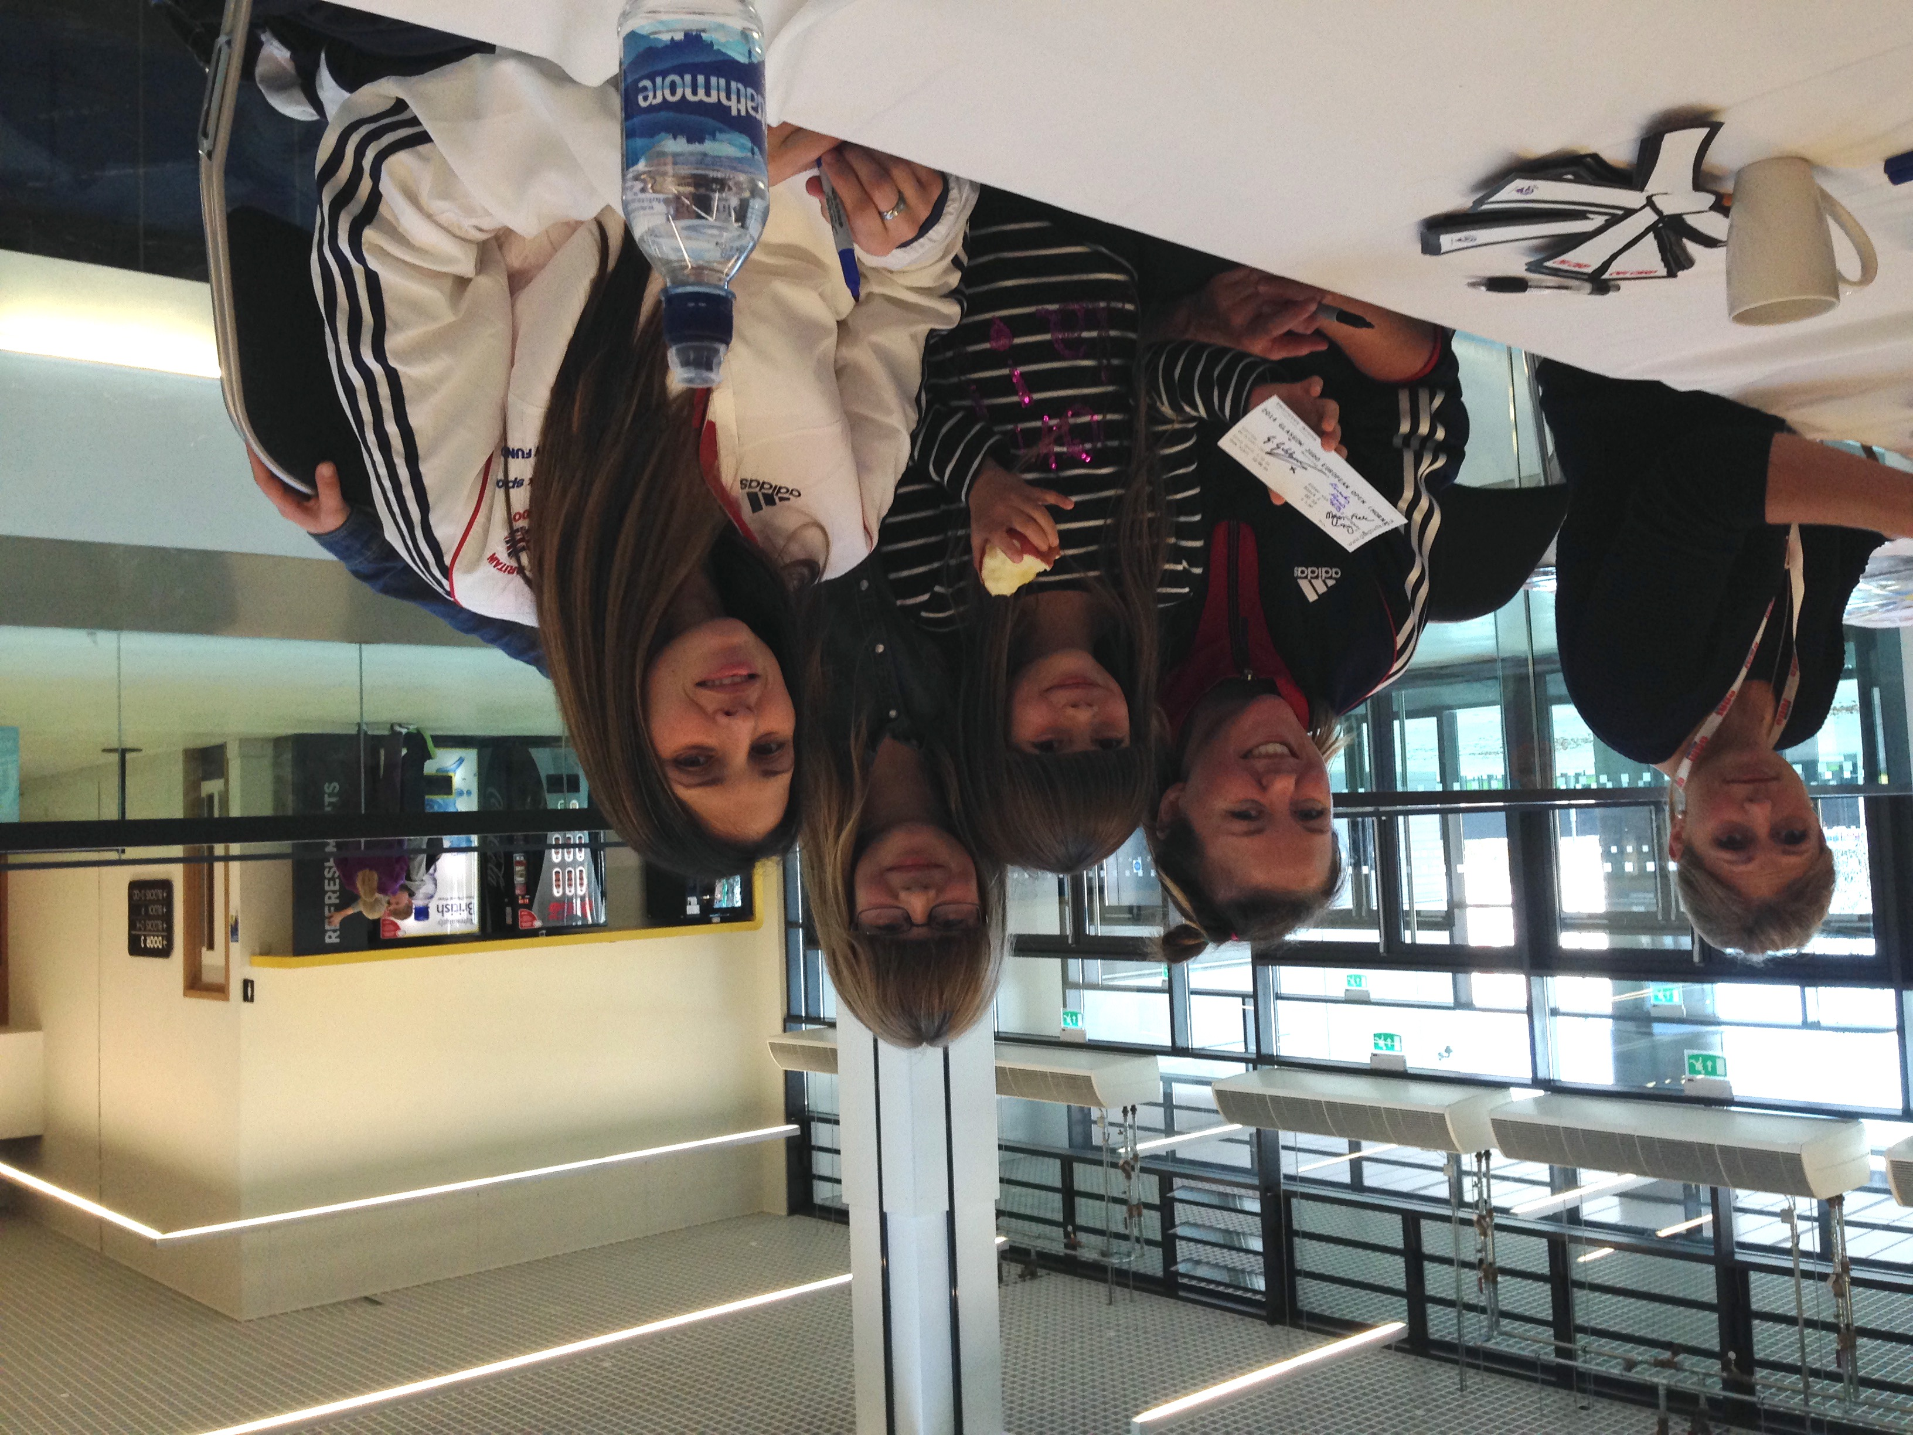
Me and Kimberly Renicks, Connie Ramsay and Gemma Gibbons

Slide 24
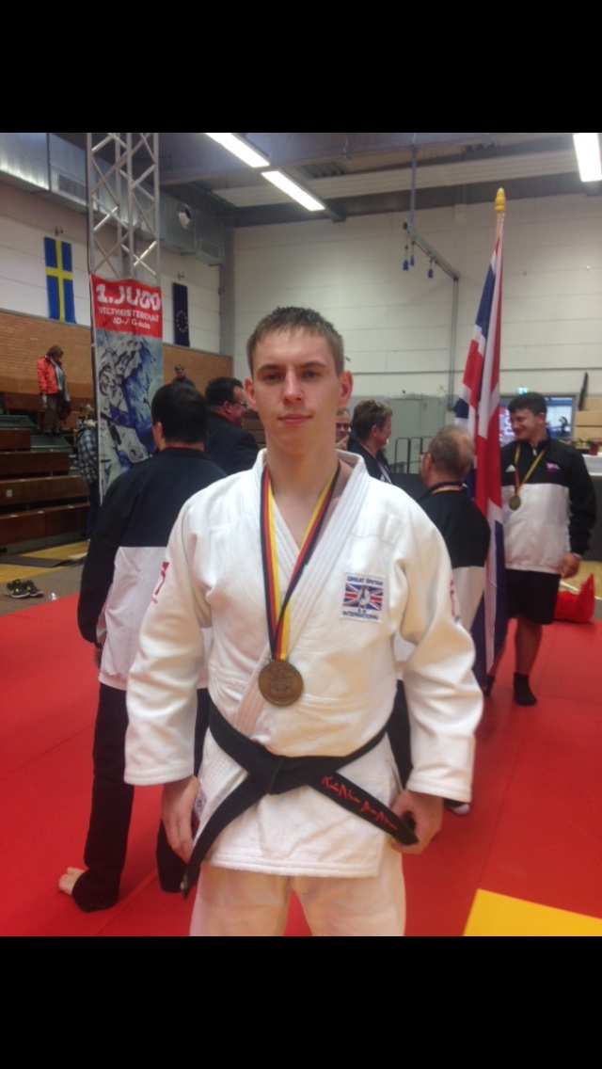
Chris Murphy
D.O.B- 13 October 1994 (23 years)
Weight- fights Under 81 kg
Favorite throw- Uchi Mata
Favorite hold- Tate Shiho Gatame

Slide 25
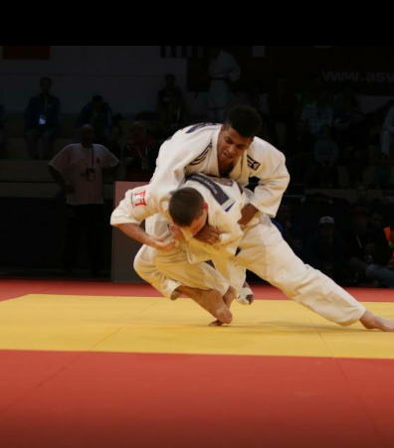

Slide 26
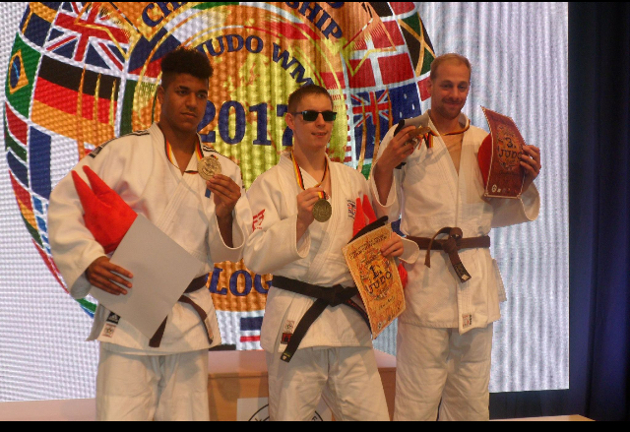
Chris at the world ID Championships

Slide 27
Quiz

Slide 28
1. When Was Judo Created?
a. 1882 b. 1888 c. 1881
1882

Slide 29
2. What is the Japanese word for Go?
a. Matte b. Hajime c. Sayonara
Hajime

Slide 30
3. What does the word Judo mean?
a. Gentle way b. Japanese way c. Peaceful way
Gentle Way

Slide 31
4. What is the Judo belt called?
a. Obi b. Tatami c. Matte
Obi

Slide 32
5. What does matte mean?
a. Start b. mats c. stop
stop

Slide 33
6. Who created Judo?
a. Louise Renicks b. Jigoro Kano c. Shohei Ono
Jigoro Kano

