Slide 1
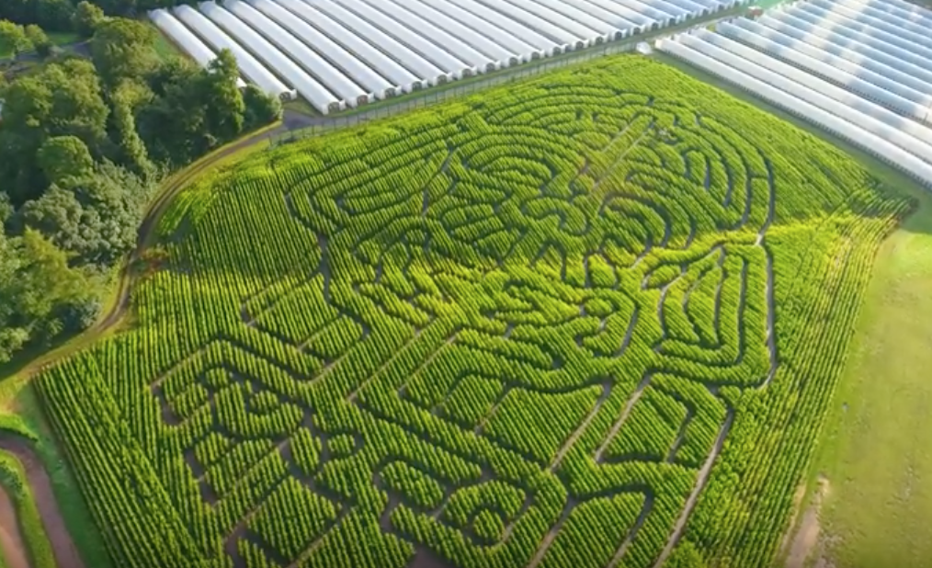
What do you see?
How was it the picture/video taken?

Slide 2
There are two types of Drone
Multi-Rotors
Unmanned Aerial Vehicles (UAV)

Slide 3
UAVs
A UAV is an aircraft capable of unmanned flight
They are usually fixed-wing which means they can glide
They are used for civilian applications but mostly used by the military today
We will talk more about multi-rotors because they are probably more fun

Slide 4
Multi-Rotors
A multi-rotor is a rotary aircraft with more than two rotor systems
They have some different parts
Propellers or rotors – they spin to lift the drone into the air
Motors - to drive the Propellers
Frame
Battery – to power the motors
Speed Controller - to control the motors
Transmitter/Receiver - for communication with the remote control unit on the ground
4G connection – for live video streaming
Camera - for taking cool pics

Slide 5
Drones can be used for lot’s of good things.
Can you think of any?

Slide 6
Delivery Drones

Slide 7
Inspection Drones

Slide 8
Medical Drones

Slide 9
Police Drones

Slide 10
News Drones

Slide 11
Farming Drones

Slide 12
Drone Taxi’s

Slide 13
Taking cool pictures

Slide 14
DRAW a cool Aerial drone view
Something like this
….or this
…or this

Slide 15
Lesson Plan (check if I can use PPT and show a Youtube video https://youtu.be/lennuAyoa_Y
Introduction
Watch the Video
How was it taken? - hands up
Chocolate to person with correct answer
How do Drones work?
Show my wee drone flying
Explain that with PPT
Do you know some interesting ways that Drones are used
Collect some answers from the class (chocs for good answer)
Then show my list
Show some good examples of drones being used (just cool pictures)
Ask everyone to draw cool drone view

