Slide 1
London 2012 Olympic and Paralympic Games What’s it all about?

Slide 2
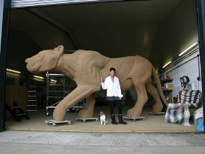
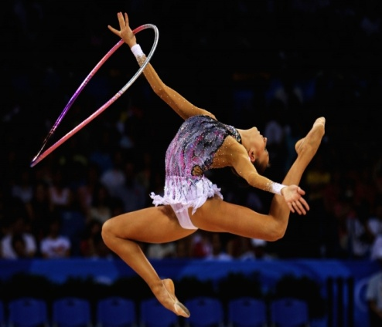
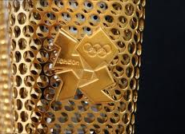
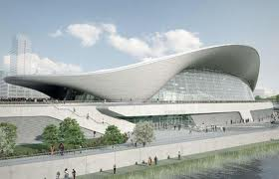
A whistle stop tour of the Games The perfect marriage - Sport, Culture and Education
A brief history of the Olympic and Paralympic Games
Values and ethos; more than just a sports competition
Making the spectacular; the influence art and design on the Games

Slide 3
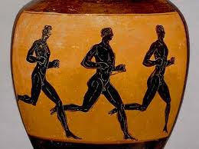
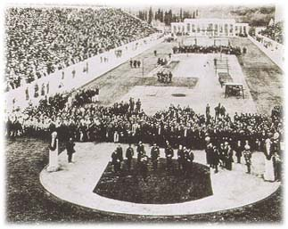
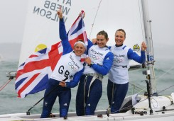
Some facts about the Olympic Games:
Date of first Olympics (Ancient):
776 BC (almost 3000 years ago)
Date of first Olympics (Modern):
1896 (115 years ago)
First Modern Olympics held:
Athens, Greece
Olympic Motto:
‘Citius – Altius – Fortius’
Olympic Creed:
‘The most important thing is not to win but to take part, just as the most important thing in life is not the triumph but the struggle. The essential thing is not to have conquered but to have fought well.’
Notes:
The FIFA world cup is the sporting event that children and young people know the most about – comparing the Games to the world cup helps to give an idea of just how massive an event we are going to stage in 2012 – expect some wows when you say that we will sell 9 million tickets!!!

Slide 4
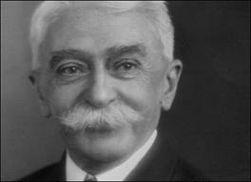
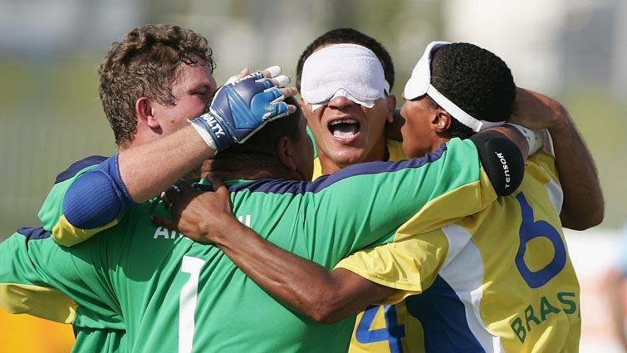
Some facts about the Paralympic Games:
Date of first Stoke Mandeville Games:
1948
Date of first official Paralympic Games:
1960
Origins of the title Paralympics:
From the word Parallel (from the Greek preposition ‘para’ ) and Olympics – to illustrate how the two games exist side by side
Paralympic Motto:
‘Spirit in motion’
Paralympic Vision:
‘To enable Paralympic athletes to achieve sporting excellence and to inspire and excite the world.’

Slide 5
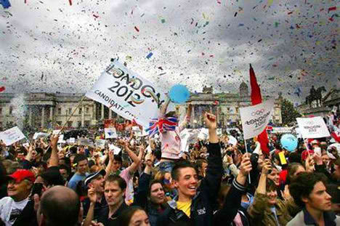
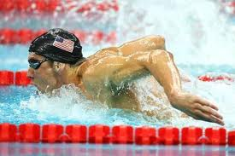
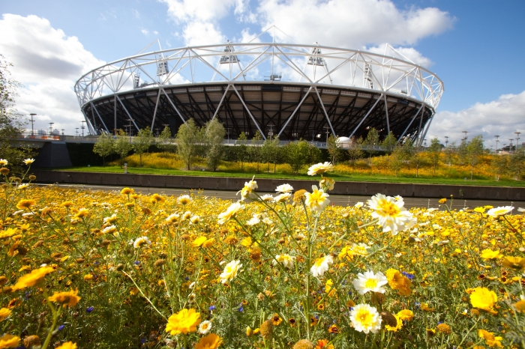
The scale of the London
2012 Olympic Games
Total number of Countries
205
Total number of Athletes
15,000
Global Audience
4 billion
Tickets
Over 9 million
Sports
Olympics – 26 (302 events)
Paralympics – 21 (471 events)
Venues
Competition venues – 36
Training venues – 41
Non - competition venues – 70 +

Slide 6
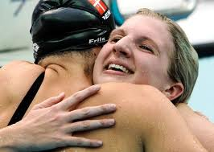
Olympic and Paralympic Values
Friendship
Respect
Excellence
Inspiration
Determination
Courage
Equality
What do they mean to you?
Notes:
We are inviting children and young people across the country to lead Paralympic Handover celebrations – we’ve even created a website to help you with some ideas etc…

Slide 7
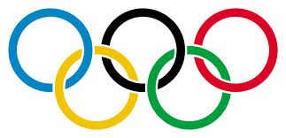
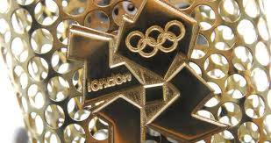
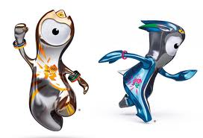
Understanding the meaning behind it
Olympic rings: Five intertwined rings to represent the unity of the five inhabited continents . Their colours - blue, yellow, black, green, and red - chosen because every nation had at least one of them on its national flag.
Olympic Flame: One of the enduring symbols of the Olympic Games, representing peace, unity and friendship. Every host nations creates it own
unique design.
Olympic Mascots: An animal or human figure representing the cultural heritage of the host country.

Slide 8
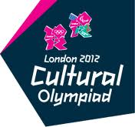
London 2012 Cultural Olympiad
Discovering Places: inspiring people in the UK to discover
their local built, historic and natural environment.
Film Nation: Shorts giving 14-25 year olds the chance to
make films celebrating the values of the Olympic and
Paralympic Games.
Legacy Trust UK: 16 programmes with more than 100 arts,
sports and education projects taking place across the UK
New Music 20x12: 20 composers and arts organisations bringing exciting new music to London’s Southbank Centre, and inviting the audience to hear their works, meet them and take part in workshops
Stories of the World: get young people working with curators, filmmakers, artists, writers and musicians to explore and reinterpret museum collections, giving a new perspective on the stories that tell us about our place in the world.
Artists Taking the Lead:
Artists have been encouraged to use the UK as a blank canvas

Slide 9
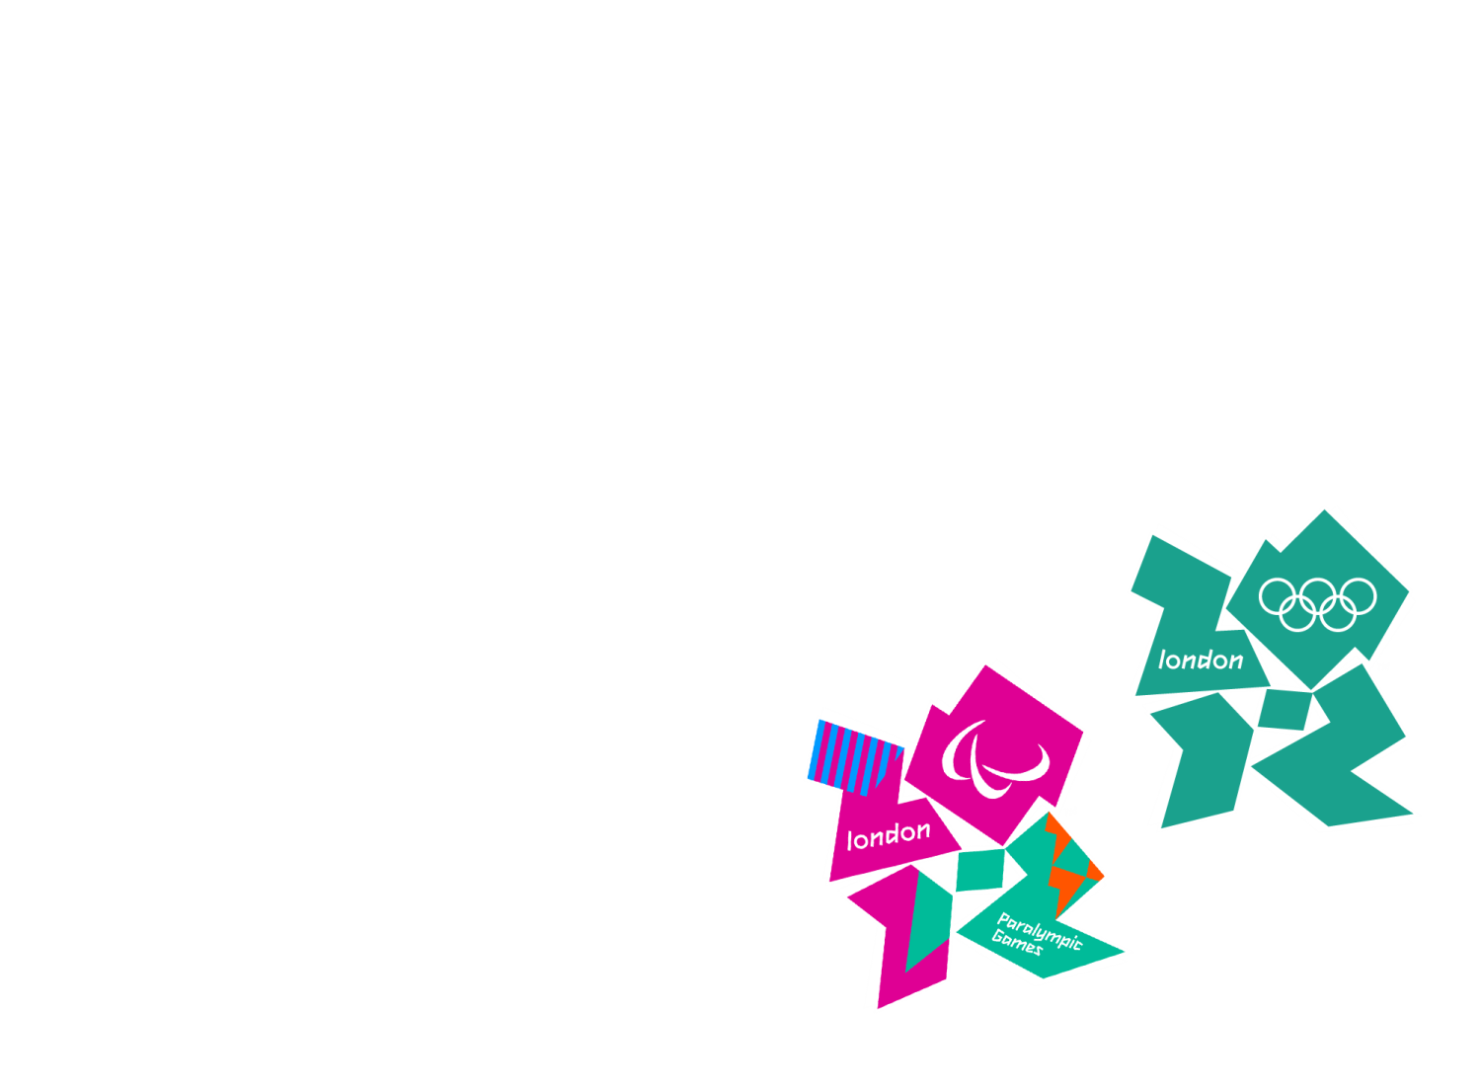
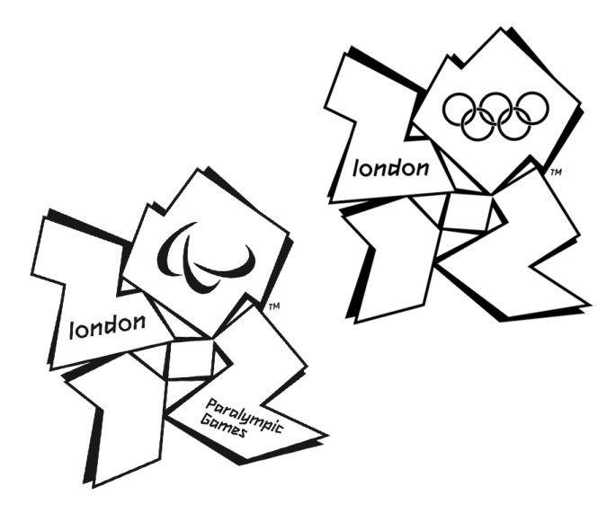
Thank you & Questions
The official Emblem of the London Organising Committee of the Olympic Games and Paralympic Games Ltd is protected by copyright. © London Organising Committee of the Olympic Games and Paralympic Games Ltd 2007. All rights reserved.

