Slide 1

What’s on at Lawmuir?
Lunch Menu
Week 2
Week Beginning 21st September 2026
Monday 21st September
Breakfast Club 8.15am
Cluster Support Teacher in School (pm)
Tuesday 22nd September
Breakfast Club 8.15am
School Assembly
P5 Swimming Sessions
Fire & Rescue Visit
Wednesday 23rd September
Breakfast Club 8.15am
R3 Uddingston Hockey Club Sessions (pm)
Uddingston Hockey Club After School Club
Thursday 24th September
Breakfast Club 8.15am
Whole School Assembly 11am
Friday 25th September
September Weekend Holiday – School Closed
Monday 28th September
September Weekend Holiday – School Closed
Tuesday 29th September
Change to advertised Lunch Menu due to delivery
Schedules
Spanish chicken
Fishless fingers
Cheese or Chicken sandwich and Lentil soup
Be Safe - Be successful - Be Sensible - Be Smart

Slide 2

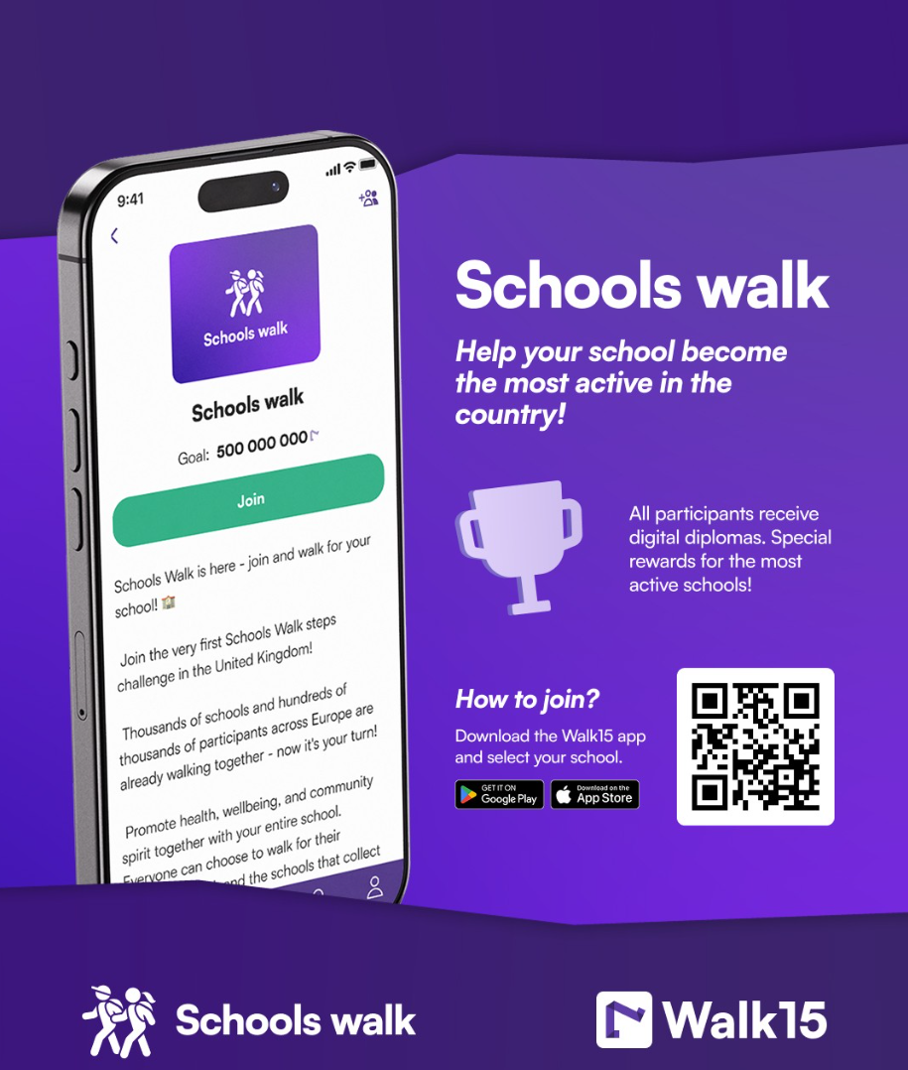
Walk 15
Download the app and join us in the challenge! Open to the whole community!
Safe Parking
Please park safely in and around the school. Please do not pack on the pavement.
We all need to work together in order to prevent an accident from happening. We will continue to work with the community police to ensure everyone is safe.

