Slide 1

What’s on at Lawmuir?
Lunch Menu
Soup & Sandwich Only
Week Beginning 27th October 2025
Monday 27th
Breakfast Club 8.30am
Class visits to Orbiston Community Hub
Tuesday 28th
Breakfast Club 8.30am
Class visits to Orbiston Community Hub
Wednesday 29th
Breakfast Club 8.30am
CSI Bellshill – P7 meet at Bellshill Academy for 9am
Thursday 30th
Breakfast Club 8.30am
Friday 31st
Breakfast Club 8.30am
Dress Up Day for Halloween
Last Day in Lawmuir PS Current Building
Dates for your Diary
October
Monday 27th October – class visits to New School
Tuesday 28th October – class visits to New School
Wednesday 29th October– P7 Transition – CSI Bellshill
Friday 31st October – Halloween Dress Up Day
November
Monday 3rd November – School Closed to Pupils
Tuesday 4th November – School Closed to Pupils
Wednesday 5th November – All pupils start in New Orbiston Community Hub
Thursday 13th November – Parents Appointments
Monday 17th November – Inset Day 3 - School Closed to Pupils
December
18th December - Friday 2nd January – School Closed – Christmas Holidays
Monday 5th January – Pupils Back in School
Be Safe - Be successful - Be Sensible - Be Smart

Slide 2
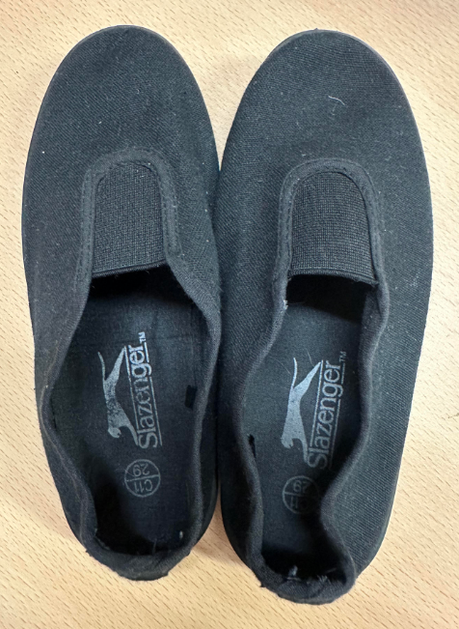
Moving to Orbiston Community Hub
All pupils will move to Lawmuir Primary School within Orbiston Community Hub, at Orbiston Community Hub, Babylon Road, Bellshill, ML4 2FA From Wednesday 5 November 2025.
The Council has also received approval from the Scottish Government for an exceptional school closure for Monday 3rd and Tuesday 4th November 2025 for pupils. These closure days will be used to support staff to relocate effectively before pupils return on 5 November 2025.
Class Hub Visits
Over the next week all pupils will have the chance to visit the new school with their teacher. This will help alleviate any concerns they may have about the move.
Change to Lunch Mon 27th – Fri 31st October
This week lunch options will change. This is to allow Catering staff to move equipment and resources to the new community hub. Pupils will be able to choose soup and a sandwich with a range of fillings. There will be no other items available. Pupils are still able to bring a packed lunch with them as usual.
Lawmuir Primary School – School Day Timings
Lunch in the new hub will be from 12.35pm – 1.20pm.
Breakfast Club – New Hours
Breakfast club hours will change from Wednesday 5th November when we move to the new community hub. Breakfast Club will run from 8.15am – 8.45am each morning. Menu will not change.
Tuck Shop
From Wednesday 5th November when we move to the new building, pupils who have money on their lunch account will be able to visit the tuck shop operated by the catering staff. The Tuck shop will sell a range of healthy snacks such as fruit, milk & popcorn. Only children who have money on their card will be able to access this service.
Change of Shoes
Pupils should bring to school a pair of
black plimsoles (labelled with their
name – both shoes). Pupils will change
into these indoor shoes when coming
into the building. These shoes should
be kept in school and be for indoor use
only. Pupils will be allocated a space to
keep their shoes in the cloakroom.

