Slide 1
Our families
I understand that families are made up of lots of different people who care for us.
I can think about my own family.
I know that I have a right to be cared for in certain ways and why this is important.
I know that care can be different and come from different people.
I understand there are lots of types of family.
I appreciate that everyone comes from different kinds of families.
I am learning to respect how people’s lives are different.

Slide 2
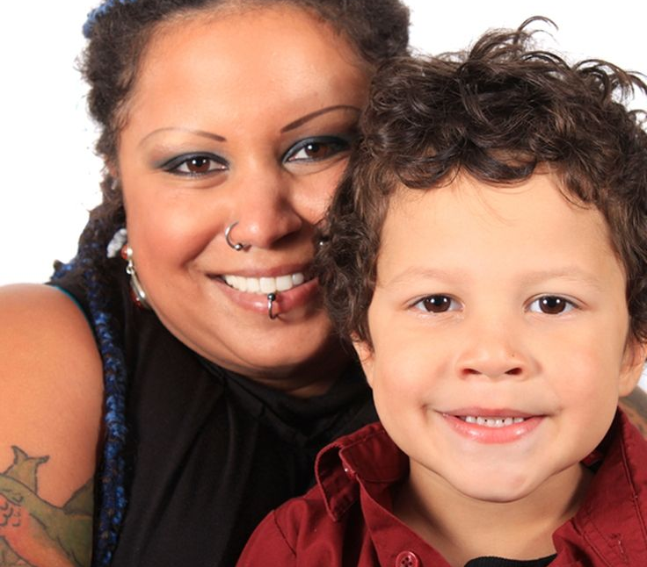
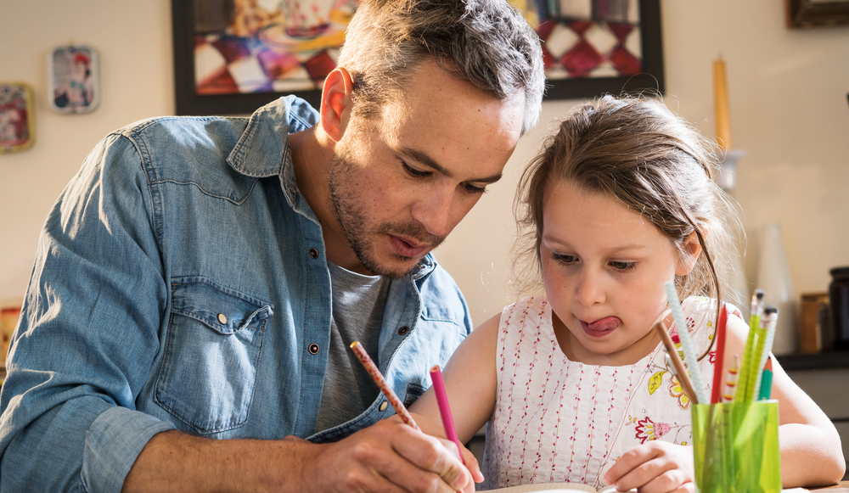
Some families are small.

Slide 3
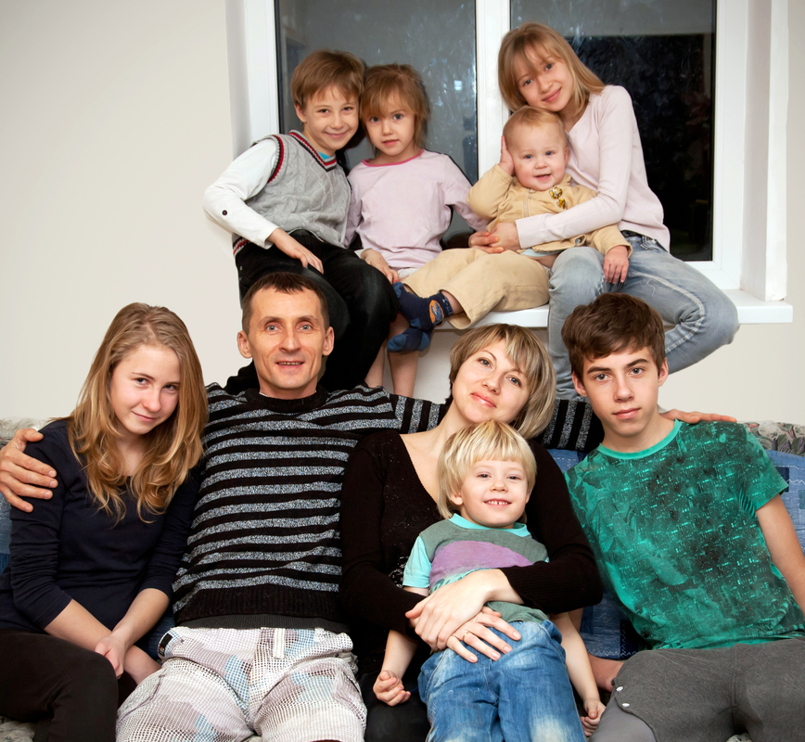
Some families are big.

Slide 4
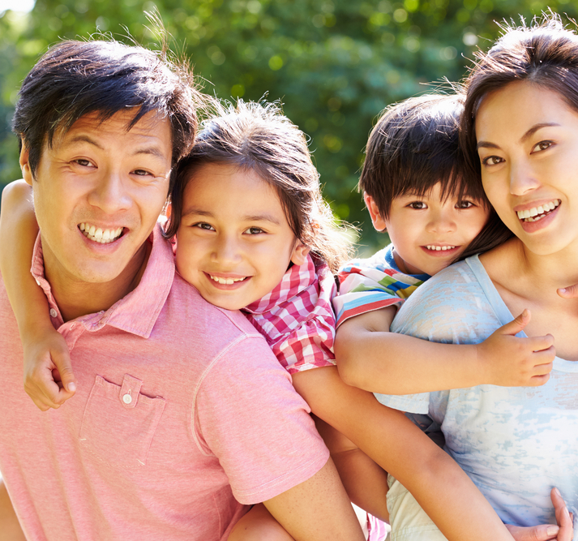
Some families have a dad and a mum

Slide 5
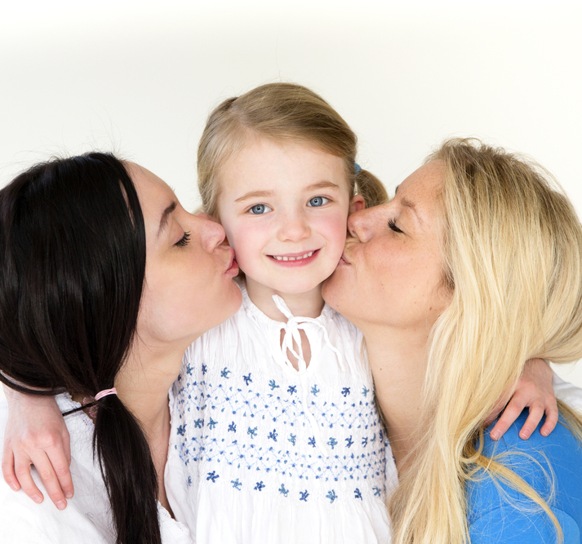
Some families have 2 mums.

Slide 6
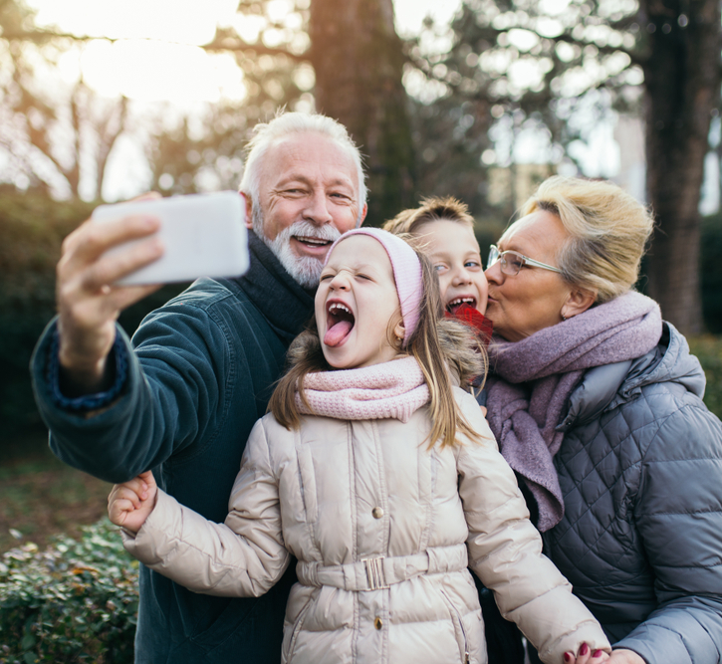
In some families, children live with their grandparents.

Slide 7
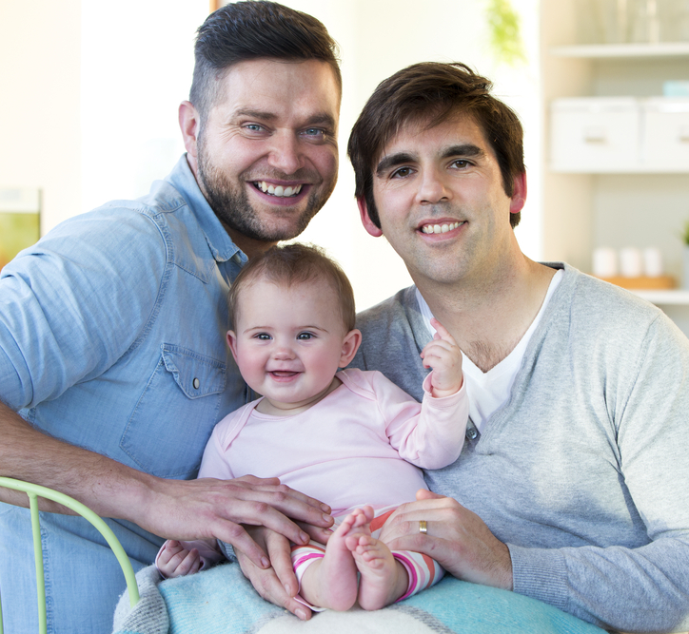
Some families have 2 dads.

Slide 8
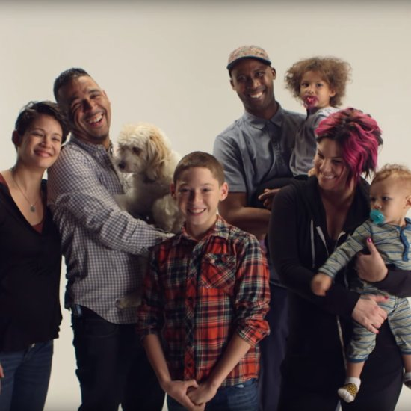
Some families have two mums and two dads.

Slide 9
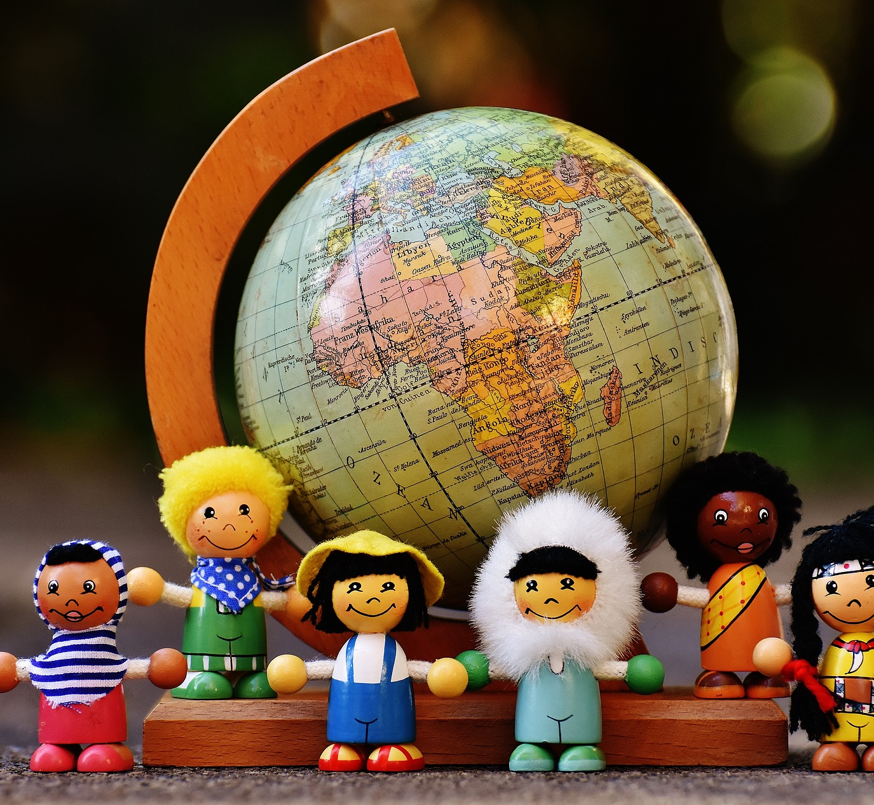
In this class, all our families are different, unique and special.

