Slide 1
AGM
Celebrating Success
2015/2016

Slide 2
Priorities 2015/2016
Children experience rich learning contexts to provide opportunities to apply learning in new situations (Planning, Food & Nutrition, Outdoor Learning)
Children are supported in their learning (Mental Maths, Seasons for Growth, Class Blogs)
Increased identification of and opportunities for achievement (Plan for MLPS, Reflective discussions, Transitions, Celebrating Success)

Slide 3
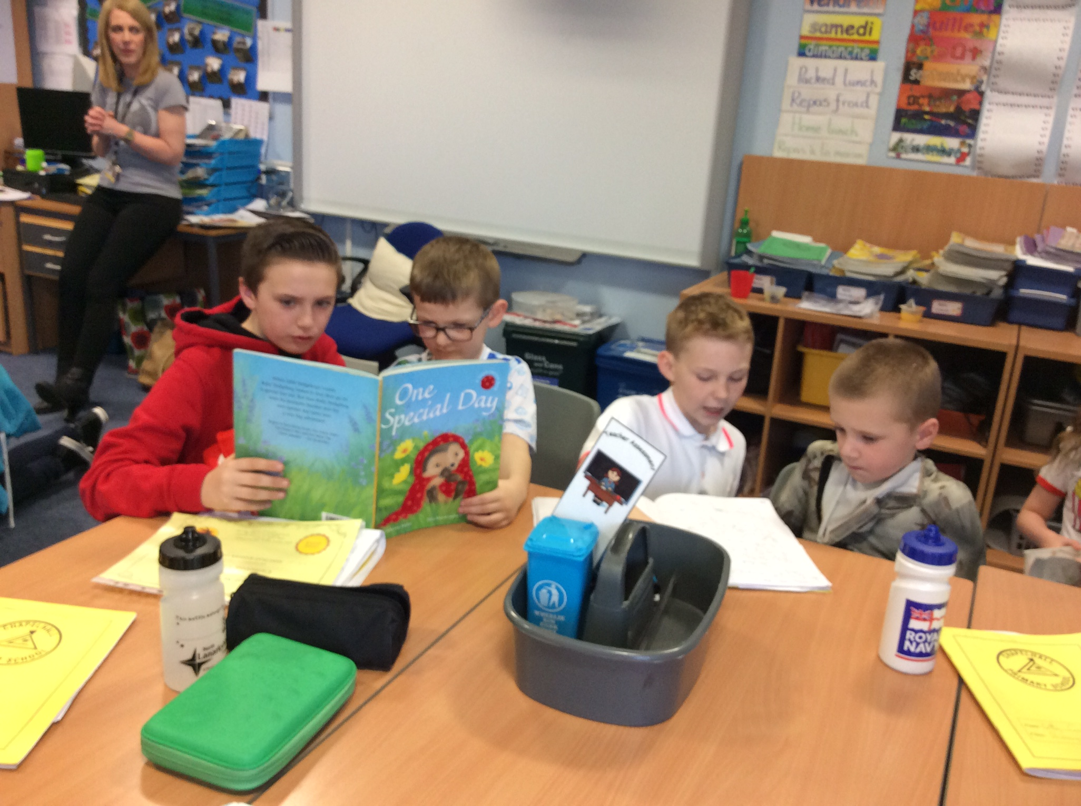
Pupil Involvement
Reading buddies
JRSO’s

Slide 4
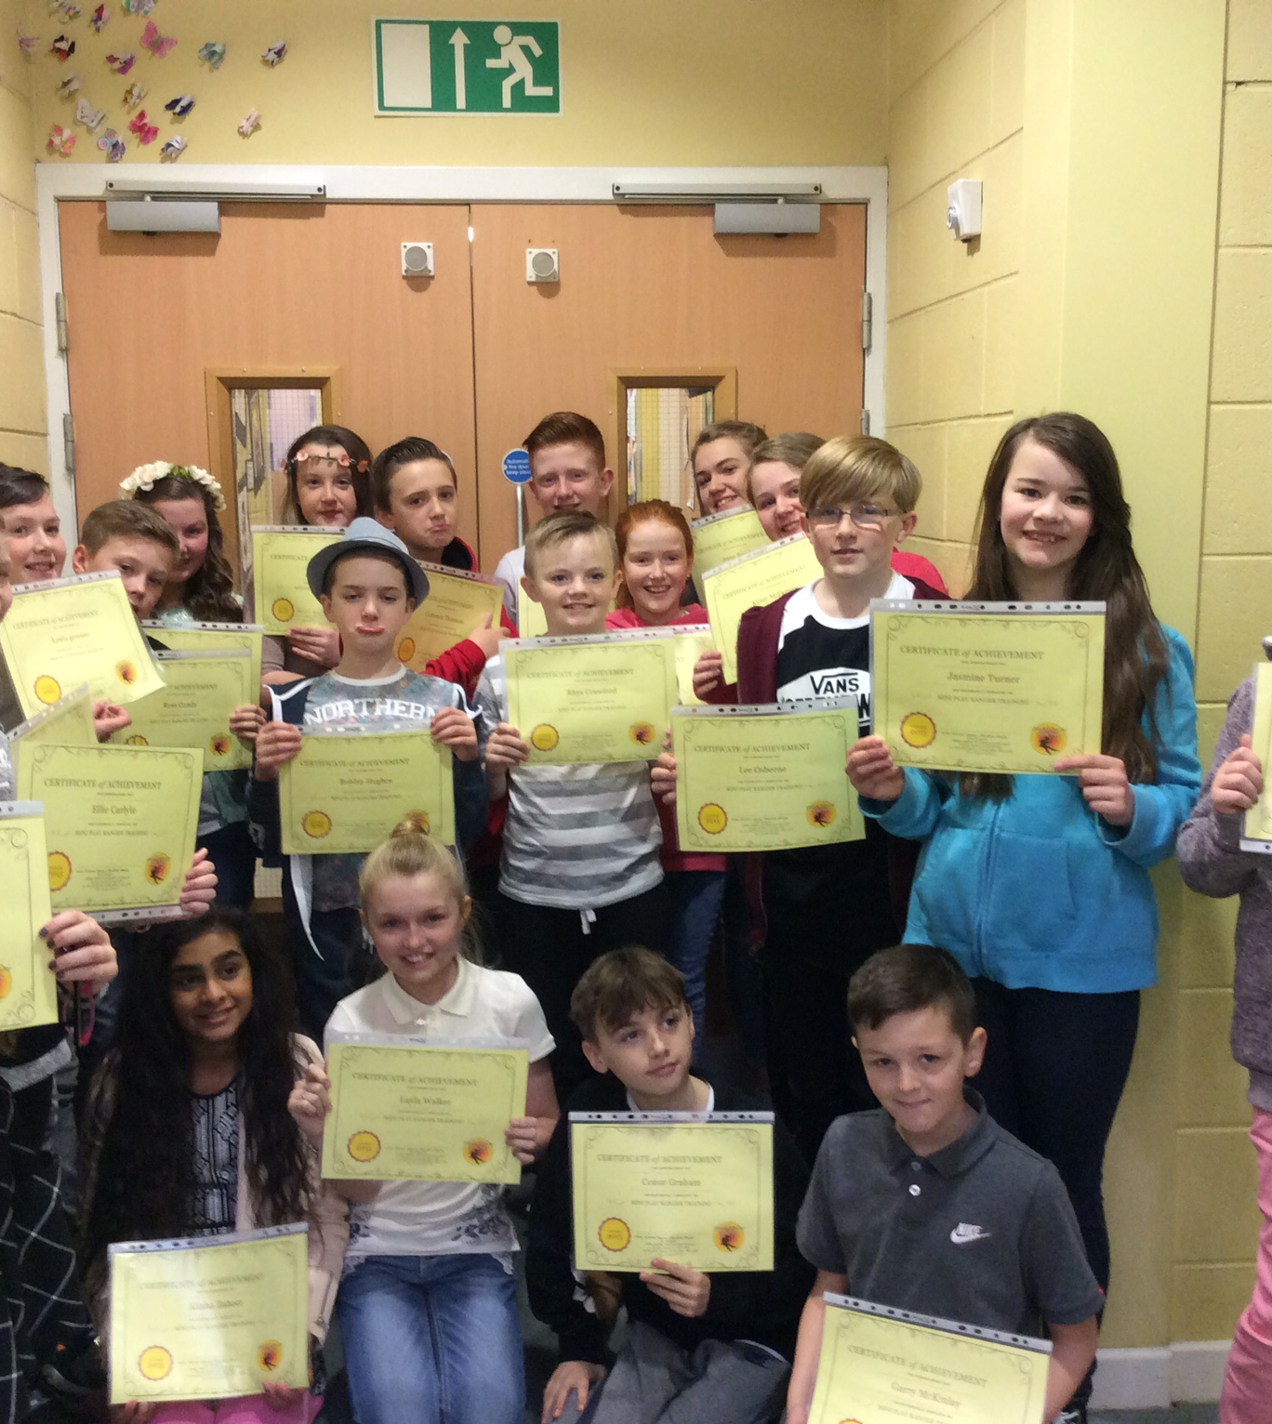
Leadership
P7 Play Leaders in action

Slide 5
Leadership
Representing pupil views at the Pupil Council Conference
Sharing learning in assembly

Slide 6
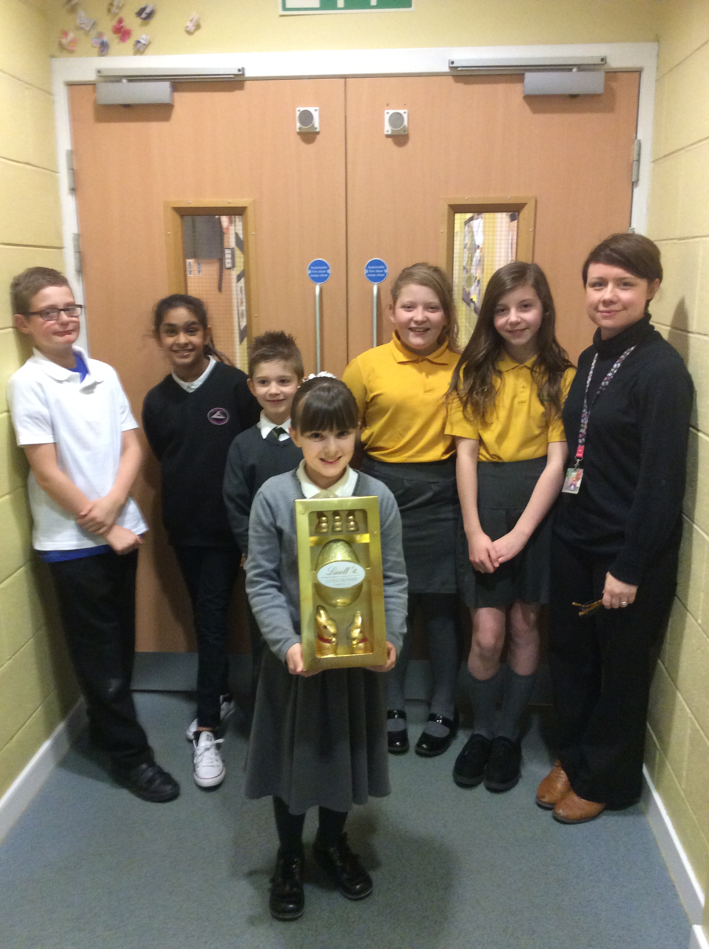
Joint Working
Community Carol Concert
Joint Pupil Council activity naming an area of the playground

Slide 7
Community Competitions
Monklands Bible Quiz Finalists, Airdrie Cup

Slide 8
Gymnastics finalists again!

Slide 9
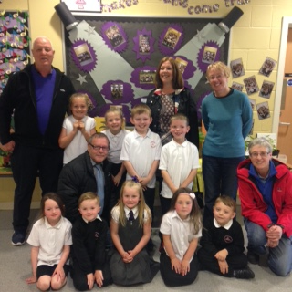
Chapelhall Allotment Society competition

Slide 10
Cooking Outdoor learning
Lottery/NLC funding

Slide 11
Autism awareness week
Visitors

Slide 12
Charity
St Andrew’s Hospice £465 +
Children in Need £623.41
Foodbank £106.50 + lots of food
Shelter £35

Slide 13
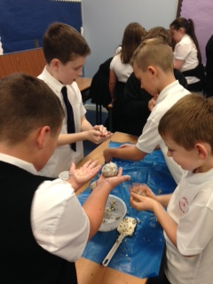
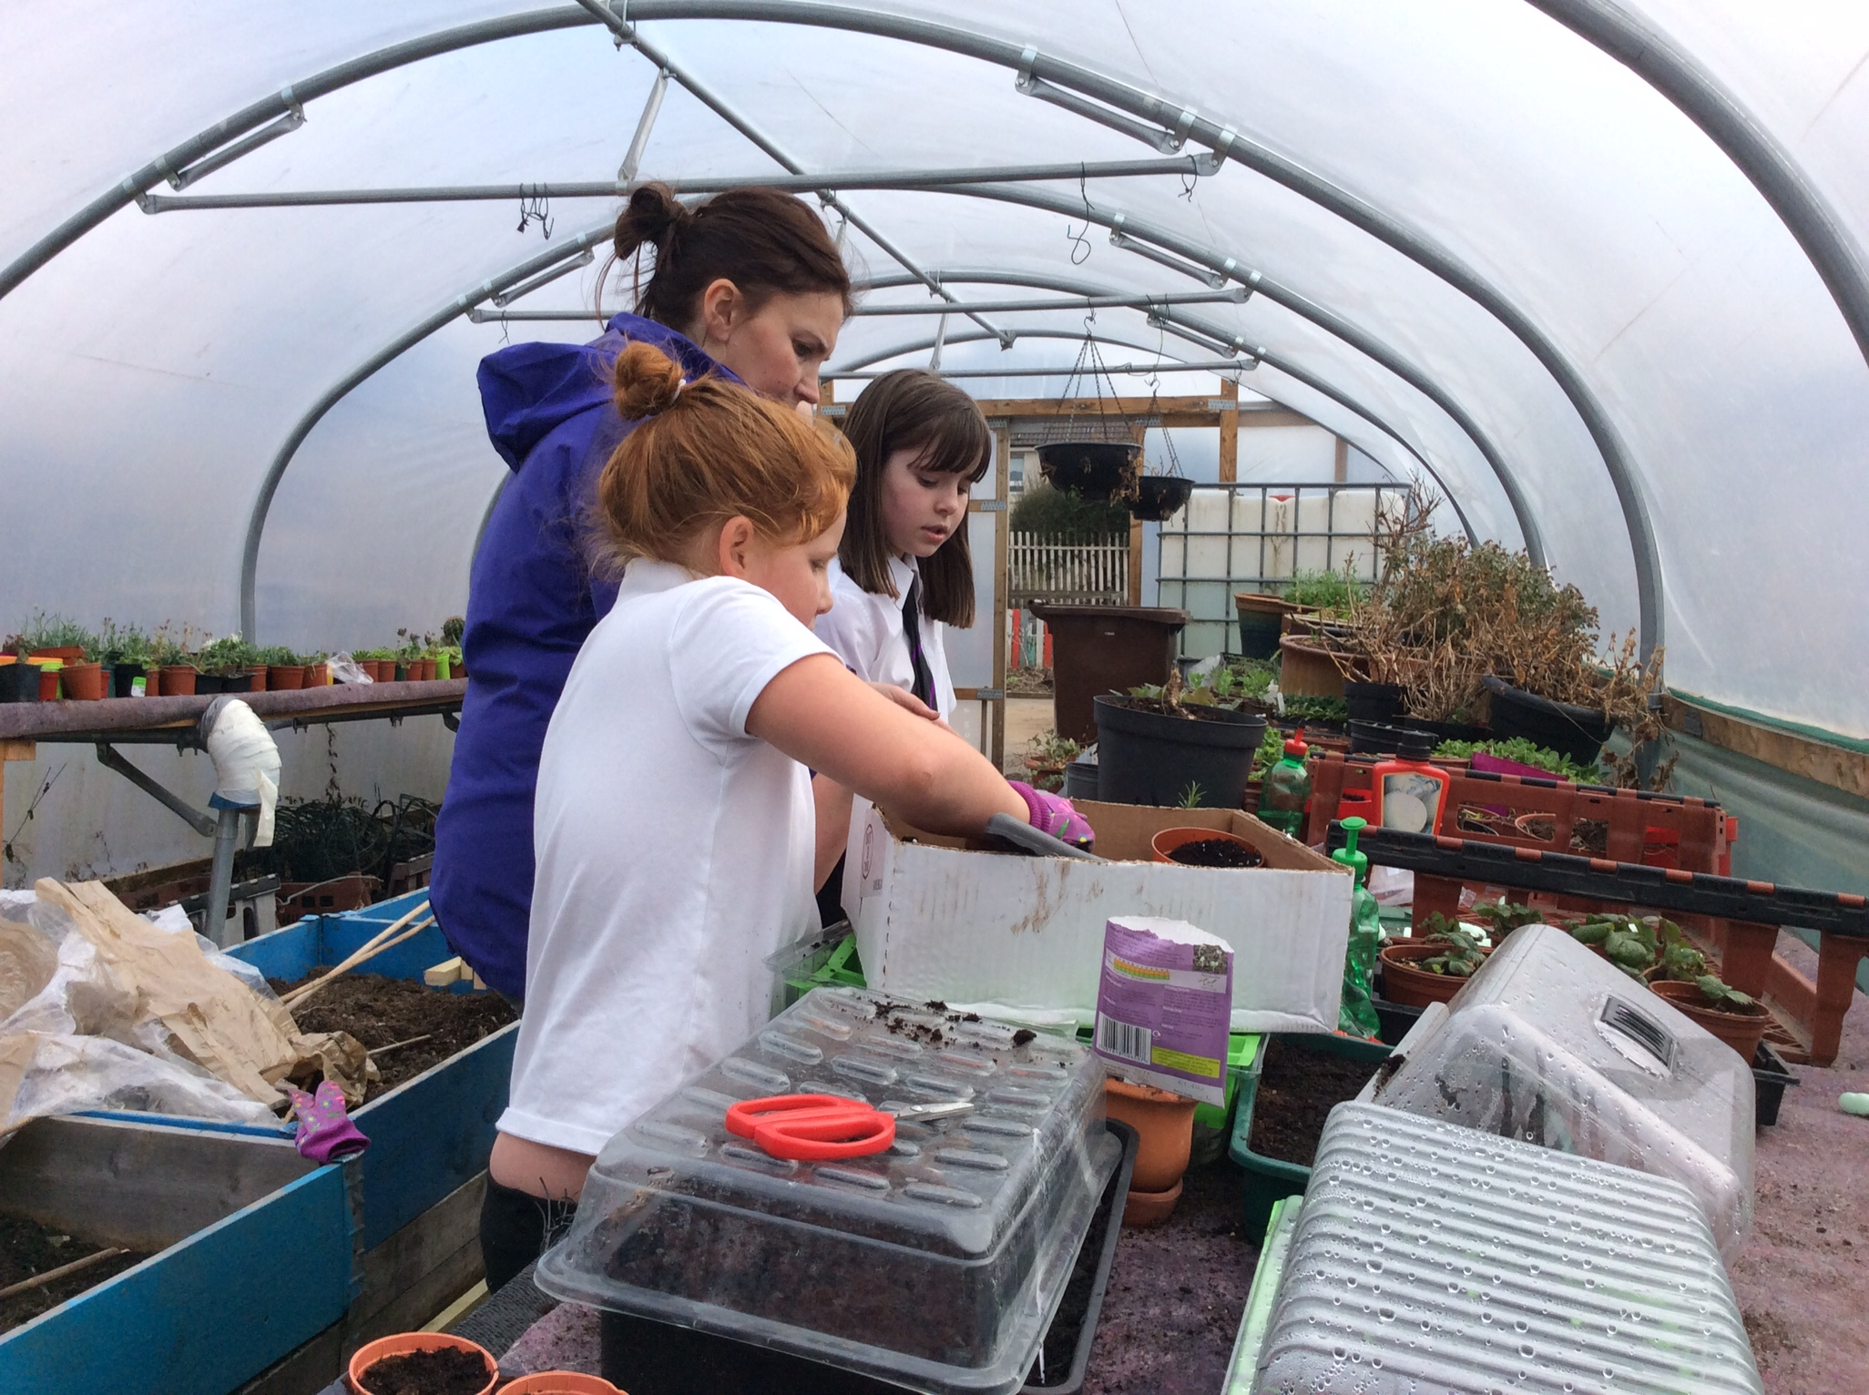
ECO/Sustainability activities

Slide 14
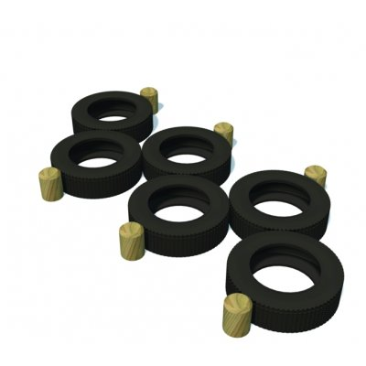
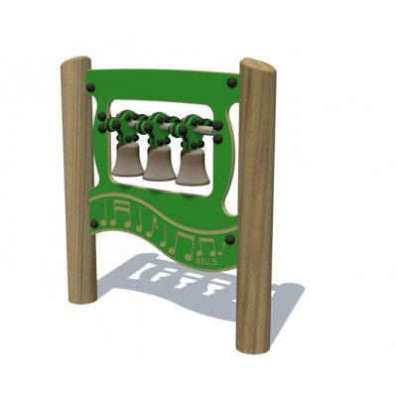
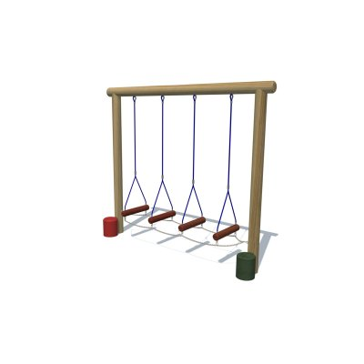
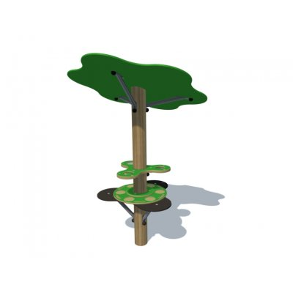
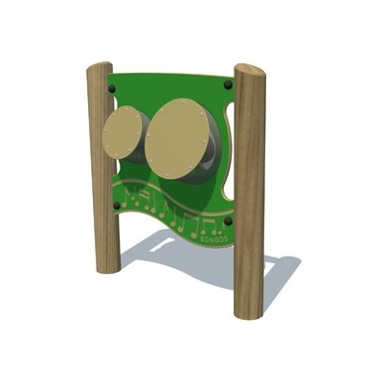
Lottery Award - Outdoor play area
Lottery funding £10,000 each school

Slide 15
School Improvement Planning
Two new key documents we need to consider:
How Good is Our School? 4
National Improvement Framework
4 areas of Priorities for 2016-2017

Slide 16
To improve attainment for all, particularly in literacy and numeracy
Literacy – focus on further developing approaches to Spelling and Writing, introduce Rainbow Readers for Support for Learning
Numeracy – Mental Maths (develop use of Numicon), Complete and implement Maths planning documents, Plan assessment activities for each area of Maths and Numeracy
Continue to become familiar with the ‘Significant Aspects of Learning’ in Literacy and Numeracy
Implement our Modern Languages 1+2 Year 1 plan, introducing French across the school and Spanish at some stages by 2020

Slide 17
To improve the learning progress of every child, by reducing inequality in education
Tracking and Monitoring Achievement and Attainment across the Curriculum using NLC new Data System - understanding the data and using it to support children’s learning

Slide 18
To improve children and young people’s health and wellbeing
Implementing a Motor Skills programme for identified children
Review the Seasons for Growth programme

Slide 19
To improve employability skills and sustained positive school leaver destinations for all young people.
Developing Young Workforce (DYW), review and add to our current activities to promote this initiative
Beginning to develop the use of GLOW 365 for staff and children, building on existing Blogging skills

Slide 20
Parental Involvement
Seeking views
Parent Council /PTA activities
Homework, School blog and Twitter – sharing learning
Parent Helpers/ Grandparents

