Slide 1
Numeracy & Mathematics
Eastfield primary school
Session 2017-2018

Slide 2
1. Topics 2. Big Maths 3. NLC pathways 4. Format of a Lesson 5. How to help

Slide 3
TOPICS

Slide 4
Number, Money and Measure Estimation and Rounding Number and Number Processes Multiples, factors and primes Powers and roots Factors, Decimal Fractions and Percentages Money Time Measurement Mathematics – its impact on the world past, present and future Patterns and relationships Expressions and Equations

Slide 5
Shape, Position and Movement Properties of 2D shapes and 3D objects Angle, symmetry and transformation Information Handling Data and Analysis Ideas of Chance and Uncertainty

Slide 6
Big Maths – Mental Starter
CLIC

Slide 7
Counting Learn Its It’s nothing new Calculation

Slide 8
5 minutes on each of the CLIC sections. Can be new learning, consolidate learning or strengthen prior understanding. The program is new to Eastfield Primary School this session. Some of the examples shown are from the end of the year or part of a bigger programme.

Slide 9
Counting
This is progressive from Nursery – p7 and progresses through the year for each stage. Examples of some of the counting tasks that they may cover through the year:
P1 – understanding numbers 1 to 10
P2 – counting to 100
P3 – counting in 10’s
P4 – partitioning and counting in 4’s
P5 – using numbers with 1 decimal place
P6 – reading 7,8,9 digit numbers and decimal places
P7 – finding gaps between negative and positive numbers

Slide 10
Learn Its
This is progressive from Nursery – p7 and progresses through the year for each stage.
Learn its are number facts that the children should memorise.
These are some Examples of some of the Learn it tasks that they may cover through this year:
P1 – 3+3, 4+4, 5+5
P2 – 4 + 2, 5 + 2, 6 + 2, 7 + 2, 9 + 2, 4 + 3, 5 + 3, 6 + 3
P3 – 5 + 4, 5 + 6, 6 + 7, 8 + 7, 8 + 9; x: 5x table
P4 – 4x table
P5 – x11 table
P6 – revision
P7 – revision

Slide 11
It’s nothing new
This is progressive from Nursery – p7 and progresses through the year for each stage.
It’s nothing new is how the children apply their learning.
These are some Examples of some of the it’s nothing new tasks that they may cover through this year:
P1 – double one digit numbers
P2 – finding the missing piece to 10 (I have 4 what do I need?)
P3 – I know half of 30, 50, 70, 90
P4 – I know half of 300, 500, 700, 900
P5 – I can find the missing piece to 1000
P6 – I can add hundredths
P7 – revision

Slide 12
Calculation
This is progressive from Nursery – p7 and progresses through the year for each stage.
Calculation is how the children use the learning to work out answers.
These are some Examples of some of the calculation tasks that they may cover through this year:
P1 – I can take away numbers of objects to 10
P2 – I can add 1 to a number up to 20
P3 – I can add 1 to a 2 digit number
P4 – I can take any 2 digit number from 100
P5 – I can solve any 1 digit x 1 digit
P6 – I can solve any 1dp + 1dp
P7 – I can solve 2dp + 1dp

Slide 13
Beat that! Challenge, not a test. Children to see their own progress as well as Teacher. Focused on one topic till mastered. Weekly on a Friday.

Slide 14
Done every week for 10 weeks or till teacher changes the program.
Measures Progress and shows the child how they’re getting on.

Slide 15
Done every week for 10 weeks or till teacher changes the program.
Measures Progress and shows the child how they’re getting on.
How many answers can they get correct in a minute

Slide 16
North Lanarkshire Maths Pathways
Progressive pathways

Slide 17
Early Level is covered by Nursery and Primary 1.
It mainly focuses on the basic Maths topics.

Slide 18
First Level is covered by P2, P3 and P4.
It is progressive for each stage and each code ie MNU 1-02a is broken into 3 parts (1 for each stage). This will then be built upon in second level.

Slide 19
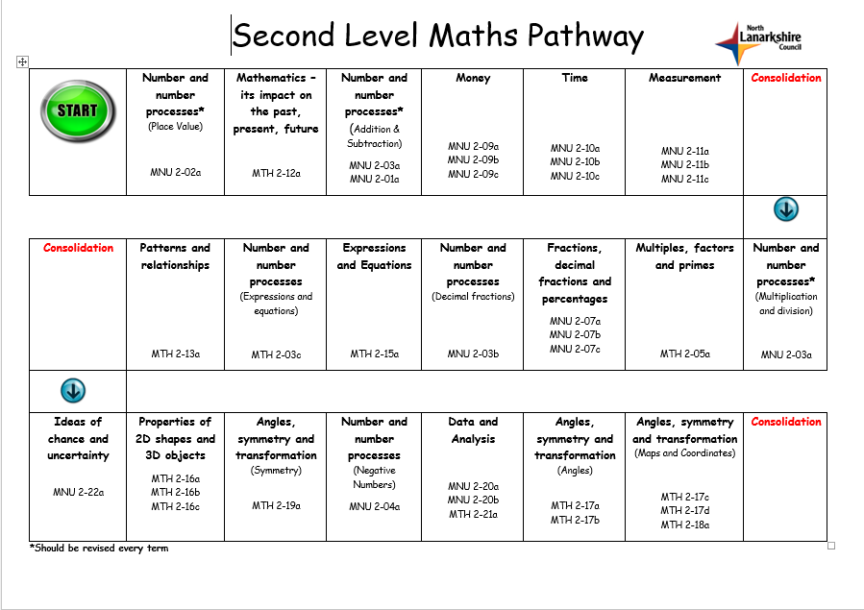
First Level is covered by P5, P6 and P7.
It is progressive for each stage and each code ie MNU 2-02a is broken into 3 parts (1 for each stage).

Slide 21
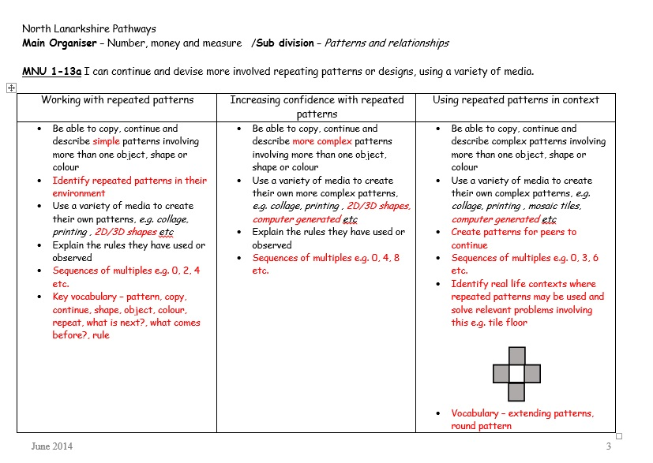

Slide 22
Format of a Numeracy Lesson
Big Maths, Teaching, Physical/Practical application, Differentiation, Application

Slide 23
5. Differentiated learning / tasks
Format
3. Physical learning & or Practical Application
1. Big Maths
2. Learning Intention & Success Criteria
4. Teaching
6. Formative Assessment – Plickrs, lollipop sticks, etc
7. Plenary

Slide 24
How you can help
Learning journeys (see snapshot jotters, website)
Discussion about learning from twitter, school website
Daily conversations (real life use)
Practice number bonds, doubles, tables, reading time, counting money

Slide 25
How you can help (cont)
Links on school website to helpful websites such as top marks, bbc, sumdog, math.com, twinkl
Apps – skoolbo, maths rockx Apps, maths games for maths genius, doodlemaths plus millions more.
Helper sheets (see front)
Making maths count (a positive approach from all angles)

Slide 26
Making Maths Count (Scottish Government)
The Report focuses on three key themes:
Transforming public attitudes to maths;
Improving confidence and fluency in maths for children, young people, parents and all those who deliver maths education to raise attainment and achievement across learning;
Promoting the value of maths as an essential skill for every career.

