Slide 1
Decision Making
Higher Business Management

Slide 2
Examples of Personal Decisions
Will I stay in and wash my hair?
Will I go to the cinema with my friends?
Will I paint my bedroom?
Will I hang wallpaper on the walls?
Will I go to College locally?
Will I study and live in another town or city?

Slide 3
What is a Decision?
A decision is a choice between alternatives
Decision making is the most important aspect of management
Effective decision making is essential for successful business practice
Poor decisions can have negative effects on a business

Slide 4
What is a Decision?
Decision
Decision
Decision
Decision
Decision
Decision
Decision
Decision
Decision
Decision
What decisions do business make?
In your groups come up with at least 10 different decisions business may make
The type of company and the objectives
The time it will take to implement the decision
How often the decision is made
How to display the stock in a shop

Slide 5
Decisions, Decisions, Decisions!
Will I stay in and wash my hair?
SHORT-TERM DECISION (Low Risk)
Will I paint my bedroom?
MEDIUM-TERM DECISION (Medium Risk)
Will I go to College locally?
LONG-TERM DECISION (High Risk)

Slide 6
What is a Decision?
Decisions can be categorised into three different types
Strategic
Tactical
Operational
Executive/Top Management
Senior/Middle Management
Supervisory/Bottom Management

Slide 7
Type of Decisions
STRATEGIC DECISION
Made on a long term basis
Set out the company objectives
Made by Top Management (Directors/Owners)
Affect the entire business
Tend to lack specific detail (visionary)
Often proactive, to stay ahead of the competition

Slide 8
Type of Decisions
STRATEGIC DECISION
What products the business will produce
What sections of the market the business will aim for
Where the business will be in 5-10 years time

Slide 9
Type of Decisions
TACTICAL DECISION
Made on a monthly/yearly basis (medium term)
Made by Middle Management
Made to achieve the businesses main objectives
Often very specific

Slide 10
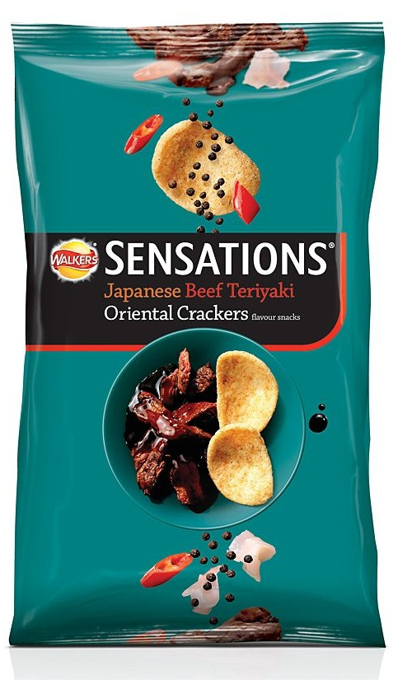
Type of Decisions
TACTICAL DECISION
If Walkers strategic decision was to increase sales, then developing more product lines (varieties) is a tactical decision

Slide 11
Type of Decisions
TACTICAL DECISION
Tesco needed to recruit more staff when it decided to offer bag packing services. This was to increase competitiveness against Sainsbury's 24/7 open hours.

Slide 12
Type of Decisions
OPERATIONAL DECISION
Made on a daily/weekly basis (short term)
Made by all
Often reactive, when a change occurs
When an employee is ill, the manager must reorganise the shift rota
When something breaks, calling the repair service

Slide 13
Revision
(a) whether to enter the European market with the firm’s products
STRATEGIC
(b) to move an Admin Assistant to another Department to help out on a temporary basis
OPERATIONAL
(c) whether to increase or decrease departmental staffing levels
TACTICAL
(d) when to schedule the weekly team meeting
OPERATIONAL
(e) whether to introduce flexi-time to the organisation
TACTICAL

Slide 14
Revision
(f) whether to re-rorganise the layout of desks in the office
OPERATIONAL
(g) whether to merge with another organisation
STRATEGIC
(h) whether to change from traditional to an open-plan layout by knocking down walls etc
TACTICAL
(i) whether to change the supplier of office stationery
OPERATIONAL
(j) whether to install new computers in the organisation
TACTICAL

Slide 15
Types of Decisions
Decision
Decision
Decision
Decision
Decision
Decision
Decision
Decision
Decision
Decision
Your Task
Using the 10 decisions you listed earlier:
On your own decide if they are
In your group compare your answers and discuss any inconsistent views
Strategic (s)
Tactical (t)
Operational (o)

Slide 16
Some Key Terms
Questions - 1
What is a Strategic Decision and give an example.
What is a Tactical Decision and give an example.
What is an Operational Decision and give an example.

Slide 17
Types of Decisions
Your Task
Suggest a tactical decision that could be made to help achieve each of the strategic decisions below. Justify your answer.
To increase market share by 15% within 5 years
To have 100% customer satisfaction
(4 marks)

Slide 18
Types of Decisions
Model answer
Suggest a tactical decision that could be made to help achieve each of the strategic decisions below. Justify your answer.
To increase market share by 15% within 5 years
To have 100% customer satisfaction
(4 marks)
(Starting an aggressive advertising campaign would help the business increase market share in the next 5 years.) (This is because a successful advertising campaign would encourage customers to switch from a competitor.)

Slide 19
Types of Decisions
Model answer
Suggest a tactical decision that could be made to help achieve each of the strategic decisions below. Justify your answer.
To increase market share by 15% within 5 years
To have 100% customer satisfaction
(4 marks)
(Improving the training offered to sales assistants would help the business reach a customer satisfaction level of 100%.) (This is because training would help the sales assistants provide a better service to the customer.)

Slide 20
Role of the Manager
Manager
Manager
Manager
Manager
Manager
Manager
Manager
Manager
Manager
Manager
Your Task
In your group discuss the duties and responsibilities of a manager. Think about everything a manager has to do.
Motivates staff
... etc

Slide 21
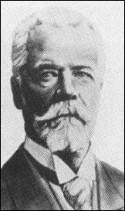
Role of the Manager
Henri Fayol (1916) specified five functions of management
Plans
Organises
Commands
Coordinates
Controls

Slide 22
Role of the Manager (Fayol)
Planning
Organising
Commanding
Co-ordinating
Controlling
Setting forward plans in relation to the business objectives
Collecting, storing and processing information
Being the leader
Decision Making
Setting vision and supporting staff
Making sure staff and resources are in the right place at the right time
Ensuring the plan is on target and in budget
Monitoring the quality of work
POCCCDM
Delegating
Motivating

Slide 23
Describe the role of managers in achieving the objectives of an organisation.
(6 marks)
Notes:
2003

Slide 24
Plans/sets objectives and the way they are to be achieved.
Gives instruction to others to carry out the tasks.
Takes responsibility for performance of organisation.
Delegates authority to achieve objective/informs others of targets.
Organises jobs within departments/brings together activities within the organisation/liase with other department heads.
Controls/corrects activities of the organisation.
Monitor/Analyse/Evaluate performance.
Motivates staff.
Acts as an information channel.

Slide 25
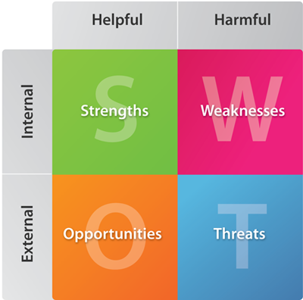
SWOT Analysis

Slide 26
SWOT Analysis
Strengths (Internal)
What the business is good at that may help
Weaknesses (Internal)
What the business is bad at that may harm

Slide 27
SWOT Analysis
Opportunities (External)
Factors outside the business that may help
Threats
(External)
Factors outside the business that may harm

Slide 28
SWOT Analysis
Competitor has gone bankrupt
Experienced workforce
High production costs
New competitor
Growth in demand for your product
Poor location
Increased income tax
Loyal customers
Notes:
Can you work out where you would put the following factors on the SWOT analysis: 4 minutes GO!

Slide 29
SWOT Analysis
A planning tool
Assesses for potential risks and rewards
Considers effectiveness/success in relation to the business environment
Helps evaluate and adjust strategies
Helps a company to operate in a competitive environment.

Slide 30
Feature of a SWOT analysis
Usually shown in a grid
Although in an exam it may be best to use the SWOT headings
Bullet points under each heading are quick, easy and effective
Conclusions must be drawn
Conclusions drawn must be justified by the analysis

Slide 31
Purpose of a SWOT analysis
Identify strengths, weaknesses, opportunities and threats
Build on strengths, minimise weaknesses, grasp opportunities and avoid or counter threats
Assist with the decision making process
By identifying opportunities early the company can gain a competitive edge
Turn threats into opportunities
Turn weaknesses into strengths
Proactive decision making rather than reactive decision making

Slide 32
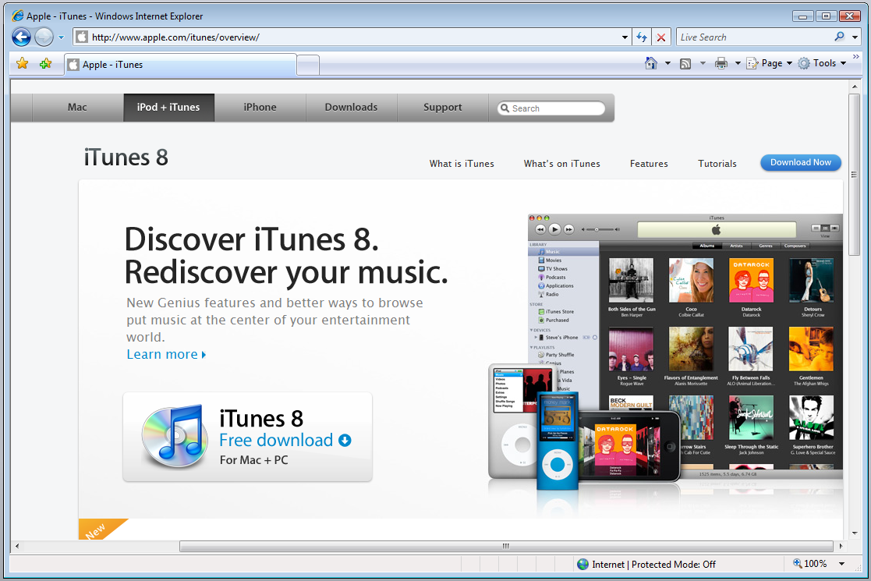
Threat becomes an Opportunity

Slide 33
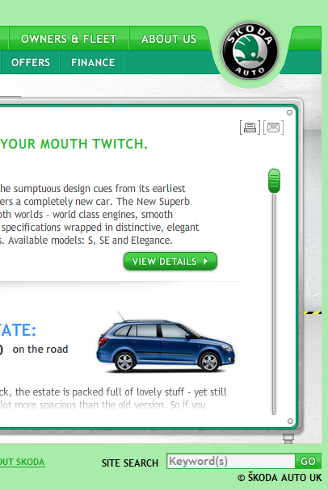
Cast Study: Skoda
Read the case study on Skoda carefully
As you read note the:
Strengths
Weaknesses
Opportunities
Threats
Notes:
http://businesscasestudies.co.uk/skoda/swot-analysis-in-action/#axzz31V86p9Pt

Slide 34
Cast Study: Skoda
Read the case study on Skoda carefully
As you read, annotate the case study, highlighting the SWOT factors.
Create a SWOT analysis
Bullet point under each heading
List at least 5 Strengths, 3 Weaknesses, 2 Threats and 2 Opportunities
From your SWOT suggest and justify how Skoda could:
Improve their brand position.
Increase sales and customer satisfaction.
Based on your SWOT analysis:
What Weaknesses can be turned into Strengths and how?
How do you suggest Skoda overcomes potential threats?
Notes:
http://businesscasestudies.co.uk/skoda/swot-analysis-in-action/#axzz31V86p9Pt

Slide 35
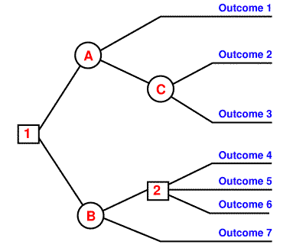
Decision Making Models
There are other decision making techniques:
Brainstorming
PESTEC analysis
Expert Systems
Decision / Logic Trees

Slide 36
Benefits of the DM Models
No rash or hasty decisions are made, as time is taken to go through the decision making process
Better quality decisions are made, as decisions are based on gathered relevant information
Opportunity to explore alternatives
May enhance innovation, motivation and responsiveness by allowing employees to be involved in the decision making process.

Slide 37
Constraints of the DM Models
Time consuming, may slow the decision making process
Limited information available
Problems of generating and choosing between alternative solutions
Internal constraints: finance, policy, staff attitudes or resistance
External constraints: legislation, competitors, lack of technology
Stifles creativity

Slide 38
Quality Decision Making
Why is it important to make high quality decisions?
What factors influence the quality of decisions making?
The accuracy and quantity of information gathered
Limited technology
Staff training
Risk taking
Time and finance restrictions

