Slide 1
Stakeholders
Understanding Business
Higher Business Management

Slide 2
Types of Stakeholders
There are two types of Stakeholders
INTERNAL
These are Stakeholders from within the business
EXTERNAL
These are Stakeholders from outside the business

Slide 3
Stakeholders
Internal
External
Suppliers
Employees
Managers
Shareholders
Banks and Lenders
Government
Local Community
Customers

Slide 4
Internal Stakeholders
EMPLOYEES
INTEREST
Good Salary
Job Satisfaction
Good Working Conditions
Job Security
INFLUENCE
They can change the standard of their work
Industrial Action

Slide 5
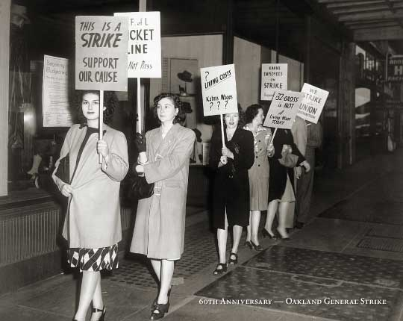
EMPLOYEES
INFLUENCE
Industrial Action
Strike
Sit in
Overtime Ban
Work to Rule

Slide 6
Internal Stakeholders
MANAGERS
INTEREST
Good Salary/Bonuses
Job Satisfaction
Responsibility and Status
INFLUENCE
They make Decisions Such as, hiring staff, selling products, etc

Slide 7
Internal Stakeholders
SHAREHOLDERS
INTEREST
Want the firm to be profitable
Healthy dividends
Improved share value
INFLUENCE
They can influence decision making
They can vote for certain Directors
They can choose to sell their shares

Slide 8
Some Key Terms
Questions - 1
Name 3 Internal Stakeholders of an organisation.
In your jotters:
Describe the Interest these Stakeholders may have in the organisation.
Explain what influence each of these Stakeholders may have over the organisation.

Slide 9
Some Key Terms
Your Task
Use the worksheet and find out current or recent news stories which may affect Internal Stakeholders.

Slide 10
Stakeholders
Internal
External
Suppliers
Employees
Managers
Shareholders
Banks and Lenders
Government
Local Community
Customers

Slide 11
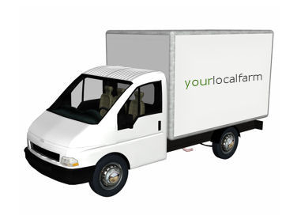
External Stakeholders
SUPPLIERS
INTEREST
Will want the business to be successful to ensure repeat custom
They depend on this custom for survival
INFLUENCE
Change prices
Offer discounts
Change their lead times

Slide 12
External Stakeholders
BANKS AND LENDERS
INTEREST
They want to make sure cash flow is stable
So they can ensure repayment
INFLUENCE
They can choose whether to grant or withhold loans
They can extend or shorten the loan repayment period
They can change the interest rates

Slide 13
External Stakeholders
GOVERNMENT
INTEREST
Notes:
Philosophical enquiry technique with class, draw out conclusion and implication to form a cohesive answer

Slide 14
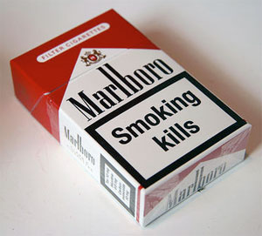
External Stakeholders
GOVERNMENT
INFLUENCE
Legislation (Minimum Wage Act)
Can issue bans (Smoking in local areas)
Set taxation rates
Offer or withhold grants and licences

Slide 15
External Stakeholders
LOCAL COMMUNITY
INTEREST
Companies provide jobs for an area
Businesses offer goods/services
The community cares about the area they live in
INFLUENCE
Can make complaints to Local Authority
Can protest against the company

Slide 16
External Stakeholders
CUSTOMERS
INTEREST
They want best quality products
At lowest possible price
A range of goods and services
INFLUENCE
They can choose whether or not to purchase goods or services
They may recommend the business to friends and family

Slide 17
Some Key Terms
Questions - 2
Name 4 External Stakeholders of an organisation.
In your jotters:
Describe the Interest these Stakeholders may have in the organisation.
Explain what influence each of these Stakeholders may have over the organisation.

Slide 18
Some Key Terms
Your Task
Use the worksheet and find out current or recent news stories which may affect External Stakeholders.

Slide 19
Exam Style Question
Describe the influence stakeholders could have on an organisation.
(5 Marks)

Slide 20
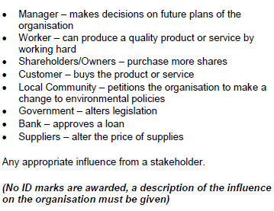
Exam Style Question

Slide 21
Exam Style Question
Identify 2 stakeholders, other than employees, that will be affected by the closure of a call centre. Describe their interest in the business.
(4 Marks)

Slide 22
Exam Style Question
(Customers) will be affected as they will no longer be able to (contact that particular call centre for help or advice and may not get as good customer service).
(Banks) will be affected if the call centre has an outstanding loan. They are (interested in the stability of the organisation and will be concerned as to whether or not the call centre can repay the loan).
(4 Marks)

Slide 23
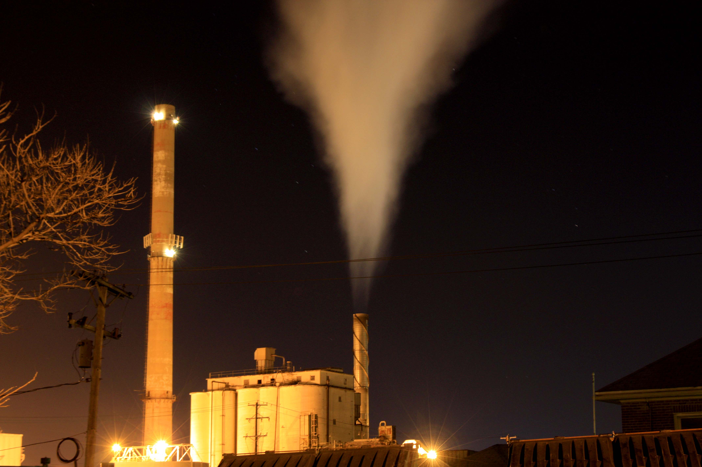
Social Implications of Business
Would you be happy living next to this?
Notes:
Teacher Note
I find that explaining the concept of “social”, students can come up with some of these. But you do need to explain these fully and bring them into as many topics as possible. This can appear in an exam paper. Try to use an example of something locally, eg the building of a new supermarket, cinema or leisure complex. How some people think it is a “good” or “bad” idea. Why is it good? Why is it bad?

Slide 24
Stakeholders
Interdependence
Why a stakeholder needs another stakeholder

Slide 25
Stakeholder Interdependence
Owners need employees to be as productive as they can
Employees need owners to provide the necessary job training
Owners need customers to buy products from them to make profit
Customers need owners to provide them with the product they want

Slide 26
Stakeholders
Conflict
Disagreements that can occur between different stakeholders

Slide 27
Stakeholder Conflict
Managers will want to make high profits on goods and services
Customers want the best quality for the cheapest price
Managers may want to close a branch to save on staff wages
Employees will want to keep their jobs

Slide 28
Exam Style Question
Explain how the interests of employees might conflict with 2 other stakeholders in the business.
(2 Marks)

Slide 29
Exam Style Question
Explain how the interests of employees might conflict with 2 other stakeholders in the business.
(2 Marks)
A business may be facing financial difficulties and to resolve this it may be necessary for the manager/owner to close a branch to save on staff wages however this will not be a popular decision with staff as they could lose their jobs.
Employees may want to reduce the number of hours that a shop is open (close on Sundays) however customers will not be happy with this as they are now used to retailers being open 7 days a week.

