Slide 1
Human Resource Management
What is it all about?

Slide 2
Here are the ‘answers’
1 Workforce planning
Motivation theories
3 Recruitment Process
4 Training
Employee Relations
Appraisal
7 Legislation affecting the workplace

Slide 3
4 – Motivation: Appraisal
identifies the strengths and weaknesses of employees
identifies the training needs of employees
motivates workers to reach targets
identifies those employees who are ready for promotion
gives feedback on a worker’s ability to do a job
provides information for target setting
Why conduct an appraisal?

Slide 4
THE APPRAISAL INTERVIEW
Takes place between the employee and her/his line manager
Normally held at regular intervals, usually a year
Aims to find out how well the worker has done
What can be done to improve their work
PURPOSE OF THE INTERVIEW
match employees’ achievements against targets set
set new targets for employees
discover employees’ strengths and weaknesses

Slide 5
Advantages - Disadvantages
4 – Motivation: Appraisal
Workers are motivated because they have targets set
identifies training needs
strengths and weaknesses of employees are identified
Employees may feel threatened because they think that appraisers are only looking for faults

Slide 6
Question
Explain the benefits of an appraisal system.
4 marks

Slide 7
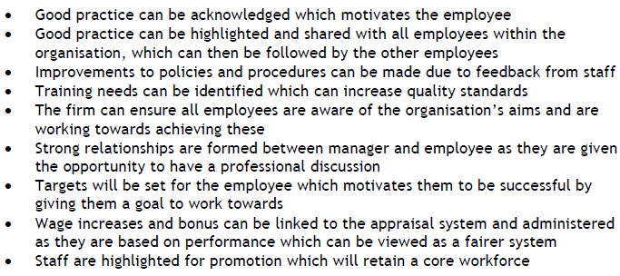
Solution

