Slide 1
Human Resource Management
What is it all about?

Slide 2
Topics
  1 Workforce planning
  Motivation theories
  3 Recruitment Process
  4 Training
  Employee Relations
  Appraisal
  7 Legislation affecting the workplace

Slide 3
TRAINING
Training is teaching workers new skills or improving their existing skills.
What are the benefits that training brings to the workplace?

Slide 4
Benefits of Training
Improved efficiency and productivity as skills increase
Improved quality of work which benefits customers
Helps to maintain or improve competitiveness
Business’s profits increase
Employee motivation and job satisfaction is increased
Staff can become more flexible and work in a variety of roles
Drawbacks of Training
Workers may have to spend time away from work
Training has to be paid for
Sure training is expensive, but it’s kept us competitive and increased our profits.

Slide 5
TYPES OF TRAINING
INDUCTION TRAINING
VIRTUAL LEARNING (VLE)
MULTI-SKILLING
ON THE JOB
OFF THE JOB

Slide 6

INDUCTION TRAINING

Slide 7
INDUCTION TRAINING
Induction training is the training given to new employees to introduce them to the business.
Not sure why I’m pointing with this stick, as there is nothing on the board to point at.
Likely to be 1 day – 1 week
Introduces new employee to colleagues, layout, facilities
Gives information about the business eg aims, ethos, standards
Involves training of how to do the job - to meet job description
Fantastic stick. Really great!

Slide 8
VIRTUAL LEARNING ENVIRONMENT (VLE)
Using IT such as a website whereby there are tasks, challenges and assessments to complete.
Could be a tailor-made programme that employees work through at their leisure or as part of formal training.
Could be linked to a ‘mentor’ who the employee regularly speaks to
Staff could collaborate with each other on projects.
Think of a situation/occupation where this is most likely?

Slide 9

Multi-skilling
What is it?
Why?
Multi-skilling allows workers to perform different tasks
Allows the workers to be more flexible
Allows the business to make efficient use of resources
Allows the business to save costs eg not hiring extra staff

Slide 10
ON-THE-JOB TRAINING
Takes place at the workplace. The employee trains alongside an experienced worker while doing the job.
Think of occupations where this is best suited. Why?
ADVANTAGES
Possibly cheaper as done in-house by the business itself.
Workers do not have to leave the workplace. Normal work may be able to continue.
Skills improved in workplace
DISADVANTAGES
Bad habits might be passed on
Training is not done by a qualified instructor
Don’t benefit from meeting other employees and sharing ideas.

Slide 11

OFF-THE-JOB TRAINING

Slide 12
OFF-THE-JOB TRAINING
Off-the-job training occurs when workers are trained away from the business. Often with employees from other businesses and/or at college.
Think of occupations where this is best suited. Why?
ADVANTAGES
Delivered by qualified and trained instructors
A formal qualification or certificate may be given at the end of the course
May pick up tips & skills from other industries
DISADVANTAGES
More expensive than on-the-job training
Employees have to catch up when returning to workplace
Staff may need covered (costs) when on training

Slide 13
Questions - 1
Sainsbury’s trains staff in purpose-built colleges. Compare this type of training with off-the-job training. 4
Justify the use of staff training for an organisation. 4
You have 20 mins max. When complete swap and mark.

Slide 14
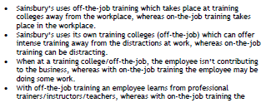

Solutions - 1

Slide 15
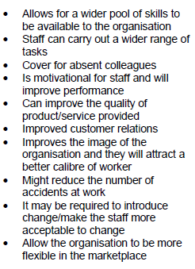
Solutions - 1

Slide 16
Changing patterns of employment in the UK

Slide 17
Changing Patterns of Employment
Write down 3 ways in which you think employment has changed in the last 10/20 years.
(How people work/Where people work/What people work)
Structural changes - movement away from primary and secondary industries to tertiary sector - provision of services
Decline in full-time employment
Increase in part-time and short-term contracts
Increase in home working
Greater flexibility of the workforce – mobility has increased
Many more women in employment
Increase in self-employment

Slide 18
Why has part-time/casual employment increased?
Write down three suggestions in pairs
Wage costs are lower for the business
Allows a business to be more flexible and respond to changes in demand
Workers only at the work place when needed
Beneficial/opportunities for parents and students
Until recently part-time workers were not entitled to the same benefits as full-time workers.

Slide 19
Why are there more women in employment?
Write down three suggestions in pairs
More women now prefer to go out to work than stay at home in their traditional roles as housewives. Need for finance and lifestyle.
Increased availability of part-time work allows women to be ‘housewives’ and also work.
Social trend – more acceptable, necessary?
Change in type of work available – growth in tertiary sector – retail, administration – lend themselves to part-time work
Increased availability of child care

Slide 20
Why has employment decreased in the secondary sector and increased in the tertiary sector?
Write down three suggestions in pairs
Mainly because of competition from abroad
Products produced much cheaper in China, Taiwan…
As a country becomes wealthier the population demand more services such as entertainment and leisure
Increased earning capacity – higher levels of disposable income
UK has developed financial services, tourism, leisure industries

Slide 21
Why has there been an increase in homeworking and teleworking?
Write down three suggestions in pairs
Because of Information and Communication Technology (ICT)
Many employees no longer need to be in their place of work
Less office space is needed which reduces costs
Employees do not have to travel to work which saves them time and money
Many workers feel they work better at home

Slide 22
Questions - 2
Describe the changing patterns of employment that have occurred recently in the UK. 5
You have 15 mins max. When complete swap and mark.

Slide 23
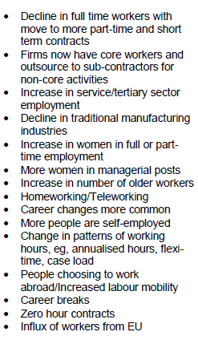
Solutions - 2

