Slide 1
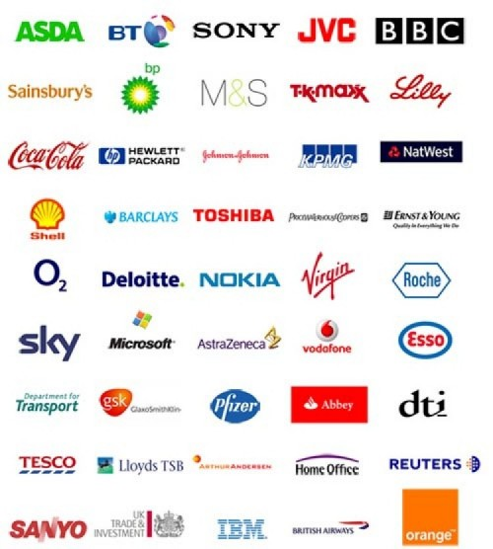
Types of Organisations
Understanding Business Higher Business Management

Slide 2
Types of Businesses
Private Sector
Partnership
Private Limited Company
Public Limited Company
Public Sector
Local Council (Government)
Public Corporation
Sole Trader
Public Sector Organisation
Voluntary Sector
Charity
Voluntary Organisation
Notes:
Teacher Note
Explain what each sector involves, try to use q and a to establish the basics:
Private – to make money (profits)
Public – to provide a service which the whole country benefits from (refer back to “services”
Voluntary – to raise FUNDS for worthy causes, at this stage it is good to ensure pupils do not just think about money. If your school does the Xmas shoe box appeal (another “thing” for BM pupils to be involved in from Oct to Xmas through Red Cross) where we put “goods” together to send to children and adults less fortunate than us, you can use this to put the voluntary across of not just being “money”.

Slide 3
Story Time
Bill had been working for a large building and construction company for 20 years
One morning he woke up and decided to start his own construction business
“Bill’s Builds”
Notes:
N5 revision

Slide 4
Bill’s Builds
Sole Trader
Advantage
What type of business has Bill started?
Disadvantage
List the advantages and disadvantages of this type of business in your jotter

Slide 5
This is a business which is owned and managed by one person
Sole Trader
ADVANTAGES
Relatively easy and cheap to set up
The owner makes all the decisions
The owner keeps all the profits
DISADVANTAGES
It is harder to get loans from banks
Unlimited liability
Long working hours with few holidays
Sole responsibility
Problems if owner falls ill even for a short time
Notes:
Class to give examples of sole traders.

Slide 6
Three months later ...
Bill’s Builds is booming! Bill has been run off his feet with work, the phone is never off the hook with new customers and emails are pouring in!
Bill’s wife, Jean, is an accountant. Bill thinks Jean should partner with him in the business to cover the office work. They rename the business
“Building Up”

Slide 7
Building Up
What type of business is Building Up?
List the advantages and disadvantages of this type of business in your jotter

Slide 8
This is a business which is owned by 2 – 20 people
Partnership
ADVANTAGES
Workload can be shared
Partners can specialise in different areas
More money can be invested in the business
DISADVANTAGES
Unlimited liability
Arguments may occur
Profits must be shared between partners
Partners may leave, upsetting the running of the business

Slide 9
Questions - 1
What are 2 advantages for the Sole Trader?
What are 2 advantages of a Partnership?
Compare a Sole Trader with a Partnership.
If you had to choose between a Sole Trader and a Partnership, which would you choose and why?
Both offer Unlimited Liability. What does this mean?

Slide 10
Two Months Later ...
Building Up is still doing well, so they decide to expand
Jean suggests they bring in two new partners
Why bring in more partners?
Expertise
Ideas
Capital Investment

Slide 11
New Partners
Jean’s pal, Sue, is an interior designer. Jean thinks it would be great idea to expand into the interior design market.
Bill’s pal, Tom, is an architect. Bill thinks it would be great idea to expand into the custom housing market.

Slide 12
One Year Later ...
Financially the business was fine, however there was big trouble in the boardroom
Workload was getting heavier and more complicated
The partners were constantly disagreeing about business decisions

Slide 13
Business Conflict
One day Sue had enough, she felt overworked and undervalued for her creative input
RAWR!
RAWR!

Slide 14
Business Conflict
RAWR!
ARRGH!
RAWR!
After a fight with Jean, Sue left

Slide 15
Business Conflict
Disturbed with the internal conflict of the business, Tom pulls out of the partnership
What problems will this cause for Building Up?

Slide 16
Shortly After ...
Sue was still raging about the fight. She decided to set up her own company to compete with Building Up.
RAWR!
RAWR!

Slide 17
Shortly After ...
Her husband was a joiner by trade and her son had just finished his apprenticeship as a Painter and Decorator …how convenient.
They decided to set up a
HAHAHA!
Private Limited Company (Ltd)

Slide 18
Limited Companies
What is the difference between a Private Limited Company and a Public Limited Company?

Slide 19
Limited Companies
Private Limited Company (Ltd)
Public Limited Company (plc)
A company whose shares are owned privately
A company whose shares are available for purchase by the public on the Stock Market
Shares are not available to the public on the Stock Market
Minimum of one Shareholder
Minimum of two Shareholders
Owned by the Shareholders
Controlled by a Board of Directors
Must produce a Memorandum and Articles of Association

Slide 20
Private Limited Company (Ltd)
ADVANTAGES
Control of company not lost to outsiders
More finance can be raised from shareholders and lenders
BOD brings significant experience to aid decision making
Limited liability
DISADVANTAGES
Profits shared amongst more people
Shares can’t be sold to the general public
Must abide by the Companies Act
Notes:
Class to give examples of sole traders.

Slide 21
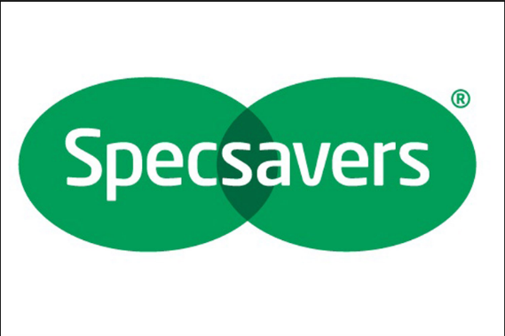
Private Limited Company (plc)

Slide 22
Public Limited Company (plc)
ADVANTAGES
Huge amounts of finance can be raised by selling shares
Plc’s often dominate the market
Easy to borrow money due to their large size
Limited liability
DISADVANTAGES
Set up costs may be high
No control over who buys shares
Must publish annual accounts
Must abide by the Companies Act
Notes:
Class to give examples of sole traders.

Slide 23
Public Limited Company (plc)

Slide 24
Questions - 2
What is meant by a Private Limited Company?
What is meant by a Public Limited Company?
Both offer Limited Liability – what does this mean?
Who controls both types of company?
Name a difference between a Private and a Public Limited Company.

Slide 25
Explain 3 reasons why an organisation would become a Private Limited Company.
(3 marks)
Private Limited Companies have (limited liability. This is an advantage because it reduces the risk of personal loss for the shareholders).
(Shares are not sold to the public with a Ltd company. This is beneficial as control will not be lost) to complete outsiders.
Finally (shareholders will bring experience, knowledge, skills and investment into the business. This will reduce risk of liquidation and can help the organisation grow).
3

Slide 26
Meanwhile ...
Tom decides to explore new business opportunities
Tom’s favourite food is a Double Whopper with cheese from Burger King, so Tom thinks a franchise would be a good idea

Slide 27
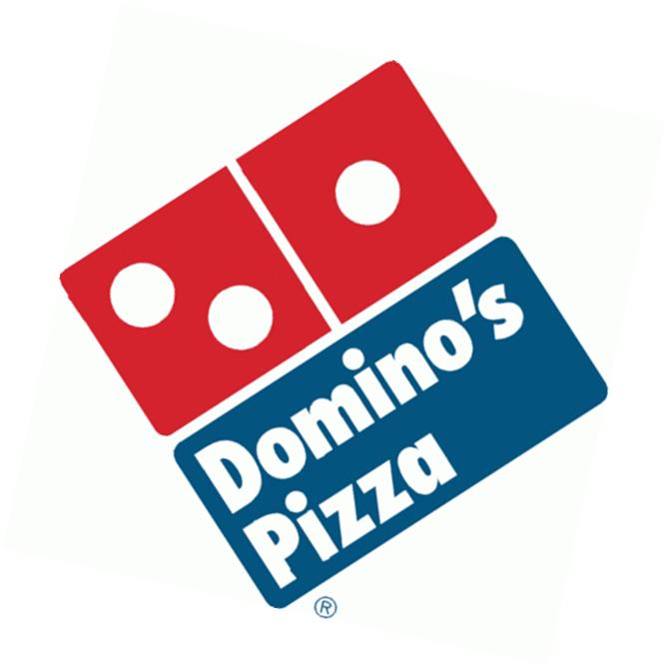
Franchise
A business agreement that allows the use of an established business (brand) name and to sell their products or services

Slide 28
Franchise
A franchise is not a type of business, but a way the business can be run
For example, a Sole Trader can have a Burger King Franchise

Slide 29
Franchise
Franchiser
Franchisee

Slide 30
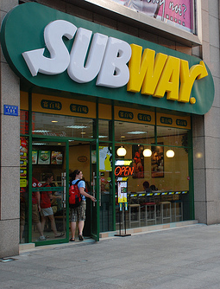
Case Study Subway
Spending between £100,000 and £150,000 would allow you to open a fully-fitted Subway sandwich shop
Subway would give you the right to operate in a particular location, and to use their brand and signage
By paying a fee you benefit from national advertising, brand awareness and support

Slide 31
Franchise
For the Franchiser
ADVANTAGES
Fast method of expanding without heavy investment
Provides a steady cash flow from royalty payments
Shared risk between Franchiser and Franchisee
DISADVANTAGES
Only receives a share of the profits
Poor franchisee can damage company reputation
A weak franchisee may not return much profit
Notes:
Class to give examples of sole traders.

Slide 32
Franchise
For the Franchisee
ADVANTAGES
Reduced marketing costs
Reduced risk as the brand is already established
Franchiser may produce training and administration duties
DISADVANTAGES
Products, prices and layout of store may be dictated
A royalty payment must be paid (often a % of revenue)
Initial cost is expensive

Slide 33
Questions - 3
Describe 2 advantages of becoming a Franchise for the Franchisee.
Describe 2 disadvantages of becoming a Franchise for the Franchisee.
Describe 2 advantages of becoming a Franchise for the Franchiser.
Describe 2 disadvantages of becoming a Franchise for the Franchiser.

Slide 34
Computer Task - 1
Complete your worksheet in small groups or 2/3 researching companies which you could run as a Franchise. Try to find out start up costs and fees for a UK based Franchise.

Slide 35
Private Sector - Public Limited Company (plc)
Private Sector - Public Limited Company (plc)
Private Sector - Franchise
Public Sector Organisation

Slide 36
Voluntary Sector - Charity
Private Sector - Franchise
Private Sector - Private Limited Company (Ltd)

Slide 37
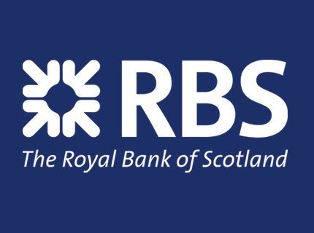
Public Sector - Public Limited Company (plc)
Private Sector - Franchise
Voluntary Sector - Charity

Slide 38
Public Sector Organisation
Voluntary Sector Organisation
Public Sector Organisation

Slide 39
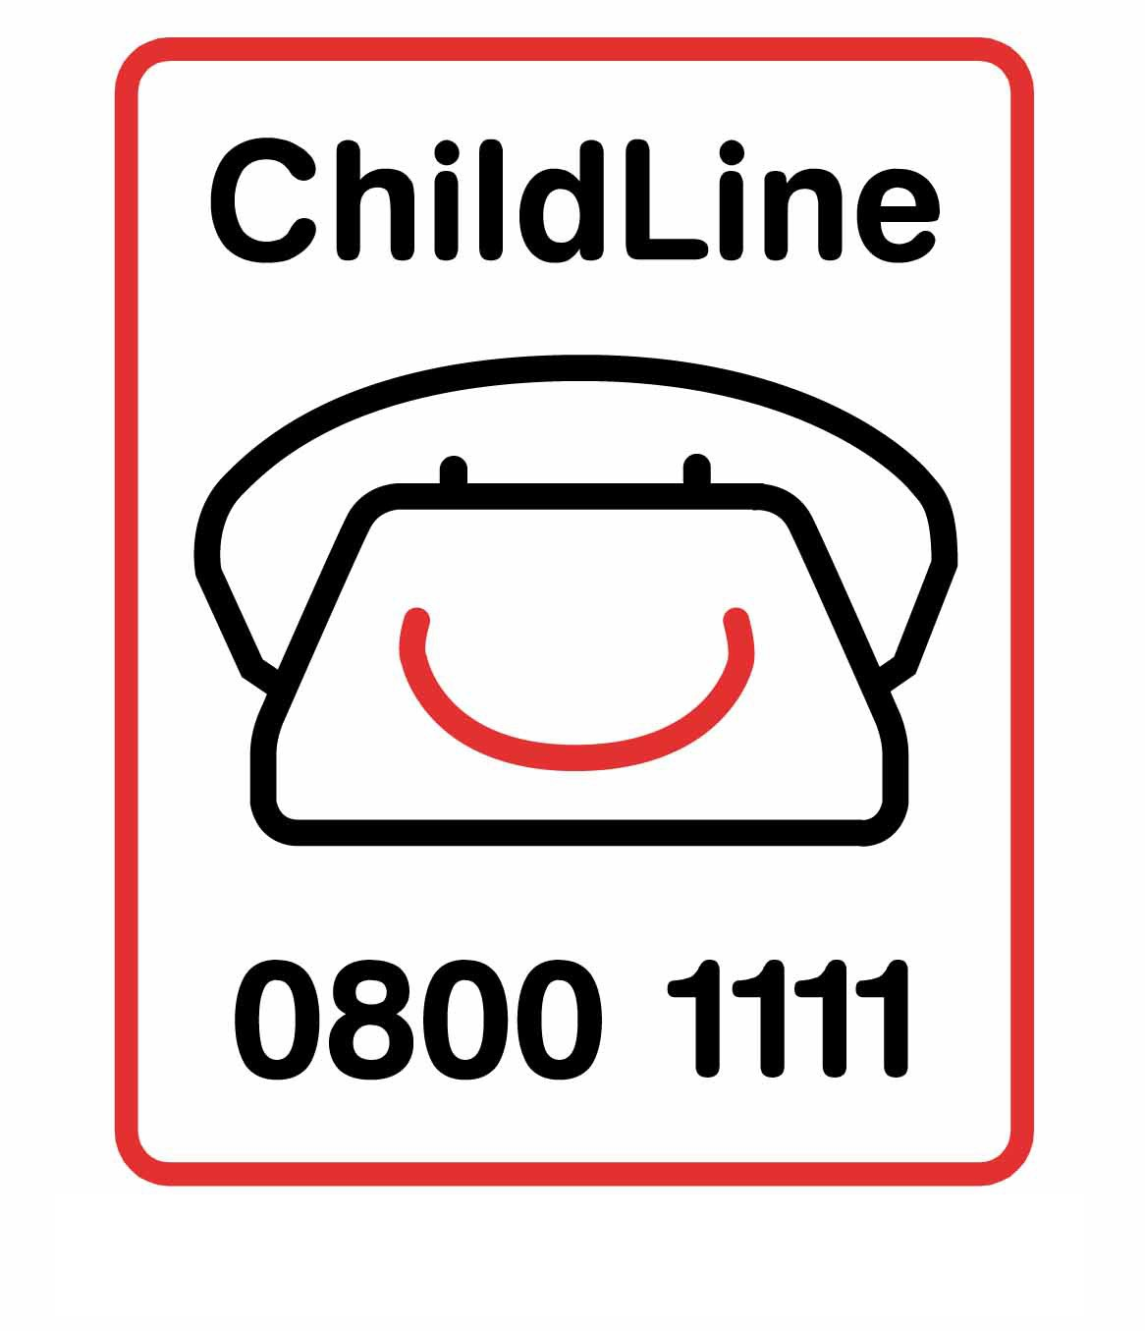
Public Limited Company (plc)
Voluntary Sector - Charity
Voluntary Sector - Charity

Slide 40
Multinational Corporations (MNC’s)
A Multinational has branches (called subsidiaries) in more than one country. The distinguishing feature of an MNC is that it sets up production facilities in more than one country.
Increase market share
Cheaper labour and production
Take advantage of Government Grants
Avoid or reduce tax
Save costs of transport
Avoid trade barriers

Slide 41
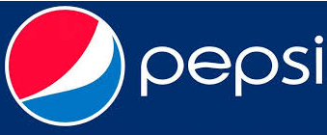
Multinational Corporations (MNC’s)

Slide 42
Computer Task - 2
Complete your worksheet in small groups or 2/3 researching companies which are:
Sole Traders
Partnerships
Private Limited Companies (Ltd)
Public Limited Companies (Plc)
Franchises
Multinational Corporations (MNCs)

Slide 43
Question
Shares can be sold on the stock exchange meaning large amounts of finance can be raised.
PLCs often dominate their market meaning they can force smaller organisations out of business OR This also means they can dictate market prices.
Lenders are more likely to give money as they have greater confidence it will be paid back.
Investors will have limited liability meaning PLCs will find it easier to attract shareholders.
Initial set-up costs will be high resulting in poorer profit results for the first few years.
There is a large amount of legislation which must be complied with or the company may be fined OR have legal action taken against them.
PLCs have no control over who buys shares which might mean investors can plan a hostile takeover.
PLCs are required by law to publish annual accounts which will be costly to produce.

Slide 44
Types of Business Activity
Each slide should have a title, definition, 1 clear image, 3 advantages and 3 disadvantages
You do not need to put advantages and disadvantages for the Public and Voluntary Sector business types
Private Limited Company
Public Sector Organisation
Charity
Public Limited Company
Local Council (Government)
Franchise
Voluntary Organisation
Public Corporation
Multinational
Notes:
Working with your 10am partner…

